Slide 1

Online_v2 – An upgraded control &
monitor software for GMRT
                Presenter : Raju Uprade
                Date : 17/03/2016
Online_v2 Team :-
Santaji Katore Charu Kanade N.G.Kantharia
Deepak Bhong Naresh Sisodiya S.Nayak
Sachin sherkar Mahadev Misal
Raju Uprade C Sateesh

Slide 2
Features of Online_v2
The features of OnlineV2 include :
(1) Parallel & fast control of 30 antenna
(2) Extensive web-based control data monitoring tools allowing for real time and statistical studies
(3) Full web based tools & support for observing in absentia
(4) Generalized & modular framework to support future expansion
(5)Customized graphical interfaces for operators, engineers and astronomers
(6) Fast background monitoring of system parameters
(7) Higher level Python Environment

Slide 3
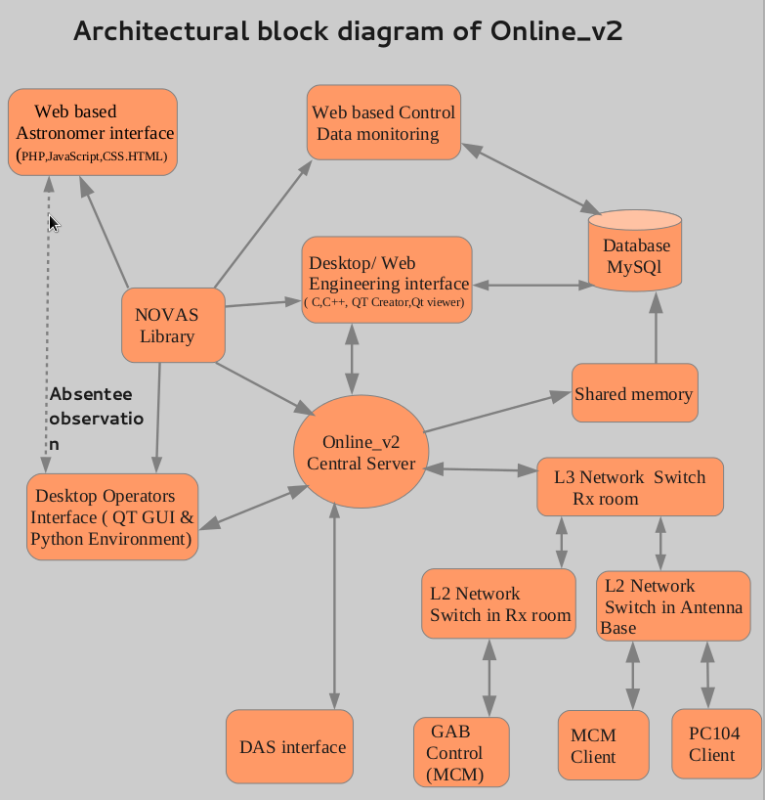
Online_v2 Architecture diagram

Slide 4
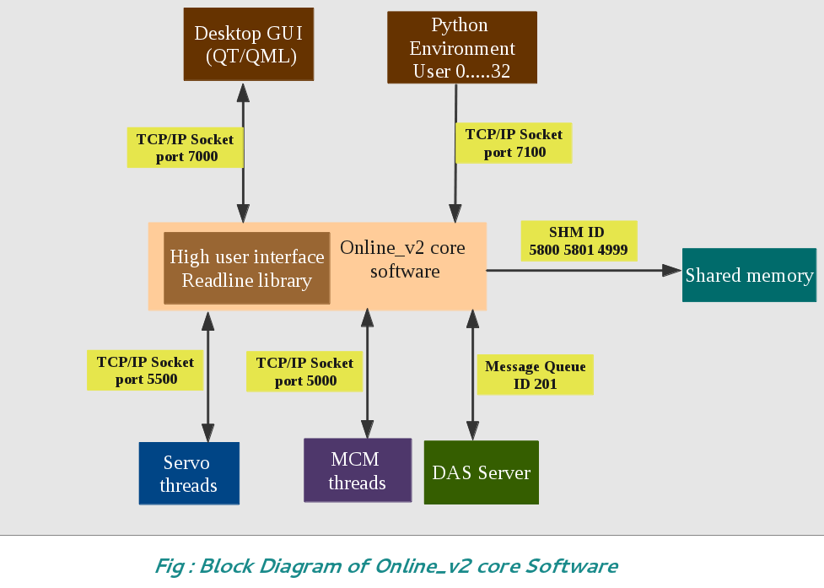
Online_v2 core software

Slide 5
Python Enviornment
1. Interactive command line environment for Online_v2 using Ipython.
2. Grouping of commands, custom procedure and automation in execution of science observations and system tests.
3. Power of Python is utilized in decision making on basis of complex logic of tasks.
4. Python package is developed to control all GMRT subsystems using Object oriented Programming. It provides API to control and monitor systems.
5. Exmaple :
Move servo of C00 antenna in elevation by +10 degree
$ C00.servo.mvelev(10d)
GAB setting command to define sub array of antennas
$ gab.set()

Slide 6
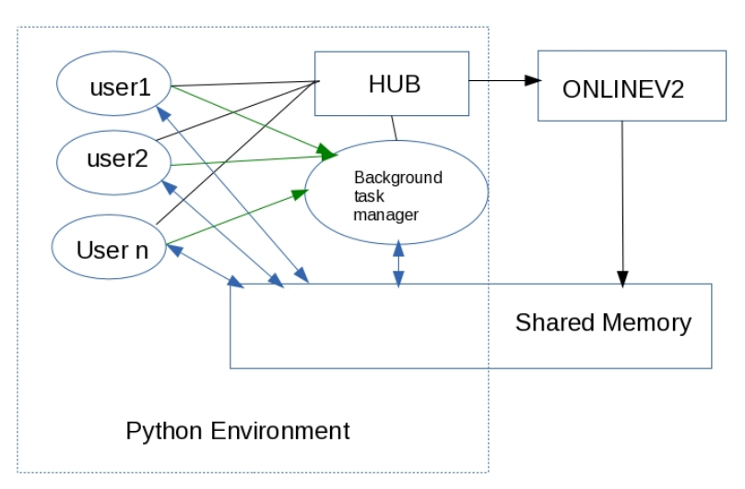
Python Scripting Environment

Slide 7
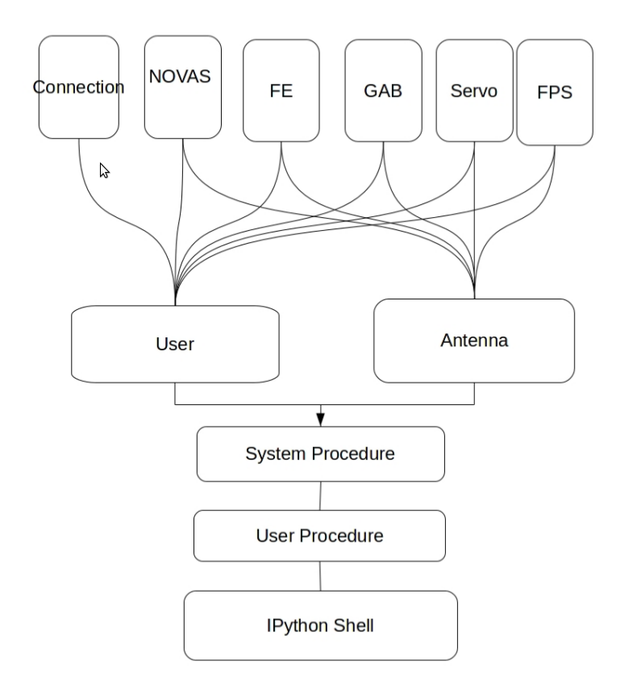
Object Oriented Design of API

Slide 8
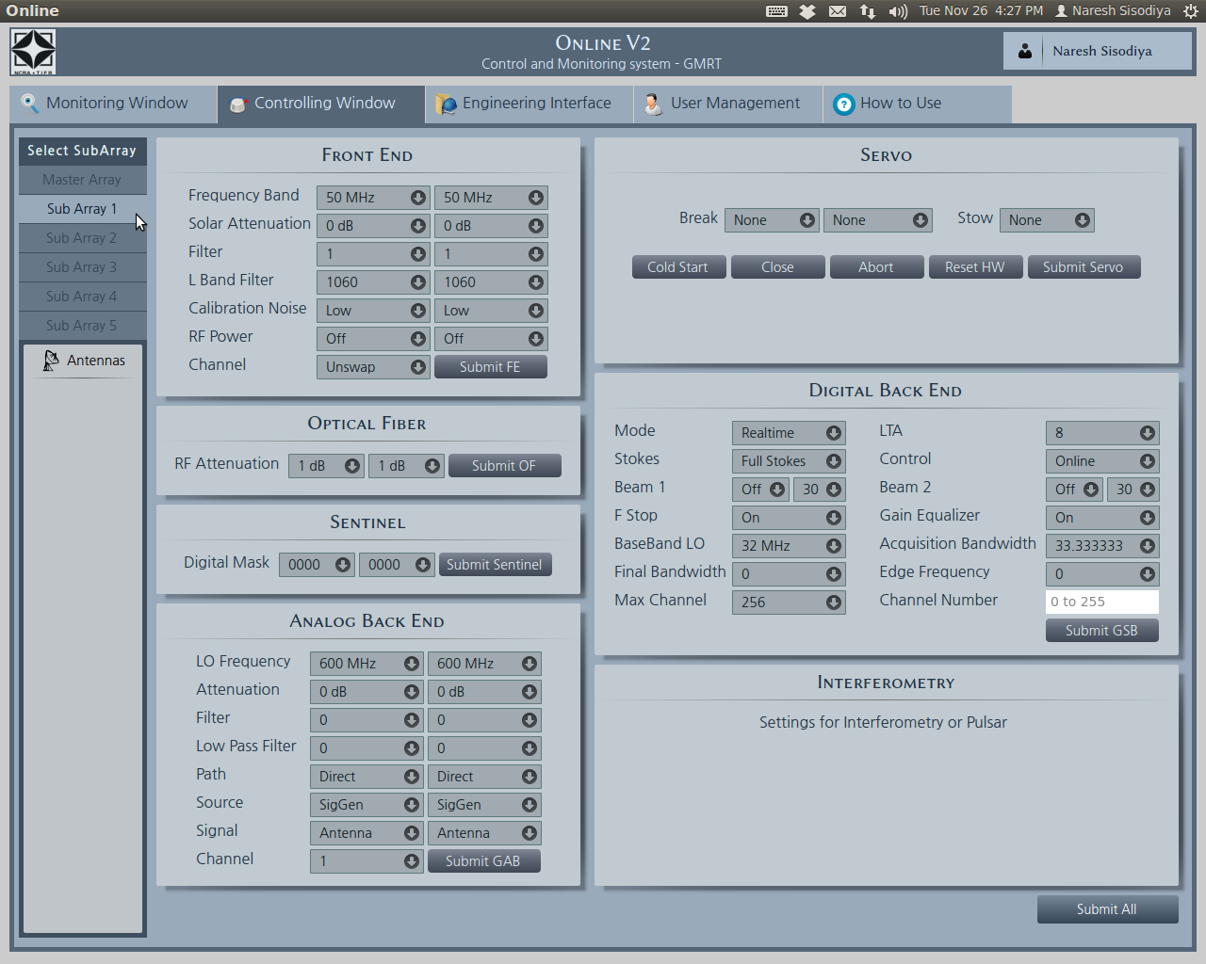
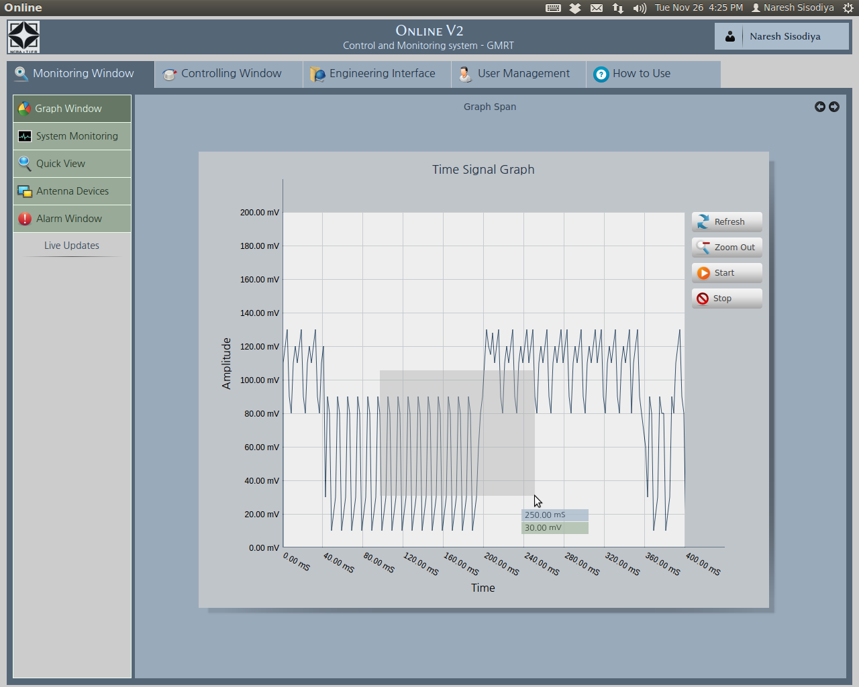
Online_v2 : QT/QML GUI

Slide 9
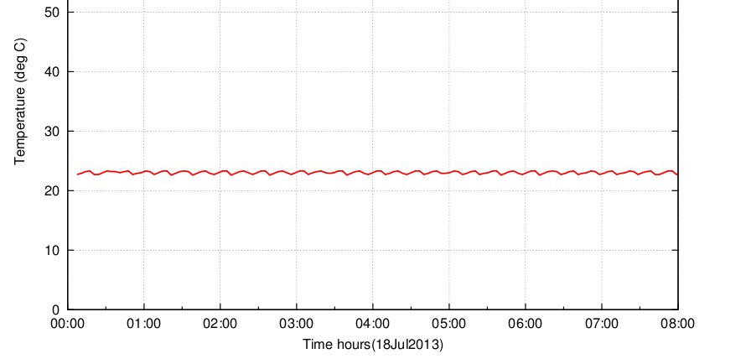
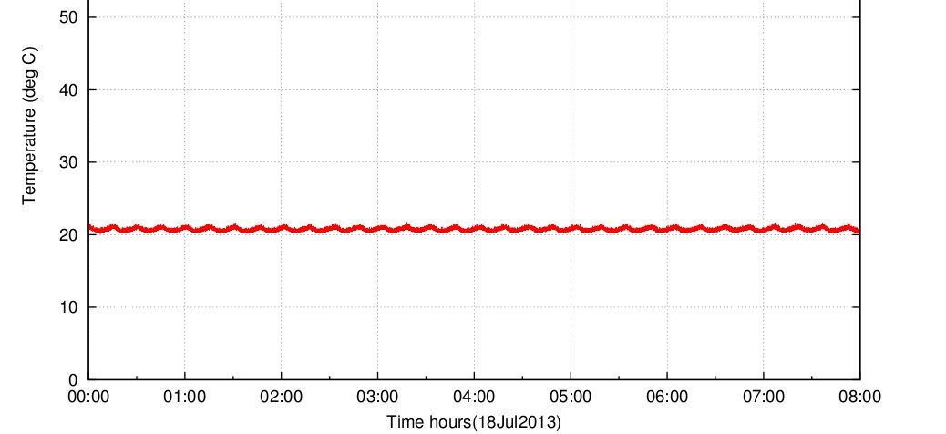
Online_v2 monitoring tools
c) Temperature monitor test:
One temperature monitoring unit was connect to the MCM card at C03 antenna. The data behavior was similar like existing online with higher resolution.
Fig. existing online temperature monitoring @ C03 antenna
Fig. online_v2 temperature monitoring @ C03 antenna

Slide 10
Online_v2 details
Software Languages used :
Insistence on using Open Software - LAMP
Software Language used: C, C++, Dynamic C, Perl, Python, PHP,HTML, Javascript, gnuplot, QT/QML
Database: MySQL
Libraries: XML, Readline, TCP/IP, HTTP, Pthread

Slide 11
Time Line
Project started: October 2012
Prototype Demonstration: April 2014
Three antennae tested software: October 2014
16 Antennae tested software : April 2015
Time Line :
Project start: October 2012
Prototype Demonstration: April 2014
Final Version: October 2014
Time Line :
Project start: October 2012
Prototype Demonstration: April 2014
Final Version: October 2014
Time Line :
Project start: October 2012
Prototype Demonstration: April 2014
Final Version: October 2014
Time Line :
Project start: October 2012
Prototype Demonstration: April 2014
Final Version: October 2014
Time Line :
Project start: October 2012
Prototype Demonstration: April 2014
Final Version: October 2014
Time Line :
Project start: October 2012
Prototype Demonstration: April 2014
Final Version: October 2014
Time Line :
Project start: October 2012
Prototype Demonstration: April 2014
Final Version: October 2014

