Slide 1


Development of New monitor and control systems
for Giant Metrewave Radio Telescope (GMRT)
Presenter : Raju Uprade
National Centre For Radio Astrophysics, TIFR, INDIA
January 3rd 2014

Slide 2

TEAM MEMBERS
Operation Group
Dr. Ishwar Chandra,
Dr. Nimisha Kantharia,
Lab Members
Control Room
S. Nayak
C. Satish,
B. Rajendran,
C.P. Kanade,
J.P. Kodilkar,
R. Uprade,
N. Sisodia,
M. Misal
J.P. Kamble
M. S. Samble
S. N. Katore
D. B. Bhong
S. Sherkar
N. Raskar
R. Vasawe
S.S. Dubal
P. Padwal
S. Goril
P. Padwal

Slide 3
Outline of the talk
Introduction : GMRT Monitor and Control (M&C) System
M&C System Hardware Up-gradation
M&C System Software Up-gradation
GMRT Online Version 2.0
Next Generation M&C System : Industrial Collaboration
Summary : Salient Features of Generic Framework

Slide 4
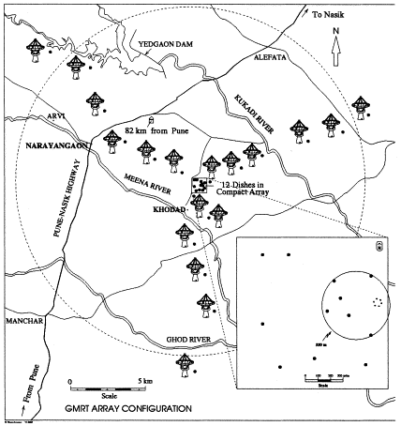
GMRT Monitor & Control System
GMRT M&C Features :
Central Supervisory system
provide User Interface
Sub-arrays : for Concurrent science/maintenance activity
Execute scheduled observing session in batch mode.
Safety majors
Sufficient interlocks are implemented in the servo system
Alarms/Alert
Archive and retrieve the logged information.
M&C | Link | Ant. Base Computer | Control Cards | Device Interface | OS and Software | User Interface
Existing (1996-2012) | HDLC/FSK @ 250 kbps | 80C186 μp (16 bit, 128k RAM) | MCM: 85C353 (16 TTL I/O &64 analog channels) SERVO: 8086 microcontroller | RS485 RS422 @9.8 kbps | Solaris 5.2-10 C,Fortran, C++ | Terminal, batch-mode under AIPS-shell environment. and Cursorlib-based UI.

Slide 5


Motivation and Objectives
GMRT Upgradation :
Wide-Band Feeds (150 to 1500 MHz), Broad-band Fiber Link, Servo
Systems, GMRT Analog Base-Band (GAB) and GMRT Wide-Band
Back-end (Correlator) Systems.
All Sub-system provides 10/100 Mbps Ethernet Interface
Existing GMRT M&C System (ONLINE) Successfully Operational
since Last ~ 15 yrs.
GMRT M&C System based on Solaris Operating system, sub-system
interface for Control & Monitoring uses RS 485, 422 and RS232
Communication. ONLINE code is tightly coupled to 80186, 8086
micro-controllers.
OBJECTIVES : (i) Develop end to end Radio Telescope Software which
takes input from Observing proposal, execute observing session in
auto mode and provide Meta-data support for post processing
of Science data.
(ii) Support for Remote Observing
(iii) Develop a generic Specification driven Frame-work for M&C System

Slide 6

M&C System Hardware Up-gradation
M&C | Link | Ant. Base Computer | Control Cards | Device Interface | OS and Software | User Interface
New/Up- gradation (2012-) | Ethernet 1 Gbps | High end EMI/EMC protection PC | MCM: Rabbbit RCM 4300 Labjack UE9 SERVO: PC104 | Ethernet TCP/IP 100 Mbps | Linux/Unix Java tech. , EPICS, CSS based. Dynamic C, Propriotry s/w | GUI, web-browser, terminal, batch mode.
Salient M&C System Hardware Features :
High end Server Class machines in CEB
Dediced Ethernet/Optical Fiber Link (1 Gbps) to all thirty antennas
spread over Radial distance of ~ 15 km
Modern Monitor & Control Modules based on Rabbit RCM 4300 processor and
PC 104 embeded computer at each antenna.
10/100 Base Ethernet Port
Total ~180 Sub-system to be control and supervise.

Slide 7
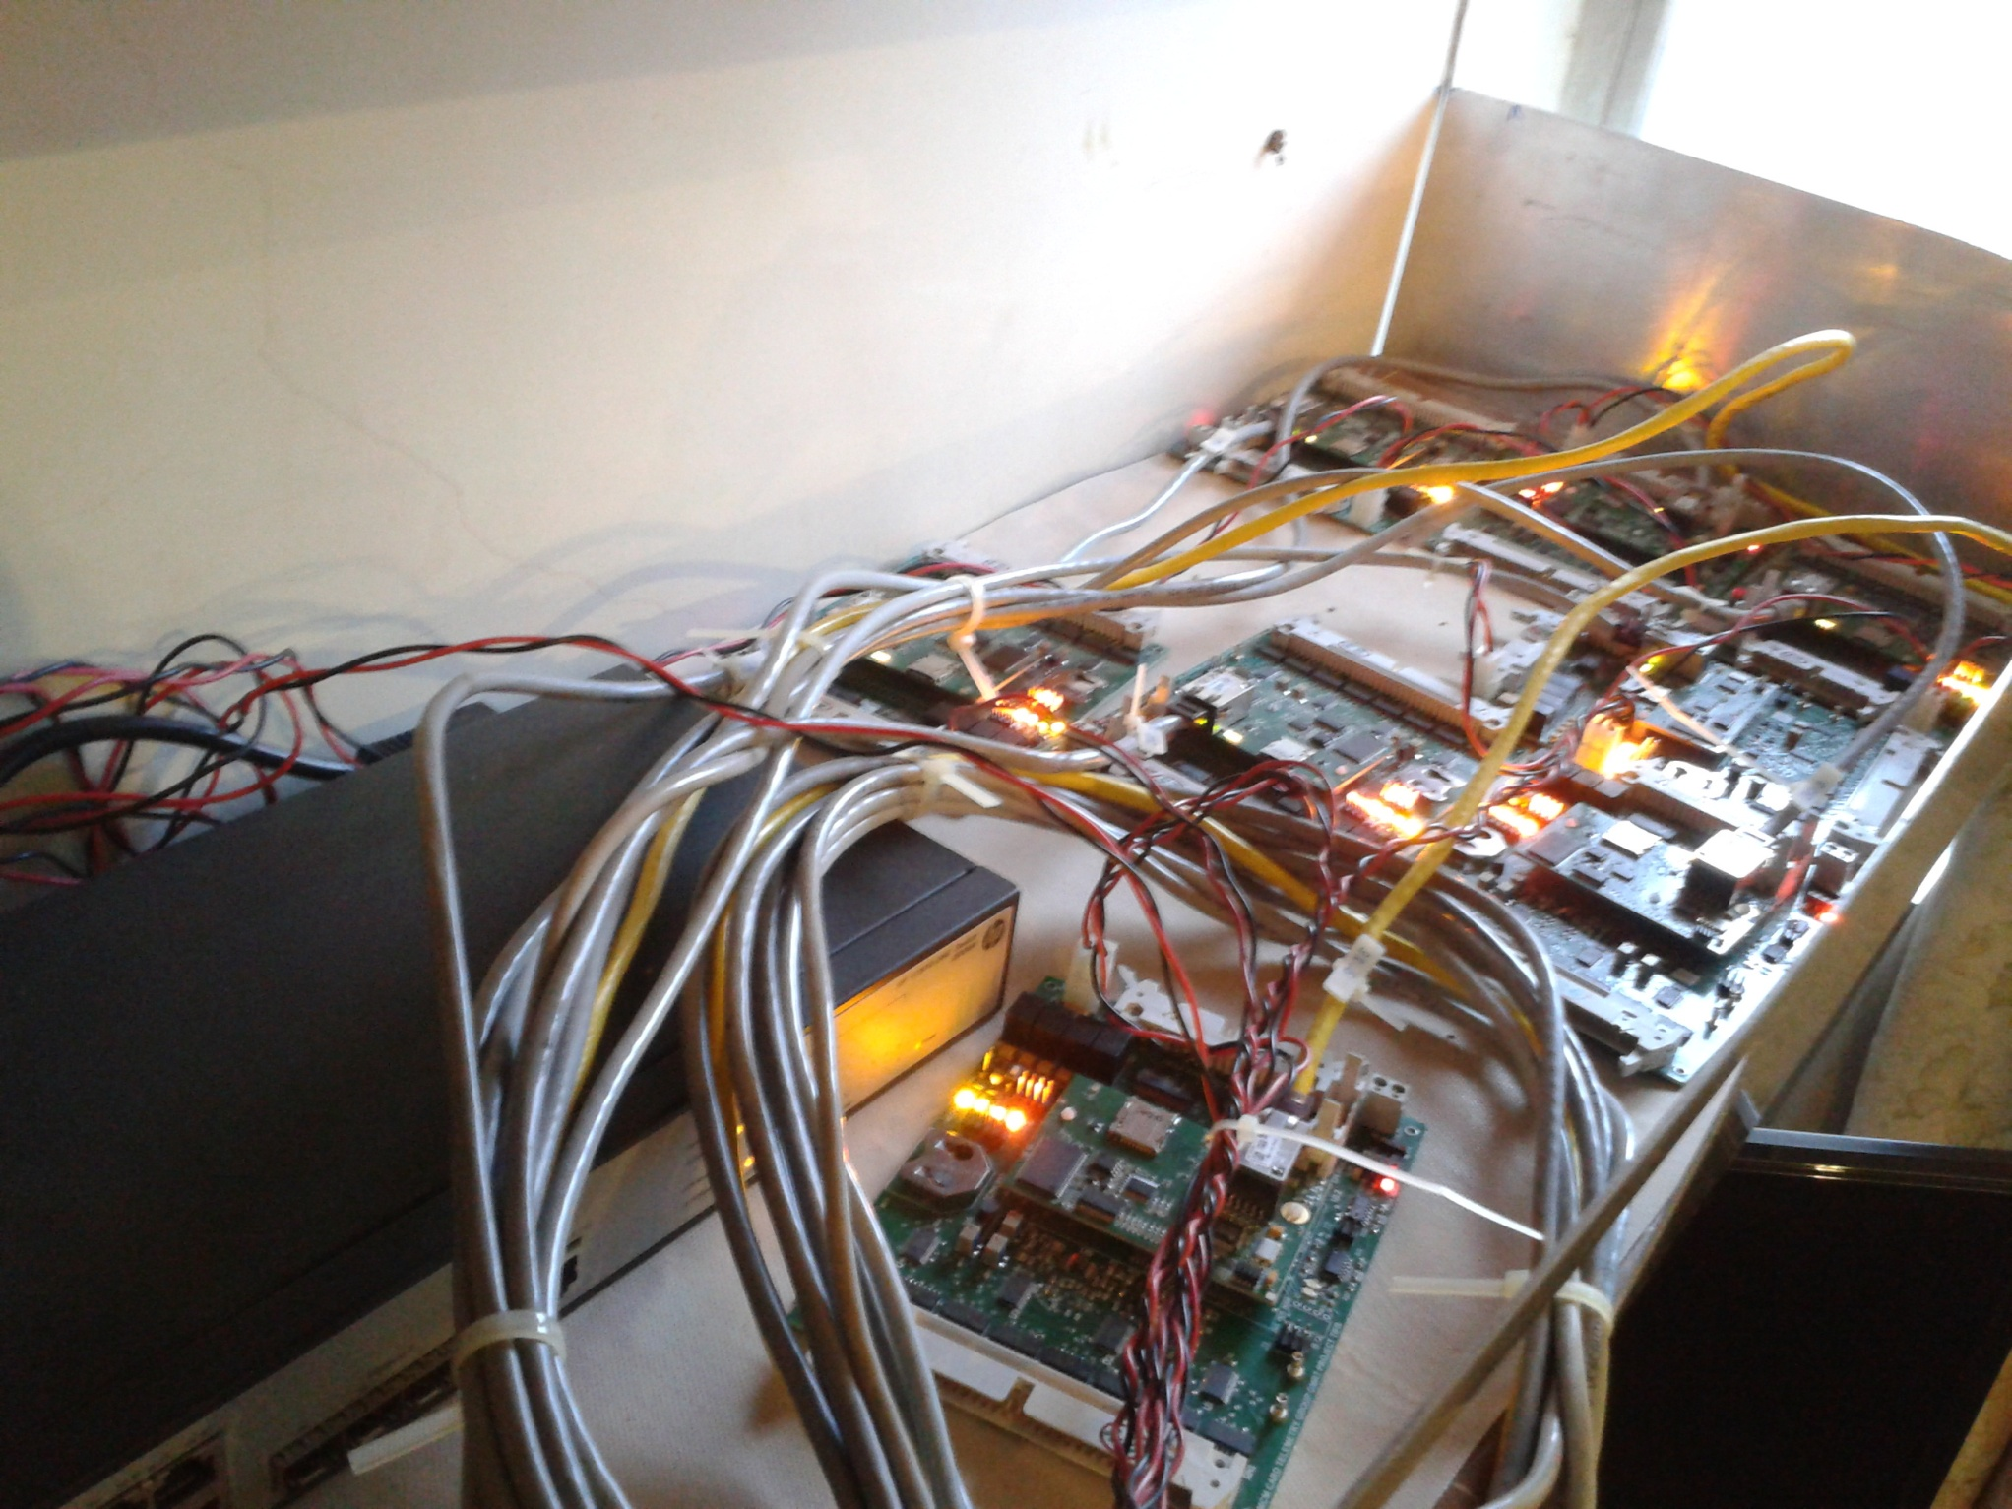
Lab Test Set Up

Slide 8
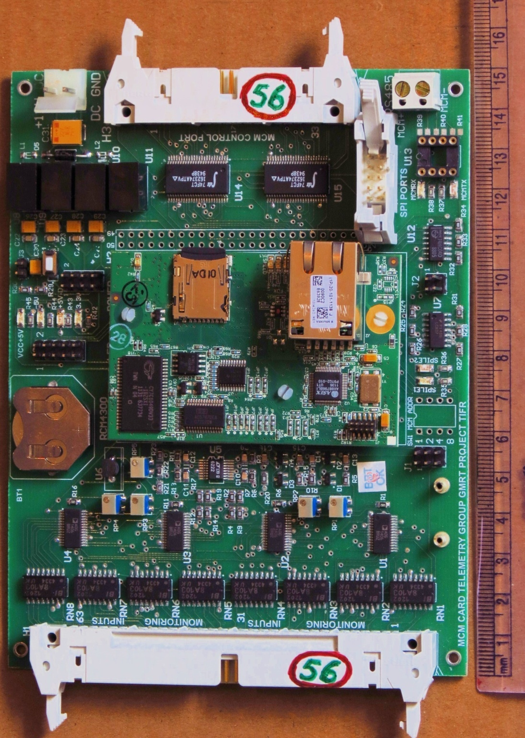
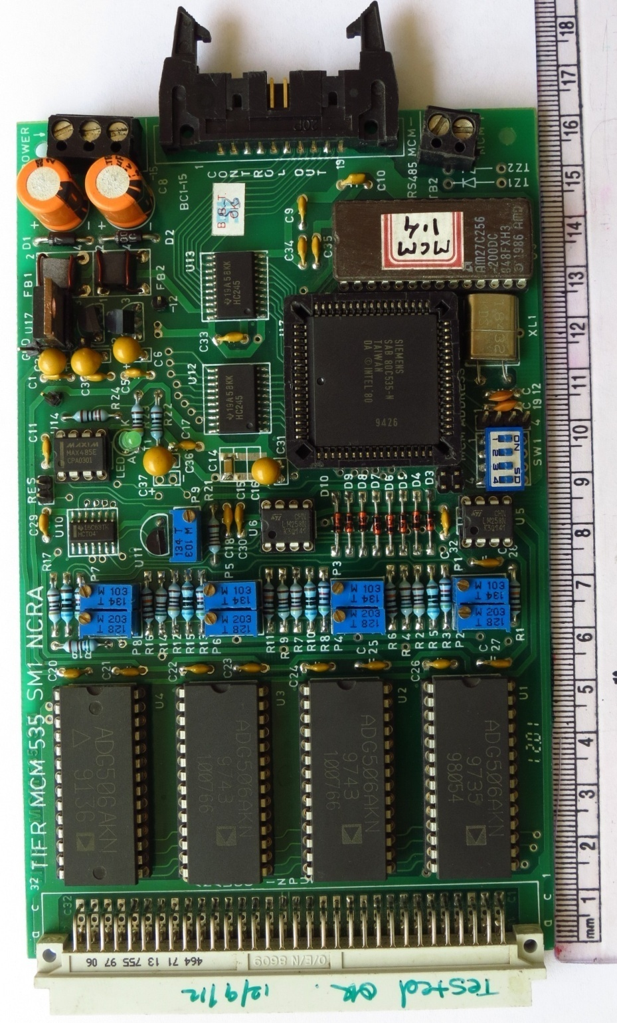
Monitor & Control Module (MCM)
New MCM
Old MCM

Slide 9
New MCM Vs Old MCM
Feature | New MCM | Old MCM
Processor | RCM 4000 | 8051 based 80535
Operating Frequency | 60 MHz | 1.8 MHz
Memory | SRAM : 1Mb (512Kb + 512Kb) Flash : 1Mb Micro SD : up to 1Gb | RAM : 256 bytes ROM : 64 Kb
ADC | 11 Bits, 8 Channels | 8 Bits, 8 Channels
Real Time Clock | Yes | No
Battery Back Up | Yes – 3.3V | No
Monitoring Channels | 64 | 64
Control Bits | 32 | 16
Communication Channels | Serial (RS485) @ 9.8Kbps Ethernet @ 10/100Mbps 2 SPI ports | Serial (RS485) @ 9.8Kbps
Programming Method | Serial Programming | EPROM burning
Programming Language | Dynamic C | Assembly
Command Structure | ASCII Structure Based | Protocol Based
MCM Address setting | Hardware + Software IP Based | Hardware
Access from Online | Direct or via ABC | Via ABC Only
Configurable for RFI parameters | Yes – Using Spectrum Spreader and Frequency divider | No

Slide 10

M&C System Software Up-gradation
M&C Software Development :
Two parallel development activities are in progress
In House M&C System Development : ONLINE_V2
Aim to support Upgradation testing activities and smooth change
over from existing M&C (ONLINE) System to new M&C System
(ONLINE_V2) to support newly up-graded sub-systems of the
GMRT.
M&C System Collaboration with Industry Partner (TCS, Pune)
Develop a next generation M&C System for the Radio Telescope,
test specification driven frame-work approach as a pre-cursor
demonstration for SKA1.

Slide 11
Architectural Block Diagram of Online V2
Web Based interface
Data Monitoring/charts/plots
Engineering Interface
GSB
Shared Memory
Data Bases
Analog Backend
Online V2
Logs
User 0...5
Operator
Interface/User
Interface
High User
thread
Low User
thread
All arrow indicate TCP/IP based socket communication except shared memory.
Multi threading
MCM 0,2,3,5,10,14
Servo System

Slide 12

Features of Online V2
The Online_v2 will directly communicate with Antenna based sub-systems using TCP/IP based socket communication, eliminating the need of ABCCOM ( Antenna base computer ).
Online_v2 communicates with Antenna sub-system using structure based protocol with most of the intelligence shifted to the lower level MCM program.
Online_v2 has been successfully tested with two antenna four sub-systems each in Telemetry lab
Online_V2 is successfully monitoring Antenna C03 shell temperature for last three months.
Online_v2 Provides QML Web-based GUI for Control & Monitoring.

Slide 13
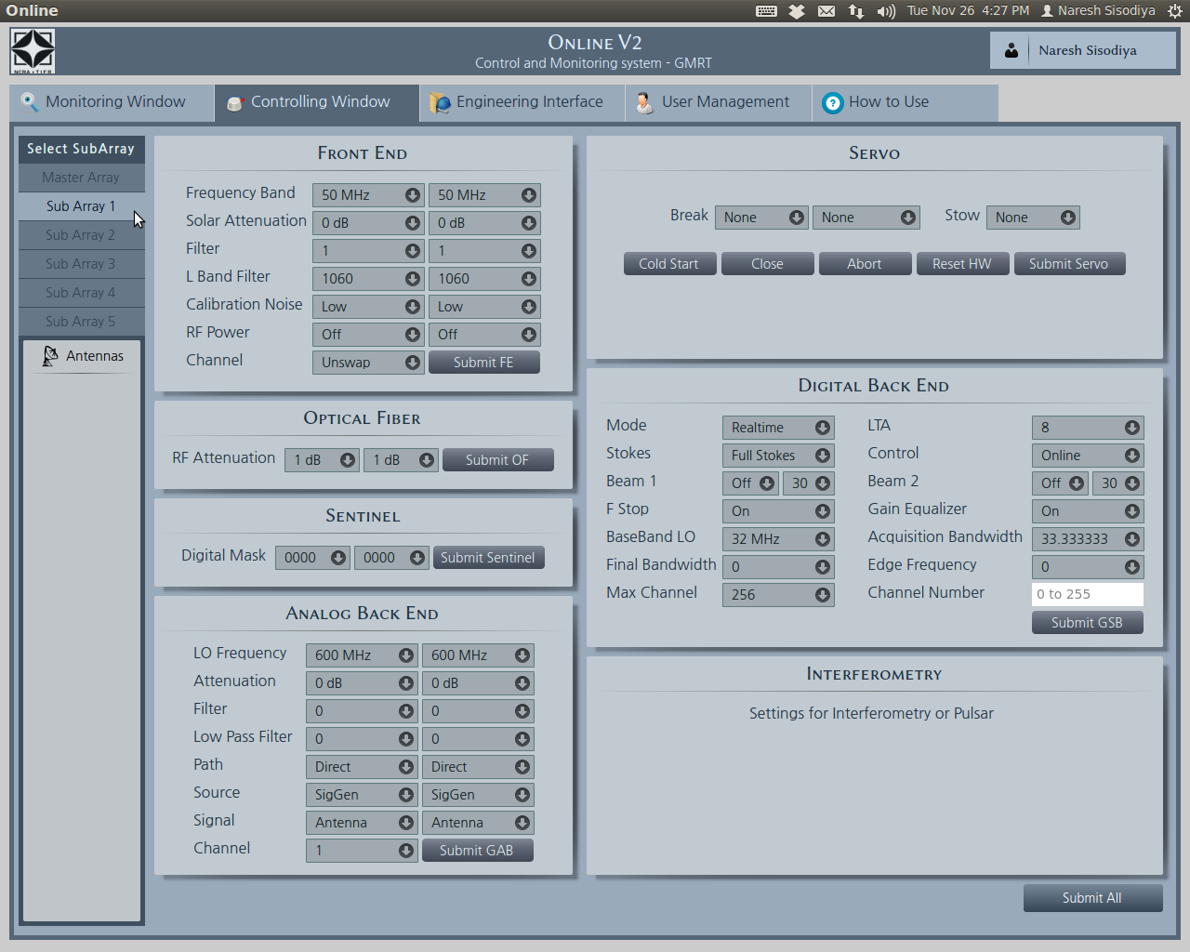
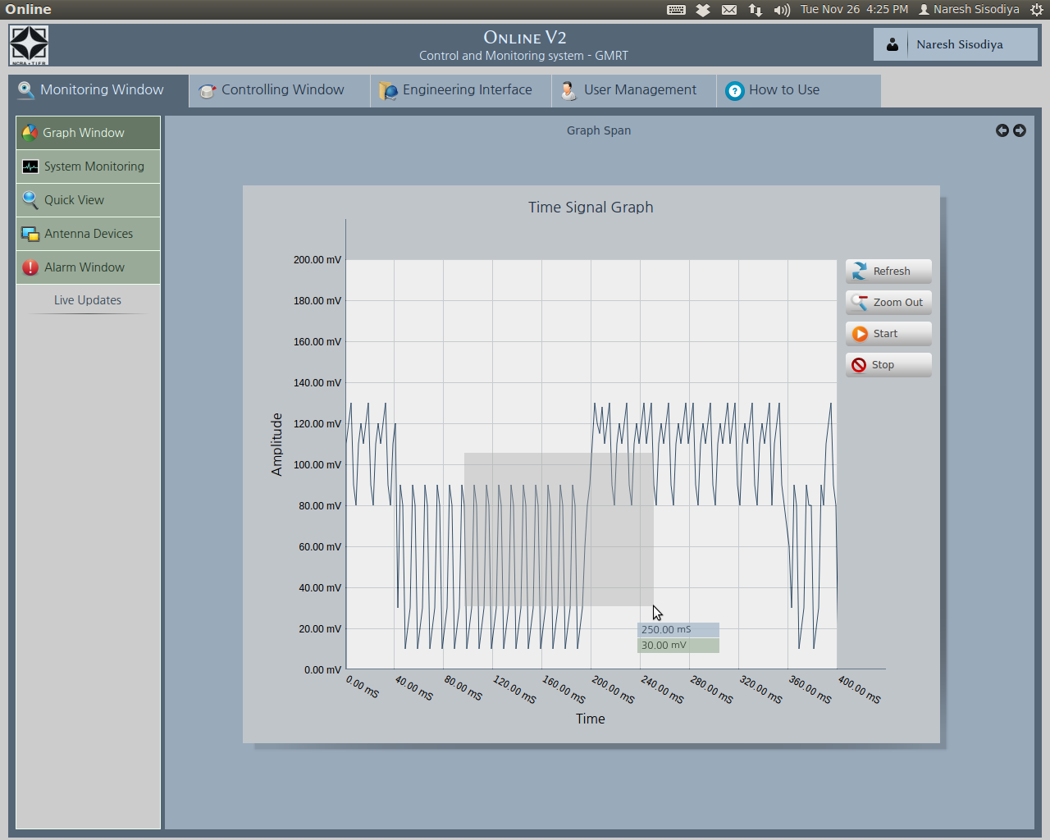
QML Based M&C GUI (Online_V2)

Slide 14
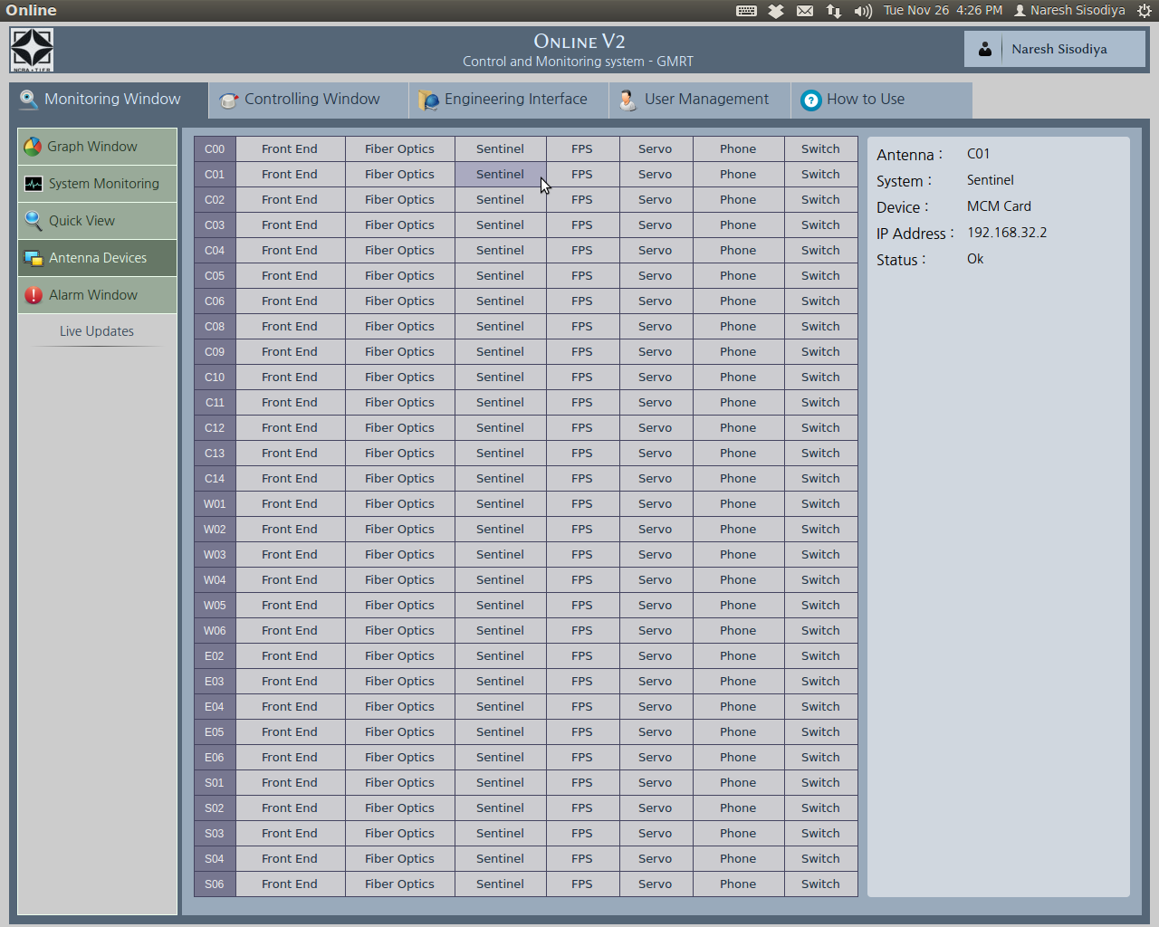
QML Based M&C GUI (Online_V2)

Slide 15
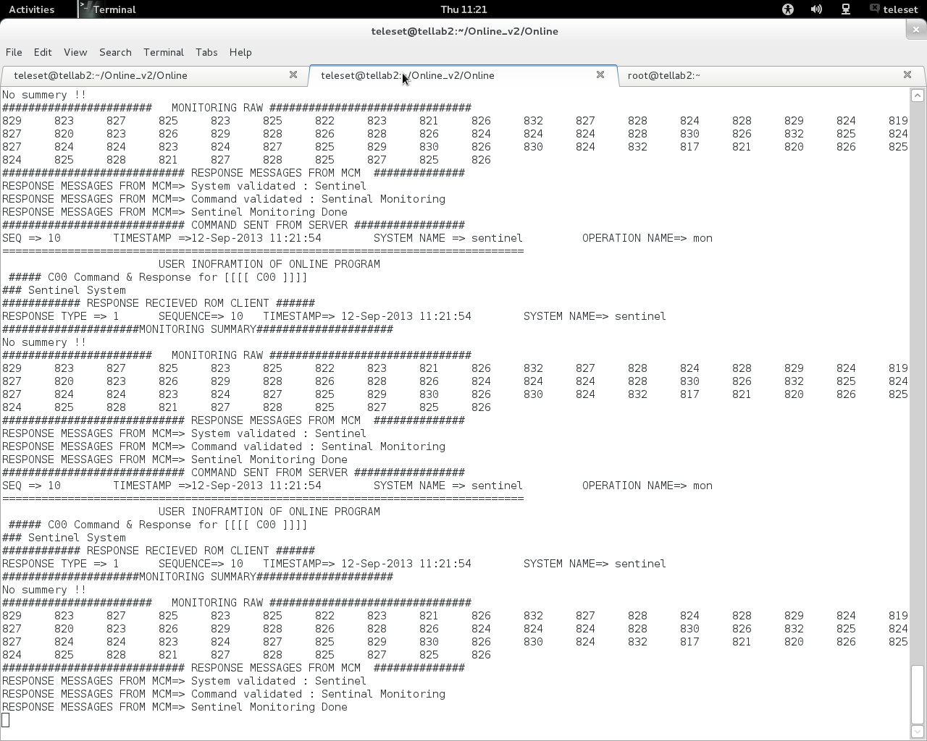
Shared Memory Display of Online V2 (Lab Set Up)

Slide 16
Performance Improvement
New MCM is 30 times faster
Higher program and data memory and 1GB storage
Higher ADC resolution
Double control bits
Ethernet, RS485 and SPI connectivity
High level programming language and method
20dB less EMI
Additional features like : Real Time Clock, Battery Backup
ASCII structure based Command structure
Failure rate will be minimum
New MCM will be 10-15 times more efficient than Old MCM.

Slide 17
GMRT Upgrade : M&C Challenges
Aims to develope a Generic Specification Driven M&C frame-work to support evolution or upgrade phase over next decade (Instead of developing device specific bespoke solution)
End-to-end Radio Telescope M&C software which processes and execute scheduled Observing proposal in auto mode and supports science data analysis by providing meta-data (Observation log, bad-data flagging, M&C system and metrology data Logs etc)
Modern M&C System, industry collaboration (TCS, Pune) to leveraging the technlogy trends to upgrade the M&C Hardware and Software.
Showcasing the capabilitites of NCRA for handling the Telescope Manager (TM) Package for SKA1

Slide 18
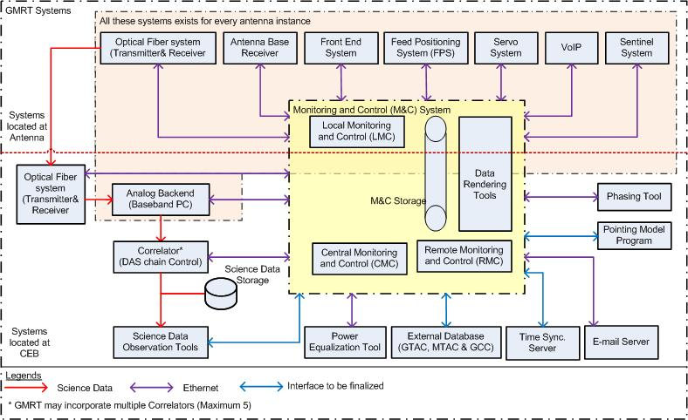
GMRT M&C System upgradation

Slide 19
URS and SRS Phase for the New GMRT M&C System
User Requirement Specifcation (URS) Dec 2012 to Feb 2013
Aim : To clearly communicate the end-user/customer needs to the vendor/technical community so that development gaps and errors can be avoided at the beginning of design phase of the system itself.
- All stake holders Inputs (Astronomers, Engineers, Coordination/Management personnel and Telescope Operator) collected through Questionnaire – To identify expectation and work-flow associated with each User Role.
- A system description of upgraded GMRT and Observing modes capability doc.
- Total 35 Use-cases/Business Process documented along with UML diagram, process rule, exception etc.
- High level Functional and Non-functional Requirements Documented.
Software Requirement Specification (SRS) Mar to Aug 2013
Aim : (i) Identify Software and Hardware Requirements of GMRT's M&C System and orgnize systematically in HRS and SRS documents such that it shall enable designer to design a system to satisfy those requirements, and testers to test that system satisfying those requirements.
(ii) Reduce the development effort by careful review of the requirements in the SRS to reveal inconsistencies, omissions and misunderstandings early in the development cycle.
- Total 730 requirements documented with ranking for stability, importance, verifiability and traceability.

Slide 20
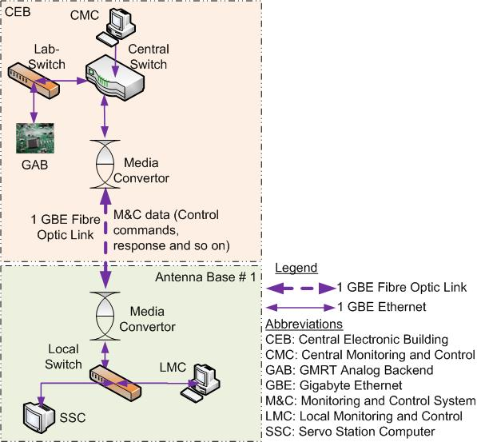
M&C System Prototype : PoC study
Aim :
(i) Explore the possible technology selection (Open Source) in a view of finalizing the M&C system architecture for the final production version.
(ii) Identify and Mitigate possible risks that may occur while implementing the next generation GMRT M&C System production version
The PoC aims to explore the selected technologies :
EPICS (Experimental Physics and Industrial Control system)
CSS (Control System Studio) for Front-end (UI)
Scripting engine (python/jscript)
Real-time communication to control Servo and GAB
(Channel Access Protocol, ModBus, TCP/IP).
Alarm and Exception handling

Slide 21
Summary : Salient Features of Generic M&C Frame-work
Frameworks discussed in case of the M&C systems for GMRT, NCRA 15m antenna, ASKAP, and MeerKAT provides standardize functionality with following salient features :
Cost-effective proven approach : As off the shelf packages used that can be updated easily with new
Technology.
Generic Platform : Framework is OS independent can work on Linux, MacOSx, windows etc.
Loose Coupling : Any changes done at lower tier make less impact on higher tier i.e.
Modulariy and higher level specifications allows upgrade/modification of h/w or s/w with minimal impact
to other systems.
Scalability and configurability : scalable and configurable sub-systems along with command
parameters and response validation using specification /self-description files (XML-DTD, .ini etc.)
Automatic state-restoration, exception handling : by abstracting the local operating states to
common set of global operating state (e.g. Init, halt, reset, shutdown, connection-status etc.)
Context-based UI and reporting strategies
Alarm Audio, visual and emails/SMS notification
Integrated access to remote node or monitoring storage (Archive)
Conclusion : Generally, at the time of development of a new M&C system large resources like money, time, and man power invested to design and develop a customized M&C and even during the up-gradation of the new hardware can be avoided by using the generic frameworks.

Slide 22
Thank you...

