Slide 1
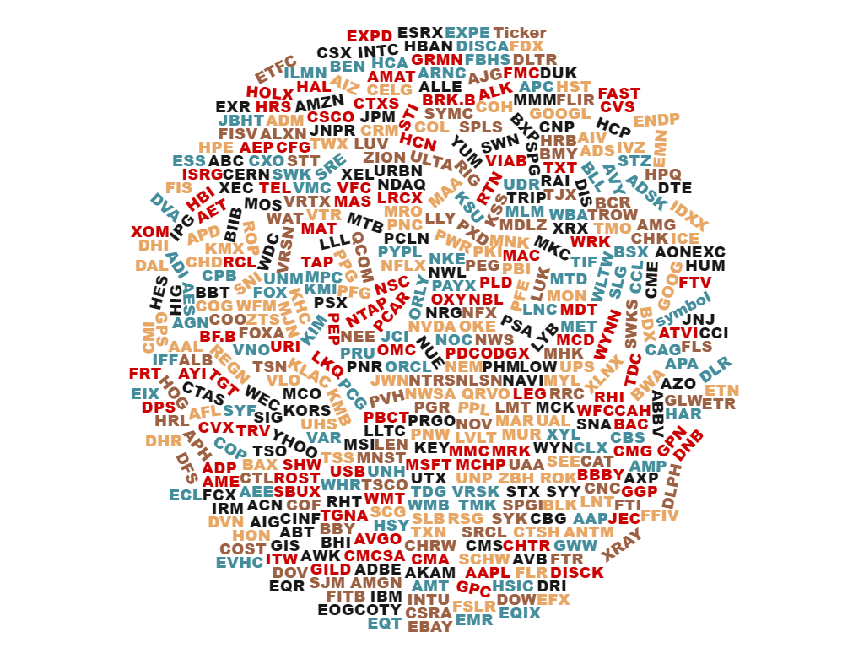
Investment Baskets
ADM Week 8 Project – Raju Penmetcha

Slide 2
Agenda
Goal Overview
Data Discovery and Preparation
Analysis
Validation and Review
Recommendation
Disclaimer: All investments involve risk. There can be no guarantee that the strategies, tactics and methods discussed here will be successful. Shares may be more or less valuable than purchase price at any time in the future. If you have any doubts as to the merits of an investment, you should seek advice from an independent financial advisor.

Slide 3

Goal Overview
IB Company: Identify alternative stock investment ideas from S&P500 index component companies to establish new investment baskets or funds for customer asset allocation and return potential.
Standard and Poor’s 500 (S&P 500) is American stock market index based on market capitalizations of 500 (plus 5 due to share class) large companies.
A drawback using S&P 500 index is it is disproportionately weighted towards large companies. The top 50 companies account for around 50% of the index value.
Identify more focused equal weighted high profitable and return potential companies out of S&P 500 index.

Slide 4
Data Discovery and Preparation
Data Sources
S&P 500 Companies with Financial Information
kaggle.com
dataokfn.org
Wikipedia.org
Different financial metrics were combined together for the analysis
Full data available for 442 companies out of 500
Data contains both financial ratios and quantitative variables

Slide 5
Analysis
Selected Unsupervised Learning Method Cluster Analysis
K-means – Classify or group based on attributes/features
To find hidden patterns and groupings in the data
Selected 18 financial attributes for the analysis
Gross margin, Return of Equity, Dividend Yield, Book Value, Operating margin, EBITDA, and etc.
Normalized some numeric attributes to scale them within a smaller range
Total Revenue, Net Cash Flow, Total Equity, and etc.

Slide 6
Analysis
Select K
Number of Clusters K Centroid
Cluster Separation
Distance Object to Centroid
Cluster Cohesion
Grouping based on minimum distance
Ran for K = 2 to 9
Examined the between and within ratios
Used “Elbow Method” for cross validation
Created aggregate profiles for centroids
Selected best fit cluster model K = 7 as a final result

Slide 7
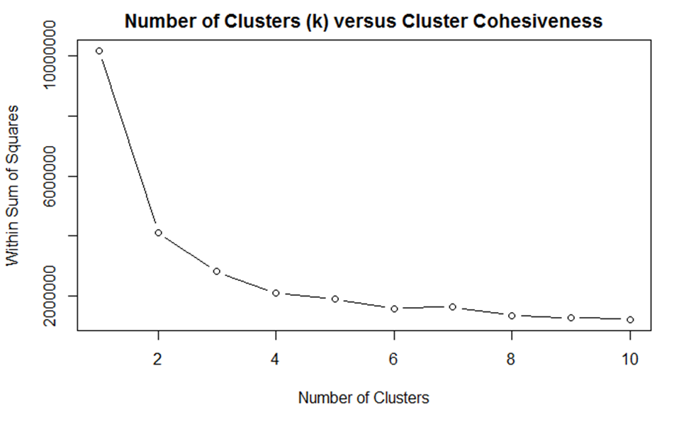
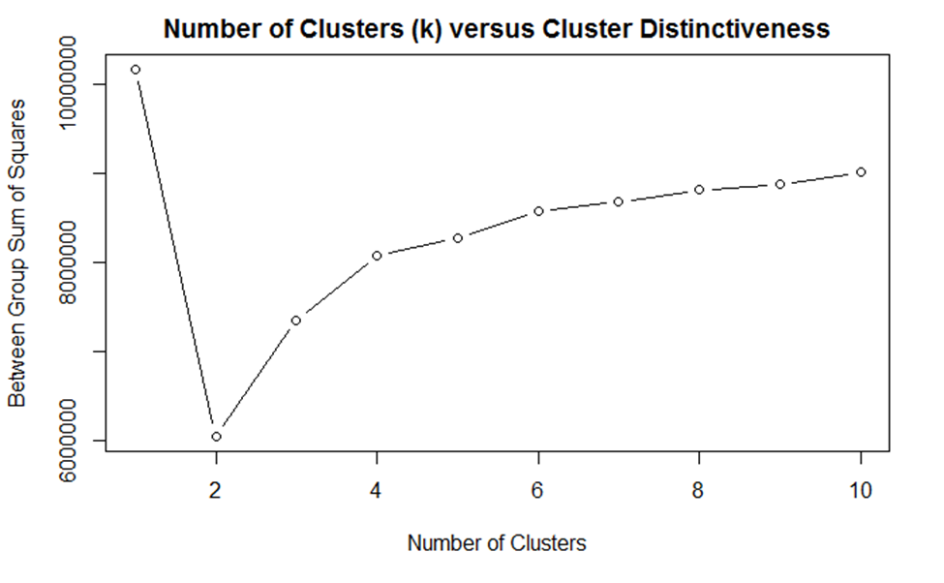
Validation and Review
K = 3 | K = 4 | K = 5 | K = 6 | K = 7 | K = 8 | K = 9
0.2773 | 0.2065 | 0.1872 | 0.1775 | 0.1467 | 0.1335 | 0.1302
K = 3 | K = 4 | K = 5 | K = 6 | K = 7 | K = 8 | K = 9
0.7226 | 0.7934 | 0.8127 | 0.8224 | 0.8532 | 0.8664 | 0.8697

Slide 8
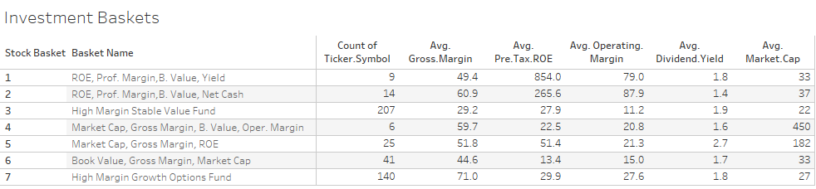
Validation and Review
Cluster K = 7 Results

Slide 9
Recommendation
"High Margin Stable Value Fund“
Contains 207 high quality companies
Main attributes:
High Gross Margin, Return on Equity, Book Value, with medium Market Cap
"High Margin Growth Options Fund“
Contains 140 high quality companies
Main attributes:
High Gross Margin, Return on Equity, Operating Margin, and Earning Potential
Visualization URL
https://public.tableau.com/profile/raju.penmetcha#!/vizhome/RUWeek8a/Sheet1

Slide 10
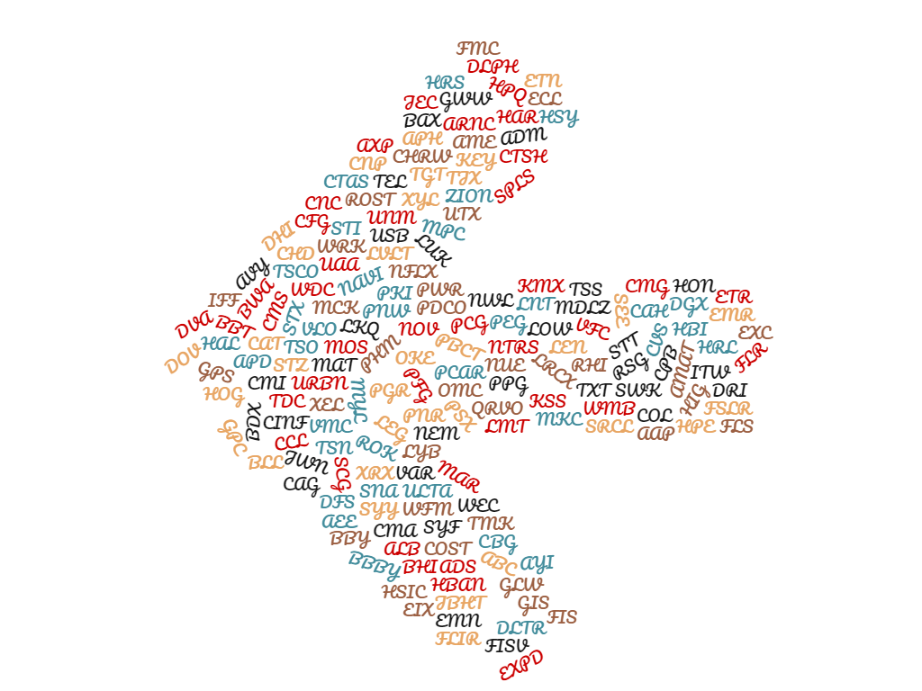
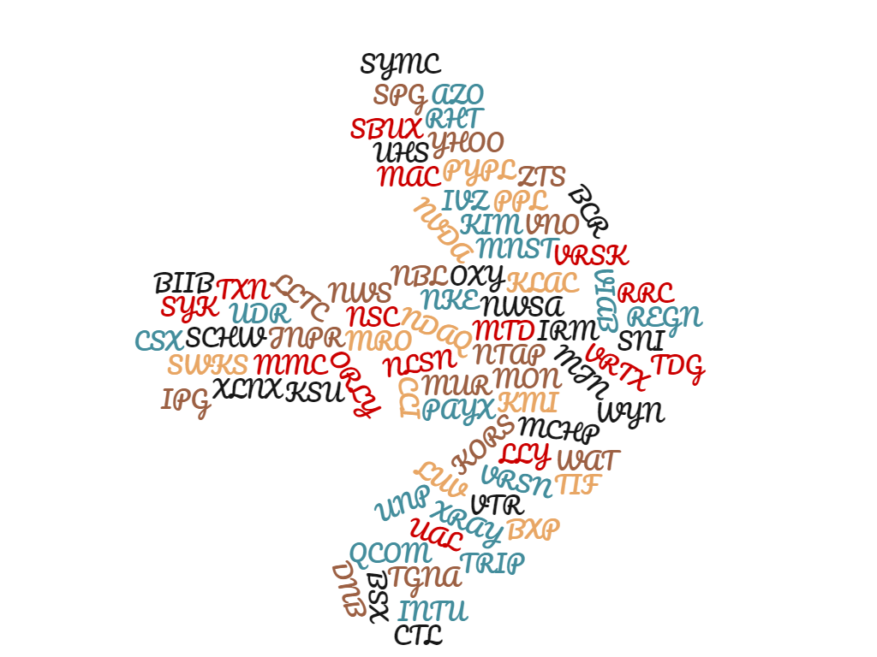

High Margin Growth Options Fund
High Margin Stable Value Fund

