Slide 1
JIRA
1.JIRA LOGIN
2.It shows Empty backlog
3.Create Bug in cart page
4.Start Spirit

Slide 2
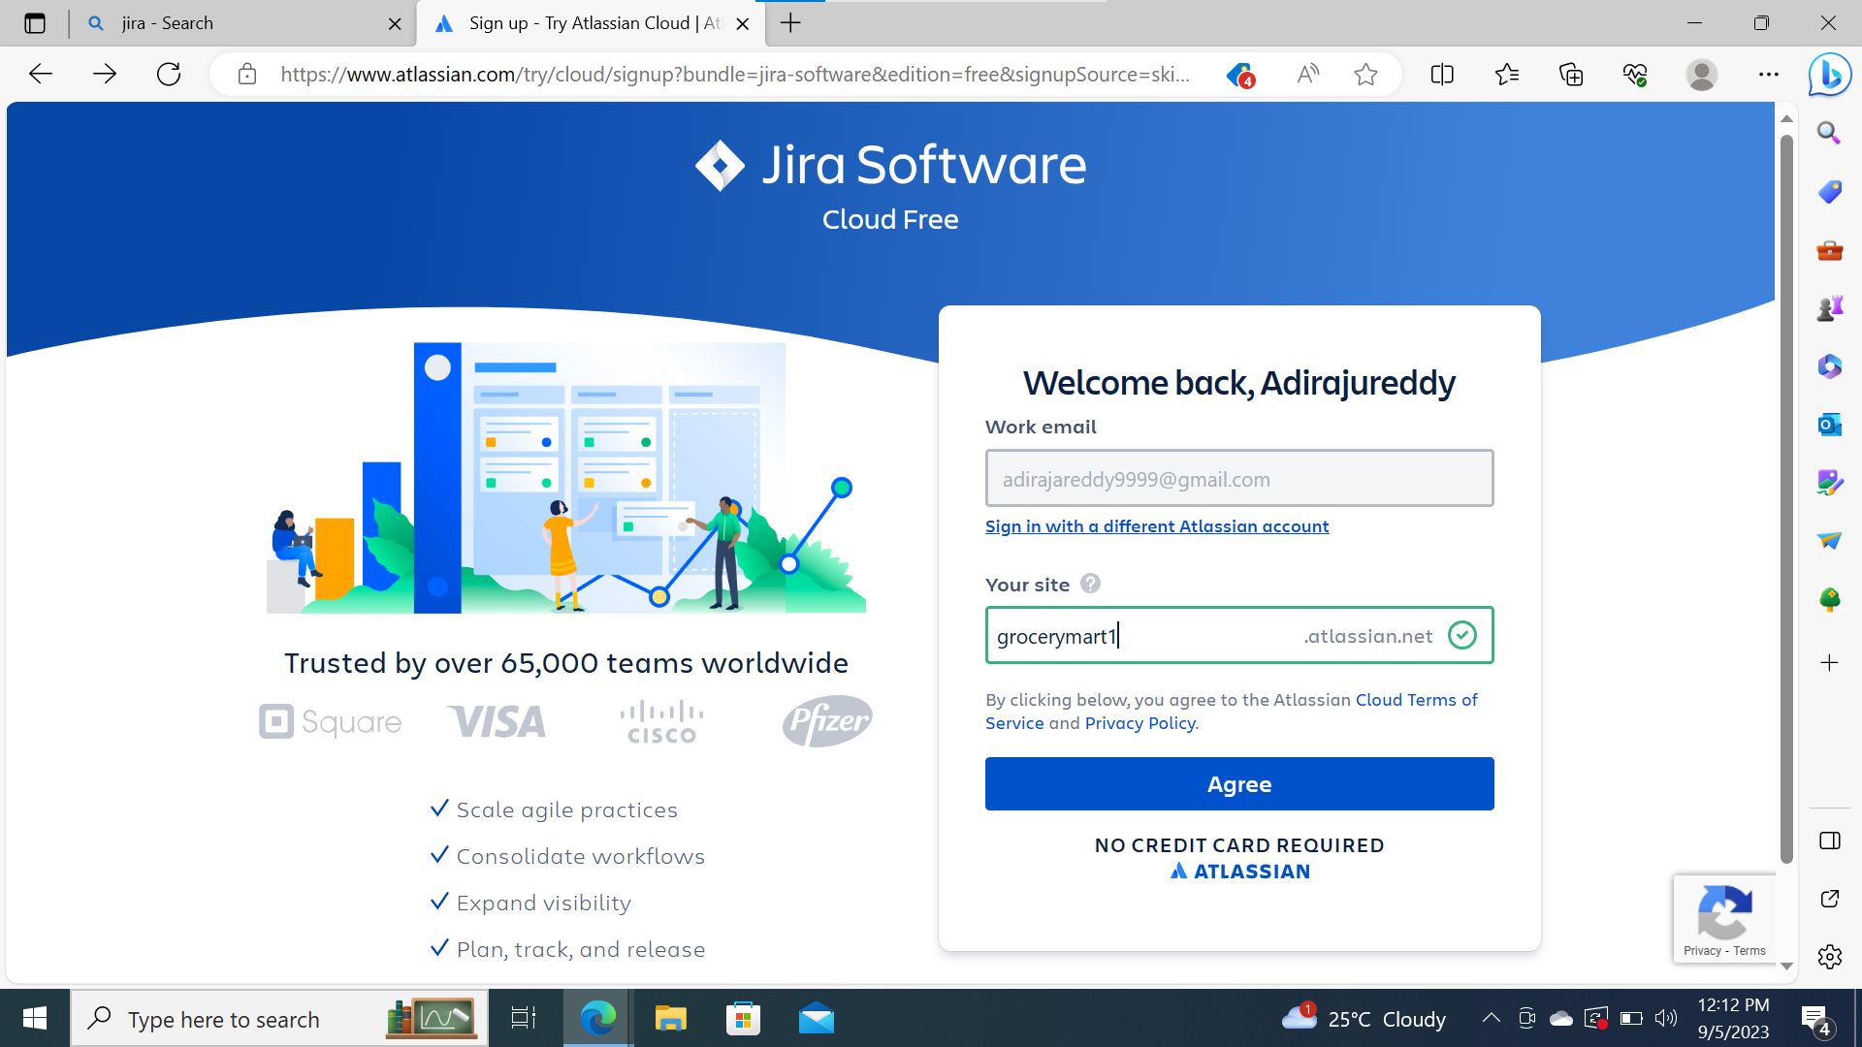
Jira login

Slide 3
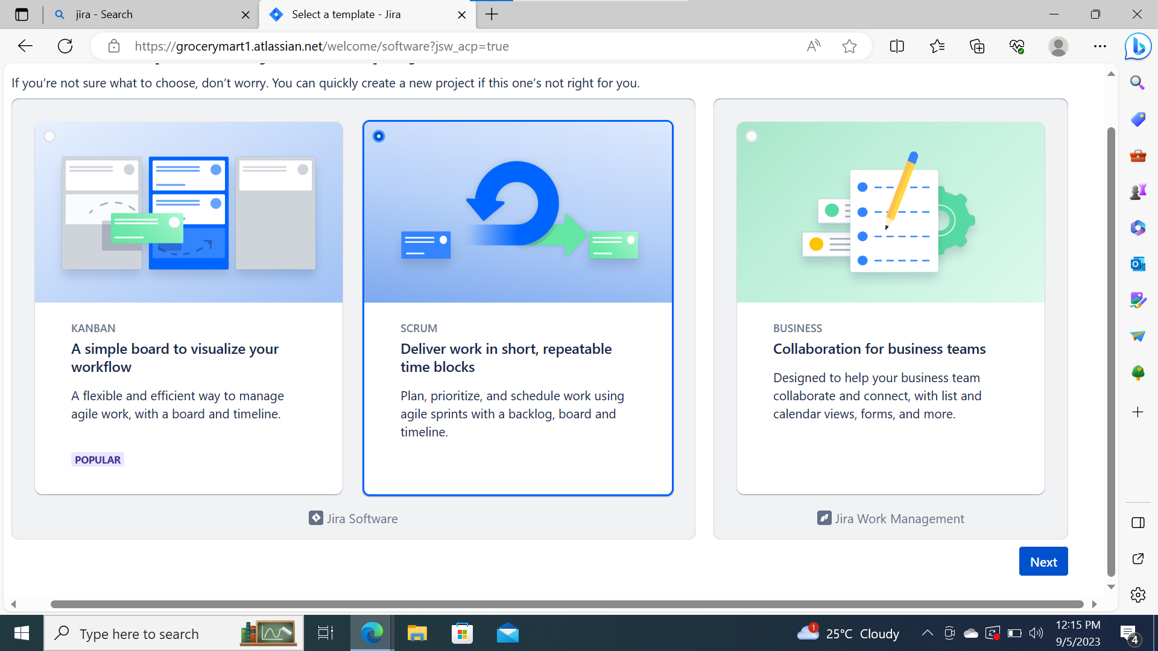

Slide 4
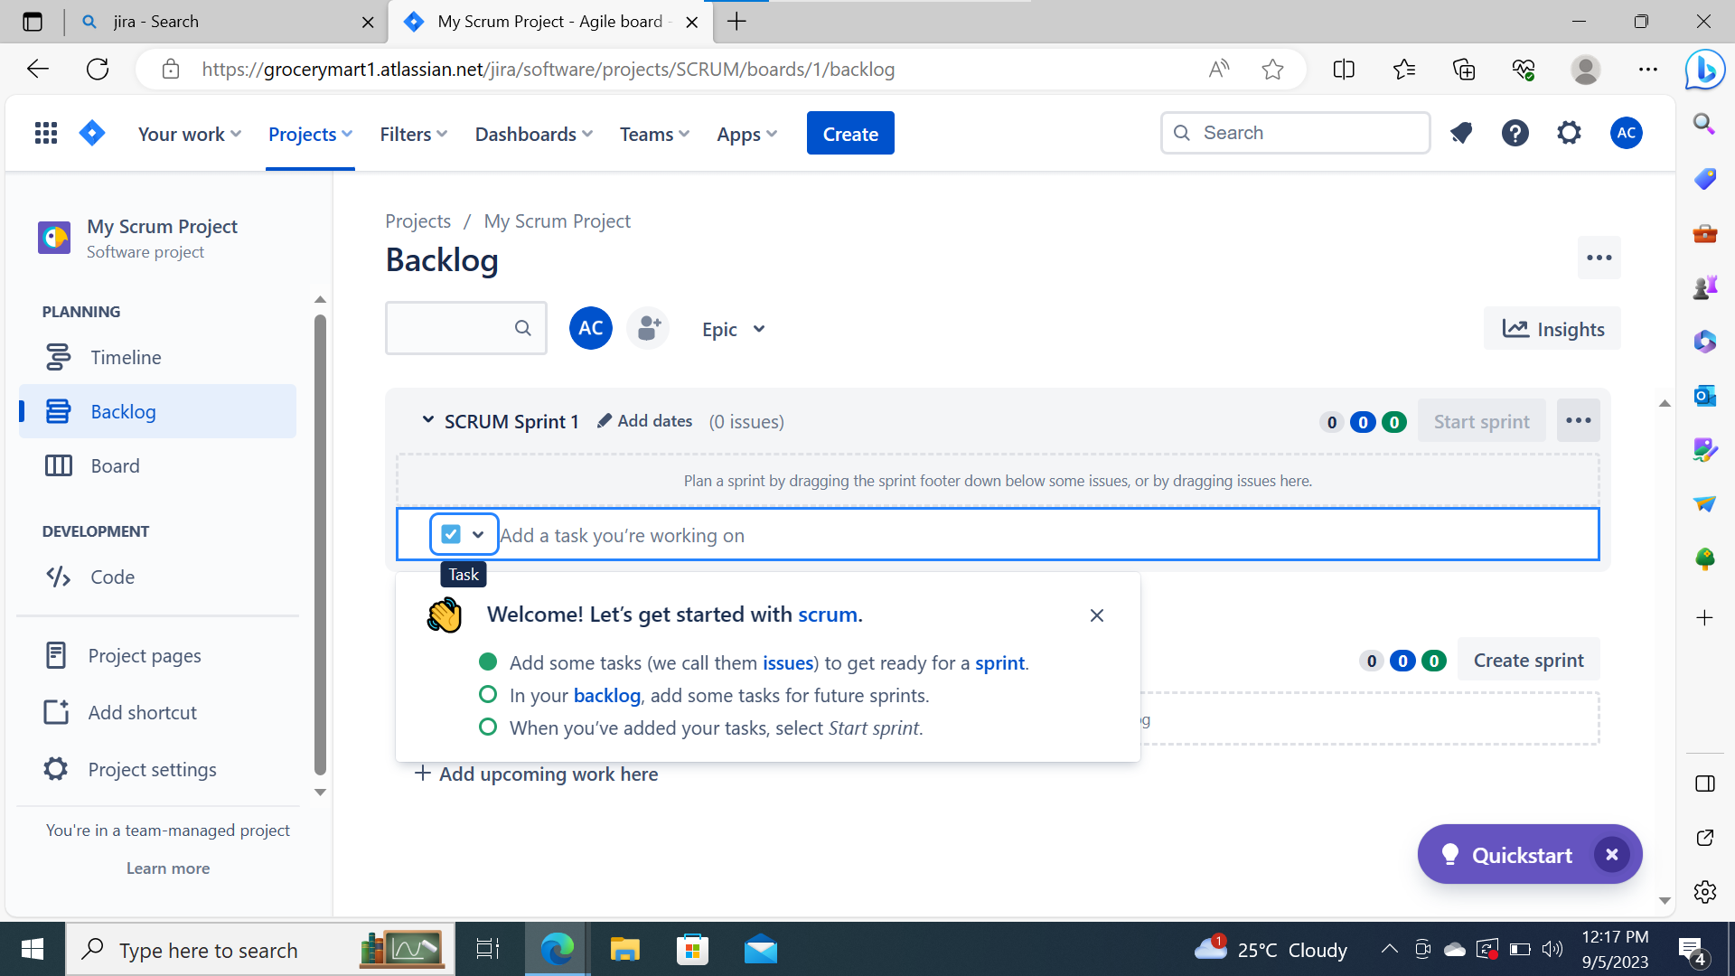
Its open a Empty Backlog

Slide 5
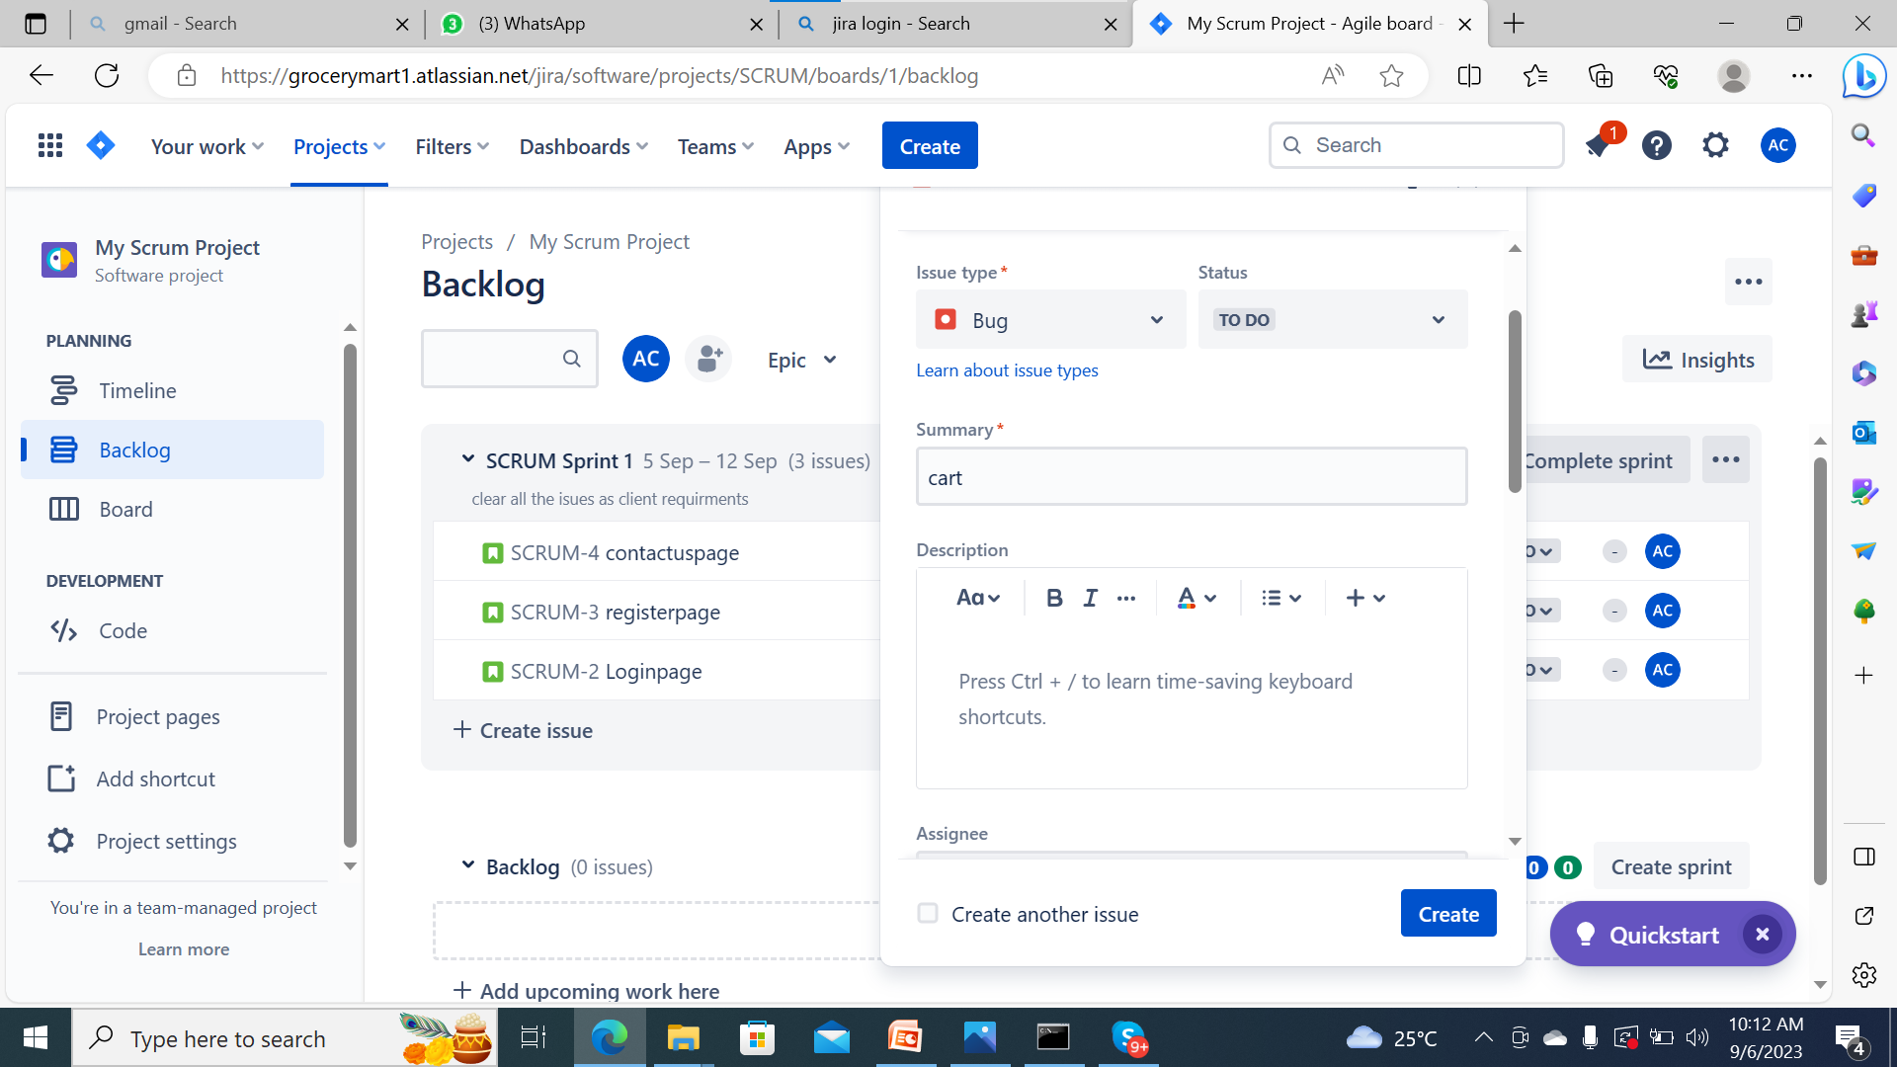
Create a cart page an bug

Slide 6
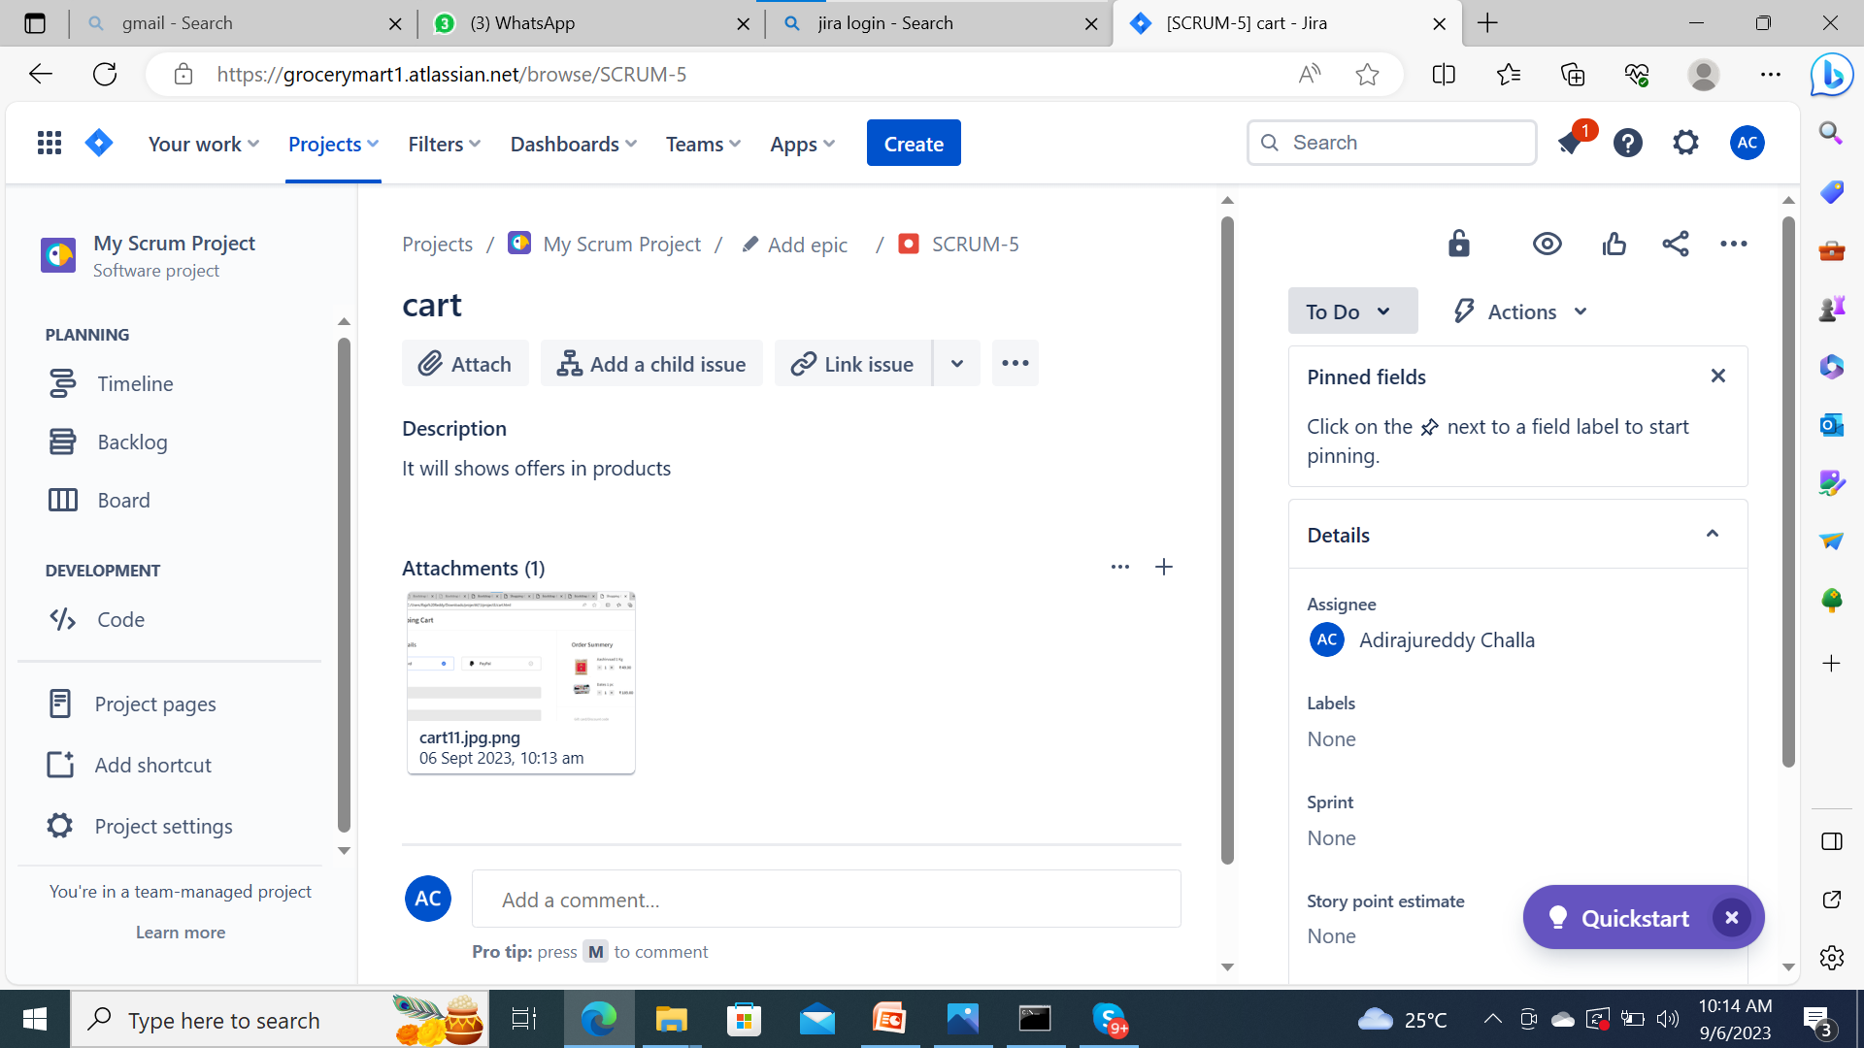

Slide 7
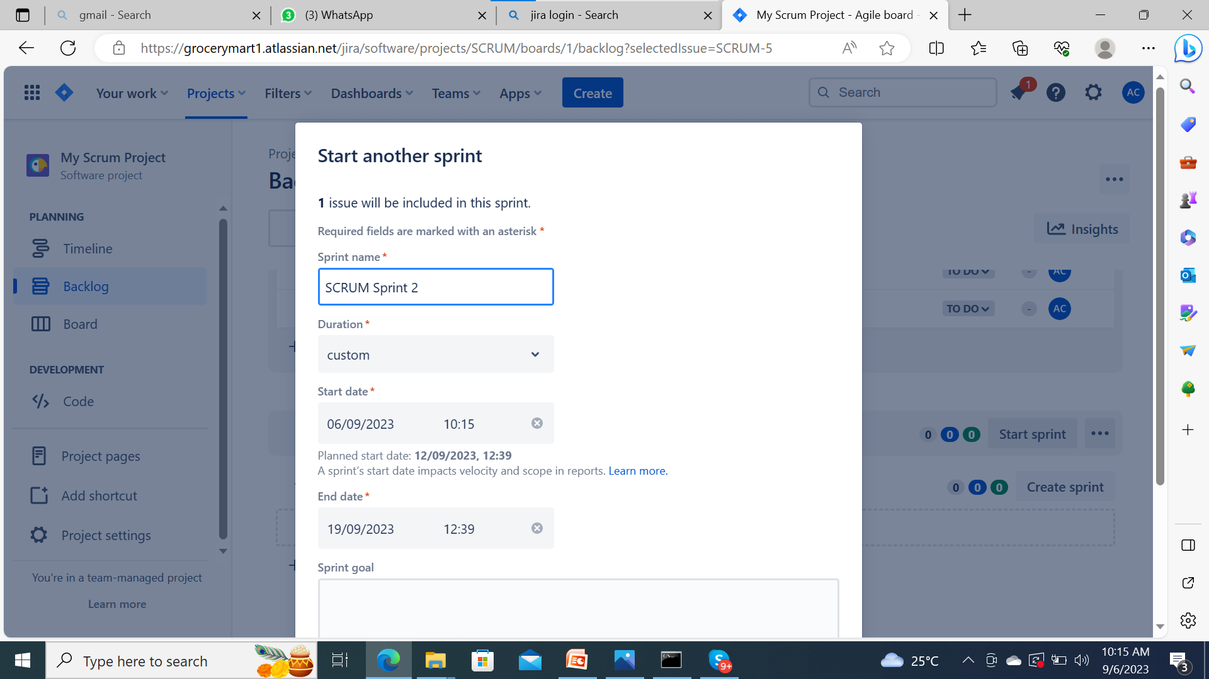
Can Start Sprint

Slide 8
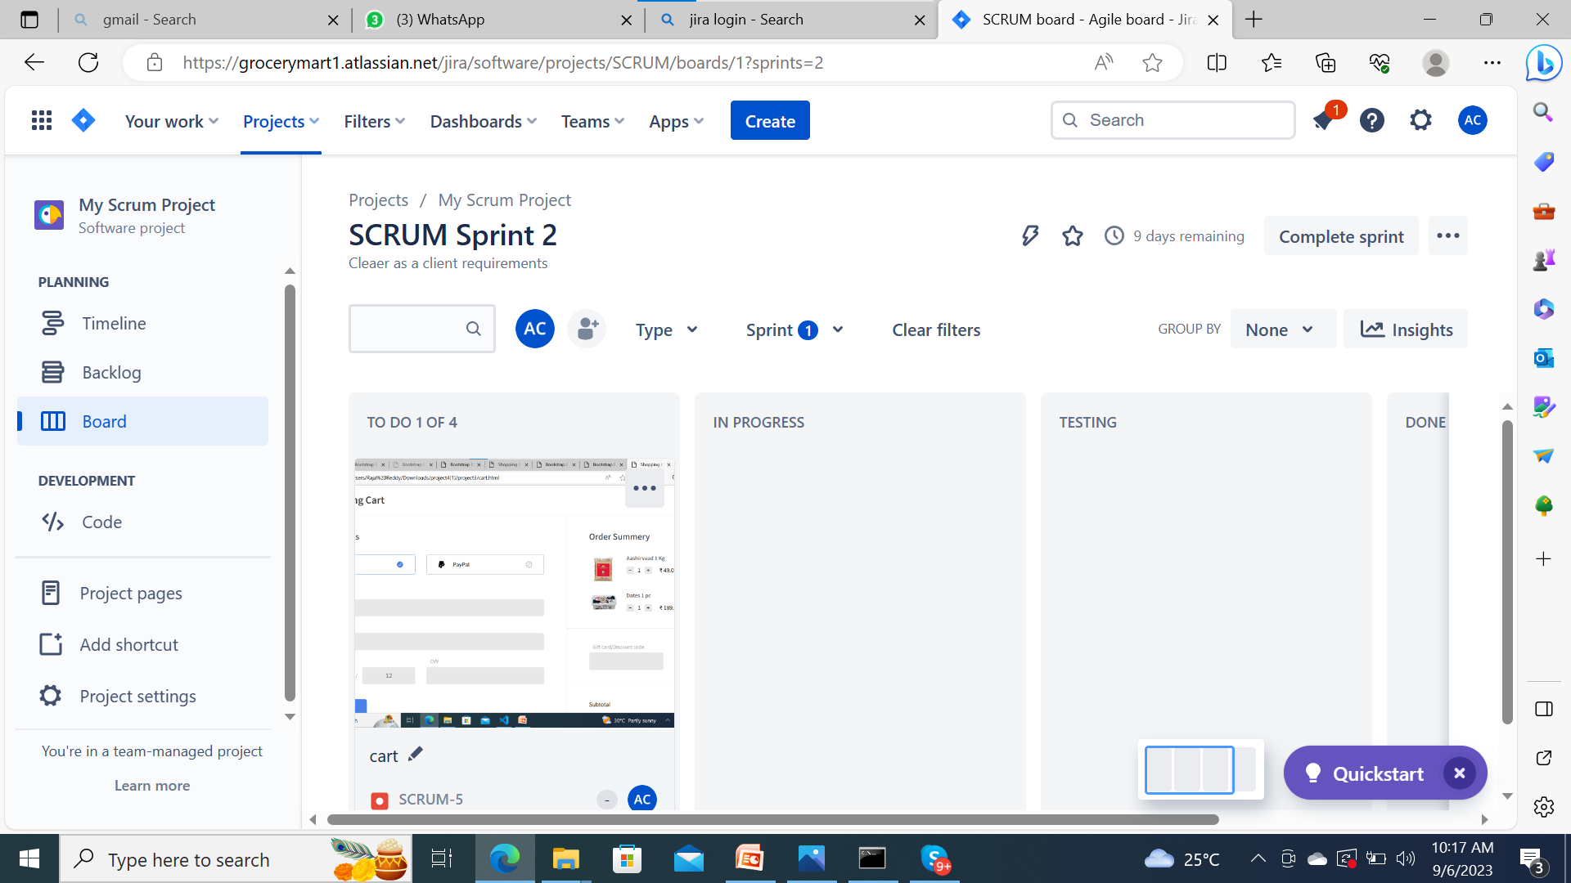
Scrum Sprint stages

Slide 9
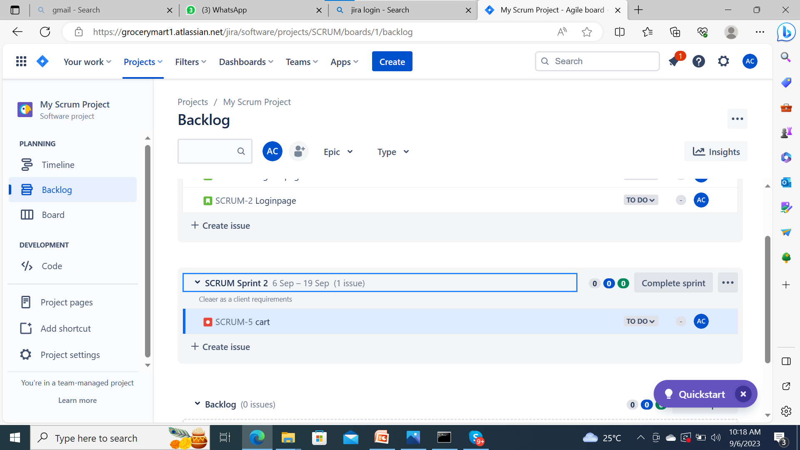
Scrum Sprint status

Slide 10


