Slide 1
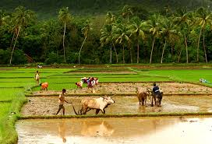
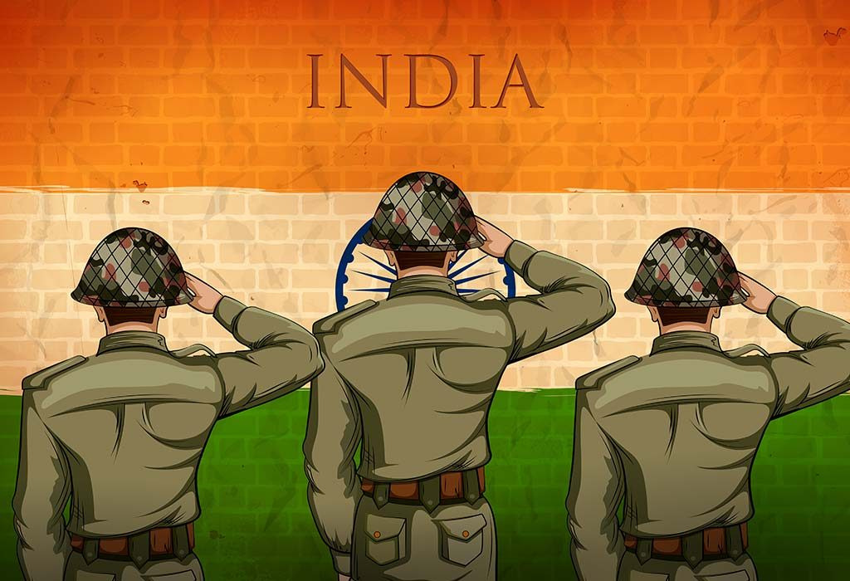
FARMING IS CHANGING DAY BY DAY
THE GOOD TRUE SOLDIER IS A ARMY

