Slide 1
Rugged Board
GPIO
https://community.ruggedboard.com

Slide 2
RB-GPIO
SAMA5D27 Pin Numbers vs. GPIO Port Numbers
How to calculate SAMA5D27 pin number using GPIO port number?
Port value PA --> 0
PB --> 1
PC --> 2
PD --> 3
SAMA5D2_PIN_Number = (32 * PX) + GPIO_PX_Number,
Where X takes A / B /C /D
For PC13 SAMA5D2 pin number is 77
(32 * PC) + 13 = (32 * 2) + 13 = 77
SAMA5D27 Pin Numbers | GPIO Port Numbers
0 - 31 | PA0 - PA31
32 - 63 | PB0 - PB31
64 - 95 | PC0 - PC31
96 - 127 | PD0 - PD31

Slide 3
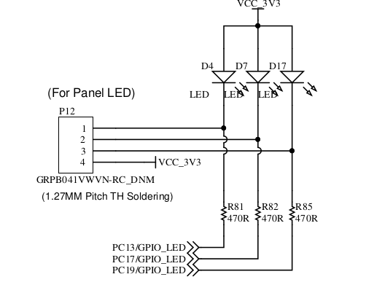
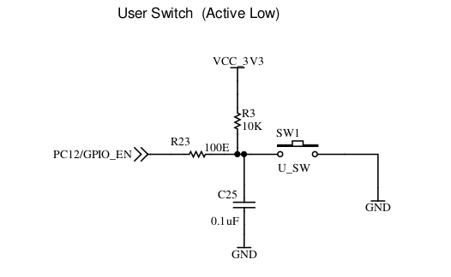
RB-GPIO
On Board Switch and LED circuit

Slide 4
RB-GPIO
Accessing the GPIO using SYSFS
Example: PC13 as output pin
Export PC13
root@rugged-board-a5d2x-sd1:~# echo 77 > /sys/class/gpio/export
Set PC13 as output pin
root@rugged-board-a5d2x-sd1:~# echo out > /sys/class/gpio/PC13/direction
Set PC13 as Low
root@rugged-board-a5d2x-sd1:~# echo 0 > /sys/class/gpio/PC13/value
Set PC13 as High
root@rugged-board-a5d2x-sd1:~# echo 1 > /sys/class/gpio/PC13/value
Unexport PC13
root@rugged-board-a5d2x-sd1:~# echo 77 > /sys/class/gpio/unexport

Slide 5
RB-GPIO
Accessing the GPIO using SYSFS
Example: PC12 as input pin
Export PC12
root@rugged-board-a5d2x-sd1:~# echo 76 > /sys/class/gpio/export
Set PC12 as input pin
root@rugged-board-a5d2x-sd1:~# echo in > /sys/class/gpio/PC12/direction
Keep pressing user switch
root@rugged-board-a5d2x-sd1:~# cat /sys/class/gpio/PC12/value
0
Switch not pressed
root@rugged-board-a5d2x-sd1:~# cat /sys/class/gpio/PC12/value
1
Unexport PC13
root@rugged-board-a5d2x-sd1:~# echo 76 > /sys/class/gpio/unexport

Slide 6
RB-GPIO
C program to blink the LED connected to PC13,PC17,PC19

Slide 7
RB-GPIO
C program to blink any one of the LED by pressing user switch connected to PC12

Slide 8
Open Discussions

Slide 9





Connect-us
Developer
Wiki

Slide 10
