Slide 1
Rugged Board
I2C
https://community.ruggedboard.com

Slide 2
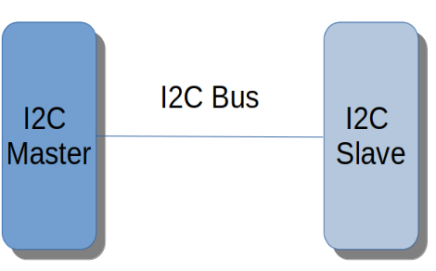
RB-I2C
In 1982, Phillips has developed I2C protocol. I2C bus is for communication between digital devices.
There will be a master and a slave device.
I2C is called Inter Integrated Circuit.
Data transfer speed for I2C could be upto 3.4 mbps. Generally, it is 100 kbps.
I2C is a master and slave configuration. There will be Single master and one or many slaves.
I2C has two lines … SDA: Serial data line SCL: Serial clock line SDA SDA is bi Directional Line.
SDA is used to transfer data between I2C Master and I2C slave. SCL SCL line provide clock to slave device.
SCL line is managed by I2C Master.

Slide 3
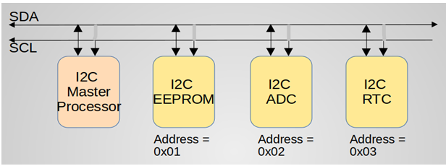
RB-I2C
In a nutshell, one I2C master can be connected with more than one I2C slave chips.

Slide 4
RB-I2C
EEPROM is interfaced with I2C in RuggedBoard
Using the below path we will write and read the EEPROM
"/sys/class/i2c-adapter/i2c-0/0-0050/eeprom";
/*Required Hearder Files*/
#include <stdio.h>
#include <stdlib.h>
#include <linux/i2c.h>
#include <linux/i2c-dev.h>
#include <sys/ioctl.h>
#include <sys/time.h>
#include <fcntl.h>
#include <errno.h>
#include <time.h>
#include <unistd.h>
#include <string.h>
// EEPROM path
char const EEPROM_FILE_BOARD[] = "/sys/class/i2c-adapter/i2c-0/0-0050/eeprom";
// EEPROM content format
typedef struct _cBoardEEPROM
{
char ModuleID[16];
char SerialNo[16];
char data[512];
}cBoardEEPROM;

Slide 5
RB-I2C
// Read board EEPROM
int ReadBoardEEPROM(cBoardEEPROM* boardEEPROM)
{
int Fd = 0;
int ReadBytes = 0;
memset(boardEEPROM, 0, sizeof(boardEEPROM));
if ((Fd = open(EEPROM_FILE_BOARD,O_RDONLY)) < 0)
{
printf("EEPROM_FILE_BOARD open error: %s\n", strerror(errno));
return -1;
}
ReadBytes = read(Fd, (void*)boardEEPROM, sizeof(cBoardEEPROM));
if( ReadBytes < 0 )
{
printf("EEPROM_FILE_SOM read error: %s\n", strerror(errno));
close(Fd);
return -1;
}
close(Fd);
} // ReadBoardEEPROM

Slide 6
RB-I2C
// Write board EEPROM
void WriteBoardEEPROM(cBoardEEPROM* boardEEPROM)
{
int Fd = 0;
int WriteBytes = 0;
if ((Fd = open(EEPROM_FILE_BOARD,O_WRONLY)) < 0)
{
printf("EEPROM_FILE_BOARD open error: %s\n", strerror(errno));
return;
}
WriteBytes = write(Fd, (void*)boardEEPROM, sizeof(cBoardEEPROM));
if( WriteBytes < sizeof(cBoardEEPROM) )
{
if (WriteBytes < 0)
printf("EEPROM_FILE_BOARD write error : %s\n", strerror(errno));
else
printf("EEPROM_FILE_BOARD write error : Partial write to EEPROM (%d)\n", WriteBytes);
}
close(Fd);
} // WriteBoardEEPROM

Slide 7
RB-I2C
// main routine
int main(int argc, char *argv[])
{
int Result = 0;
cBoardEEPROM boardEEPROM ,board;
strcpy(boardEEPROM.ModuleID,"RBEEPROM1234");
strcpy(boardEEPROM.SerialNo,"112233445566");
strcpy(boardEEPROM.data,"Phytec Embedded Pvt Ltd");
WriteBoardEEPROM (&boardEEPROM);
memset(&board, 0x00, sizeof(board));
// Read EEPROM
Result = ReadBoardEEPROM(&board);
printf("[EEPROM content]=============================\n");
printf("Module ID : %s\n", board.ModuleID);
printf("Serial NO : %s\n", board.SerialNo);
printf("Data : %s\n", board.data);
return 0;
}

Slide 8





Connect-us
Developer
Wiki

Slide 9
Open Discussions

Slide 10
