Slide 1
Rugged Board
SPI
https://community.ruggedboard.com

Slide 2
RB-SPI
Since the SPI dev interface was introduced into the kernel, it is easy to access the SPI device in user space via the device node “/dev/spidev”.
The device node below is used to access the SPI bus driver. The first number 3 indicates bus number 3, the second 0 indicates the CS number
/dev/spidev3.0

Slide 3
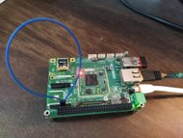
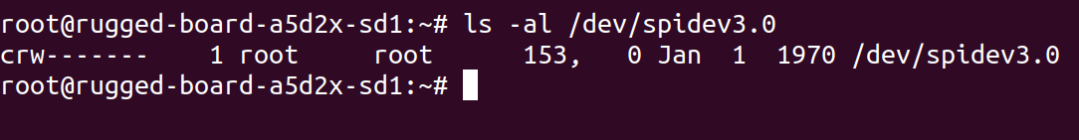
RB-SPI
RuggedBoard Mikro Bus MOSI MISO
loopback connection

Slide 4
RB-SPI
Sample Code Logic
struct spi_ioc_transfer trx;
uint32_t scratch32;
open("/dev/spidev3.0 ",O_RDWR);
ioctl(fd, SPI_IOC_RD_MODE32, &scratch32)
ioctl(fd, SPI_IOC_WR_MODE32, &scratch32)
ioctl(fd, SPI_IOC_RD_MAX_SPEED_HZ, &scratch32)
ioctl(fd, SPI_IOC_WR_MAX_SPEED_HZ, &scratch32)
ioctl(fd, SPI_IOC_MESSAGE(1), &trx)

Slide 5
Open Discussions

Slide 6





Connect-us
Developer
Wiki

Slide 7
