Slide 1
Rugged Board
Socket
https://community.ruggedboard.com

Slide 2
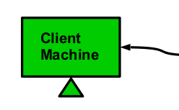
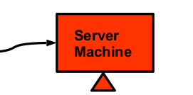
RB-Socket
Socket
A socket is a communication end point to which an application can write data (to be sent to the underlying network) and from which an application can read data.
The process/application can be related or unrelated and may be executing on the same or different machines
Client Server Paradigm

Slide 3
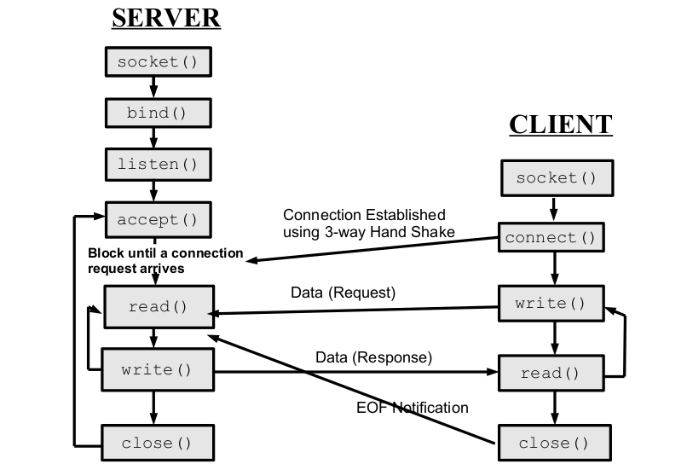
RB-Socket
System Call Graph: TCP Sockets

Slide 4
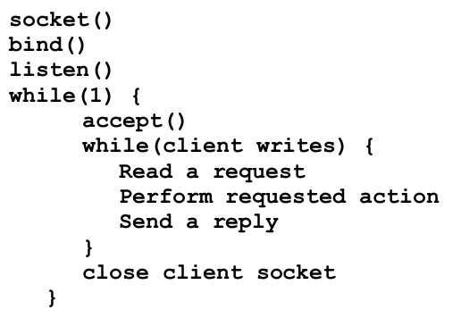
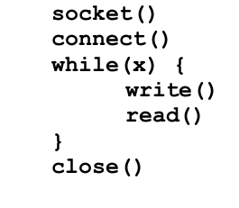
RB-Socket
Pseudocode: TCP Sockets
Server
Client

Slide 5
RB-Socket
C programs for TCP socket - Client , Server
1)Loop Back (in Rugged Board)
2)Host PC and Rugged Board

Slide 6
Open Discussions

Slide 7





Connect-us
Developer
Wiki

Slide 8
