Slide 1
Linux Memory Management
https://community.ruggedboard.com

Slide 2
Agenda
Linux Memory Management

Slide 3
Linux Memory Management
Some concepts about addresses
Address translation
-logical address
User space vs Kernel space
- linear address
A.) 0~4GB (2^32 bytes) in x86 with 32-bit and 64-bit
B.) 0~ XGB (2^64 bytes) in Alpha
- physical address
Address from main memory

Slide 4
Some concepts about addresses
1. Virtual address:
Virtual addresses are used by an application program. They consist of a 16-bit selector and a 32-bit offset. In the flat memory model, the selectors are preloaded into segment registers CS, DS, SS, and ES, which all refer to the same linear address. They need not be considered by the application. Addresses are simply 32-bit near pointers.
2. Linear addresse:
Linear addresses are calculated from virtual addresses by segment translation. The base of the segment referred to by the selector is added to the virtual offset, giving a 32-bit linear address. Under RTTarget-32, virtual offsets are equal to linear addresses since the base of all code and data segments is 0.

Slide 5
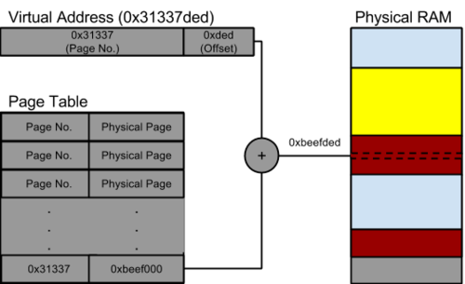
3. Physical address:
Physical addresses are calculated from linear addresses through paging. The linear address is used as an index into the Page Table where the CPU locates the corresponding physical address. If paging is not enabled, linear addresses are always equal to physical addresses. Under RTTarget-32, linear addresses are equal to physical addresses except for remapped RAM regions (see section RTLoc: Locating a Program, sections Virtual Command and FillRAM Command) and for memory allocated using the virtual memory manager.

Slide 6
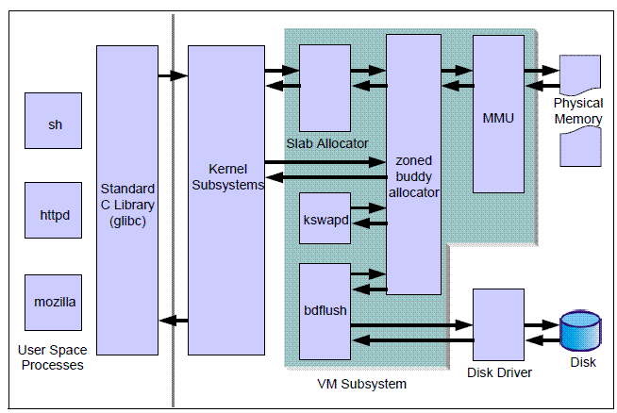
Virtual memory subsystem

Slide 7
Logical address
Linear address
0GB
Task
User
space
Segment
hardware
3GB
Kernel
Space
4GB

Slide 8
Logical Address:
- local descriptor table LDT
for user space
every task has one LDT
ie: struct desc_struct* ldt ;
- global descriptor table GDT
for kernel space
- sgment descriptor
entry in LDT/GDT
- selector
decide a segment descriptor in LDT/GDT

Slide 9
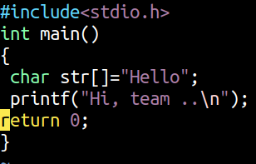
MAX_SIZE
Stack
Heap
Data
Text
Virtual Address map of a process
a.out
./a.out
0

Slide 10
stack_stack
Stack
Kernel variable
“current”
mmap_base
Memory mapping
brk
Heap
start_brk
BSS (uninitialized)
task_struct
mm_struct
end_data
Initialized data
start_data
end_code
start_code
Text segment

Slide 11
1. Logical Address / Linear Address is comprises of -->
Segment selector | Offser register
16-bit
32-bit
CPU | Segmentation unit | Demand pagging unit | Physical Adress

Slide 12
CPU
TLB
Cache
RAM
RAM
Page frame | Block no
1 | 6
2 | 2
3 | -
4 | -
Swap memory
MMU
1 | 2 | 3
4 | 5 | 6
Process page Table
Block no | Page frame no | Present bit | Dirty bit | Protected bit
1 |  | 0 | 0 | 0
2 | 2 | 1 | 0 | 1
3 |  | 0 | 0 | 0
4 |  | 0 | 0 | 0
5 |  | 0 | 0 | 0
6 | 1 | 1 | 1 | 0

Slide 13
MMU
Kernel global variable, i.e current which points to staruct task_struct..
RAM
Page directory selector | Page table(index) | offset
Page frame no | offset
current
Page table -1
task_struct
Page global directory
mm_struct
1
2
3
4
5
Page table - 2
Page global directory

Slide 14





Connect-us
Developer
Wiki

Slide 15
Open Discussions

Slide 16
