Slide 1

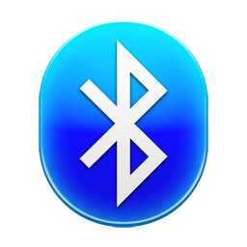
BlueTooth Chat Android App

Slide 2

Motivation
Android is the Linux based fastest growing platform, with the richest applications as compared to other platforms.
Android is the latest technology in the smartphone’s which provide the open sourcing and powerful application API.
The android system provide many bluetooth APIs for developers to call.
There is no such popular android app for short distance communication .
Bluetooth/Hotspot technology can be used for such type of communication.
In this App we are using the Bluetooth Technology for this short distance communication.

Slide 3
Introduction
This android app facilitate the user to chat without using the internet.
This App provides two types of connection between the devices.
Secure connection : A secure connection is a connection that is encrypted by one or more security protocols to ensure the security of data.
Insecure connection : An insecure connection is a connection that does not uses any kind encryption to ensure the security of data.
If Bluetooth of a device is off then it will ask for making Bluetooth on.
After making the connection between the devices the user communicate via the text messages.
This app is most useful in the school and college campus.

Slide 4
Use case diagram
Make discoverable
Secure connection
Insecure connection
Scan device
Accept pairing
user
Send message
Developer
Update app

Slide 5
Project Description
Flow Diagram
Created Connection
Make Connection With Device
Send Message
Search For Bluetooth Devices
Receive Message

Slide 6
Technology
Android – Target API-22
Java (v1.8)
XML
Bluetooth

Slide 7
Tools
Android Studio (v1.2.2)
Eclipse
Sublime Text 3

Slide 8
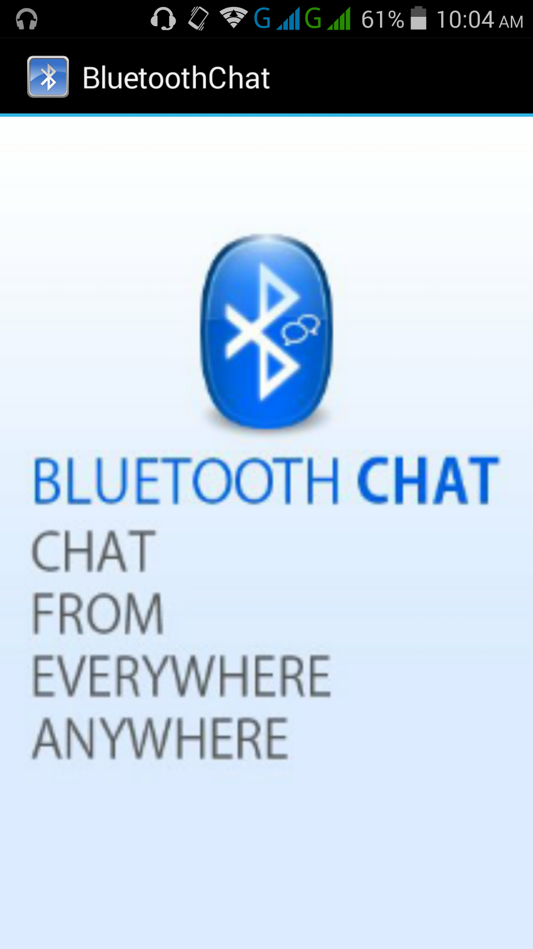
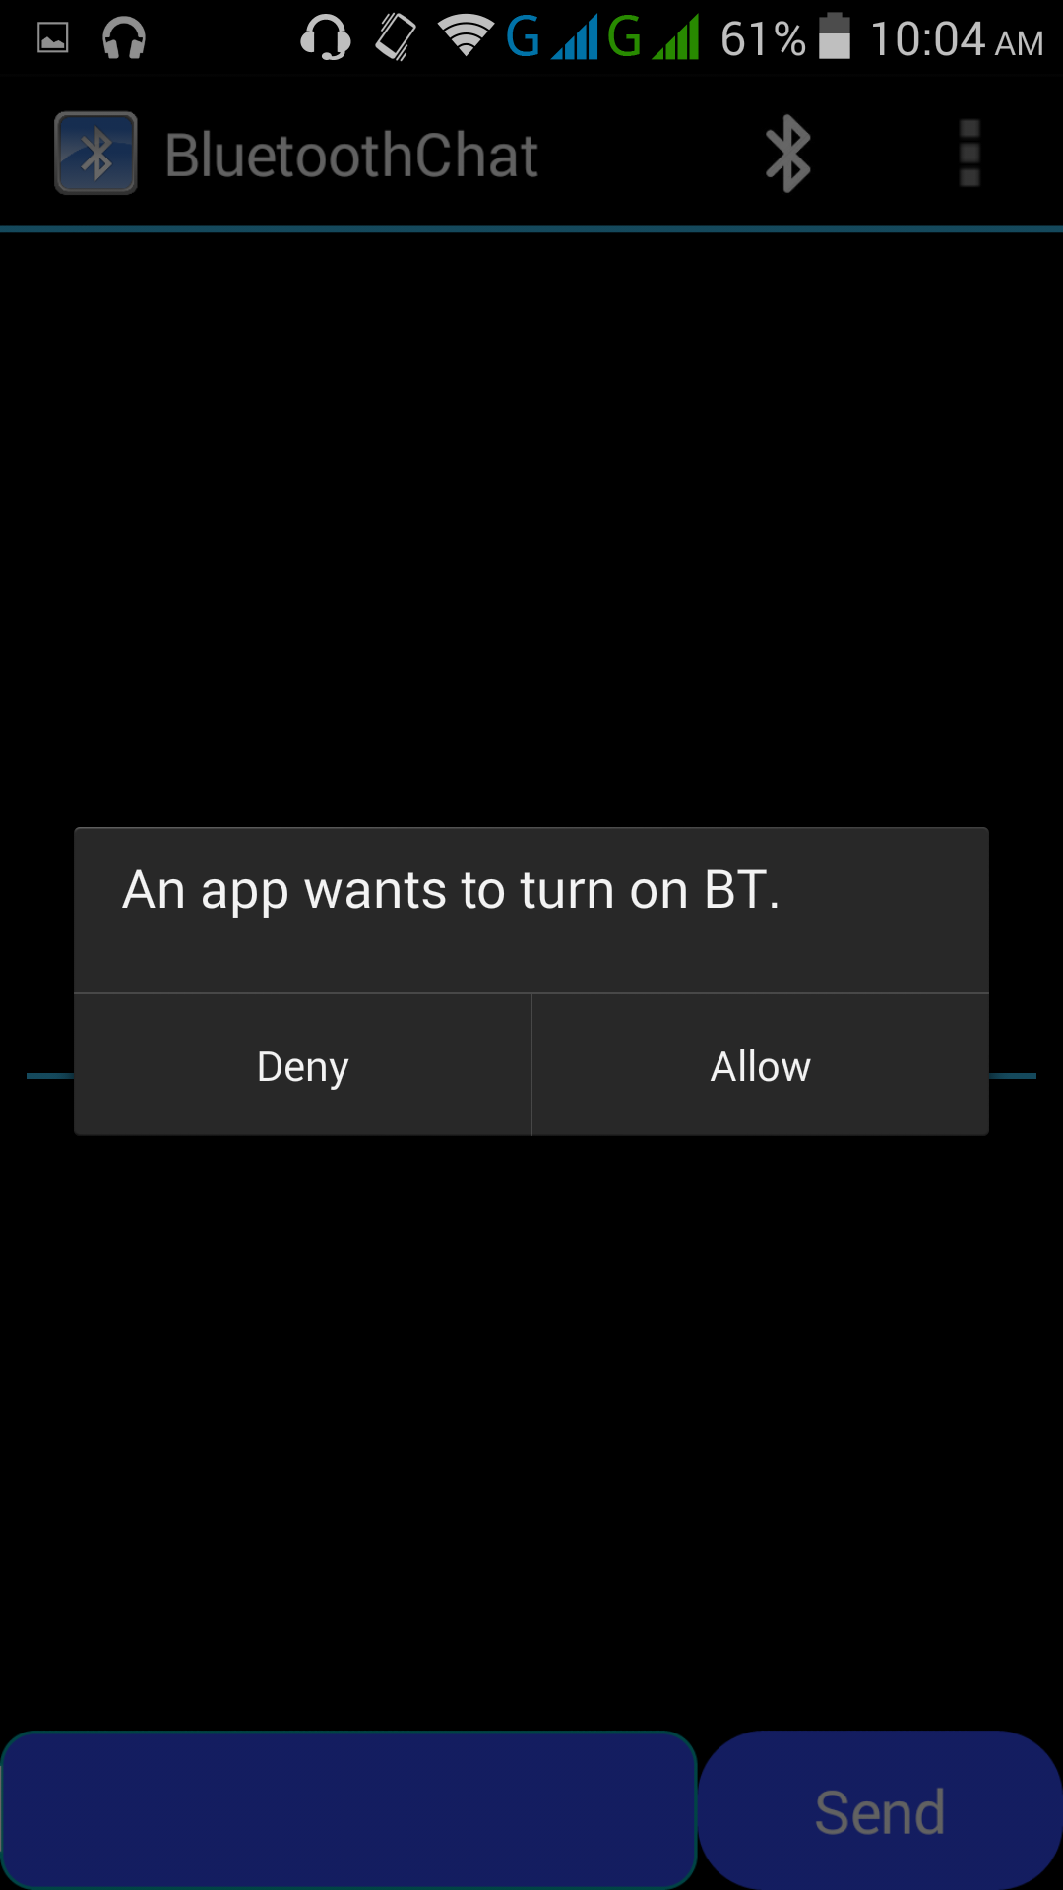
Screenshots

Slide 9
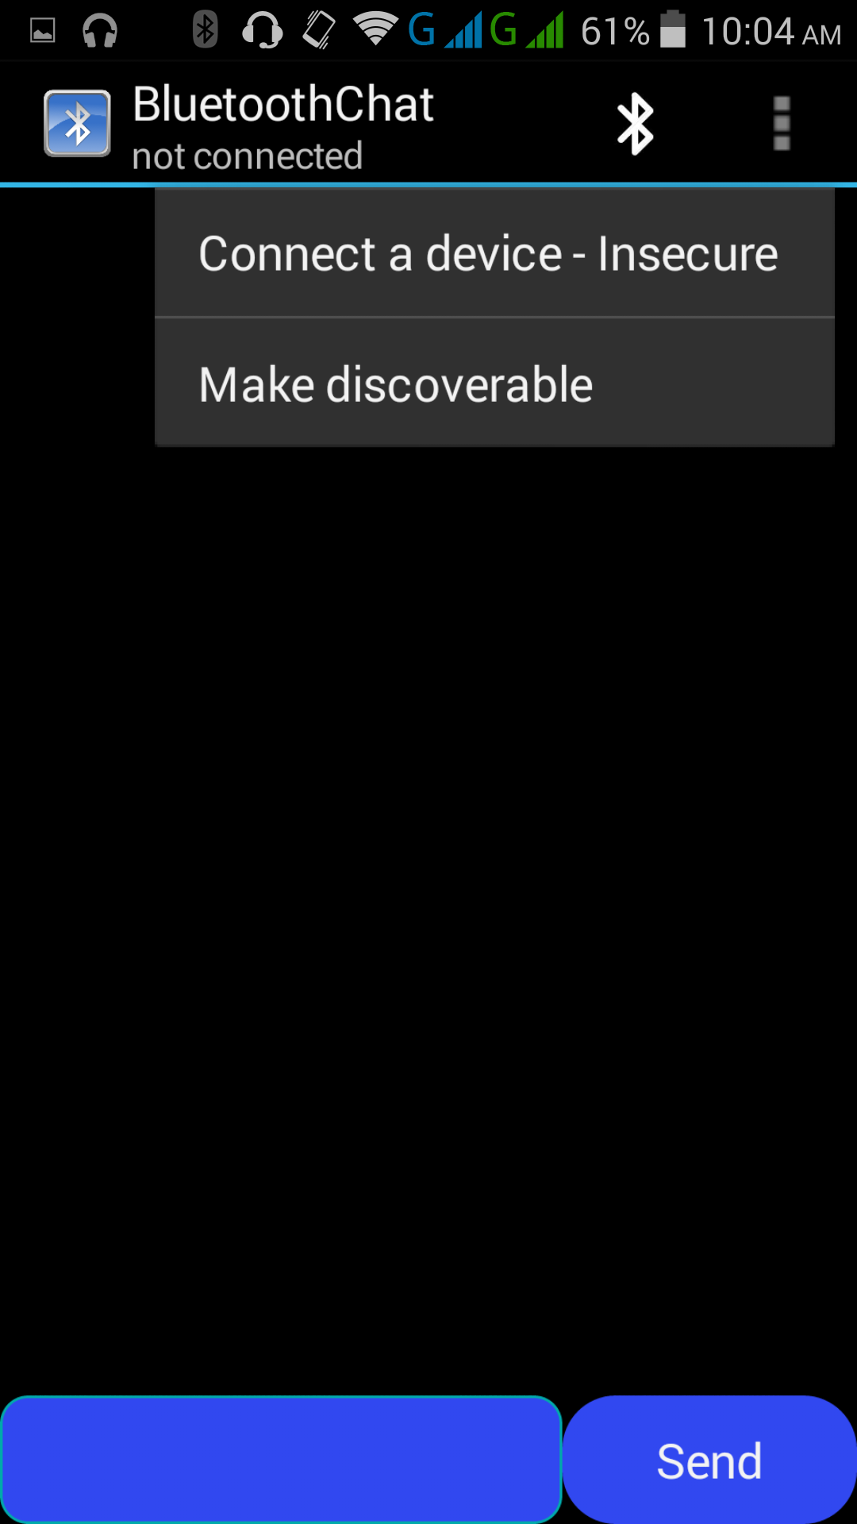
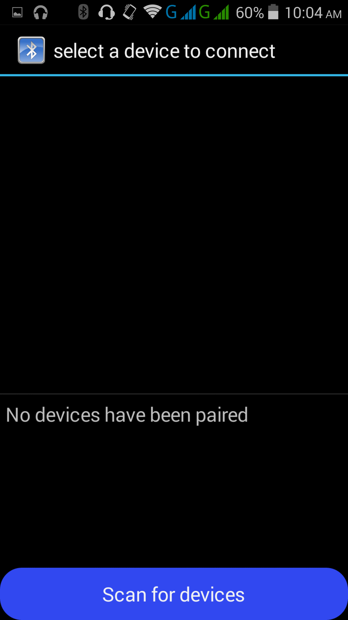
Screenshots

Slide 10
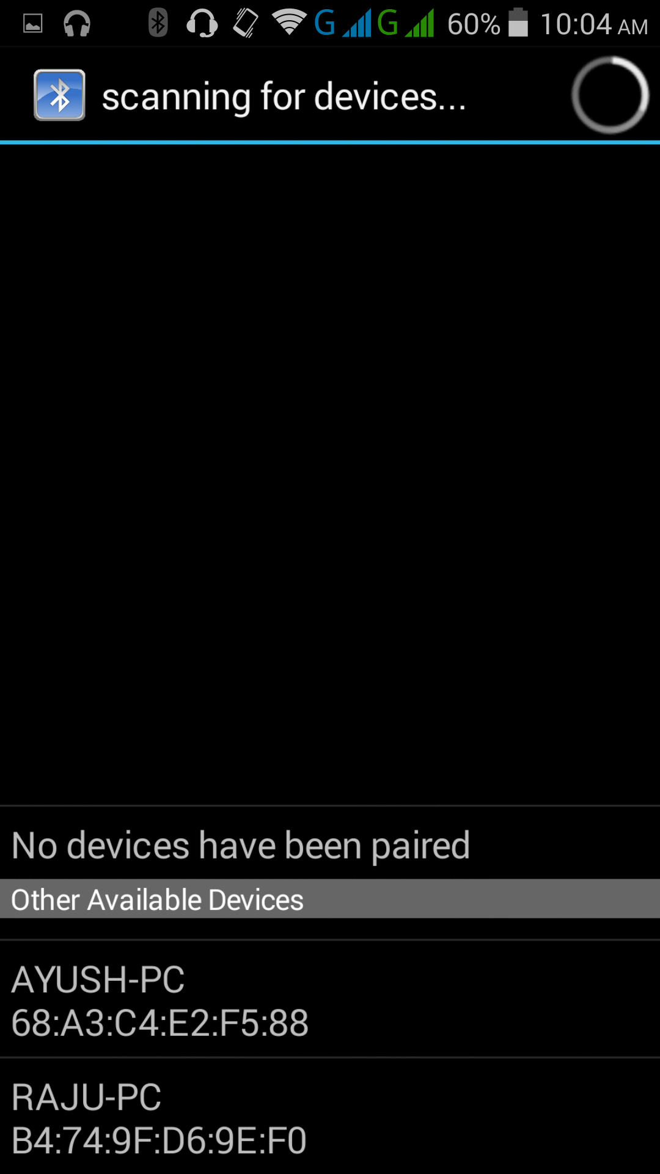
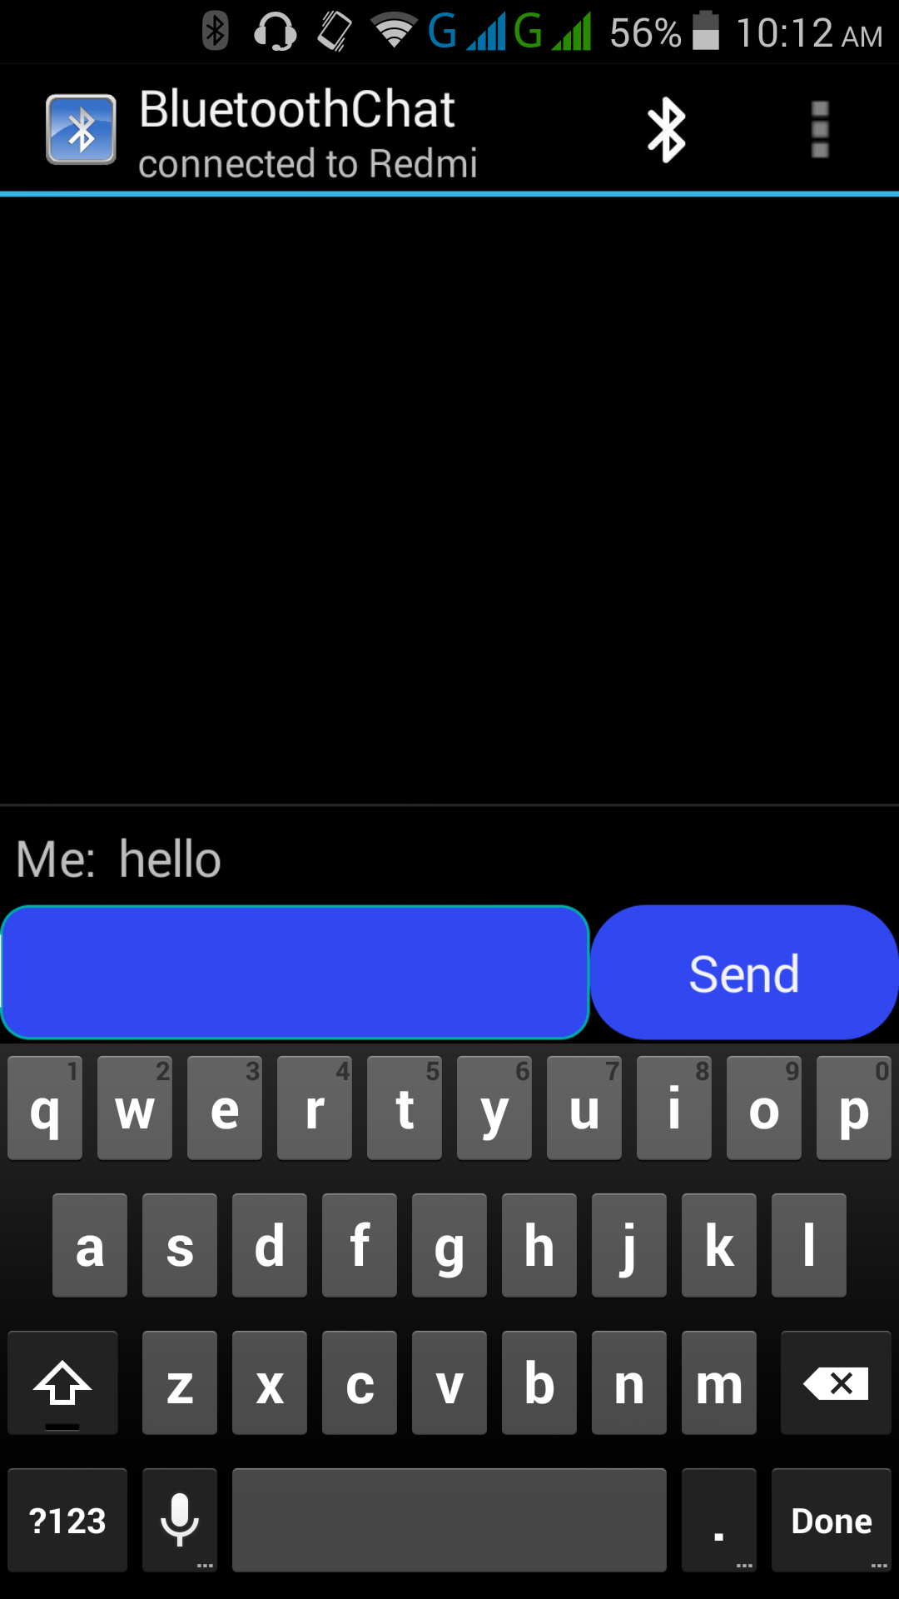
Screenshots

Slide 11
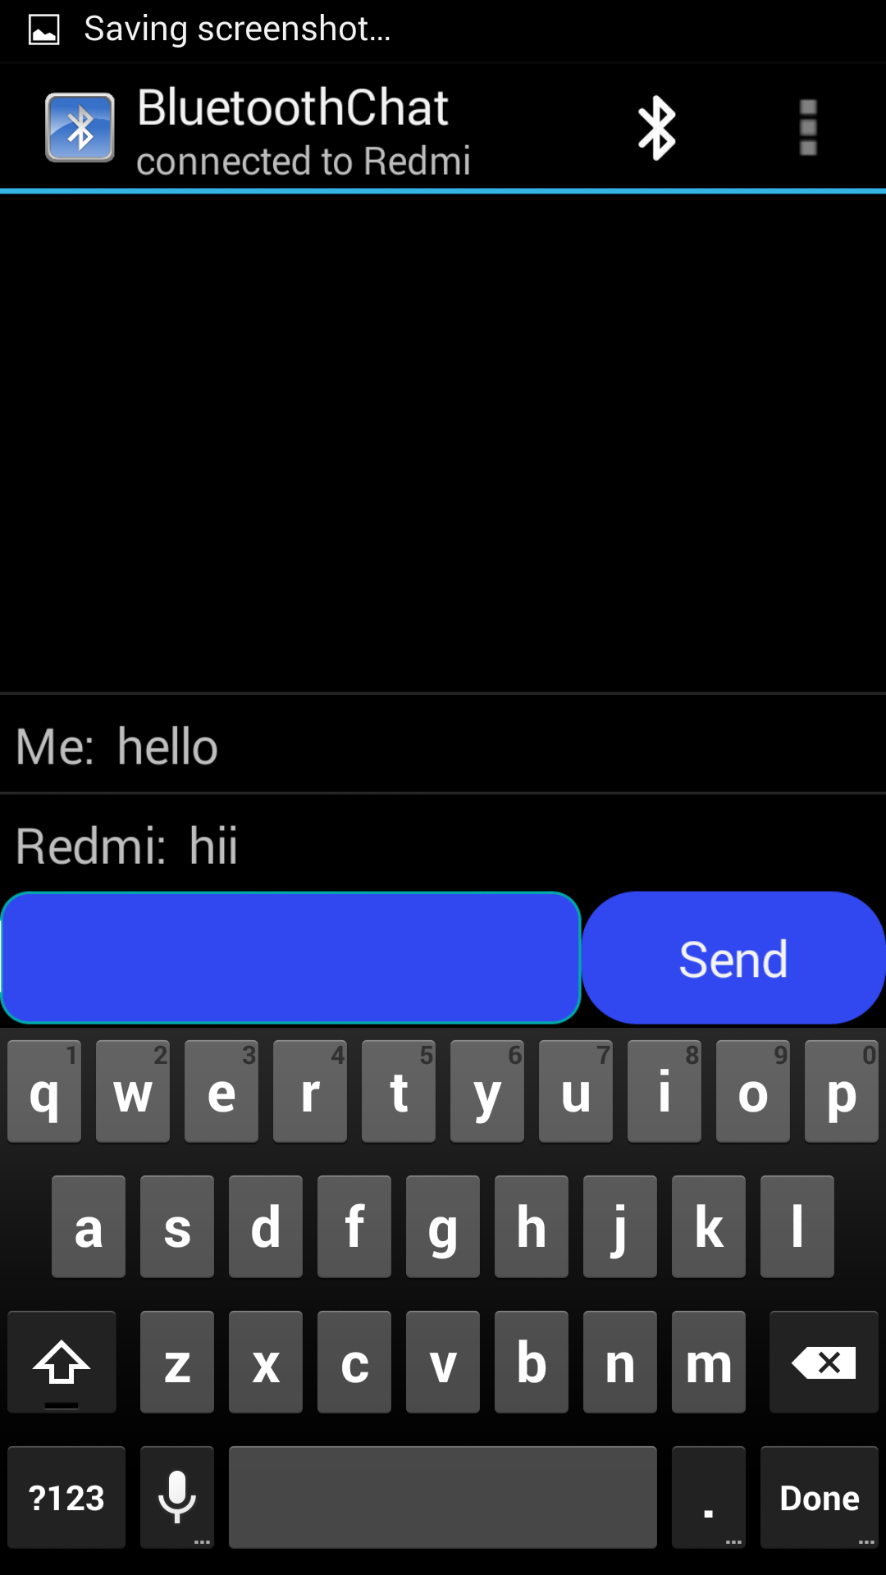
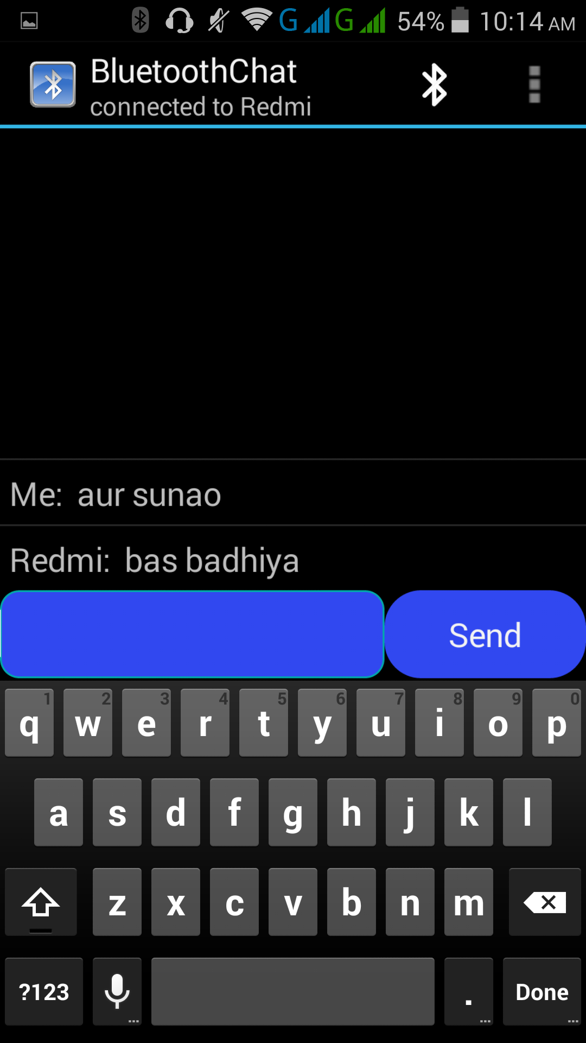
Screenshots

Slide 12
Conclusion
People are more adapt in using Mobiles than their PC’s or Laptops.
Bluetooth chatting is an innovative approach to mobile world.
This application shows the use of Bluetooth in terms of chatting.
This app make colleague gossips more attractive.
This project was helpful for sharpening Core Java skills.

Slide 13
Future Works
The app can be introduced with function of group chat .
Pictures and video exchanged can also be introduced.
This App is not Dynamic yet.
The App can add features like –Bluetooth calling Hotspot connections, Database Storage.

Slide 14
References
Websites
http://www.stackoverflow.com/
http://android.stackexchange.com/
http://forum.xda-developers.com/
http://developer.android.com/
http://android-developers.blogspot.com/
http://developers.google.com/
EBooks
Professional Android 4 Application Development
Android 3.0 Animations
Pro Android UI

Slide 15
Thank You

