Slide 1
PROJECT 15 · SDAI TRACK
Workforce Shift Planning &
Fatigue Risk Management System
A multi-tenant scheduling platform with rule-based fatigue scoring and an AI explanation layer
TEAM
DURATION & DOMAIN
— Ayushman Singh
— Raju Sutradhar
— Aryan Kumar
— Devansh Saxena
— Ambika Darare
— 10-day build sprint
— Domain: workforce safety & scheduling
— Stack: React · Node/Express · MongoDB

Slide 2
THE PROBLEM
Manual shift scheduling is blind to fatigue risk
• Spreadsheets don't check rest hours. Managers assign shifts by availability alone — nothing flags that an employee has only 4 hours of rest before their next shift.
• Overtime stacks invisibly. Weekly-hour caps and consecutive-day limits are easy to lose track of across dozens of employees and rotating shifts.
• Fatigue is a safety issue, not a preference. In healthcare, security, and logistics, fatigued staff drive real incident rates — medical errors, accidents, and near-misses correlate directly with insufficient rest.
• No audit trail. When an incident does happen, there's usually no record of whether the schedule that caused it was ever flagged as risky.
WHY IT MATTERS
• Regulatory rest-hour requirements exist across healthcare, transport, and industrial shift work
• Fatigue-related incidents carry direct cost: liability, turnover, lost productivity
• Multi-location organizations can't manually cross-check every employee's rolling 7-day workload
• A system that catches this before publishing the schedule — not after an incident — is the actual product gap
2

Slide 3
DATA & DOMAIN REFERENCE
What the system is built on
This isn't a trained ML model — it's a rule engine over a real operational data model, plus an LLM used only for language, never for scoring.
Tech Stack : React with Tailwind for Frontend, Express.js in Backend, Mongo as Database, JWT Token for Authentication etc.
Data model (MongoDB)
Domain reference rules
Demo / seed dataset
• Tenant → Users → Employees
• Shifts (start/end, type, status)
• Availability records
• FatigueRule (per tenant)
• FatigueAssessment (AI output log)
• Min rest between shifts: 11h default
• Max consecutive working days: 5
• Max rolling 7-day hours: 48h (or the employee's own stricter cap)
• Risk weight added per violated rule
• Mirrors standard labor-safety rest guidance
• Seeded demo tenant for testing
• Sample employees across departments
• Realistic shift patterns incl. violations
• Used to validate every risk flag end-to-end
• Same schema every new tenant gets
3

Slide 4
SYSTEM WORKFLOW
From a shift edit to a reviewed risk score
1
2
3
4
5
6
Manager action
Tenant scoping
Rule engine
AI explainer
Auto re-check
Manager review
Add / edit / delete a shift in the Shift Calendar
auth → tenantContext → roleGuard middleware chain scopes every query
FatigueEngine checks rest hours, overlaps, weekly hours, consecutive days
Claude turns the engine's flags into plain-English text + a suggestion
Editing one shift invalidates & re-assesses that employee's other shifts too
Score + explanation surface in the Dashboard and Fatigue Report for sign-off
ARCHITECTURE
• MVC + service layer: routes → middleware → controllers (HTTP only) → services (all business logic) → Mongoose models
• Multi-tenant by design: every tenant-scoped collection carries a tenantId; no query anywhere skips it
4

Slide 5
AI DESIGN & GUARDRAILS
AI explains risk — it never invents it
The core innovation: a hard split between deterministic scoring and generative explanation, so a hallucinated number can never reach a manager.
GUARDRAILS IN THE AI LAYER
No scoring authority
• Deterministic core: FatigueEngine computes the risk score from fixed rules — auditable, reproducible, zero AI involvement
• LLM has one job: Claude only turns the engine's flags into plain-English text + a suggested alternative
• Same input every time: the model only ever sees the engine's own structured flags — never open-ended user text
• Runs in the background: assessment never blocks the manager's workflow while it waits on the API
AI never sets or influences the risk number
Fail-safe fallback
Falls back to a template if the AI is unavailable
Human-in-the-loop
Every explanation is labeled for manager review
Scoped input, no injection surface
Model sees only engine flags — never raw user text
Tenant isolation
Scoped by the same tenantId as every other query
No duplicate / stale results
Re-assessing a shift replaces its prior result
5

Slide 6
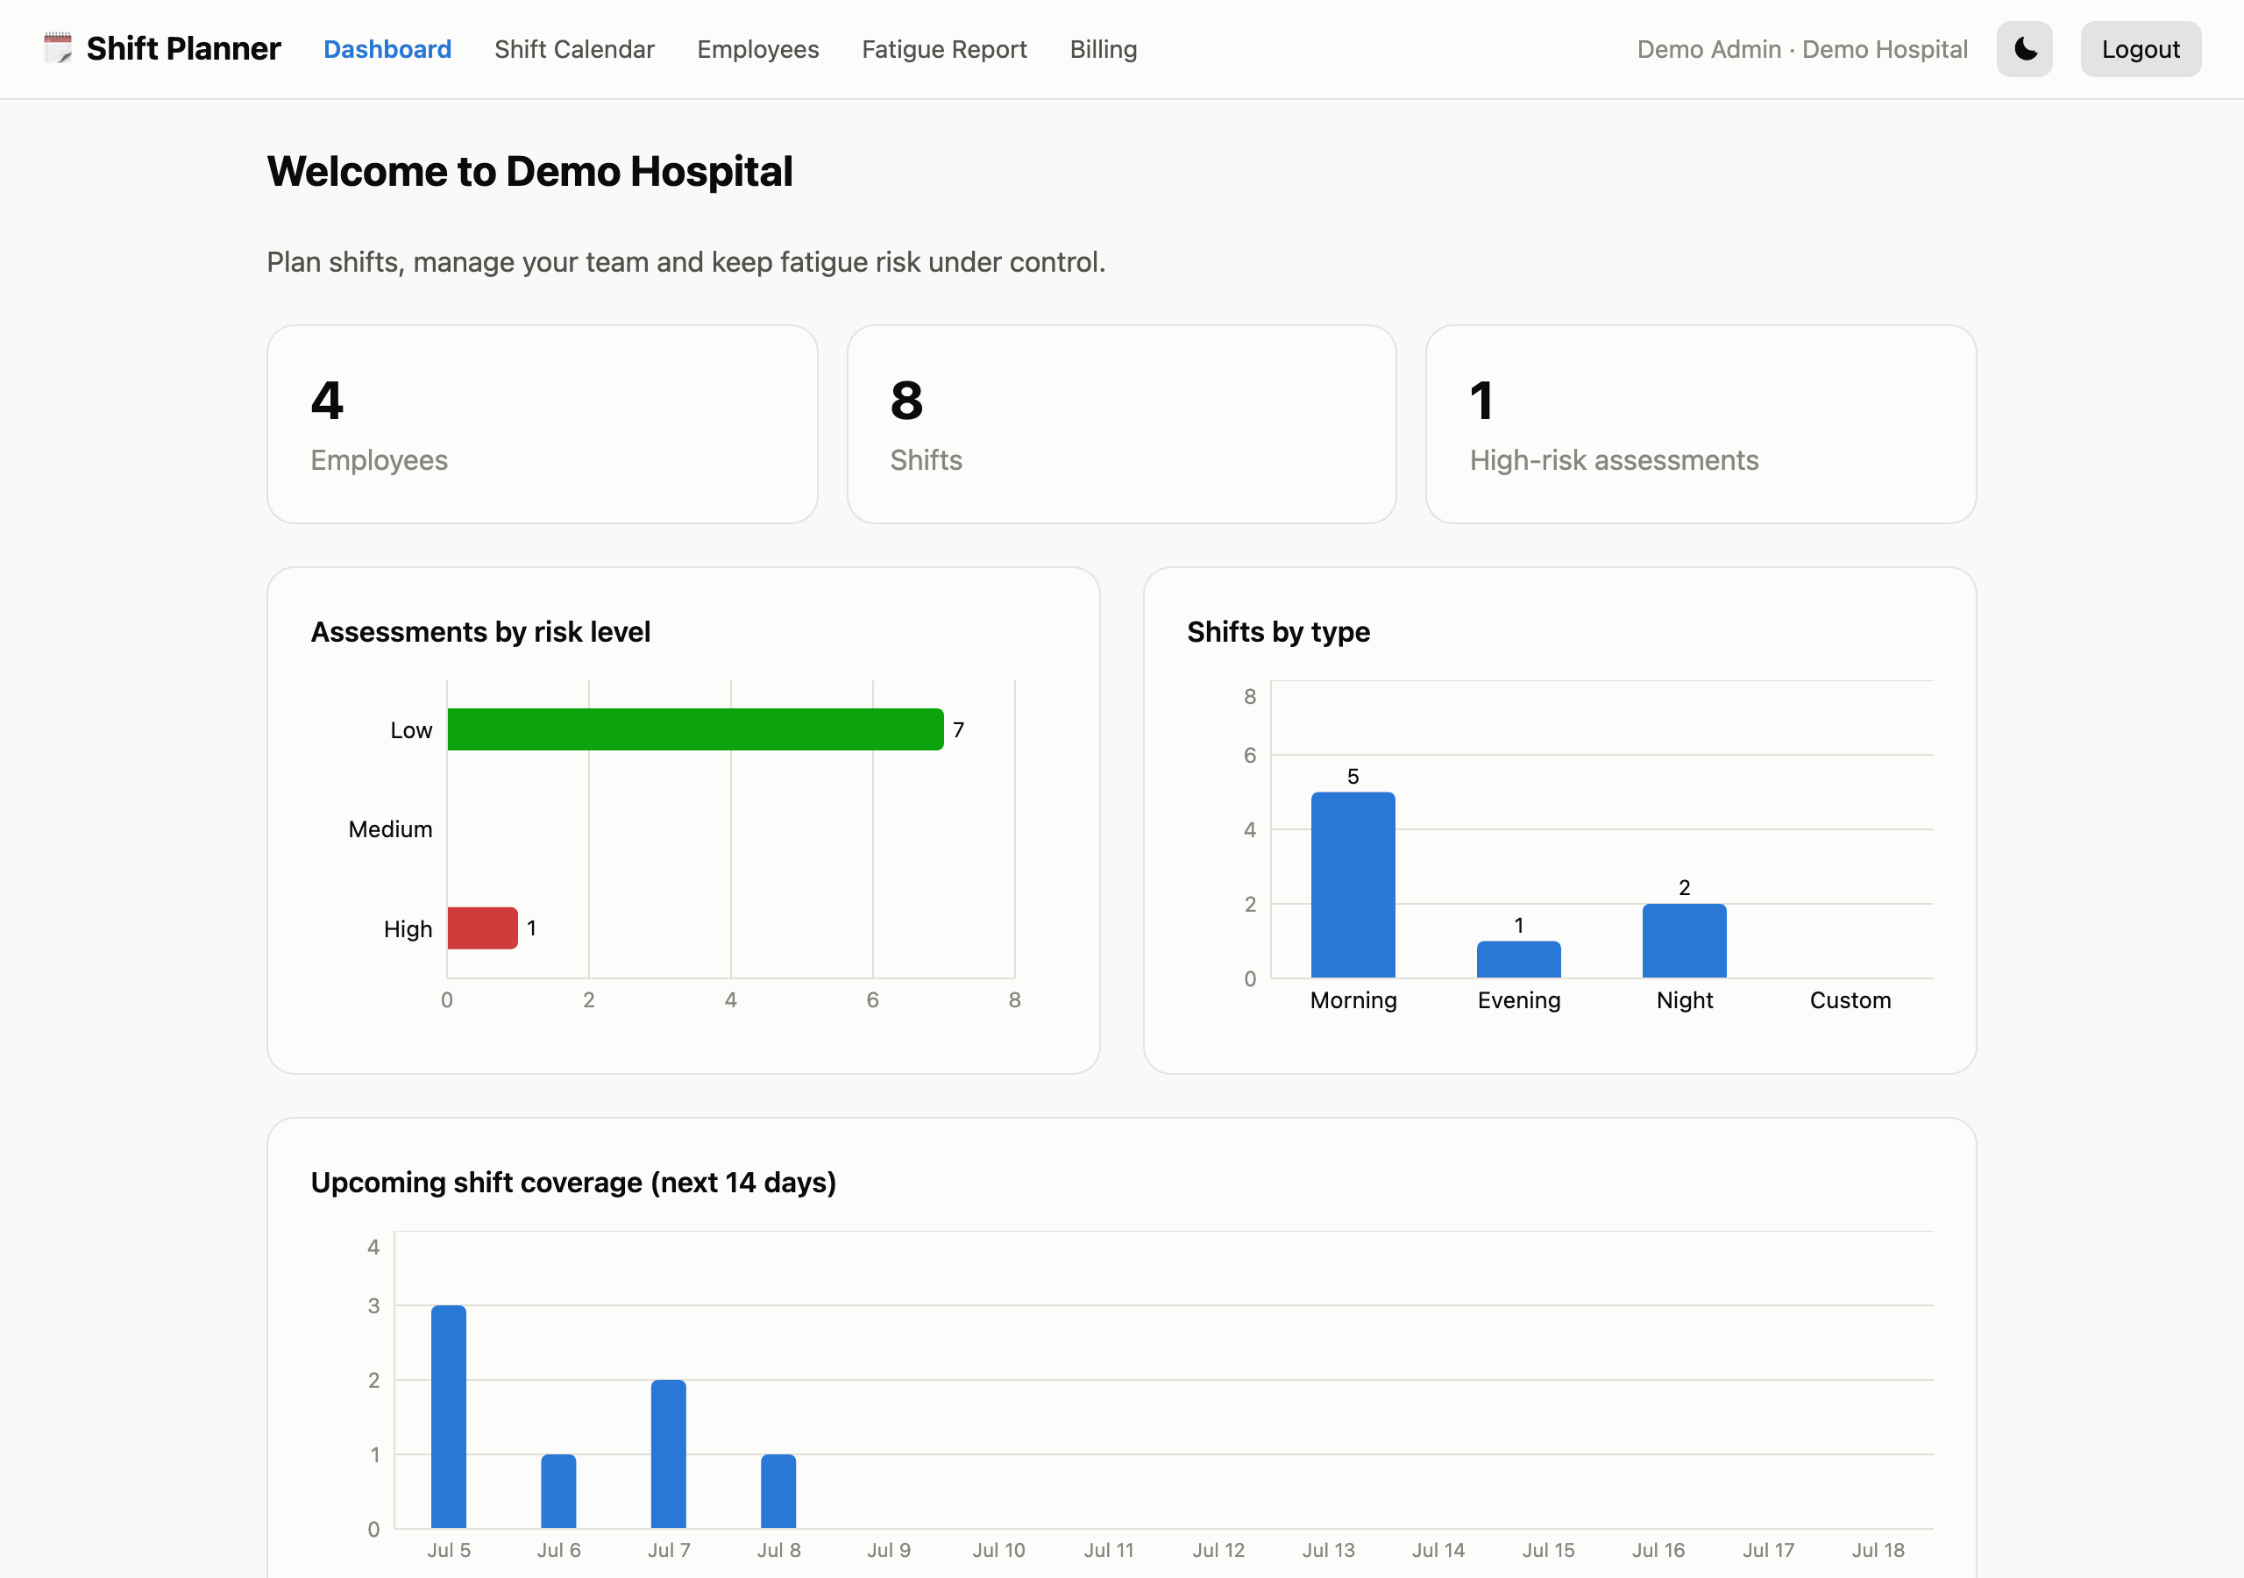
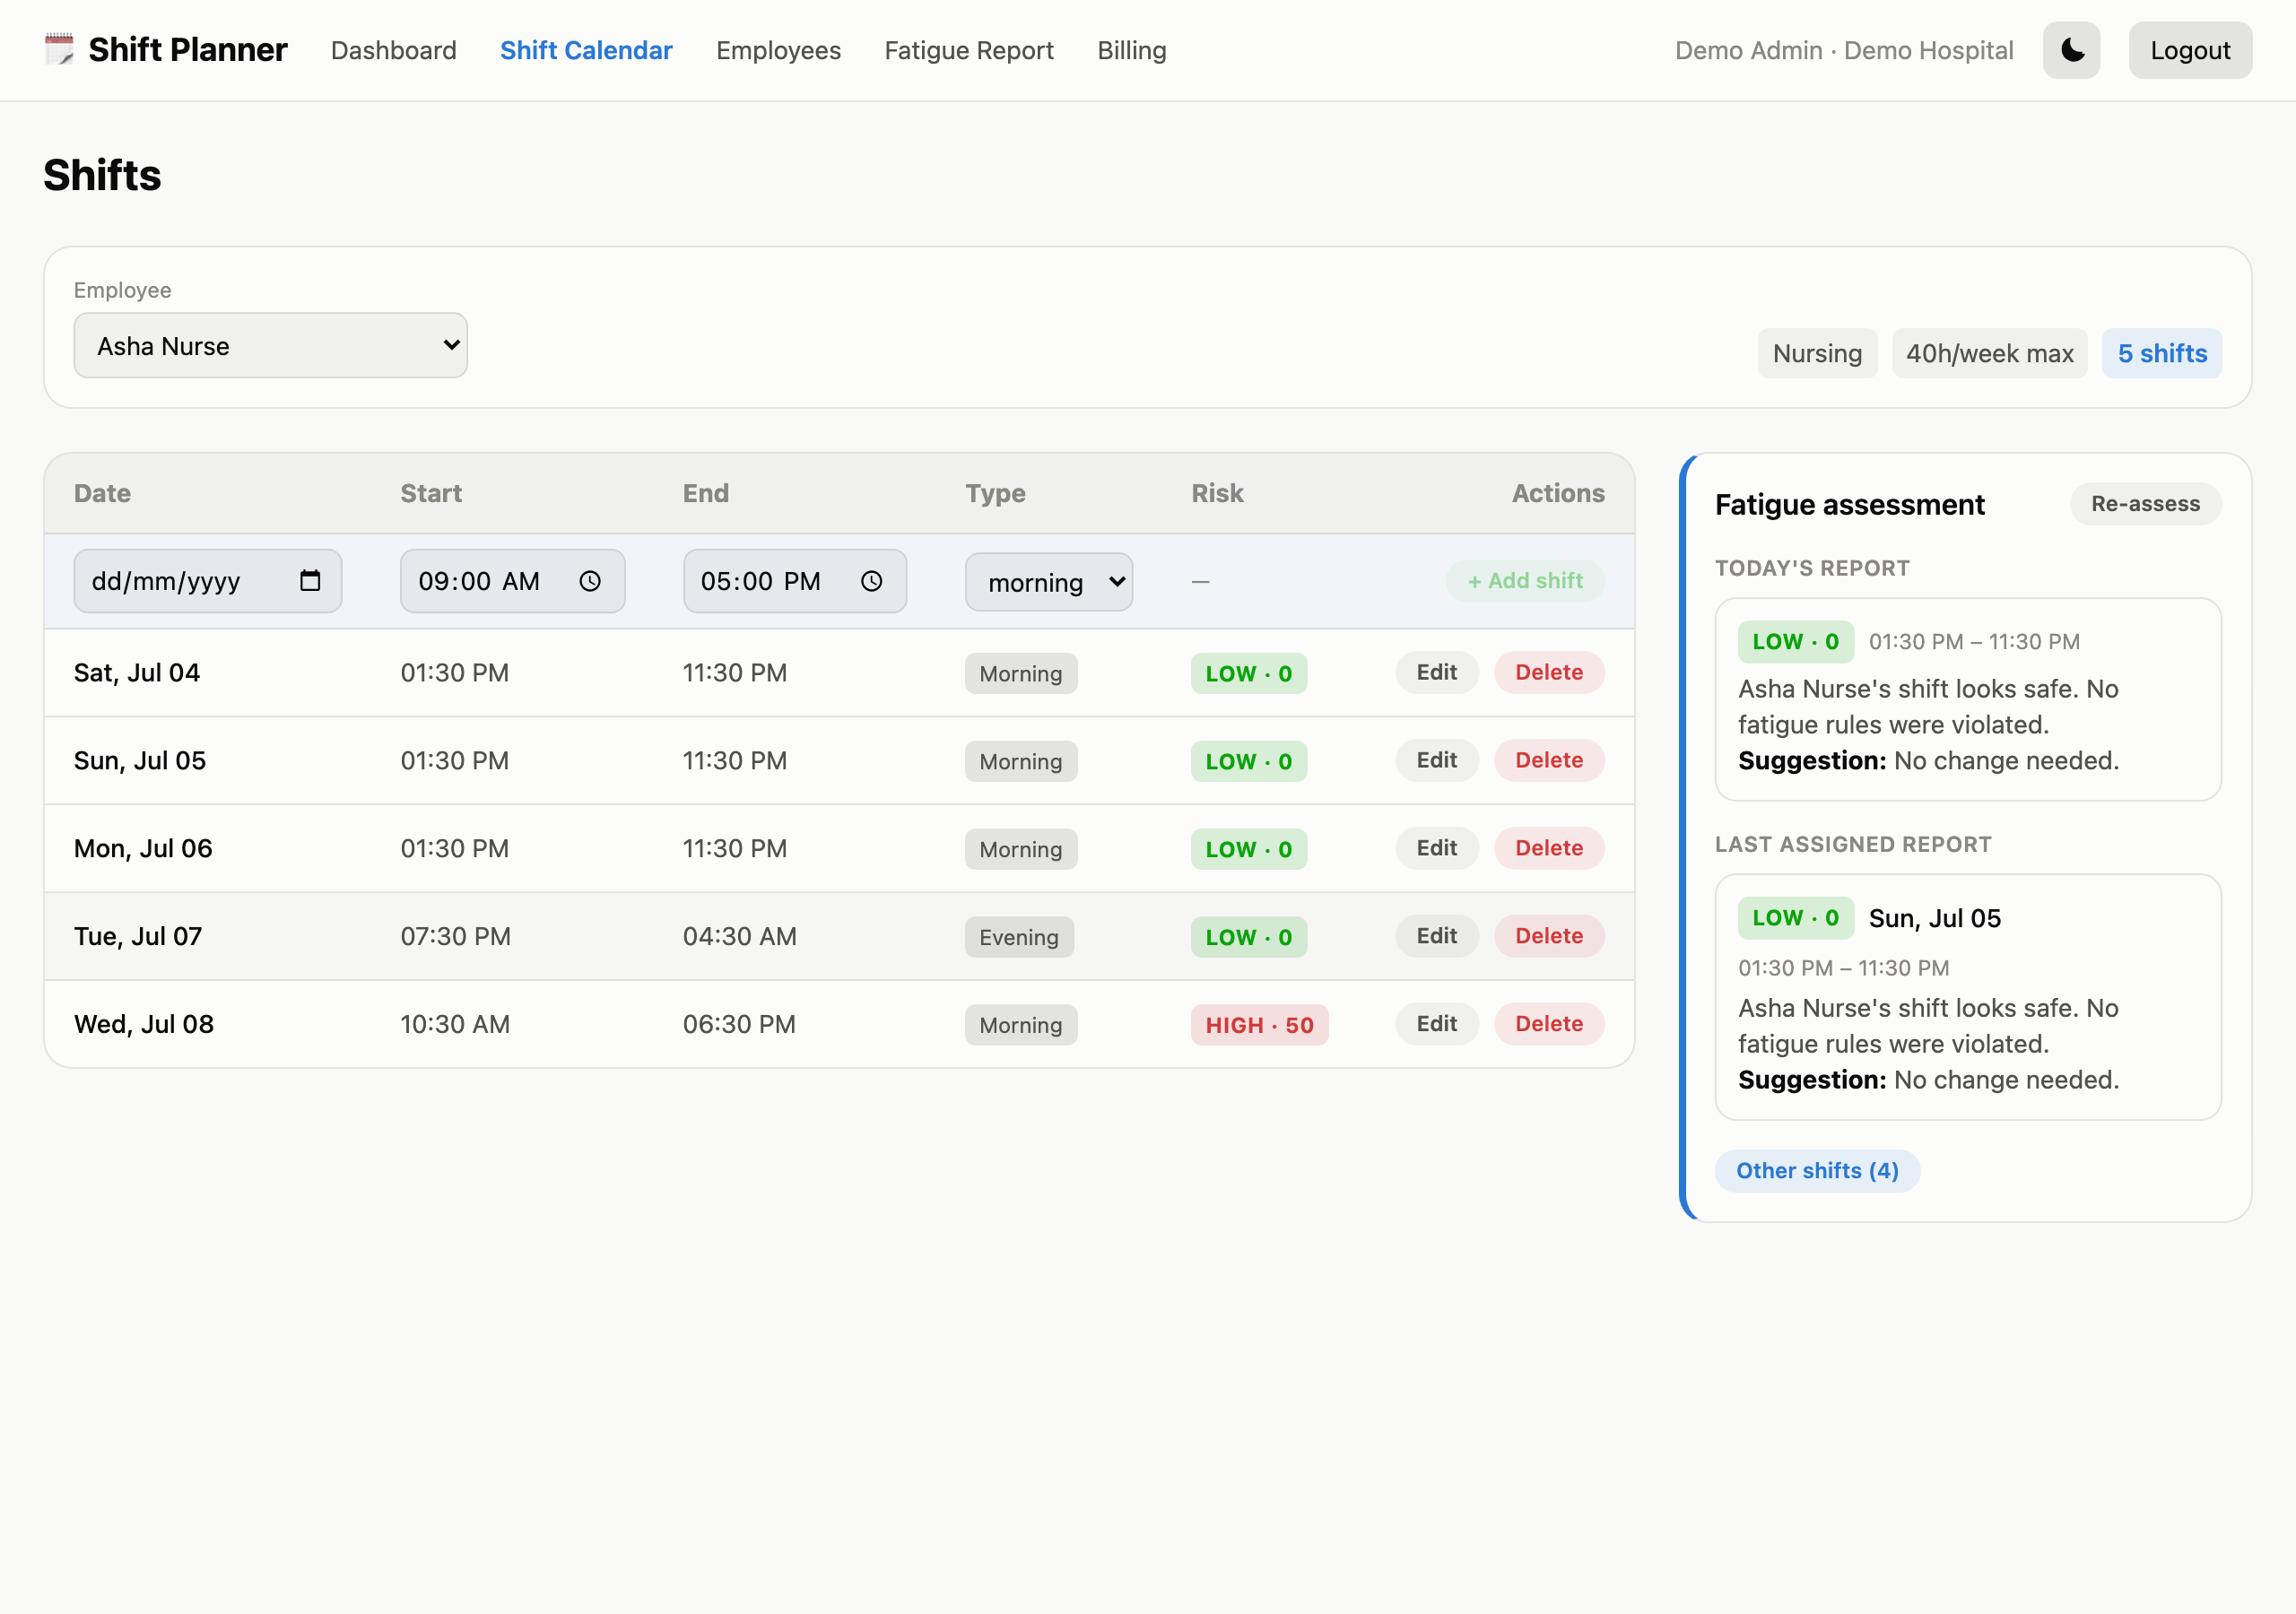
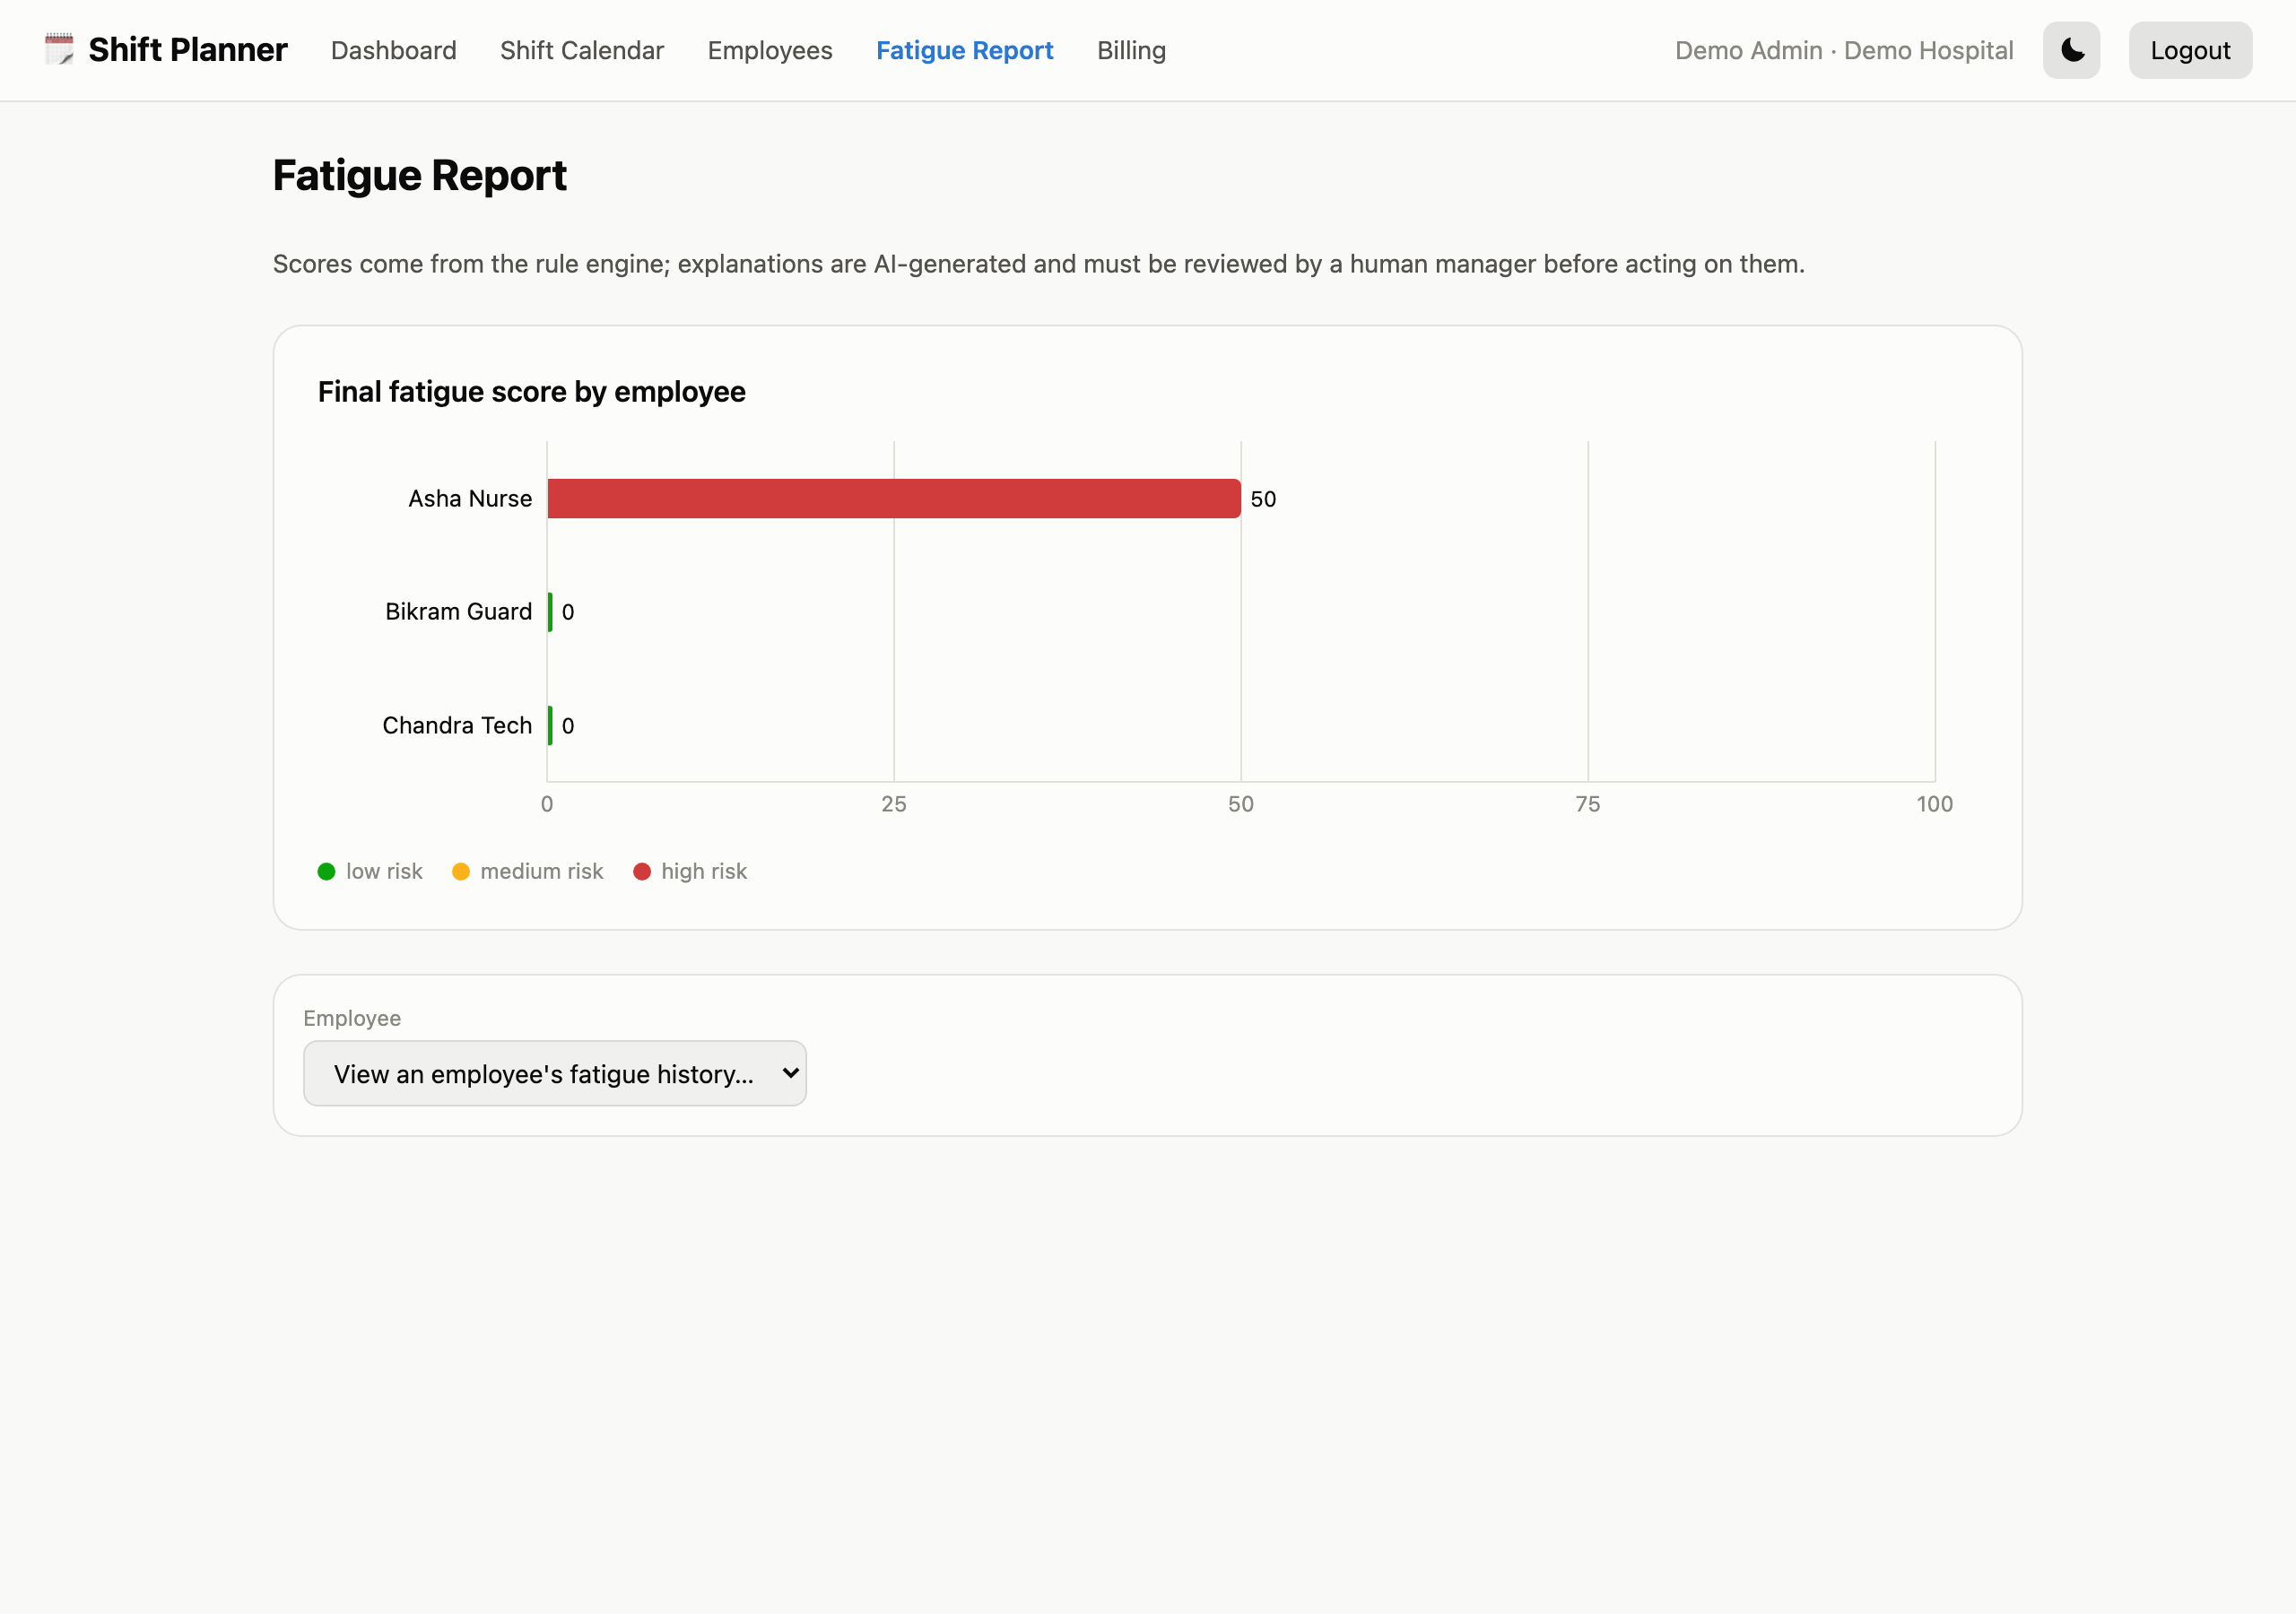
PROTOTYPE
Live product walkthrough
Analytics dashboard
Shift calendar + auto fatigue assessment
Fatigue report & employee risk history
6

Slide 7
SAMPLE OUTPUT
A real assessment produced by the system
HIGH · 50
Asha Nurse — Wed, Jul 08 shift
DEMO TENANT SNAPSHOT
ENGINE FLAGS (deterministic)
• 7 low risk assessments — no rule violations
• 0 medium risk assessments in this snapshot
• 1 high risk assessment — flagged automatically, no manual click required
• 8 shifts across 4 employees, reassessed automatically on every add/edit/delete
• Only 6.0h rest before this shift (minimum is 11h)
• 47.0h worked in the last 7 days (maximum is 40h)
AI EXPLANATION
“Asha Nurse's shift is rated HIGH risk (score 50/100) because: Only 6.0h rest before this shift (minimum is 11h). 47.0h worked in the last 7 days (maximum is 40h).”
SUGGESTED ALTERNATIVE
Move the shift later, assign it to another available employee, or add a rest day so all rules pass.
7

Slide 8
LIMITATIONS
Where this system should not be trusted blindly
• Not a medical or occupational-health judgment. Rule-based fatigue scoring is a scheduling safeguard, not a substitute for clinical or HR expertise.
• AI suggestions require sign-off. Every AI-generated explanation and alternative must be reviewed by a human manager before being acted on.
• App-layer tenant isolation. Isolation is enforced by tenantId filtering in code today; a production deployment handling sensitive HR data should add encryption at rest and regular security audits.
• Demo-mode billing. Without live payment-gateway keys, Razorpay/PayPal flows run in demo mode — not yet wired to a production billing provider.
• One fixed rule set per tenant. Fatigue thresholds are configurable in the data model but have no admin UI yet — a future-improvements item, not a current feature.
8

Slide 9
ROADMAP
Future improvements
Custom rule configuration UI
Cross-tenant analytics for superadmins
Let each tenant tune rest-hour minimums, weekly caps, and consecutive-day limits themselves.
Roll up risk trends across every organization on the platform, not just one tenant at a time.
Push/email alerts on high-risk assignment
Employee-initiated shift swaps
Notify a manager the moment a newly created shift is auto-assessed as high risk.
A request/approval workflow so employees can trade shifts without a manager re-typing the schedule.
AI-layer audit logging
Log every explanation shown to a manager, with rate limiting, as an additional guardrail at scale.
9

Slide 10
CONCLUSION
Safer schedules, built on rules you can audit — not a black box
• A working multi-tenant SaaS platform, built in 10 days, that turns fatigue risk from a blind spot into a visible, explained, and reviewable number
• Deterministic rule engine for the score, AI strictly for explanation — with guardrails at every step so the model can never hallucinate a safety-critical number
• Automatic, always-current re-assessment: edit one shift, and every affected shift for that employee is quietly re-checked in the background
• Designed to extend: per-tenant rule tuning, cross-tenant analytics, and notification workflows are the clear next steps
Thank you — questions welcome.

