Slide 1
Hand-Written Character Recognition with Image Super Resolution
Under The Supervision Of-
Dr. Vishal Krishna Singh
IIIT - Lucknow

Slide 2
INTRODUCTION
Handwriting recognition (HWR) is the ability of a computer to receive and interpret intelligible handwritten input from sources such as paper documents, photographs, touch-screens and other devices.
Handwriting recognition has been one of the active and challenging research areas in the field of image processing and pattern recognition. It has numerous applications which include, reading aid for blind, bank cheques and conversion of any hand written document into structural text form.

Slide 3
LITERATURE SURVEY
1- Xiaole Yan,Qiu Shen,Xin Liu ,“Super Resolution Reconstruction for License Plate in Video Surveillance System” in 10th International Conference on Communications and Networking in China-2015.
2- M.S. Sarfaraz , A. Shahzad, Muhammad A. Elahi , M. Fraz , I. Zafar , E. A. Edirisinghe, “Real-Time Automatic License Plate Recognition for CCTV Forensic Applications”, Journal Of Real Time Image Processing Springer 2011.
3- http://cs230.stanford.edu/files_winter_2018/projects/6910235.pdf

Slide 4
PROBLEM DEFINITION
Given the ease of Handwriting and large quantity of existing handwritten text converting handwriting to computerized text is a problem of great importance with many applications.
Current Hand-Written Character Recognition produces more error rate due to Low Resolution of the input Images because Low resolution images present a challenge to OCR because it is virtually impossible to do character segmentation independently from recognition. Hence it is important to have a high resolution image for better results.
Presently, 88% accuracy has been achieved using Deep Learning.

Slide 5
OBJECTIVES
Our Objective is to enhance the current handwritten character recognition model to produce less error rate and produce better results so that true negative rate is minimized and true positive rate is maximized.

Slide 6
PROPOSED APPROACH
TRAINING : 1-Preprocessing (Black VS White Densities).
2-Fitting and finding accuracies to find hyper parameters.
3-Finally training our model of best accuracy we have found.
INPUT : A series of Low resolution Images of hand-written or printed documents.
RECOGNIZING : 1-Preprocess Image (Image Registration and Reconstruction).
2-Segmentation.
3-Send To Classifier.
4-Send Output.

Slide 7
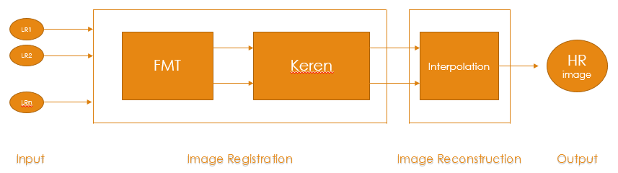
FLOW CHART OF PROPOSED APPROACH

Slide 8
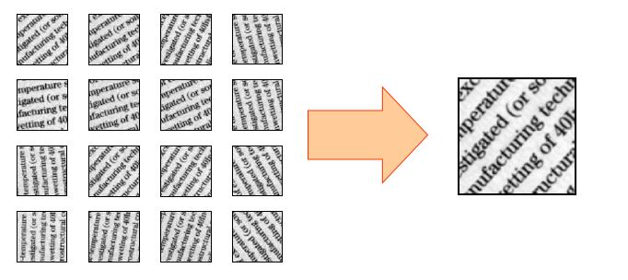
DESIRED RESULT
GIVEN : An Image Of a Document with hand-written or printed Characters.
REQUIRED :

Slide 9
HARDWARE AND SOFTWARE REQUIRED
PROGRAMING TOOLS :
Python3
Keras tensorflow as backend , Open-CV
DATASETS :
NIST Special Dataset
(Contains 8,00,000 characters of 62 classes)
Link : https://s3.amazonaws.com/nist-srd/SD19/by_class.zip

Slide 10
CONCLUSION
We have surveyed various research papers and observed that they have some limitations and if we succeed to implement our proposed approach then it may be a new stepping stone in the world of Optical Character Resolution. Our approach will help in getting better results than the current model.

Slide 11
THANK YOU !
GROUP MEMBERS :
Vijay Kumar Giri LIT2016038
Manish Kumar Shukla LIT2016035
Utkarsh Gupta LIT2016009
Chetan Gahane LIT2016037
Upendra Yadav LIT2016039

