Slide 1

“Counter Strike AutoPlay Simulator”
BY
Utkarsh Gupta (LIT2016009)
UNDER THE SUPERVISION OF
DR. VISHAL KRISHNA SINGH

Slide 2
TABLE OF CONTENTS
Problem Definition
Objectives
Proposed Approach
Class Diagram
Software Requirement

Slide 3
PROBLEM DEFINITION
Computer game named Counter Strike – Global Offensive is a extremely time taking and long game as per talking about it’s computational intensiveness. And it’s tedious to predict or compute it’s outcome as no mathematical model can be developed.

Slide 4
OBJECTIVE
To develop a simulator of the computer game named Counter Strike - Global Offensive using Object – Oriented – Methodology ( O.O.M. ), to model the players, their strategies as JAVA classes, encapsulating features and actions of players as member attributes and member functions of JAVA class respectively.

Slide 5
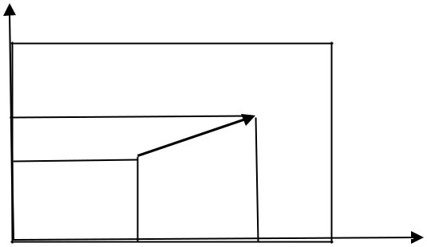
PROPOSED APPROACH
Use Object – Oriented – Methodology ( O.O.M. ), to model the players, their strategies as JAVA classes, encapsulating features and actions of players as member attributes and member functions of JAVA class respectively.
AIMove
Every player has a position in X axis, a position in Y axis and an orientation. The orientation is an angle state governs where the person is looking at (θ).
Suppose the current position is S(x,y). The player is moving at a speed s
towards a goal at G(gx,gy). The
G
position at the next time step is given ^{gy}
by:
(x’,y’)=(x,y)+s(gx-x,gy-y)/sqrt((gx-x)²+ (gy-y)²)
The proof is simple. Consider the vector G-S, that is (gx-x,gy- y). A unit vector in the same direction is (gx-x,gy-y)/sqrt((gx- x)²+(gy-y)²),
while a vector at a distance of s from S is given by the formula.
y
S
g x
x

Slide 6
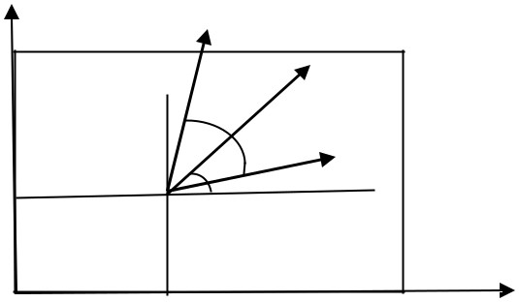
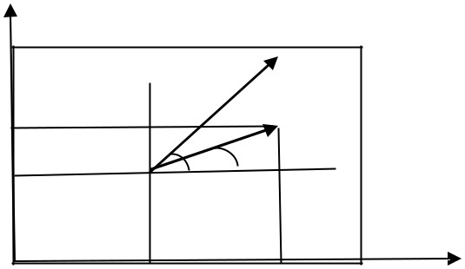
site()
The function checks if two players are in line of sight to each other. Assume each player can see α radians around the current orientation (θ). The person is facing at an angle of θ, while can look around the angle of ± α from the current orientation. The angle α is different for different players. The angular range of view of the person is hence in the range θ- α to θ+α.
Player heading direction
Player heading direction
2α
P
py
y
θ
γ
θ
α S
y
S
x
x
px
The angle subtended by a new person at (px,py) is
γ=atan2(py-y, px-x). The person is in line of site if θ- α < γ < θ+α. However since angles have a circular property the inequality cannot be directly used. The angle between the heading direction and line SP is given by θ-γ. Hence for angular coverage, cos(θ-γ)>cos(α).
The ‘ahead’ is simply taking α=60 degrees

Slide 7
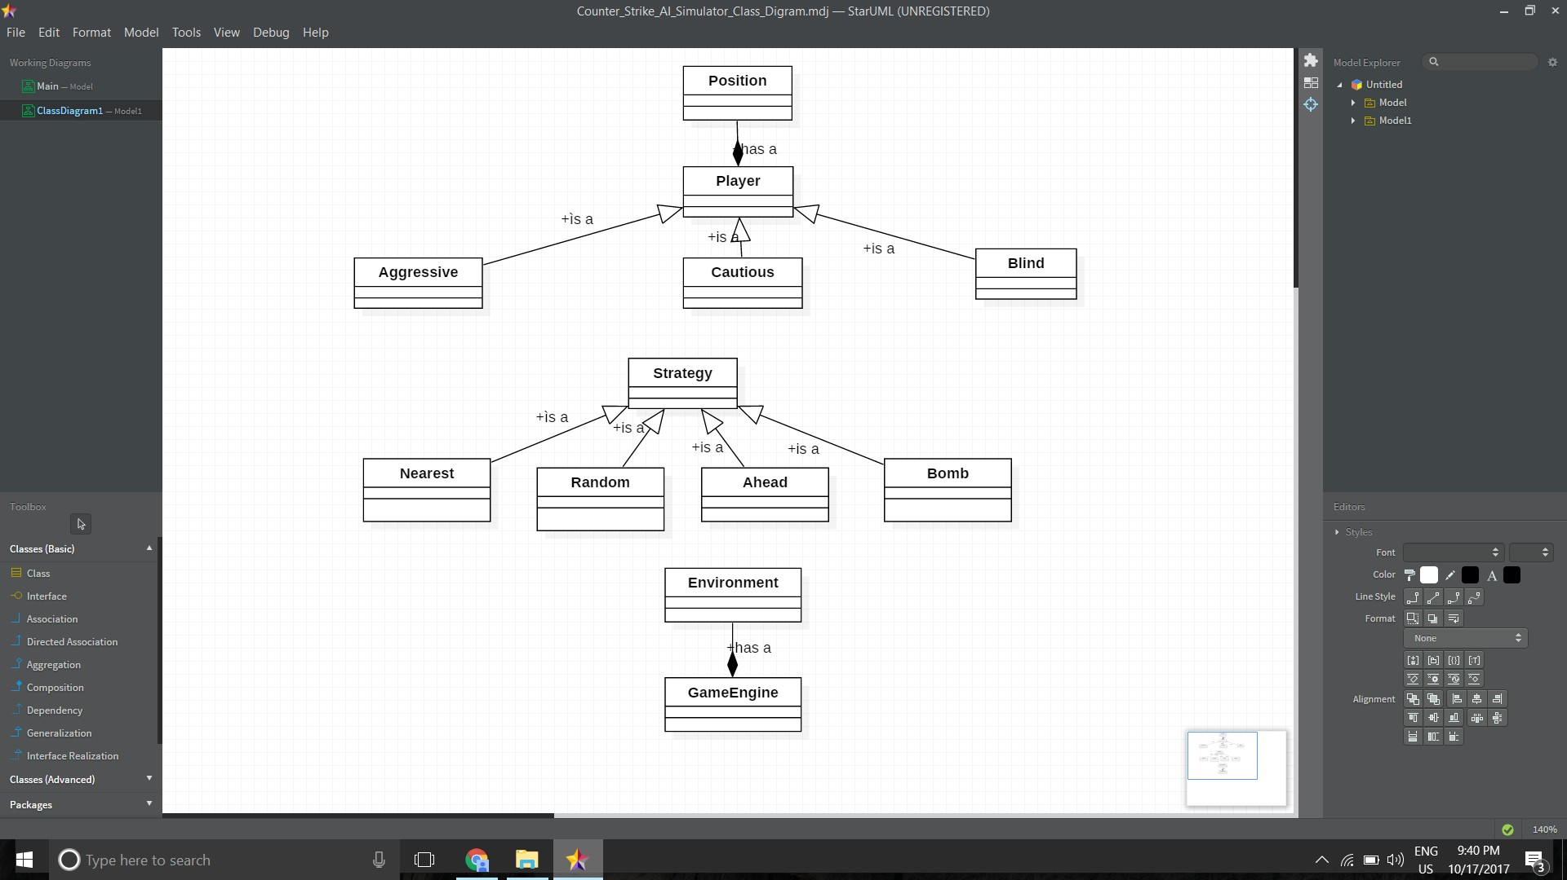

Slide 8
SOFTWARE REQUIREMENT
Programming Tools:
Object Oriented Methodology Netbeans
Star UML
Programming Language:
JAVA

