Slide 1
E-Commerce
SALES ANALYSIS

Slide 2
Introduction
THIS PROJECT ANALYZES AN E-COMMERCE SALES DATASET USING SQL WITH QUERIES CATEGORIZED INTO BASIC, INTERMEDIATE, AND ADVANCED LEVELS. THE BASIC LEVEL COVERS KEY METRICS LIKE TOTAL ORDERS AND REVENUE, WHILE THE INTERMEDIATE LEVEL IDENTIFIES POPULAR PRODUCTS AND CUSTOMER PREFERENCES.
AT THE ADVANCED LEVEL, THE FOCUS SHIFTS TO CATEGORY-WISE SALES DISTRIBUTION AND SALES TRENDS OVER TIME, PROVIDING VALUABLE INSIGHTS FOR BUSINESS GROWTH AND DECISION-MAKING.

Slide 3
Project Objective
•
•EXTRACT MEANINGFUL INSIGHTS FROM RAW SALES DATA
•Analyze ORDERS, REVENUE, PRODUCT CATEGORIES, AND CUSTOMER BEHAVIOR
• SHOWCASE SQL AS A TOOL FOR BUSINESS ANALYTICS
•PROVIDE ACTIONABLE INSIGHTS TO IMPROVE SALES STRATEGY

Slide 4
Tools & Techniques
Tools Used:
• SQL
• CSV dataset
• RDBMS
• Excel
Techniques Applied:
• Joins (INNER JOIN, LEFT JOIN, etc.)
• Aggregations (SUM, COUNT, AVG)
• Group By / Order By
• Revenue and percentage calculations
• Trend analysis and customer segmentation

Slide 5
Dataset Info
• Orders.csv → order_date,shipped_dote,delivery_date.payment_method,shipping_address.order_status
• Order details.csv →
order_detail_id, order_id,, product_id, quantity,discount percent, unit_price,total_ price
• Products.csv → product_id,brand.product_name.price,category,sub_category,color,model_number
• Customers.csv-customer_id.first_name,last_name.gender,oge,email,phone,city,state,postal_code,signup_date
• Returns.csv -
return_id,order_detail_id,return_date,reason,refund_status

Slide 6

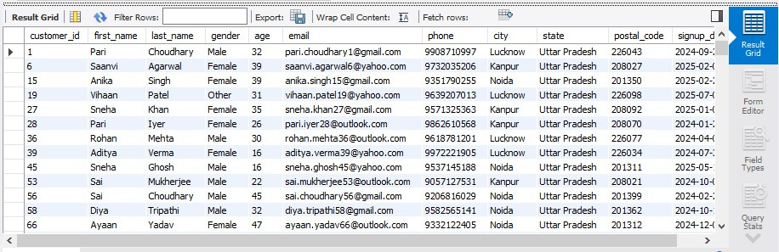
1.GET ALL CUSTOMERS FROM UTTAR PRADESH
output :

Slide 7
2.FIND THE TOP 10 MOST EXPENSIVE PRODUCTS
output :

Slide 8

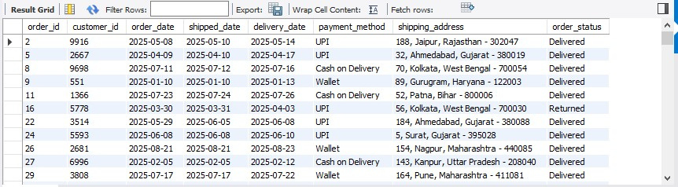
3.SHOW ALL ORDERS PLACED IN 2025
output :

Slide 9

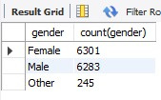
4.COUNT HOW MANY CUSTOMERS ARE MALE & FEMALE
output ->

Slide 10

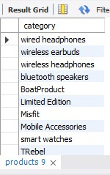
5.LIST DISTINCT PRODUCT CATEGORY AVAILABLE
output -->

Slide 11
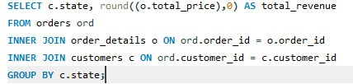
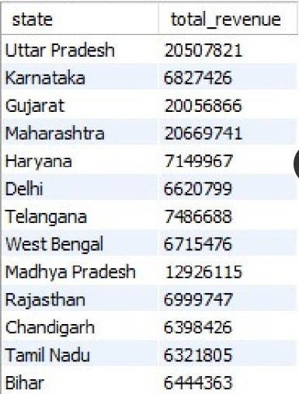
6.FIND THE TOTAL REVENUEGENERATED FROM EACH STATES
output -->

Slide 12
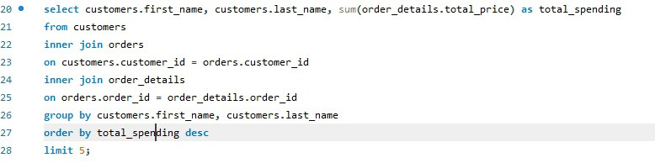
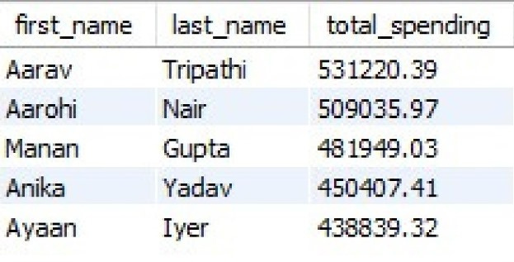
7.SHOW TOP 5 CUSTOMERS WITH HIGHEST SPENDINGS
output -->

Slide 13
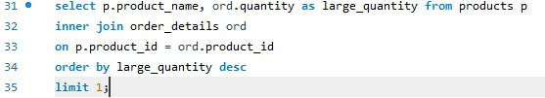

8.FIND PRODUCTS WITH HIGHEST QUANTITY SOLD
output -->

Slide 14

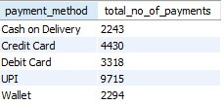
9.FIND THE NUMBER OF ORDERS PER PAYMENT METHOD
output -->

Slide 15

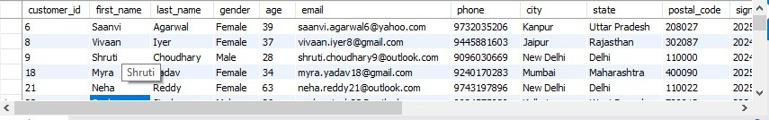
10.FIND CUSTOMERS WHO HAVE NEVER PLACED ORDER
output :

Slide 16

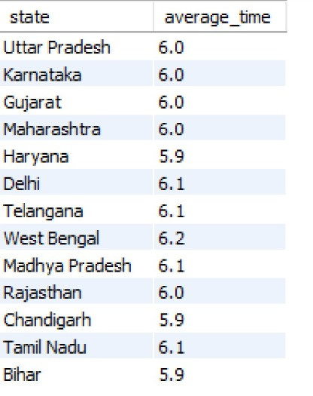
11.CALCULATE THE AVERAGE DELIVERY TIME FOR EACH STATE
output -->

Slide 17
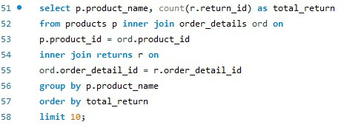
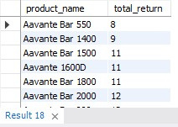
12.FIND THE MOST RETURNED PRODUCTS WITH NUMBER OF RETURNS
output -->

Slide 18

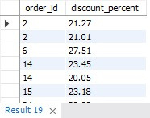
13.IDENTIFY ORDERS WHERE THE DISCOUNT_PERCENT>20%
output -->

Slide 19
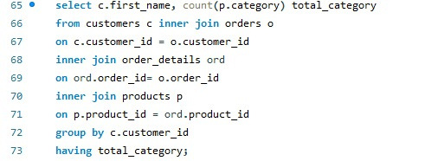
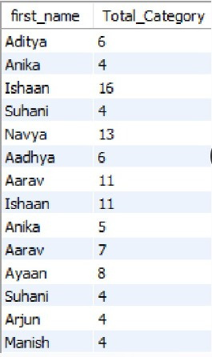
14.FIND CUSTOMERS WHO HAVE ORDERED PRODUCTS MORE THAN 3 CATEGORIES
output -->

Slide 20
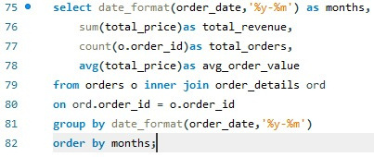
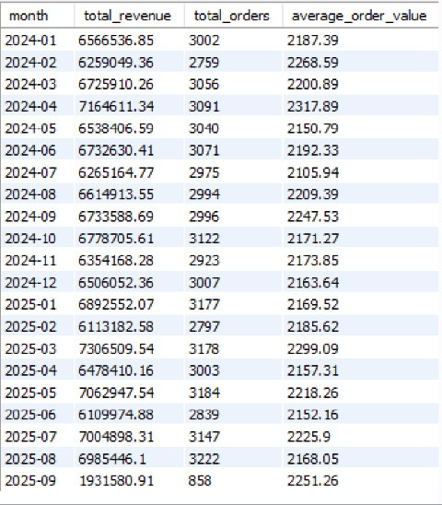
15.GENERATE A MONTHLY SALES REPORT WITH TOTAL REVENUE, TOTAL ORDERS AND AVG ORDER VALUE
output -->

Slide 21
CONCLUSION
• SQL helps convert raw data into actionable insights.
• Businesses can use these insights to:
• Identify best-selling products
• Manage inventory better
• Optimize pricing and promotions
• Understand customer behavior
• Data-driven decisions improve customer satisfaction and revenue.

Slide 22
PRESENTED BY
RAJ

