Slide 1


D.Y.PATIL COLLEGE OF ENGINEERING &TECHNOLOGY,
KASABA BAWADA, KOLHAPUR
DEPARTMENT OF COMPUTER SCIENCE & ENGINEERING
(Academic Year: 2023-24)
Code Shield
(Data Encryption and Decryption)
Roll No. Name
03 Kabir D.Patil
07 Anuj H.Sonwalkar
17 Rajvardhan G.Ulape
Under the guidance of
Mrs.Swati G.Ambi
Class: SY (CSE) Div: A Batch: S1

Slide 2
INDEX
1
Introduction
Problem Statement
Objectives
Implementation Details
Project Overview
Conclusion
Thank You
D.Y. P.C.E.T | 2024

Slide 3

2
INTRODUCTION
The Encryption and Decryption Project is a vital solution for securing sensitive information in the digital age. It addresses cyber threats by developing a comprehensive system that encrypts and decrypts data, ensuring confidentiality, integrity, and authenticity. Using sophisticated algorithms, the project transforms data for secure transmission and offers a user-friendly interface to empower seamless encryption and decryption. This effort stands as a pioneering solution to fortify digital communication against contemporary threats.
D.Y. P.C.E.T | 2024

Slide 4
3
Problem Statement
First Problem
With the increasing risk of cyber-attacks and the vulnerability of sensitive government information, there is a critical need for a user-friendly application that provides robust encryption and decryption solutions so this Project aims to tackle the escalating threats to digital data security with the help of C programming language.
With the increasing risk of cyber-attacks and the vulnerability of sensitive government information, there is a critical need for a user-friendly application that provides robust encryption and decryption solutions.
D.Y. P.C.E.T | 2024
Project Aim
This project aims to tackle the escalating threats to digital data security.

Slide 5

OBJECTIVES
4
Objective 1
Objective 2
Implement Seamless Decryption Processes
User-Friendly Interface
Objective 3
Objective 4
End-to-End Data Protection
Adherence to Security Standards:
Objective 5
Objective 6
Real – Time Encryption & Decryption
Regular Security Audits
D.Y. P.C.E.T | 2024

Slide 6
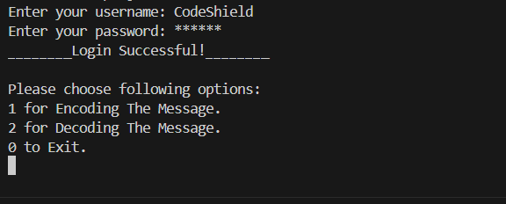
5
IMPLEMENTATION DETAILS
Login Validation
The validateLogin function takes two parameters: username and password, and compares them with hardcoded valid credentials (validUsername and validPassword).
If the provided username and password match the valid credentials, the function returns 1 (indicating successful validation), otherwise, it returns 0
D.Y. P.C.E.T | 2024
Password Masking:
- The `getPassword` function is used to securely input passwords.
- On Windows systems (`_WIN32`), the function utilizes `_getch()` to capture each character of the password without echoing it to the console. Backspace key (`\b`) is handled to allow corrections.
- On Unix-based systems, it utilizes `getpass()` to prompt for the password with masking.

Slide 7
6
Menu Options
After successful login, the user is presented with a menu to choose between encoding, decoding, or exiting the program.
- The user's choice is obtained via the `scanf` function and stored in the variable `x`.
D.Y. P.C.E.T | 2024
File Handling
- The program prompts the user to enter the name of the input file from which data is to be encoded or decoded.
- It then attempts to open the input file in read mode using `fopen`. If the file opening fails, an error message is displayed, and the program exits with a status of 1.

Slide 8
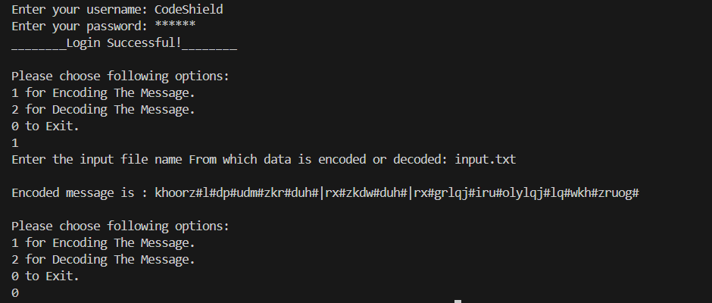
7
Encoding and Decoding
The selected operation (encoding or decoding) is performed by iterating over each character of the input message.
- For encoding, each character's ASCII value is incremented by 3, and for decoding, it's decremented by 3.
- The encoded or decoded message is displayed on the console and written to an output file named "output.txt" using `fprintf`.
D.Y. P.C.E.T | 2024
Logout
Exiting the program is achieved by setting the `loggedIn` flag to 0, which breaks the loop and displays a logout message.

Slide 9
8
Project Overview
This C program allows users to log in with a hardcoded username and password. Upon successful login, users can choose between encoding and decoding a message using a Caesar cipher with a fixed key of 3. The program reads from an input file which is given on the console , processes the message based on user choice, and writes the result to an output file (`output.txt`). It employs dynamic memory allocation for message storage and handles file operations.
D.Y. P.C.E.T | 2024

Slide 10

9
CONCLUSION
It can be concluded that this project works efficiently for offline purpose at any place provided the requirements for running environment remains same.
D.Y. P.C.E.T | 2024

Slide 11
THANK YOU

