Slide 1
Project Presentation of COOP
On
TradeLearn
Rajvardhan 2210990710
Supervised By: Dr. Ajay Kumar
Department of Computer Science and Engineering,
Chitkara University, Punjab

Slide 2
Introduction
2.1 Background
• Lack of structured skill exchange system • Dependence on paid online learning platforms • Difficulty in finding suitable learning partners • Limited opportunities for peer-to-peer collaboration • No proper recognition for teaching contributions
2.2 Problem Statement
• Develop a web-based peer-to-peer skill exchange platform • Enable users to teach and learn skills using a credit-based system • Allow users to search and discover available skills • Implement skill exchange request management • Track learning activities and request progress
2

Slide 3
Software and Hardware Requirement Specification
3.1 Methodology :-
The development of TradeLearn follows the Agile methodology, focusing on iterative development, testing, and continuous improvement. The application is developed in modular phases including:
User Authentication System Profile & Skill Management Skill Exchange Request System Credit-Based Learning System Dashboard & Activity Tracking Search and Skill Discovery Features
3.2 Programming / Working Environment
Frontend: HTML, CSS, EJS
Backend: Node.js with Express.js
Database: MongoDB Atlas (Cloud Database)
Authentication: JWT + Email OTP Verification
Communication: REST APIs (client-server interaction)
Architecture: Client-Server Architecture Model
Version Control: Git & GitHub
API Testing: Postman

Slide 4
Software and Hardware Requirement Specification (1/2)
3.3 Requirements to Run the Application
Hardware Requirements :-
Operating System: Windows / Linux / macOS
RAM: Minimum 8 GB
Processor: Intel i5 or equivalent
Software Requirements :-
Node.js & npm installed
MongoDB Atlas configured
Email Service (Nodemailer) configured for OTP
Browser: Latest version of Chrome / Firefox / Safari

Slide 5
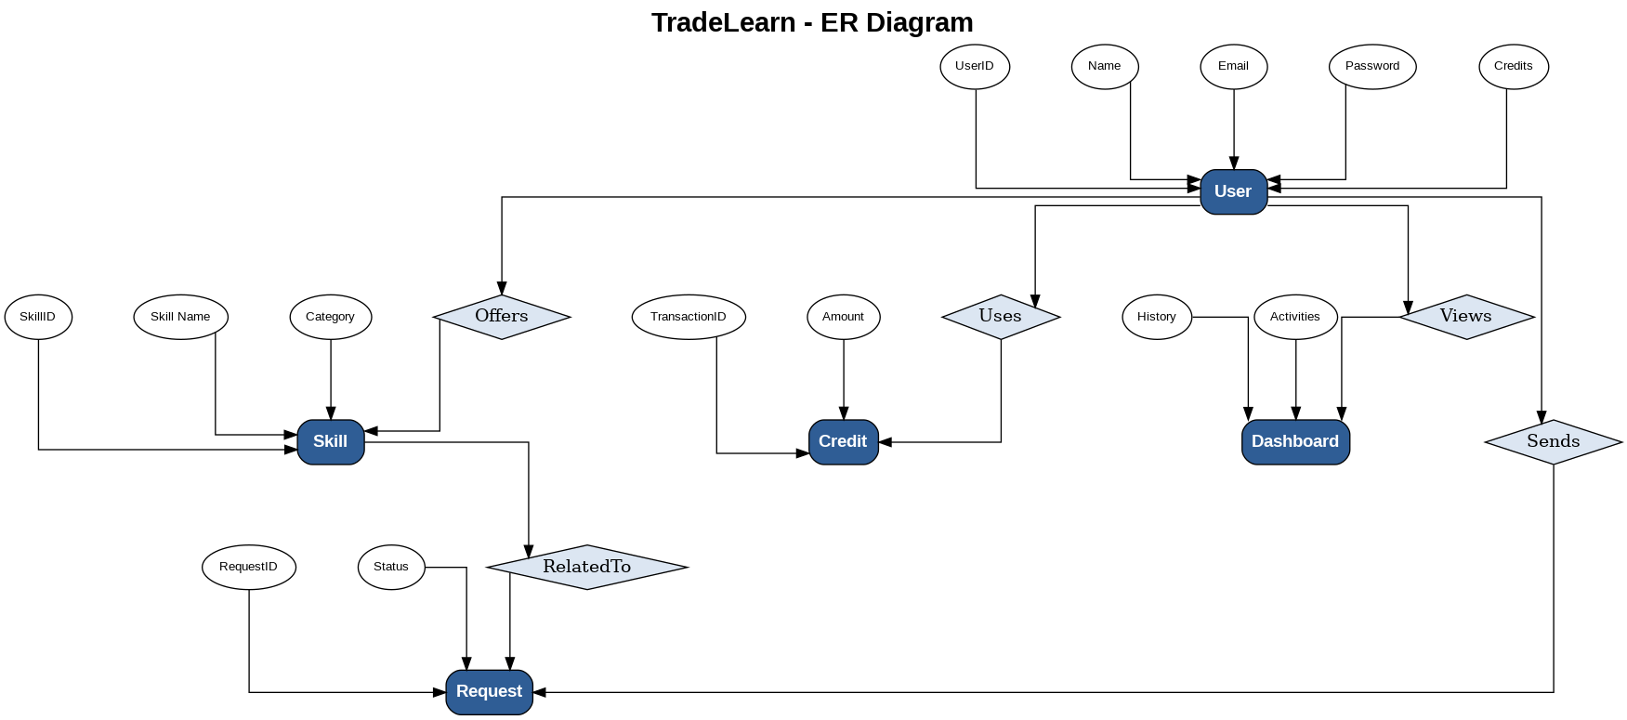
ER Diagram

Slide 6
TECHNOLOGIES AND TOOLS
TradeLearn uses modern technologies to ensure scalability, security, performance, and efficient skill exchange functionality.
HTML, CSS & EJS: Used to build a responsive, dynamic, and user-friendly interface. Enables smooth navigation between user profiles, dashboard, skills, and exchange features.
Node.js & Express.js: Provides a scalable server environment to handle APIs, authentication, business logic, and skill exchange operations efficiently.
MongoDB Atlas: Cloud-based NoSQL database used to securely store user data, skills, exchange requests, credit information, and activity records.
JWT Authentication: Ensures secure user authentication, session management, and protected route access for account safety and data security.
REST APIs: Used for efficient communication between frontend and backend components through client-server interaction.
Git, GitHub & Postman: Used for version control, project collaboration, and API testing to improve reliability and development efficiency.

Slide 7
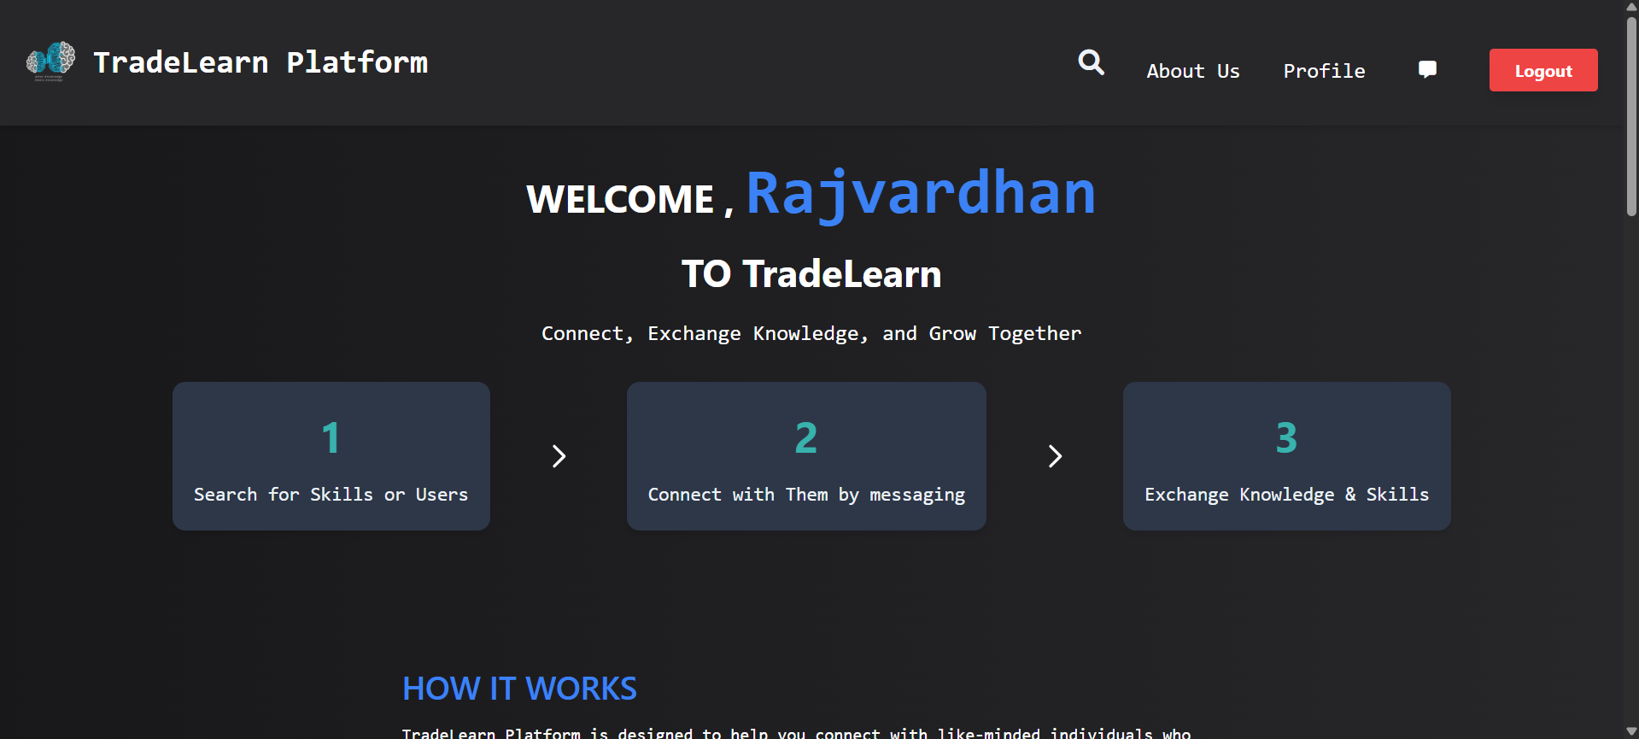
VISUAL REPRESENTATION

Slide 8
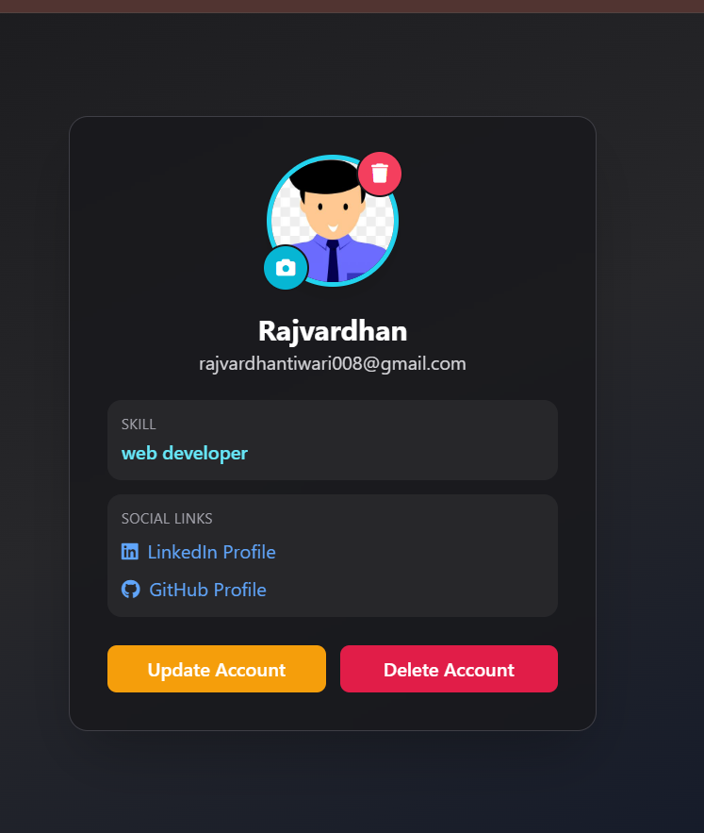
VISUAL REPRESENTATION

Slide 9
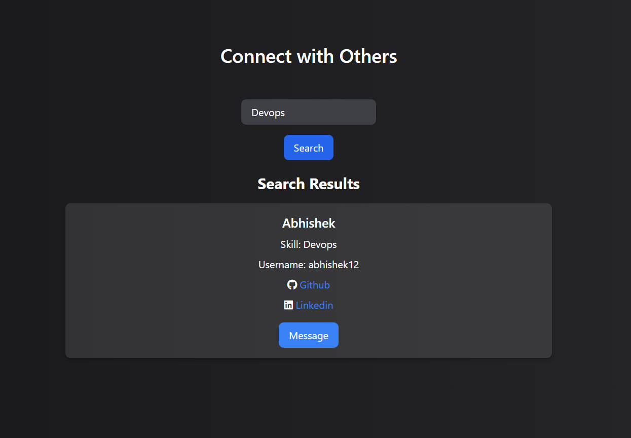
VISUAL REPRESENTATION

Slide 10
Future Scope
• AI-Based Skill Recommendations: Implement AI algorithms to recommend relevant skills and suitable learning partners based on user interests, learning history, and activity patterns.
• Mobile Application Development: Develop Android and iOS applications to improve accessibility and allow users to learn and teach skills anytime and anywhere.
• Real-Time Chat and Video Sessions: Integrate chat and video calling functionality to enable direct communication and live learning sessions between users.
• Integration with Learning Platforms: Connect with platforms like YouTube, Coursera, or NPTEL to provide additional learning resources within the application.
• Skill Verification and Certification: Introduce certificates or verification mechanisms to validate completed learning activities and enhance user credibility.
• Community and Group Learning: Enable group learning sessions, discussion forums, and collaborative communities for better peer interaction.

Slide 11
References
Node.js (Official Documentation): OpenJS Foundation. Node.js – JavaScript Runtime Environment. https://nodejs.org
Express.js (Official Documentation): OpenJS Foundation. Express – Fast, Unopinionated Web Framework for Node.js. https://expressjs.com
EJS (Embedded JavaScript Templates): EJS Team. EJS – Embedded JavaScript Templating. https://ejs.co
MongoDB Atlas (Official Documentation): MongoDB Inc. MongoDB Atlas – Cloud Database Service. https://www.mongodb.com/atlas
Mongoose (ODM Library): Mongoose Team. Mongoose – MongoDB Object Modeling for Node.js. https://mongoosejs.com
JWT (JSON Web Token Documentation): Auth0. JSON Web Tokens Introduction and Authentication Guide. https://jwt.io

Slide 12
Conclusion
TradeLearn presents an innovative and practical solution for promoting collaborative learning through a peer-to-peer skill exchange system. By introducing a structured credit-based mechanism, the platform enables users to both teach and learn without relying on traditional monetary transactions. The system transforms knowledge into a valuable asset and creates an ecosystem where users actively contribute while continuously developing new skills. Features such as secure authentication, profile management, skill exchange requests, dashboard tracking, and credit management ensure an organized and user-friendly experience. By removing financial barriers and encouraging participation, TradeLearn creates opportunities for accessible and community-driven education.
Furthermore, TradeLearn demonstrates how modern web technologies can be effectively utilized to address real-world educational challenges. The project not only provides a platform for skill development but also promotes interaction, collaboration, and knowledge sharing among users. Its scalable and modular architecture allows future enhancements such as real-time communication, AI-based recommendations, video learning sessions, and mobile accessibility. By combining educational objectives with full-stack development implementation, TradeLearn creates a sustainable and flexible learning environment that benefits both learners and contributors. Overall, the platform serves as a valuable initiative for building stronger learning communities and making education more inclusive, interactive, and accessible.

Slide 13
Thank You
13

