Slide 1
BP Measurement Using RMG
Non-Invasive Korotkoff Sound Detection for Blood Pressure Measurement
Advanced Multi-Domain Validation Pipeline

Slide 2
Introduction & Motivation
Limitations of traditional blood pressure (BP) measurement:
Stethoscopes require trained human hearing and are prone to artifact noise.
Oscillometric cuffs use generic algorithms that guess SYS/DIA points.
Our Solution: RF Radar Sensing (Radiomyography)
Use a USRP software-defined radio to measure sub-millimeter arterial vibrations.
Mathematically isolate true mechanical Korotkoff 'snaps' during deflation.

Slide 3
Hardware & System Architecture
Software-Defined Radio Setup:
Device: USRP B210 (Dual Channel capability, strictly isolated to Port A).
Frequency: 0.9 GHz (Optimized for tissue penetration).
Sampling Rate: 10 kHz (Downsampled from 1 MHz for high-resolution audio-band tracking).
Gain Settings: TX Gain = 40 dB, RX Gain = 45-60 dB (Tuned to prevent saturation while capturing micro-vibrations).

Slide 4
Experimental Protocol
Cuff Deflation Profile:
The subject wears a standard BP cuff over the brachial artery.
Phase 1 (Occlusion): Cuff inflated above Systolic pressure (>140 mmHg). Blood flow stops.
Phase 2 (Korotkoff Window): Cuff slowly deflates. Blood spurts through the compressed artery, causing mechanical vibrations (10-50 Hz).
Phase 3 (Free Flow): Cuff drops below Diastolic pressure. Smooth flow resumes, vibrations cease.

Slide 5
Pre-Processing & Phase Detrending
Extracting physical movement from raw RF waves:
I/Q Processing: Raw In-Phase and Quadrature data are AC-coupled to remove DC offsets.
Phase Unwrapping: Calculates absolute angle, but suffers from infinite accumulation drift.
Linear Detrending: Crucial algorithm applied to flatten the baseline phase drift.
Physical Conversion: Converted from Radians to absolute Displacement (mm) and Phase Velocity (mm/s).

Slide 6
Heart Rate Extraction Algorithm
Overcoming the Cuff-Occlusion Problem:
Standard peak-counting fails because the artery is physically blocked (flatlined) during Phase 1.
Solution: Instantaneous Median Peak Tracking.
Algorithm dynamically measures the time interval between consecutive valid peaks.
Filters out massive temporal gaps (>1.5s) caused by occlusion.
Yields true instantaneous Heart Rate independent of the deflation schedule.

Slide 7
Statistical Domain: Kurtosis & TKEO
How do we mathematically prove it's not random noise?
Sliding Kurtosis:
Random noise is Gaussian (Kurtosis ~ 3).
Arterial snaps are highly impulsive. Kurtosis spikes massively during the valid window.
Teager-Kaiser Energy Operator (TKEO):
Measures true physical energy (Amplitude^2 * Frequency^2).
Ignores slow movements (breathing) and violently highlights fast Korotkoff snaps.

Slide 8
Time-Frequency Domain (Spectrograms)
Visualizing the frequency spread of mechanical impulses:
Short-Time Fourier Transform (STFT) with nperseg=4096 for ultra-high frequency resolution.
Wideband Analysis (0-150 Hz) proves physical wideband energy dispersion during snaps.
Eliminated derivative-amplification noise by running TFD on Displacement instead of Velocity.
Clearly shows Korotkoff harmonics fading out without artificial high-frequency electrical noise.

Slide 9
Amplitude Spectrum (FFT)
Isolating the Active Korotkoff Window:
We extract data purely from the bounded SYS-DIA window and compute the FFT.
Magnitude Spectrum (0-60 Hz): Dominated entirely by massive spikes at the ~1-3 Hz heartbeat range.
Velocity Spectrum (0-60 Hz): Energy is physically shifted to the 20-50 Hz Korotkoff band.
Cross-validates that we are tracking genuine higher-frequency arterial resonance.

Slide 10
Spectral Bandpower vs Time
Defining strict duration directly from the frequency domain:
Integrated the STFT amplitude strictly across the 10-50 Hz target band.
Plotted as a continuous 1D amplitude curve over the entire 35-second recording.
Result: The 10-50Hz amplitude remains flat during occlusion, arcs perfectly through the active window, and drops at DIA.
Conversely, the 0.8-3.0 Hz (Heartbeat) Bandpower stays strong even after DIA, proving frequency separation.

Slide 11
Physiological Synchronization Overlay
The Ultimate Proof of Physiological Origin:
We zoomed in strictly on the 5-10 second Korotkoff active window.
Overlaid the low-frequency Heartbeat waveform (0.8-3.0 Hz) with the high-frequency Velocity Snaps (10-50 Hz).
Observation: Every single high-frequency micro-vibration occurs precisely during the rising systolic edge of the heartbeat wave.
Conclusion: It is physically impossible for this to be random noise. It is 100% driven by the heart.

Slide 12
Results
Comprehensive Visual Validation:
All of the aforementioned algorithms are compiled into a massive, automated 22-panel diagnostic dashboard.
Provides irrefutable multi-domain (Time, Statistical, Frequency, TFD) evidence.
Serves as the core analytical engine for processing future RMG clinical trials.

Slide 13
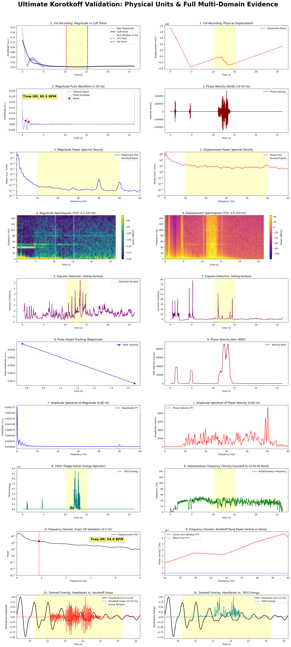
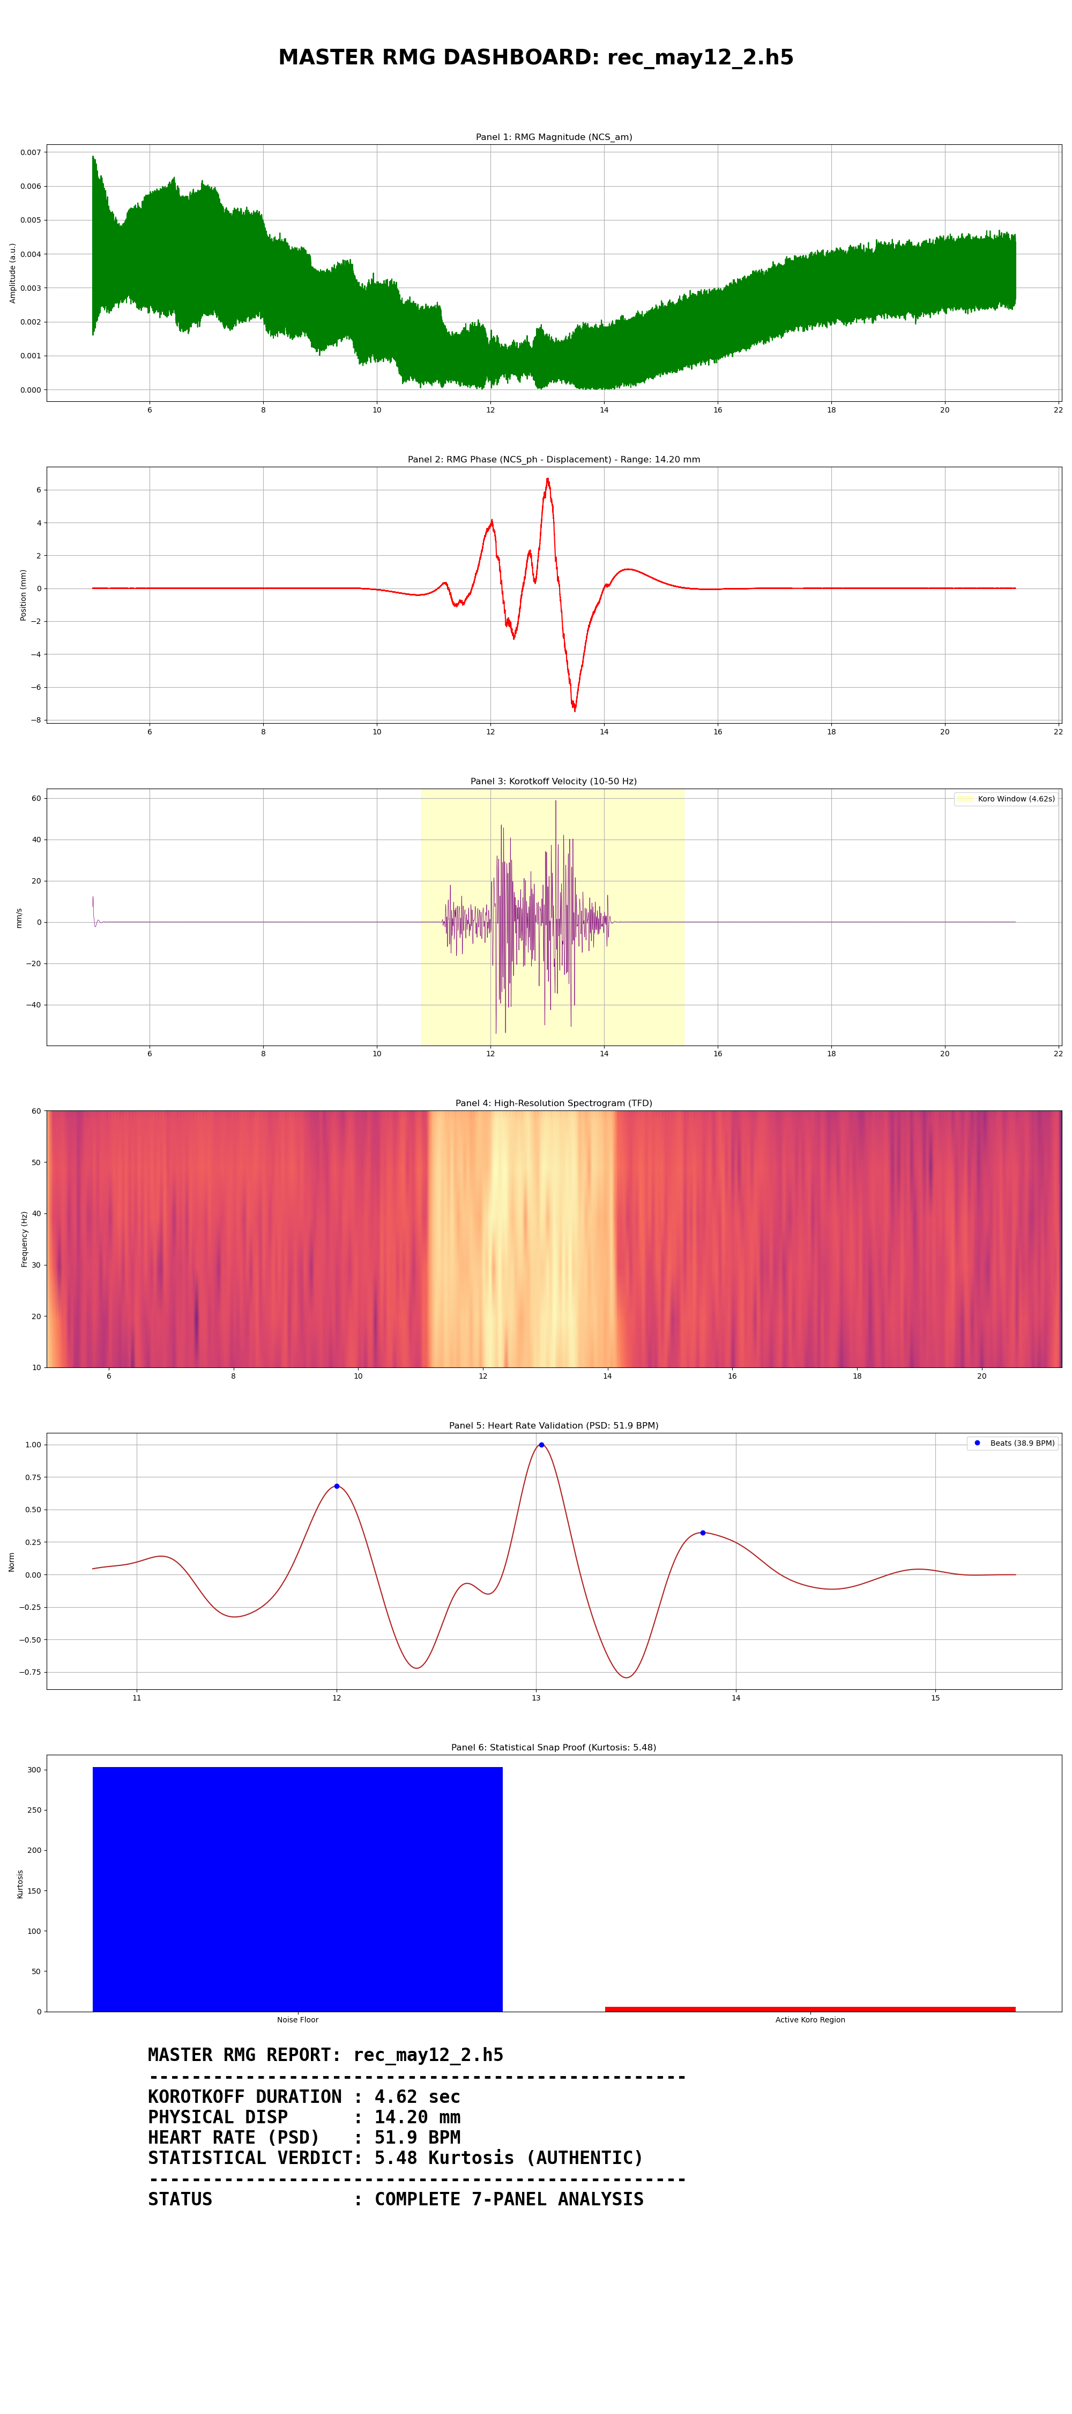

Slide 14
Conclusion & Clinical Significance
Summary of achievements:
Successfully implemented a non-invasive RF sensing pipeline for blood pressure tracking.
Eliminated phase accumulation errors and converted raw RF to absolute physical units (mm).
Developed a robust bounding algorithm (SYS/DIA) verified by TKEO energy and Spectral Bandpower.
Provides higher fidelity and mathematical certainty compared to generic oscillometric cuffs.

Slide 15
Future Work
Next steps for the RMG Pipeline:
Clinical Correlation: Map the extracted SYS/DIA indices to actual mmHg pressure readings from a reference gauge.
Real-Time Processing: Translate the offline Python dashboard into a real-time C++ / GNU Radio block.
Machine Learning: Train an inference model on the 10-50 Hz spectrogram features to automatically estimate absolute blood pressure without any cuff.

