Slide 1
RSA Algorithm in Cryptography
Group Members:
Rajveer Rathod (19CP074)
Akshat Trivedi (19CP075)
Vatsal Dhupelia (19CP076)

Slide 2
Contents:
What is Cryptography?
Features & Types of Cryptography
What is RSA Algorithm?
RSA Key Generation
RSA Encryption
RSA Decryption
How Secure is RSA?
References

Slide 3
What is Cryptography?
Cryptography is technique of securing information and communications through use of codes so that only those person for whom the information is intended can understand it and process it.
Thus it prevents unauthorized access to information.
In Cryptography the techniques which are use to protect information are obtained from mathematical concepts and a set of rule based calculations known as algorithms to convert messages in ways that make it hard to decode it.
These algorithms are used for cryptographic key generation, digital signing, verification to protect data privacy, web browsing on internet and to protect confidential transactions such as credit card and debit card transactions.

Slide 4
Features & Types of Cryptography.
Features:
Confidentiality
Integrity
Non-repudiation
Authentication
Types:
Symmetric Key Cryptography
Hash Functions
Asymmetric Key Cryptography

Slide 5
What is RSA Algorithm?
RSA is an algorithm used by modern computers to encrypt and decrypt messages.
RSA is one of the first practical public-key cryptosystems and is widely used for secure data transmission.
RSA is a asymmetric cryptographic algorithm.
RSA is made of the initial letters of the surnames of Ron Rivest, Adi Shamir, and Leonard Adleman, who first publicly described the algorithm in 1977.

Slide 6
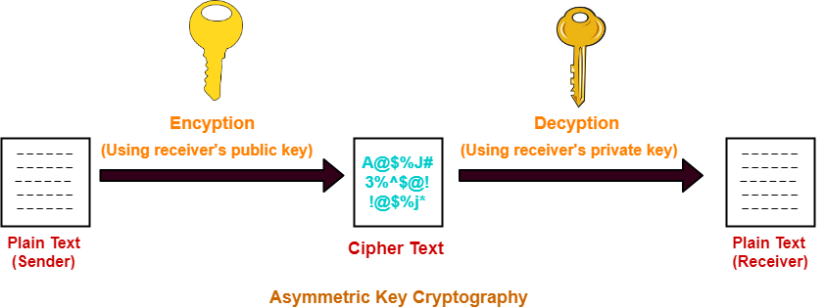
RSA Algorithm (Contd..):
As RSA is a asymmetric cryptographic algorithm so the messages encrypted using the public key can only be decrypted with the private key.
Representation:

Slide 7
RSA Key Generation:
Choose two distinct prime numbers p and q.
Compute n = p * q.
Compute φ(n) = (p - 1) * (q - 1).
Choose e such that 1 < e < φ(n) and e and n are prime.
Compute a value for d such that (d * e) % φ(n) = 1.
Public key is (e, n).
Private key is (d, n).

Slide 8
RSA Key Generation (Example):
Choose p = 3 and q = 11.
Compute n = p * q = 3 * 11 = 33.
Compute φ(n) = (p - 1) * (q - 1) = 2 * 10 = 20.
Choose e such that 1 < e < φ(n) and e and n are prime. Let e = 7.
Compute a value for d such that (d * e) % φ(n) = 1. One solution is d = 3 [(3 * 7) % 20 = 1].
Public key is (e, n) => (7, 33).
Private key is (d, n) => (3, 33).

Slide 9

RSA Encryption:
m = plain text.
Public key is (e, n).
C = Ciphertext
C = $m^{e}\% n$
Example:
m = 2
Public key is (e, n) => (7, 33).
So C = $2^{7}\% 33=29$

Slide 10

RSA Decryption:
C = Ciphertext
m = plaintext
Private key is (d, n).
$m=C^{d} \% n$
Example:
C = 29
Private key is (d, n) => (3, 33).
So $m=C^{3} \% 33=2$

Slide 11
How Secure is RSA?
At the most basic level, RSA public keys are the result of two large, randomly generated prime factors. They’re created using random number generators. This means that the entire security premise of the RSA algorithm is based on using prime factorization as a method of one way encryption. So, in other words, it’s operating under the assumption that no one can determine two randomly-generated prime numbers within a reasonable amount of time — that no one can crack the encryption of an SSL/TLS certificate until long after it’s replaced or expired.

Slide 12
References:
https://www.geeksforgeeks.org/rsa-algorithm-cryptography/
https://www.comparitech.com/blog/information-security/rsa-encryption/
Data Communications and Networking By Behrouz A.Forouzan
Chapter 30: Cryptography
Chapter 31: Network Security

Slide 13
THANK YOU

