Slide 1
Rajveer_lending_club_case_study

Slide 2
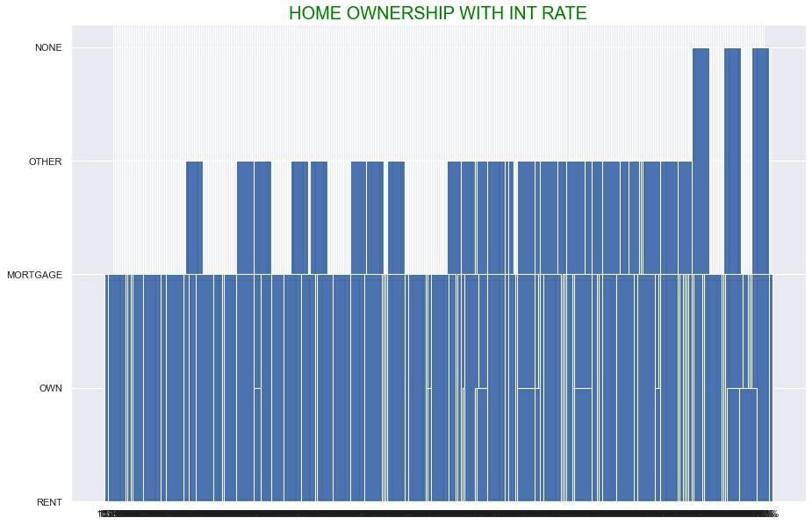
Home ownership with intial rate

Slide 3
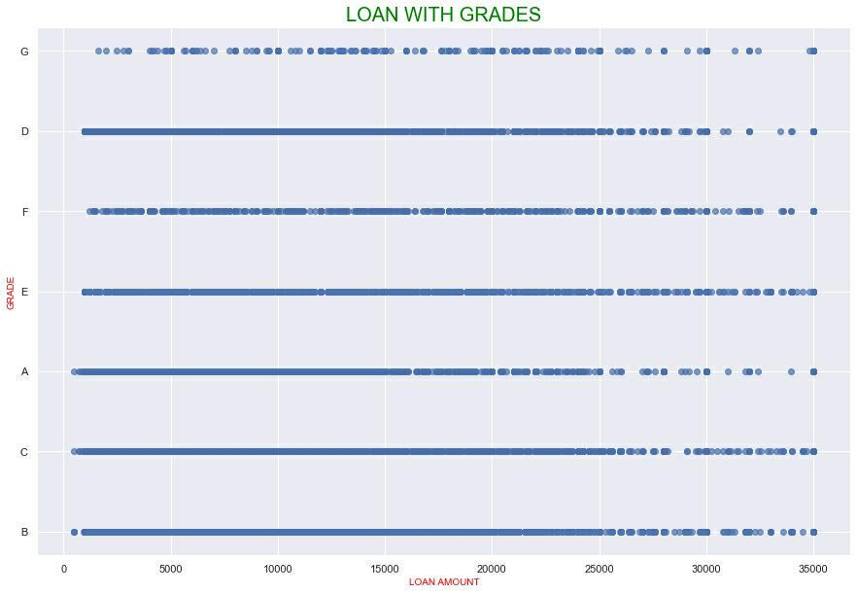
Loan with grades

Slide 4
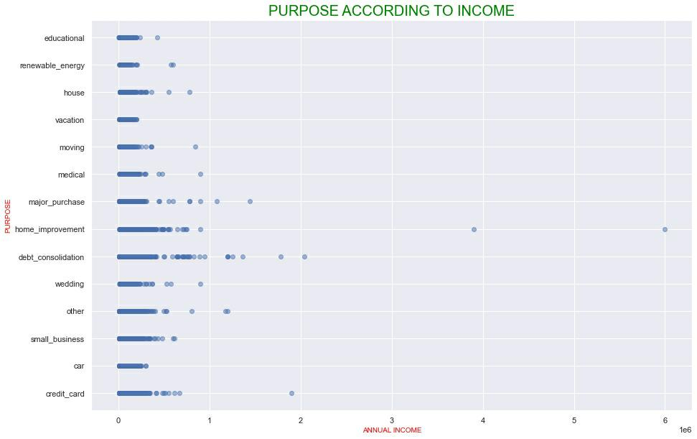
Purpose according to income

Slide 5
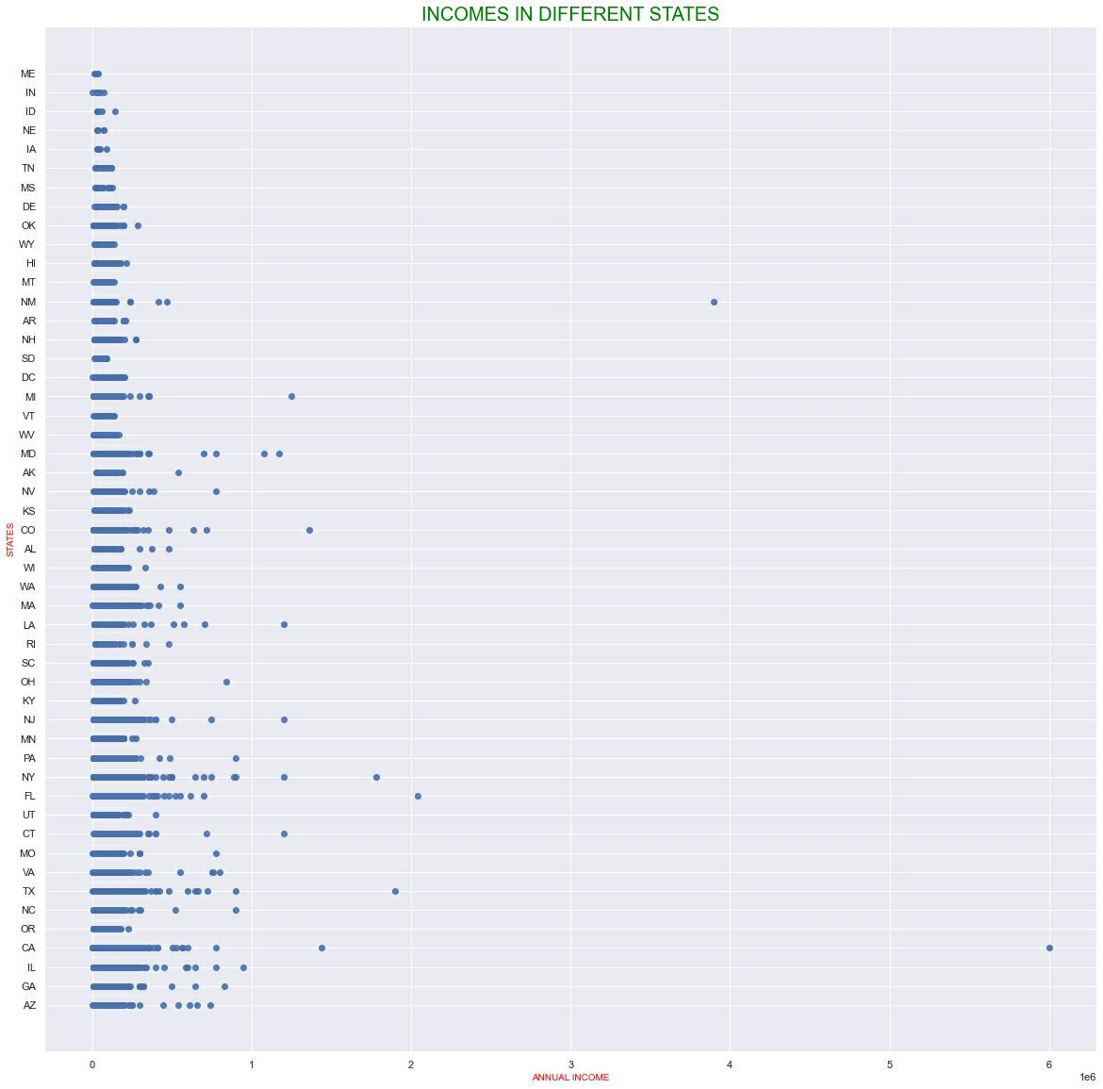
Income in different states

Slide 6


Slide 7
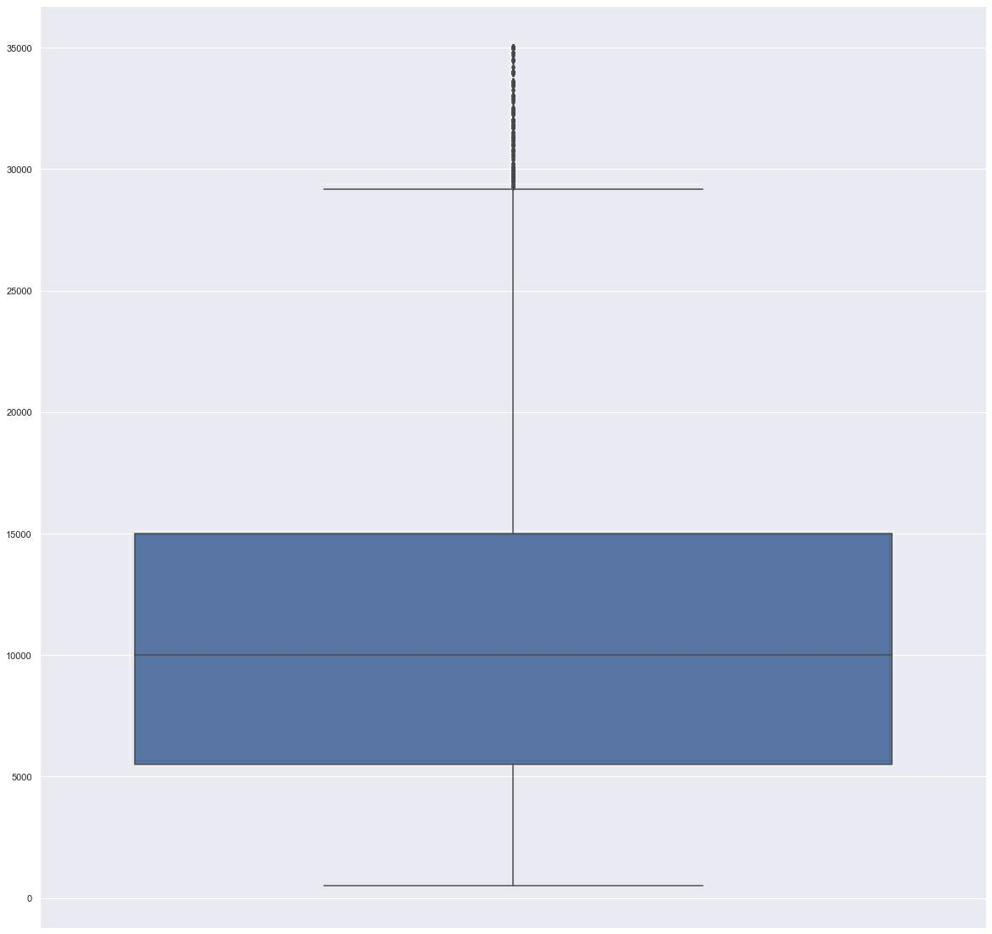

Slide 8
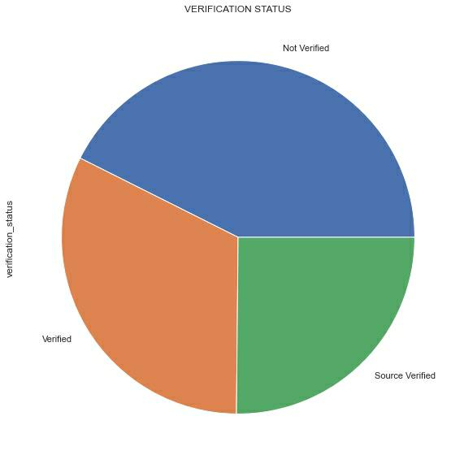

Slide 9
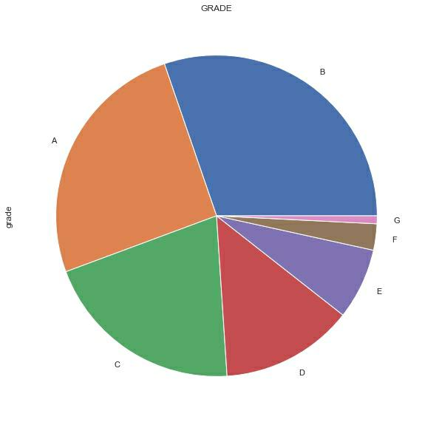

Slide 10
