Slide 1

THE
SMART BANKING
SYSTEM
TEAM MEMBERS:
RAJU CHOUDHARY:1262253997
KRISHNA RAJPUT: 1262254099
MAKARAND ARU: 1262251680
PRATIK KOTHARE: 1262253640
RAJVEER WAGH: 1262253065
INTRODUCTION:
The Smart Bank Management System is a console-based application developed using the C programming language to simulate modern banking operations in a simple and efficient way.
This system is designed to provide smart and secure banking features such as::
Admin-controlled account creation
Customer login authentication
Deposit and withdrawal operations
Fund transfer between accounts
PIN change facility
Emergency account blocking
Help and support request system
The objective of this project is to demonstrate how real-world banking systems manage customer accounts, ensure security, and handle transactions efficiently using programming concepts like arrays, structures, and functions.
This project represents a simplified model of digital banking solutions used in today’s banking environment

Slide 2
THE
SMART BANKING
SYSTEM
TEAM MEMBERS:
RAJU CHOUDHARY:1262253997
PRATIK KOTHARE: 1262253640
MAKARAND ARU: 1262251680
KRISHNA RAJPUT: 1262254099
RAJVEER WAGH: 1262253065
INTRODUCTION:
The Smart Bank Management System is a console-based application developed using the C programming language to simulate modern banking operations in a simple and efficient way.
This system is designed to provide smart and secure banking features such as::
Admin-controlled account creation
Customer login authentication
Deposit and withdrawal operations
Fund transfer between accounts
PIN change facility
Emergency account blocking
Help and support request system
The objective of this project is to demonstrate how real-world banking systems manage customer accounts, ensure security, and handle transactions efficiently using programming concepts like arrays, structures, and functions.
This project represents a simplified model of digital banking solutions used in today’s banking environment

Slide 3
Problem statement:
In traditional banking systems, managing customer accounts and transactions manually can be time-consuming, error-prone, and inefficient.
There is a need for a simple and secure system that can:
Store customer account details
Perform banking transactions accurately
Provide controlled access to admin and customers
Ensure basic account security features
Therefore, we developed a Smart Bank Management System that simulates real-world banking operations in a structured and user-friendly manner using C programming.

Slide 4


OBJECTIVES:
OBJECTIVES:
1.
2.
To implement secure admin
and customer login
To design a smart banking
simulation system

Slide 5
OBJECTIVES:
OBJECTIVES:
1.
2.
To implement secure admin
and customer login
To design a smart banking
simulation system

Slide 6


OBJECTIVES:
OBJECTIVES:
3.
4.
to allow pin change and emergency account blocking
To perform operations like deposit,withdrawal,and fund transfer

Slide 7
OBJECTIVES:
OBJECTIVES:
3.
4.
to allow pin change and emergency account blocking
To perform operations like deposit,withdrawal,and fund transfer

Slide 8

OBJECTIVES:
5.
To apply c programming concepts in a real world application

Slide 9
RELEVANT C LANGUAGE CONCEPTS USED
VARIABLES AND DATA TYPES
ARRAYS
STRUCTURES
Used to store account number, balance, PIN, and other details
Used to manage multiple customer accounts in the system.
Used to group customer information like name, account number, balance, and PIN into a single record.
FUNCTIONS
CONDITIONAL STATEMENTS(if-else/switch)
LOOPS(for/while)
Used to perform specific tasks such as deposit, withdraw, transfer money, change PIN, etc.
Used to repeatedly display menu options until the user exits.
Used to verify login credentials and control menu options.

Slide 10
System working
The Smart Bank Management System works through a menu-driven interface.
MAIN MENU
ADMIN PANEL
Admi login
Customer login
Help & Suppport
Exit
Manages overall system control
HELP & SUPPORT
CUSTROMER PANEL
Users can submit complaints or queries which are stored in the system for reference.
Deposit money
Withdraw money
Transfer funds
Change PIN
Block account in emergency

Slide 11
ALGORITHMS
MAIN ALGORITHM:
Start
Display Menu
Read user choice
Admin login
Customer login
Help & Support
Exit
If choice = Admin ➔ Redirect to Admin block
If choice = Customer ➔ Redirect to Customer block
If choice = Help ➔Redirect to Help & Support block
If choice = Exit ➔ Terminate the program
End

Slide 12
ADMIN BLOCK ALGORITHM
CUSTOMER BLOCK ALGORITHM
Enter Admin ID & password
If credentials are correct:
Display Amin Menu
Create Account
View All accounts
View All Complaints
If Create Account is selected:
Enter Customer details
Store data in array
If View Accounts selected:
Display all stored accounts
If View All Complaints is selected:
Display all stored complaints
Return to Main Menu
Enter Account No. and PIN
If credentials are correct:
Perform selected operations
Update account details
Repeat until user exits
Return to Main Menu

Slide 13
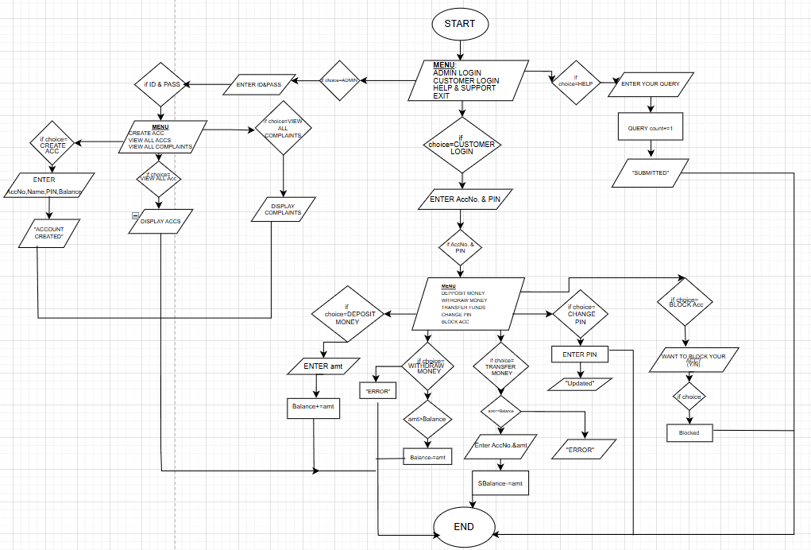
FLOWCHART

Slide 14

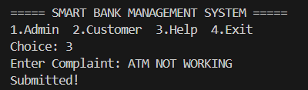
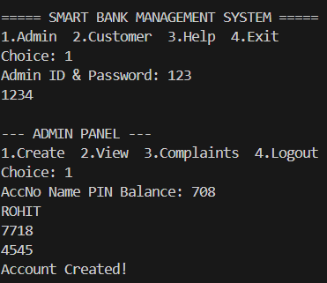


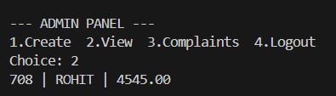

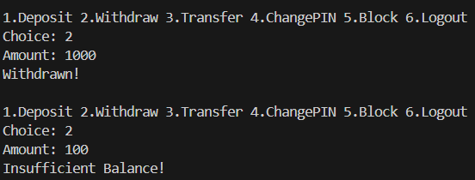
SAMPLE OUTPUTS
CREATING CUSTOMER’S ACC.
COMPLAINTS.
MONEY DEPOSIT
CHANGE PIN.
ADMIN VIEW
AMDIN’S VIEW
BLOCK ACCOUNT
WIITHDRAW EXAMPLE

Slide 15
conclusion
The Smart Bank Management System is a console-based application developed using C programming to simulate basic real-world banking operations in a structured and efficient way.
In this project, we implemented important features such as secure admin and customer login, account creation, deposit and withdrawal, fund transfer, PIN change, emergency account blocking, and a complaint system.
The system demonstrates how customer data and transactions can be managed using core C concepts like arrays, structures, functions, loops, and conditional statements.
This project improved our understanding of modular programming, logical flow control, and secure system design. Although it runs on a console interface, it reflects the fundamental working principles of modern banking systems.

Slide 16
THANK YOU

