Slide 1
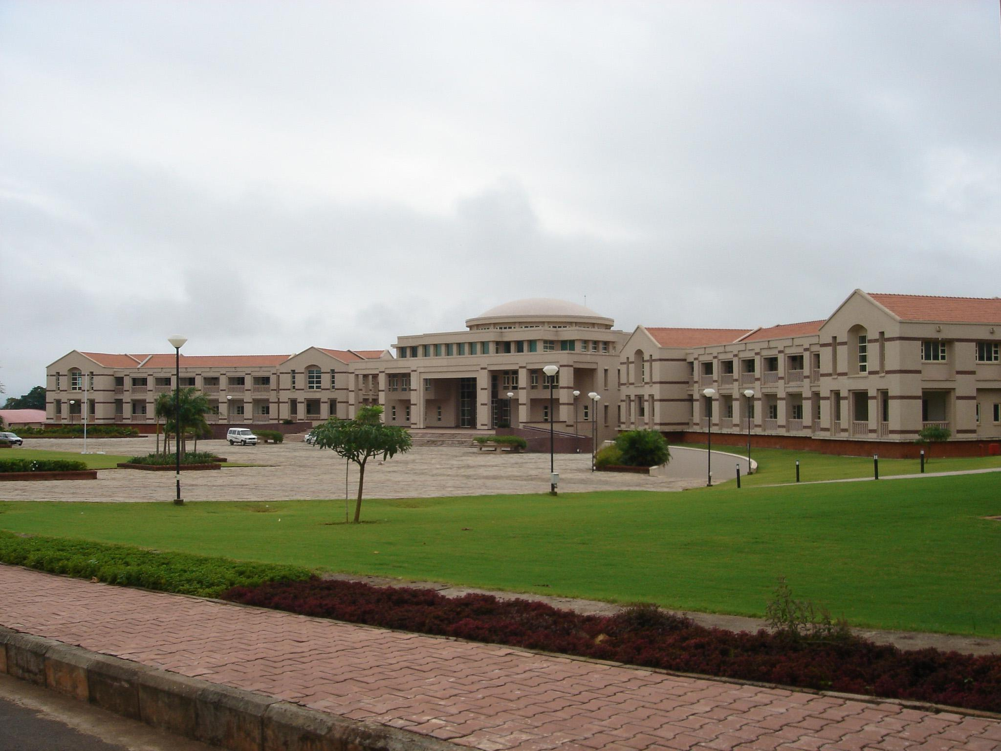

Design Oriented Project
End Semester Report
Graph Colouring
BITS Pilani
Rajvi Sampat
K K Birla Goa Campus

Slide 2
Star Colouring of Generalised Peterson Graphs
Studied the Star Colouring of Generalised Peterson Graphs and observed an upper bound for the same
We have a theorem for the upper bound of the star chromatic number of a graph of girth atleast 5.
We observe the girth of Generalised Peterson graphs. Most of these P(n,k) have girth atleast 5
We observe the independence number of P(n,k)
We extend the theorem for graphs of girth atleast 5 to the class of Generalised Peterson Graphs

Slide 3
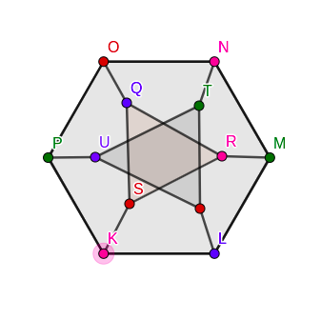
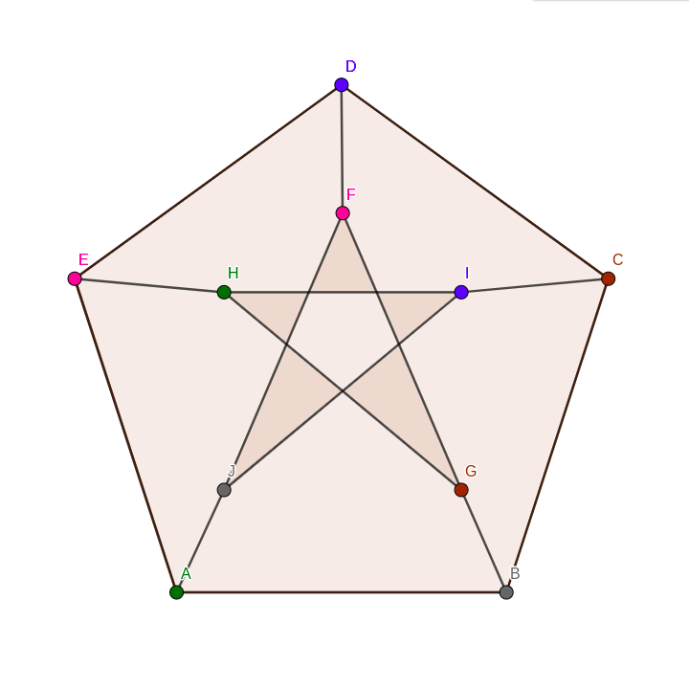
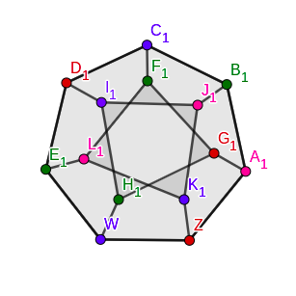
Star Colouring of Some Generalised Peterson Graphs
First, we observe the Star Chromatic Number for some P(n,k)
Star chromatic number of P(5,2) = 4
Star chromatic number of P(6,2) = 4
Star Chromatic number of P(7,2) = 4
Star Chromatic number of P(8,2)=5

Slide 4
Graphs with Girth atleast 5
The thesis studied had outlined a proof that if G is a graph with girth at least five. Then (1) χs(G) ≤ 4α(G) and (2) there is an O(n^ 5 ) time algorithm to find a 4α(G)-star coloring of G, where n is the number of vertices in G
This is found by:
  Obtaining an 8clique star partition of a {3K1, 2K2}-free graph in O(n+m)
  Obtaining a 4ω(G)-clique star partition if G is a {3K1, 2K2}-free graph
  The complement graph G is a {K3, C4}-free graph, so G admits a 4α(G)-independent set star partition and χs(G) ≤ 4α(G).
  G is a graph with girth at least five if and only if G is {K3, C4}-free
  Hence the theorem is obtained for a graph of girth atleast 5

Slide 5
Finding the girth of P(n,k)
g(GP (n, k)) = min(8, n/gcd(n,k), k + 3, n − (k − 1)floor(n/k) + 2, (1 + k) ceil( n/k ) − n + 2).
Cycles of length k+3 are the smallest cycles formed by taking consecutive vertices of the inner cycle and k vertices of the outer cycles
Cycles of length n/gcd(n,k) are the lengths of the inner cycles
Every P(n,k) has a cycle of length 8
If the girth is less than 5, then:
  n/gcd(n,k) <5: i.e n= 3k or n = 4k
  k+3 < 5; i.e k = 1
  In all other cases, girth >=5

Slide 6
Finding the girth of P(n,k)
The possible lengths of cycles in P (n, 2) are as follows.
(1) All GP (n, 2) contain l-cycles for l = 5 and 8 ≤ l ≤ 2n − 2;
(2) A GP (n, 2) contains 2n-cycles (i.e. Hamiltonian cycles) iff n 6≡ 5 (mod 6);
(3) A GP (n, 2) contains (2n − 1)-cycles iff n 6≡ 4 (mod 6);
(4) A GP (n, 2) contains 7-cycles iff n ∈ {6, 7, 8, 9, 14};
(5) A GP (n, 2) contains 6-cycles iff n ∈ {5, 6, 7, 12};
(6) A GP (n, 2) contains 4-cycles iff n = 8;
(7) A GP (n, 2) contains 3-cycles iff n = 6.
The possible lengths of cycles in GP (n, 3) are as follows.
(1) When n is even, GP (n, k) is bipartite, and is weakly even pancyclic;
(2) When n is odd, GP (n, k) contains cycles of every even length between its
girth and circumference, cycles of every odd length between b n−1
k c + 3 and
2n − 1, and cycles of length nk if n is a multiple of k.

Slide 7
Finding the girth of P(n,k)
Therefore, the class of Peterson graphs of girth atleast 5 include all P(n,k) except when
n=3k
n=4k
k=1
Thus, the theorem studied for graphs of girth atleast 5 can be extended to P(n,k)

Slide 8
Finding the independence number of P(n,k)
The independence number of a Generalised Peterson graph can be found in polynomial time, as given by Nazli Besharati in ‘Independence number of Generalised Peterson Graphs’
This is a special case of the theorem that the independence number of graphs with bounded tree width can be found in polynomial time.
Let G = (V, E) be a graph. A tree decomposition of G is a pair (X, T ), where X = {X1, X2, . . . , Xn} is a family of subsets of V , and T is a tree whose nodes are the subsets Xj , satisfying the following properties:
1) The union of all sets Xj equals V .
2) For every edge (v, w) in the graph, there is a subset Xj that contains both v and w.
3) If Xj is on the path from Xi to Xl in T then Xi ∩ Xl ⊆ Xj . In other words, for all vertices v ∈ V, all nodes Xi which contain v induce a connected subtree of T .
The width of (X, T ) is defined to be the size of the largest Xi minus one. The treewidth, tw(G), of the graph G is defined to be the minimum width of all its tree decompositions. The treewidth will be taken as a measure of how much a graph resembles a tree.

Slide 9
Finding the independence number of P(n,k)
Theorem A: The problem of finding a maximum independent set of a graph G with bounded treewidth, tw(G) ≤ l can be solved in O((2^3l)n) by dynamic programming techniques, where n is the number of vertices of graph.
For any fixed k, the problem of finding independence number of the graphs P(n, k) can be solved by an algorithm with running time O(n).
Proof: We need to show that tw(P(n,k)) is bounded
Consider the following tree decomposition of P(n, k) of width 4k + 3.
WLOG we can only consider the case where n > 2k + 1. Let T be the path of order n − 2k − 1 and define X1, X2, . . . , Xn−2k−1 as follows:
X1 = {u1, v1, u2, v2, . . . , uk+1, vk+1, un−k, vn−k, un−k+1, vn−k+1, . . . , un, vn},
X2 = (X1 \ {u1, v1}) ∪ {uk+2, vk+2},
X3 = (X2 \ {un, vn}) ∪ {un−k−1, vn−k−1},
X4 = (X3 \ {u2, v2}) ∪ {uk+3, vk+3},
X5 = (X4 \ {un−1, vn−1}) ∪ {un−k−2, vn−k−2}, and so on.
Notice that in each step we remove two elements and add two other elements. Therefore |Xi | = 4k + 4 for all i. One can easily see that (X, T ) is a tree decomposition for P(n, k) where X = {X1, X2, . . . , Xn−2k−1}. Thus, tw(P(n, k)) ≤ 4k + 3 and by Theorem A, the proof is complete.

Slide 10
Extending the Results for P(n,k)
Thus, for P(n,k)
where n != 3k,4k and k!=1,
we can find the independence number in O(n) time
we can find a 4α(G)-star coloring of G in O(n^5) time
Total time complexity : O(n^5)

Slide 11
Star Chromatic Index of P(n,k)
A star k-edge-coloring of a graph G is a proper edge-coloring using k colors such that at least three distinct colors are assigned to the edges of every path and cycle of length four. The minimum number k for which G admits a star k-edge-coloring is called the star chromatic index of G and is denoted by χ’ s (G).
Results:
χ’s (P(n, k)) = 4 if and only if n is a multiple of 4 and k is an odd number.
For any two integers k and n (≥ 2k + 1) such that GCD(n, k) ≥ 3, P(n, k) has a star 5-edge-coloring, with the exception of the case that GCD(n, k) = 3, k != GCD(n, k) and n /3 ≡ 1 (mod 3).

Slide 12
References
GRAPH COLORING AND ITS VARIANTS- Sandhya TP
INDEPENDENCE NUMBER OF GENERALISED PETERSON GRAPHS : Nazli Besharati , J. B. Ebrahimi , A. Azadi
LENGTH OF CYCLES IN GENERALIZED PETERSEN GRAPHS: Zan-Bo Zhang and Zhaojun Chen
ON THE STAR CHROMATIC INDEX OF GENERALIZED PETERSEN GRAPHS :Enqiang Zhu and Zehui Shao

Slide 13
Thank you!

