Slide 1
LINEAR DISCRIMINANT ANALYSIS
Group – 9
Nimil Shah – 1741048
Kalagee Anjaria – 1741052
Rajvi Patel – 1741078
Hetvi Suthar – 1741089
Rutvi Tilala - 1741091

Slide 2
What is LDA?
Objective: Perform dimensionality reduction, while preserving as much of the class discriminatory information as possible
Supervised dimensionality reduction
LDA technique is to project the data matrix onto a lower dimensional space.
Seeks to find directions along which the classes are best separated

Slide 3
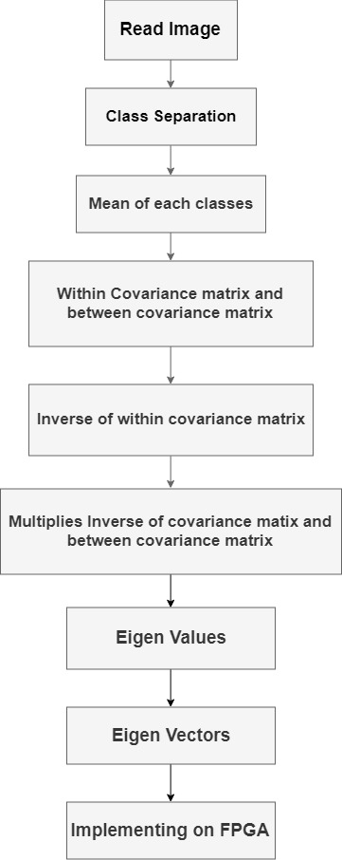
SUMMARY OF PREVIOUS WORK..
Classify the binary data into two classes
Create a matrix containing the mean of each of the features
Create a scatter matrix (Si) for each class
Calculate between-class scatter matrix
The last and final step is to project these data points in this vector
We had compared the graphs obtained by the inbuilt Matlab functions and that obtained by our code in Matlab.
The observation that was made was that there was absolutely no difference between these two graphs.

Slide 4
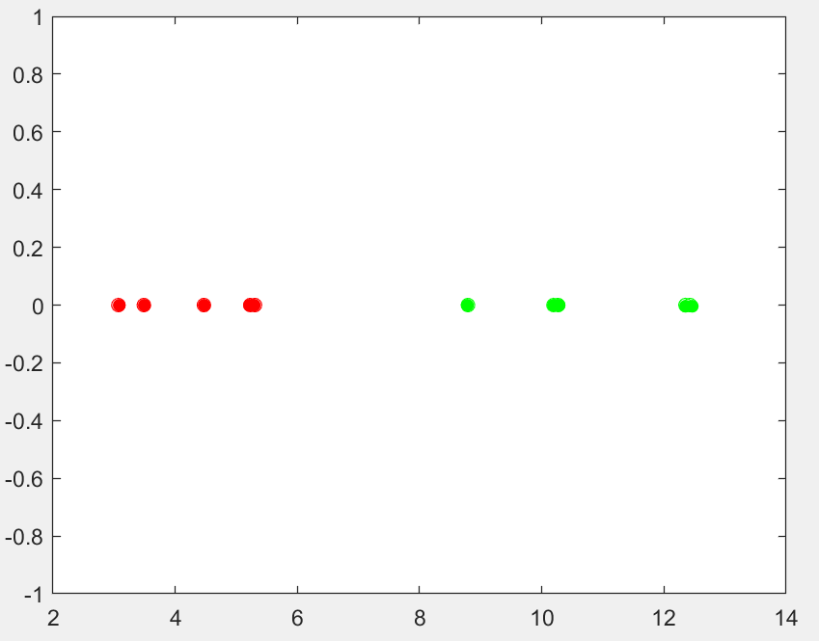
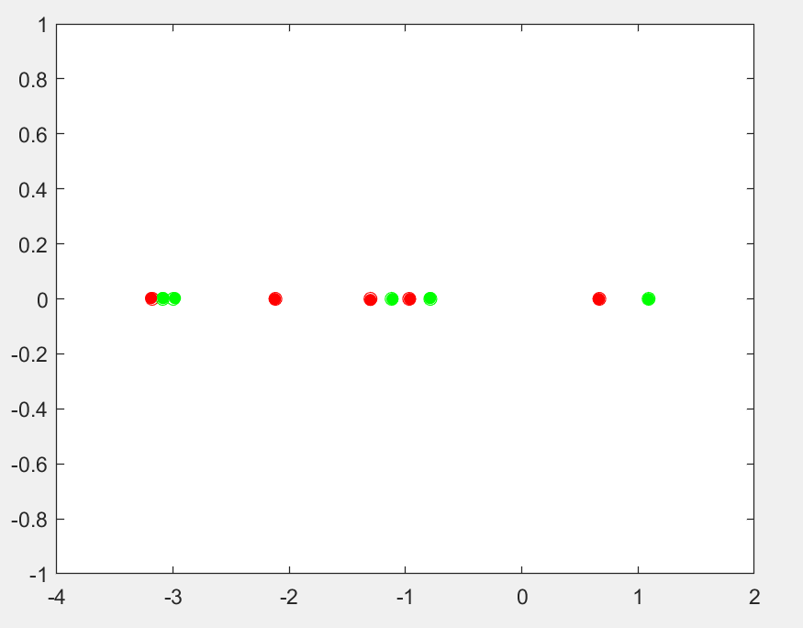
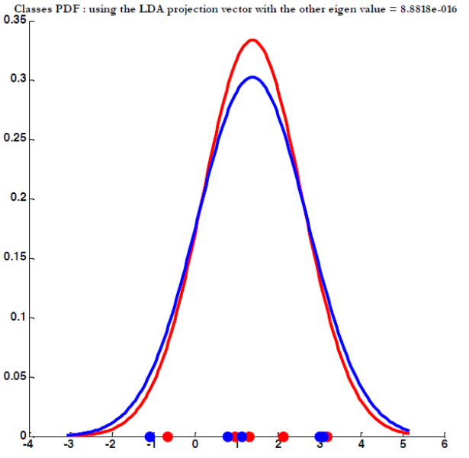
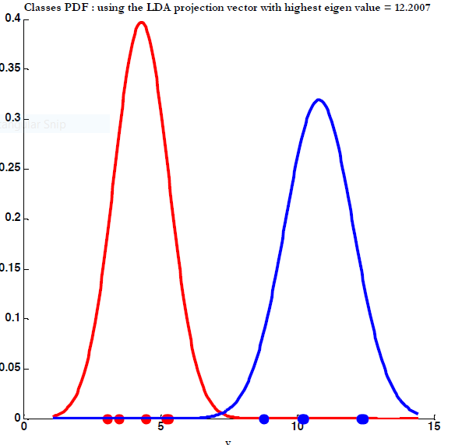
Our Previous Results in Matlab
Graph for 1st eigen vector
Graph for 2nd eigen vector

Slide 5
APPROACH…
Using HDL converter
Multiple matlab files were difficult to handle
Failure..!
Shit to
Xilinx

Slide 6
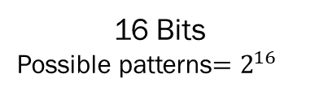
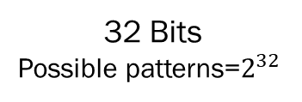
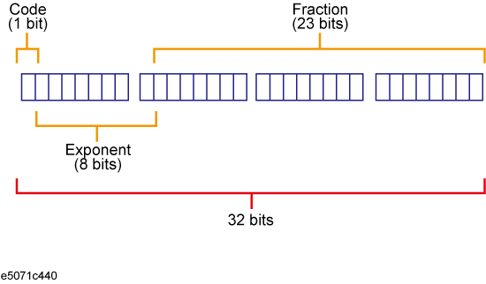

Progress..
Solutions to handle Floating point values
Fixed Point
IEEE Format for Floating point value
Not Precise Values

Slide 7
Working with Floating Point Numbers
Module that converts Integer Value to Floating Point
FPU Module which can perform addition, subtraction, multiplication, division on 32 bit operands that use IEEE standards.
FPU
Newton-Raphson division algorithm
IP CORE GENERATOR
( square-root)
Division and Squareroot not working
Square root not efficient

Slide 8
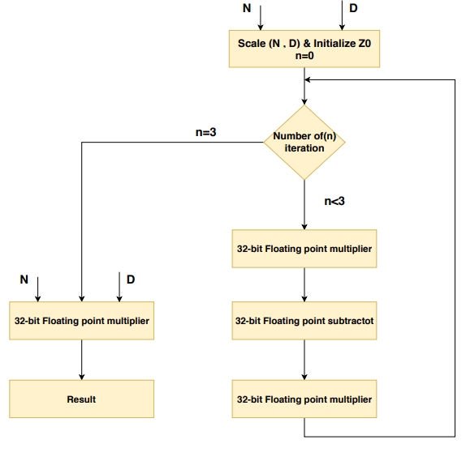
Newton-Raphson division algorithm
N : Dividend
D : Divisor
Initialize Z= (48/17) – (32/17) *D
Two multiplier and one subtraction module per iteration.
Computing three iterations in one cycle.
Zi is multiplicative inverse at iteration i, as given below.
Multiplicative inverse is multiplied to the dividend .
Zi + 1 = Z i + Zi (1 − D*Zi) = Zi (2 – D*Zi)

Slide 9
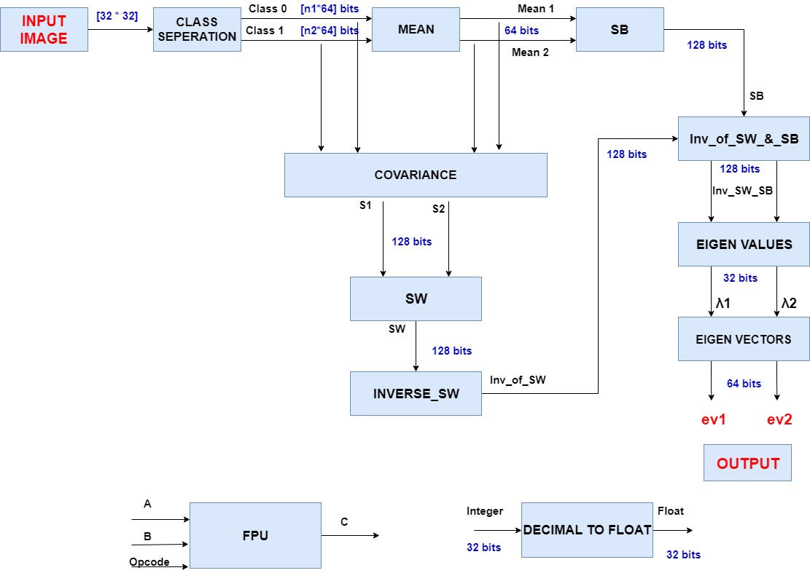

Slide 10
Challenges faced in Verilog
Module CLASS_SEPERATION
Reading 1024 values from ROM file and separating out classes was difficult.
Module COVARIANCE
Conversion of 1024*2=2048 values from int type to float type.
Used “generate statement” to call multiple statements (genvar).
Declaring Multidimensional array
Flatten the array.
Assigned each individual element of array accordingly.
When two modules work simultaneously,we get don’t care values in starting clk cycles
e.g genvar i;
generate for (i = 0; i < n; i = i + 1)
begin
myModule instance();
end endgenerate
e.g. input [31:0] in;
wire [7:0] array [0:1] [0:1];

Slide 11
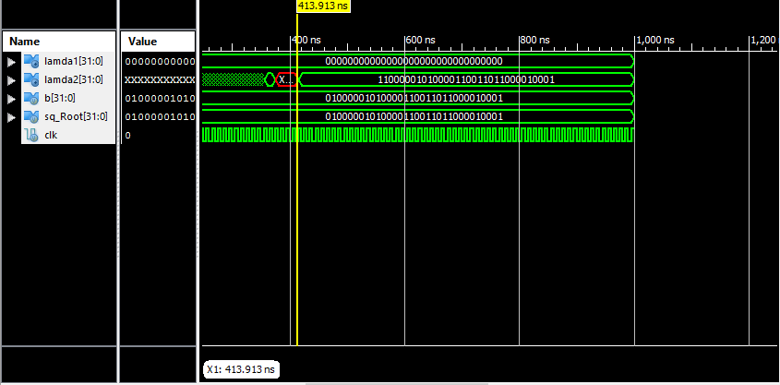
RESULTS
 | Matlab Output | Verilog Output
ev1 | 0.000 | 0.000
ev2 | 12.007 | 12.001
Time |  | 414 ns

Slide 12
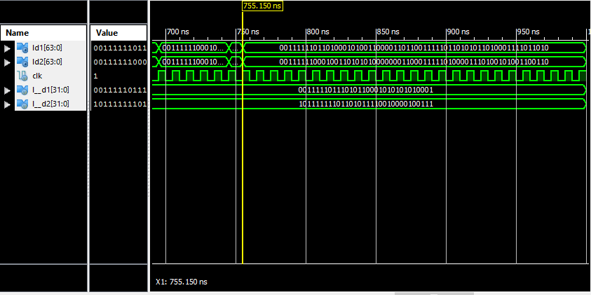
Eigen Vector | Matlab Output | Verilog Output
ev1 | (0.9088,04173) | (0.9076,0.4120)
ev2 | (-0.5755,0.8178) | (-0.5101.0.8014)
Time | 0.029s (Total) | 755 ns

Slide 13
COMPARISON
WORKING WITH MATLAB | WORKING WITH XILINX
Feasible for matrix operation Less time to process Accurate and precise output | More constraints and restrictions More time taken Less accurate output

Slide 14
REFERENCES
K. Liang, M. J. Wang, and . Schulte, A decimal floating-point divider using Newton-Raphson iteration, J. VLSI Signal Process. Syst, vol.49, issue.1, pp.3-18, 2007: https://link.springer.com/article/10.1007/s11265-007-0058-5
Is it possible to take input port as array in verilog? - Stack Overflow https://stackoverflow.com/questions/36370438/is-it-possible-to-take-input-port-as-array-in-verilog
Steve Hollasch, IEEE Standard 754 for floating point numbers
https://steve.hollasch.net/cgindex/coding/ieeefloat.html

Slide 15
Thank You

