Slide 1


Design Engineering – 2b Review
S.P.B Patel Engineering College
SOLID WASTE MANAGEMENT
GUIDED BY:- PROF. AVANI DEDHIA

Slide 2
PREPARED BY
Hemaxi Arthania :- 170390106001
Dushyant Rajput :- 170390106016
Dhavnil Thakkar :- 170390106019
Vivek Kalariya :- 170394106001

Slide 3
OVERVIEW
Background Study
Research Gap
Problem Definition
Objective
Literature Review
Methodology
Skill Set & Knowledge Required
Verification & Validation
Expected Outcome
Future Scope

Slide 4


BACKGROUND STUDY
    All essential necessities that are required for the survival of any human beings are fulfilled by mother nature but some of the products are wasted.
    This by product acquire from mother nature which is not usable buy first user at initial stage is considered as waste and that is scattered randomly on earth.

Slide 5
CURRENT INFORMATION
The MSW generation rate reported for small towns is 200-300 gm/capita and 300-400 gm/capita for medium cities and between 400-600 gm/capita for large cities.
As per the latest report of CPCB, published in February 2015, the total quantity of waste generation in the country is estimated at around 1.43 lakh metric tons per day.
However, if the current 62 million tonnes annual generation of MSW continues to be dumped without treatment, it will need 3,40,000 cubic meter of landfill space every day.
Considering the projected waste generation of 165 million tonnes by 2031, the requirement of land for setting up landfill for 20 years could be as high as 66,000 hectares of precious land, which our country cannot afford to waste.

Slide 6

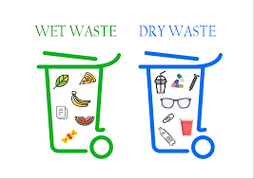
RESEARCH GAP
There are many methods existing for management of solid waste but none of them are effective and capable of segregating wet and dry waste.
So we have designed the system for convenient and effective management of wet and dry waste

Slide 7
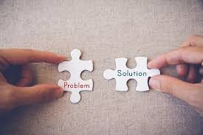
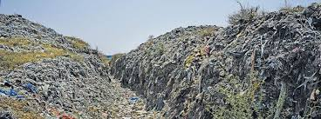
PROBLEM DEFINITION
To reduce pollution and maintaining cleanliness and harmony in nature by managing the waste in an effective and accurate manner.

Slide 8
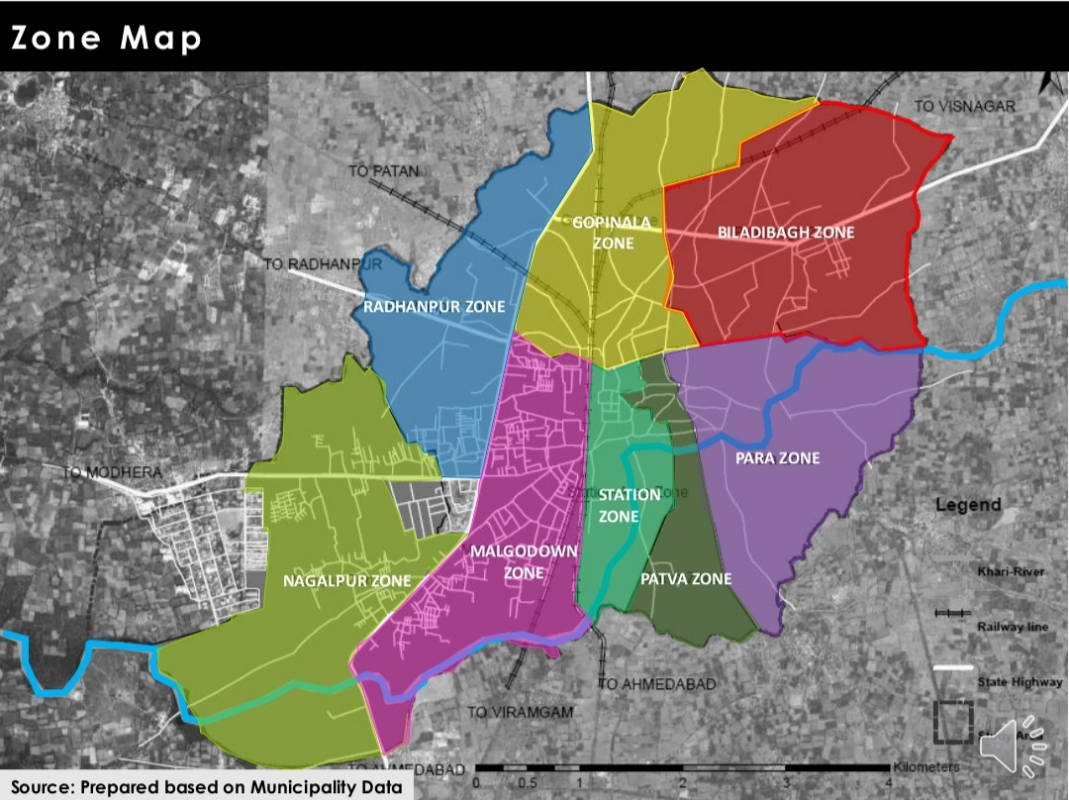
objective
To collect the waste effectively.
To treat the collected solid waste.
To treat wet and dry waste separately.
To increase waste collection area.

Slide 9


Literature review
Pyrolysis :- It is the​ ​thermal​ ​decomposition of materials at elevated temperatures in an inert atmosphere. It involves a change of​ ​chemical composition and is irreversible.
MBT :- A ​mechanical biological treatment​ (​MBT​) system is a type of waste processing facility that combines a sorting facility with a form of biological treatment such as​ ​composting or​ ​anaerobic digestion.
Biodrying :-It is the process by which​ ​biodegradable waste is rapidly heated through initial stages of​ ​composting to remove moisture from a​ ​waste stream and hence reduce its overall weight. In biodrying processes, the drying rates are augmented by biological heat in addition to forced aeration.

Slide 10
Methodology collection phase
1.
Waste Collection
Wet Waste
Dry Waste
Compactable Dustbin
Compactor Truck
Compactor Truck
Separate Pipeline
Dumping Land
Biogas Plant
Segregation
Energy Production
(i.e. gas)

Slide 11
2.Segregation phase
Segregation
Air Blower
Magnetic Separation
Speed Conveyor Belt

Slide 12

Skill Set & Knowledge Required
Software :– Sketch up pro
Subject knowledge :– Environmental Engineering, Highway Engineering
Technical knowledge :– Piping system, Road networking, Segregation methods
Management skill :- Leadership, Literature survey and research, Teamwork, Problem solving.

Slide 13
VERIFICATION AND VALIDATION
To verify that the waste is collected from every zone of the city.
To verify that waste is not thrown randomly on the land.
To verify the segregation of wet waste and dry waste.
To maintain the self cleansing velocity in the pipeline provided for wet waste collection.
To resist the blockage in the pipeline.
To follow the segregation process properly.
Proper road networking provided for various different zones of the city.

Slide 14
Expected outcome
To collect the waste effectively.
Treatment of the collected solid waste.
Treating wet and dry waste separately.
The waste collection area can be increased.
To supply biogas to the people living in the Mehsana city.

Slide 15
Future scope
To increase the number of trips.
To increase the efficiency of treating the solid waste.
To achieve a pollution free lands.
The solid waste generated from the cities/towns in India has present potential to generate power of approximately 500 MW, which can be enhanced to 1,075 MW by 2031 and further to 2,780 MW by 2050.

Slide 16


