Slide 1

Optical
Character
Recognition
Raj vinayak Meena

Slide 2
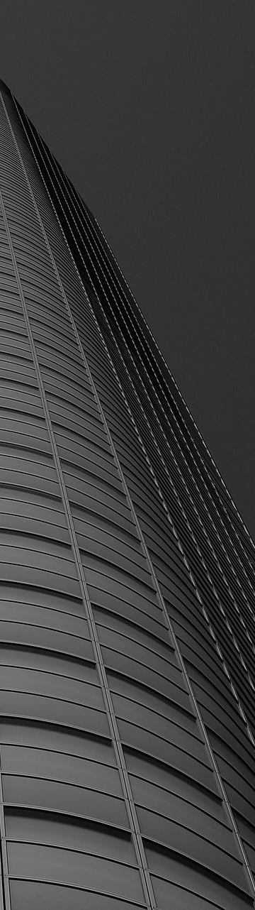
INDEX
Challenges
Image Processing
ML Pipeline
Best model?
Choosing the best Parameters
Other Algos: CNN

Slide 3
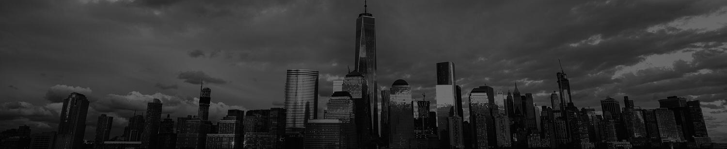
Challenges
Image processing
1. Best image processing pipeline
2. Reducing noise while maintaining quality
Machine Learning
Feature extraction
Best Hyperparameter combination

Slide 4
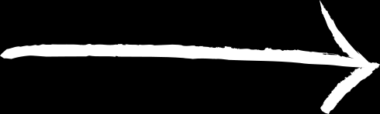
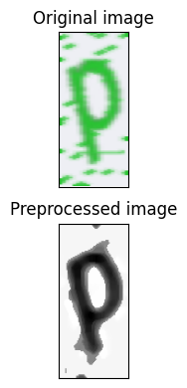


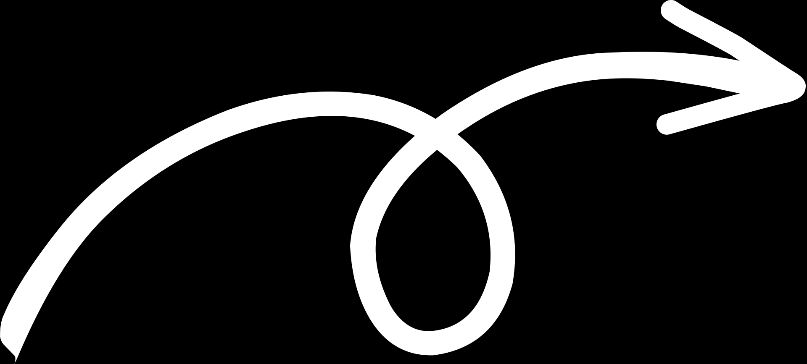
Image Processing
RESIZE
GRAYSCALE
HISTOGRAM EQUALIZATION
DILATE
DENOISE
MEDIAN FILTER

Slide 5
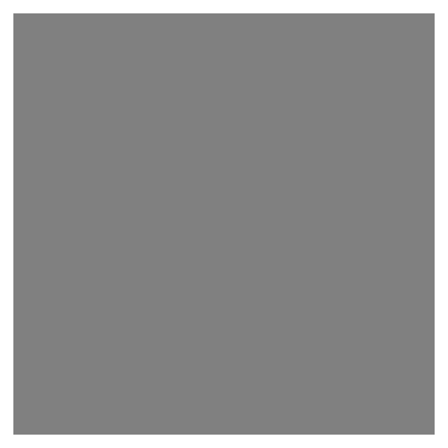
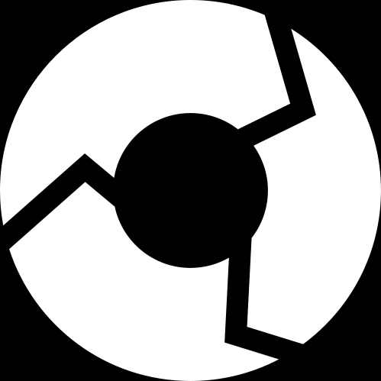


ML
Pipeline
Image processing
Feature
Extraction
Feature Exraction
Model Optimization
Model Training
Final
Model
Model Selection
Model
Evaluation

Slide 6
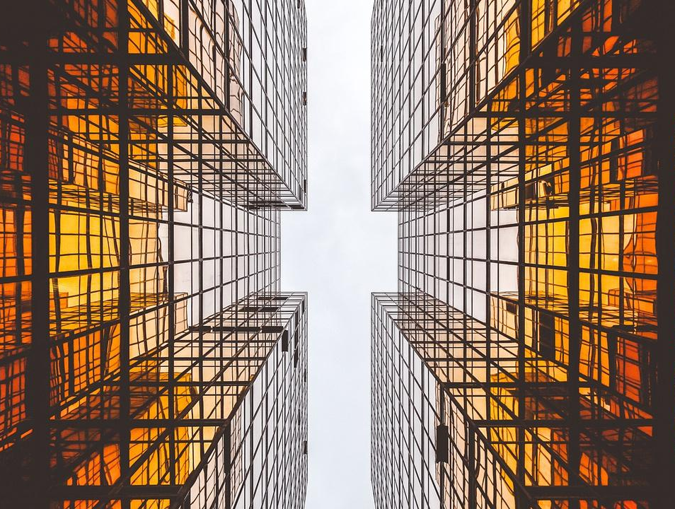
Comparison of LR, SVM and RF models

Slide 7
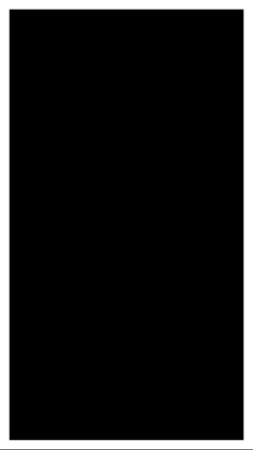
Best model?
Logistic
Regression
Support Vector Machine
Random Forest
Classifier
Accuracy
74.62%
77.53%
73.98%
SVM showed the best accuracy on various test-train splits.

Slide 8

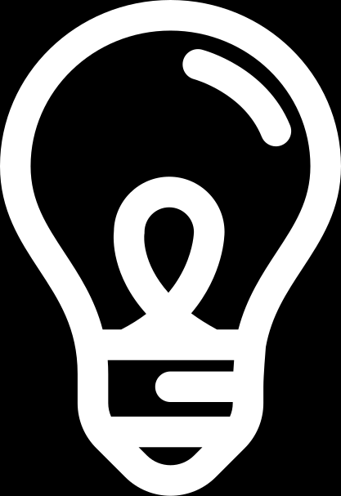
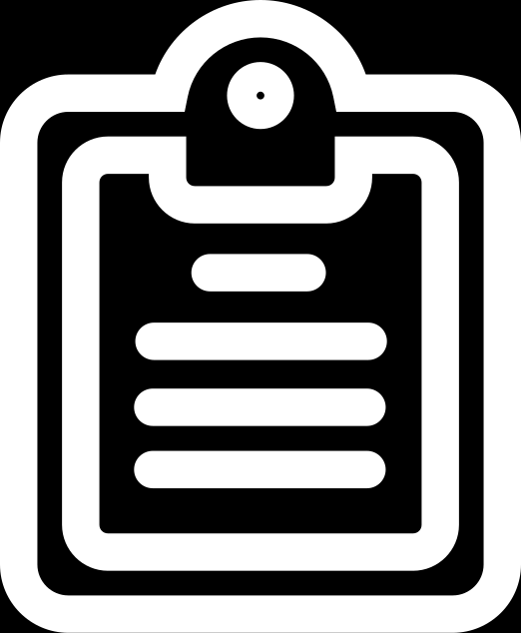
CHOOSING THE BEST
Parameters
KERNEL
C
DEGREE
GRIDSEARCHCV
Function used to map the input data into a higher-dimensional feature space
Decides the penalty for misclassifications on the training set.
Contributes to the complexity of the SVM decision boundary.
Chooses the best parameters.
This tweaked up the accuracy from 77.53% to 80.43%.
Notes:
In SVMs, the basic idea is to find a hyperplane that maximizes the margin (distance) between the data points of different classes. However, in many cases, the data may not be linearly separable in the original input space. That's where the kernel function comes in.

Slide 9
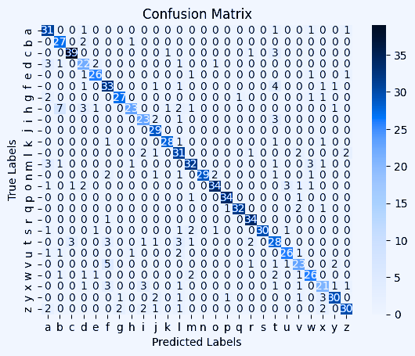
CONFUSION
MATRIX

Slide 10
Model:
Sequential model using the Keras Sequential API
Conv2D with 32 filters (ReLU)
MaxPooling2D
Conv2D with 64 filters (ReLU) and pooling
Flatten
Dense; softmax
Other
Algos: CNN

Slide 11
Thank
you!

