Slide 1
Communication and Interconnects
Lecture 10
February 10, 2025

Slide 2
Process Mapping/Allocation
0
1
2
3
4
5
6
7
8
9
10
11
0
1
2
3
Maximum number of hops?
  3 (e.g. 4 to 2)
(2) Maximum number of hops in the modified network?
(3) Suggest a process mapping where maximum number of hops = 1
4
5
7
8
9
11

Slide 3
Topology-aware Process Mapping
0
1
2
3
4
5
6
7
8
9
10
11
11
0
1
10
0 ← 2
2 ← 4
4 ← 6
6 ← 8
8 ← 10
3 ← 1
5 ← 3
7 ← 5
9 ← 7
11 ← 9
2
3
9
8
4
5
7
6
Maximum number of hops = 1 for the given communication pattern on this network

Slide 4
Virtual Topology
0
1
2
9
10
11
0
1
0 ← 1
2 ← 3
4 ← 5
6 ← 7
8 ← 9
10 ← 11
2
3
Suggest a process mapping where maximum number of hops = 1
4

Slide 5
Virtual Topology
0
1
2
9
10
11
0
1
2
3
4
5
6
7
8
9
10
11
0 ← 1
2 ← 3
4 ← 5
6 ← 7
8 ← 9
10 ← 11
0
1
0
2
5
4
0 ← 2
4 ← 6
8 ← 10
2
3
1
3
7
6
4
5
11
9
10
8

Slide 6
Interconnects

Slide 7
Attributes of Interconnects
Topology (connectivity)
Diameter
Cost
Anything else?

Slide 8
Attributes/Characteristics of Interconnects
Topology (connectivity)
Diameter
Cost
Bisection width

Slide 9
Linear Array
Total #nodes = p
Diameter p-1
Bisection width 1
Cost p-1

Slide 10
Ring Interconnect
Total #nodes = p
Diameter floor(p/2)
Bisection width 2
Cost p
Notes:
Read up on bidirectional channel

Slide 11
Star Interconnect
Total #nodes = p
Drawback?
Diameter 2
Cost p-1
Single point of failure (low fault tolerance)
Congestion at the central node

Slide 12
Hypothetical Network
Total #nodes = p
Diameter 3(√p – 1)
Bisection width 1
Cost √p (√p – 1) + (√p – 1)

Slide 13
2D Mesh Interconnect
Total #nodes = p
Diameter 2(√p – 1)
Bisection width √p
Cost 2(p – √p)
2√p(√p – 1)
Simple improvement over this interconnect?

Slide 14
2D Torus Interconnect
Total #nodes = p
Diameter √p [=2(√p/2)] (when p is even)
√p – 1 (when p is odd)
Bisection width 2√p
Cost 2p
2√p(√p – 1) + 2√p

Slide 15
Homework
3D Mesh
3D Torus

Slide 16
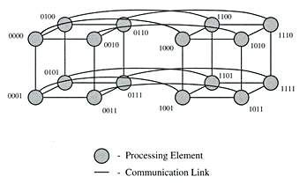
Hypercube Interconnect
0D
1D
2D
3D
Diameter log p
Bisection width p/2
Cost (Homework)
Source
https://www.researchgate.net/publication/220693596_Parallel_Algorithms_for_Regular_Architectures_Meshes_and_Pyramids
Notes:
(p log p)/2

Slide 17
Tree Networks
Problem?
Communication bottlenecks at higher levels

Slide 18
Fat-tree Networks
Optional reading: C. E. Leiserson. Fat-trees: Universal networks for hardware efficient supercomputing. In Proceedings of the 1985 International Conference on Parallel Processing, 393–402, 1985.

Slide 19
Papers (Optional Reading)
Performance analysis of k-ary n-cube interconnection networks
Implementing the MPI Process Topology Mechanism
Automated mapping of regular communication graphs on mesh interconnects
The PERCS High-Performance Interconnect
Reconfigurable Hybrid Interconnection for Static and Dynamic Scientific Applications

Slide 20
Communication Cost

Slide 21
MPI Communication
Communication is often the bottleneck in parallel programs.
We’d like communication time to be negligible!
Core
Process
Memory
4 bytes
400 bytes
40000 bytes
Notes:
Parallel codes – communication an important factor

Slide 22
Bandwidth/Throughput
Amount of data that can be transmitted in a certain amount of time
Unit?
Example: 200 bits in 2 ms
→ Achieved bandwidth = 10^5 bps = (10^5)/8 Bps = 12.2 KBps
Core
1 Gbps
Process
Memory
Notes:
Network performance is measured in two fundamental ways: bandwidth (also called throughput) and latency (also called delay). The bandwidth of a network is given by the number of bits that can be transmitted over the network in a certain period of time. For example, a network might have a bandwidth of 10 million bits/second (Mbps), meaning that it is able to deliver 10 million bits every second. It is sometimes useful to think of bandwidth in terms of how long it takes to transmit each bit of data. On a 10-Mbps network, for example, it takes 0.1 microsecond (μs) to transmit each bit.

Slide 23

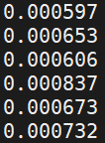
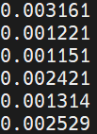
Timing MPI_Send (2 nodes)
for i in 1 2 3 ; do mpirun -np 2 -hosts csews2,csews16 ./timingSend X ; done
// X integers are being sent from one node to another (three times)
// Times from both ranks are printed
X = 4
X = 400
X = 40000

Slide 24
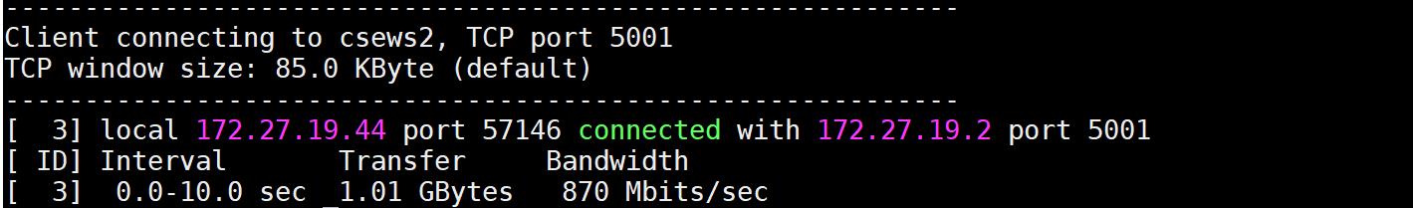
MPI Overhead
Eager
700000 bytes (1000 times) in 6.02 sec ➔ Effective bandwidth = 110.8 MB/s
Rendezvous
700000 bytes (1000 times) in 6.25 sec ➔ Effective bandwidth = 106.8 MB/s

Slide 25
Bandwidth Analysis for 1-to-many Sends
I Communication volume = 10000 integers to 29 ranks in 0.02 s
  ➔ Throughput/bandwidth achieved = 10000 * 4 * 29 bytes / 0.02 s = 55.3 MBps
II Communication volume = 1000000 integers to 29 ranks in 0.8 s
  ➔ Throughput/bandwidth achieved = 1000000 * 4 * 29 bytes / 0.8 s = 138.3 MBps
Note: This is not the network bandwidth

