Slide 1
Communication
Lecture 11
February 12, 2025

Slide 2
Throughput Analysis for 1-to-many Sends
I Communication volume = 10000 integers to 29 ranks in 0.02 s
  ➔ Throughput/bandwidth achieved = 10000 * 4 * 29 bytes / 0.02 s = 55.3 MBps
II Communication volume = 1000000 integers to 29 ranks in 0.8 s
  ➔ Throughput/bandwidth achieved = 1000000 * 4 * 29 bytes / 0.8 s = 138.3 MBps
Note: This is not the network bandwidth

Slide 3

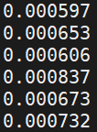
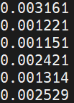
Timing MPI_Send (2 nodes)
for i in 1 2 3 ; do mpirun -np 2 -hosts csews2,csews16 ./timingSend X ; done
// X integers are being sent from one node to another (three times)
// Times from both ranks are printed
X = 4
0.03 MBps
X = 400
2.54 MBps
X = 40000
76.29 MBps
Note the gradual increase in achieved bandwidth with increase in data size

Slide 4
Effective Bandwidth (2 nodes on csews)
Data Size | Time (s) | Bandwidth (MB/s)
1 KB | 0.0005 | 1.95
2 KB | 0.0005 | 3.91
4 KB | 0.0005 | 7.81
8 KB | 0.0005 | 15.62
16 KB | 0.0005 | 31.24
32 KB | 0.0007 | 44.65
64 KB | 0.0012 | 52.08
128 KB | 0.0024 | 52.08
Data Size | Time (s) | Bandwidth (MB/s)
256 KB | 0.0032 | 78.13
512 KB | 0.0054 | 92.59
1 MB | 0.0099 | 101.01
2 MB | 0.0190 | 105.26
4 MB | 0.0370 | 108.10
8 MB | 0.0740 | 108.10
16 MB | 0.1460 | 109.58
32 MB | 0.2902 | 110.26
Note: This is as per today’s measurement

Slide 5
Effective Bandwidth
QDR Infiniband speed (or bandwidth): 40 Gbps
FDR Infiniband speed (or bandwidth): 56 Gbps
Source: Barthels et al., SIGMOD’15
Latency-bound: The leftmost (almost) flat region
Bandwidth-bound: The rightmost (almost) flat region

Slide 6

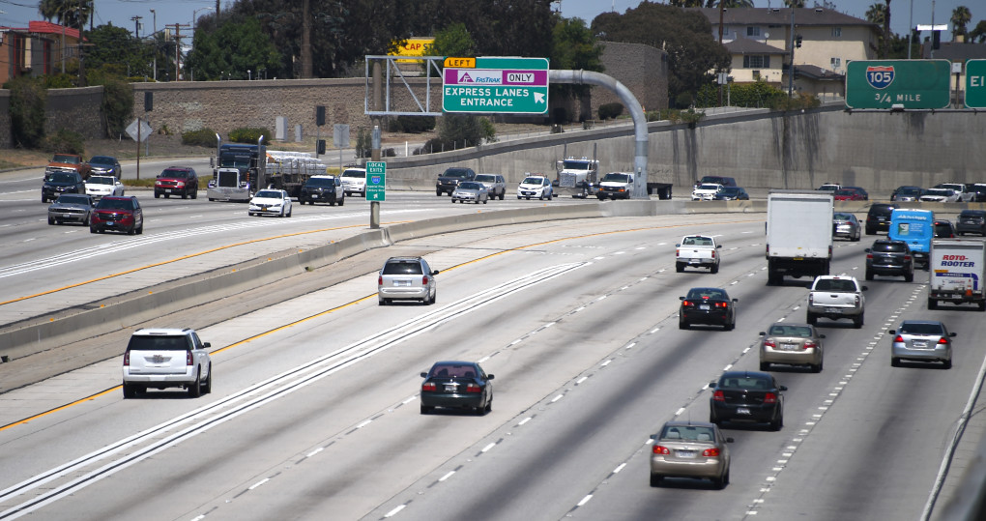
Latency and Bandwidth
SOURCE: ECESSA
SOURCE: DAILYNEWS

Slide 7
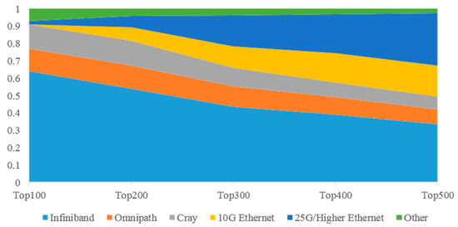
Network Distribution in Top500 Supercomputers
Source: A Survey of High-Performance Interconnection Networks in High-Performance Computer Systems, Electronics 2022

Slide 8
Communication Cost
Startup time (t_{s})
  Time required to handle a message at the sending and receiving nodes
Per-hop time (t_{h})
  Node latency
Per-word transfer time (t_{w}) / Bandwidth (B)
  Channel capacity
Transfer time of n words on l links = ?
Reading: GGKK: Chapter 2
Notes:
Startup time (ts): The startup time is the time required to handle a message at the
sending and receiving nodes. This includes the time to prepare the message (adding
header, trailer, and error correction information), the time to execute the routing
algorithm, and the time to establish an interface between the local node and the router.
This delay is incurred only once for a single message transfer.
1.
Per-hop time (th): After a message leaves a node, it takes a finite amount of time to
reach the next node in its path. The time taken by the header of a message to travel
between two directly-connected nodes in the network is called the per-hop time. It is also
known as node latency. The per-hop time is directly related to the latency within the
routing switch for determining which output buffer or channel the message should be
forwarded to.
2.
Per-word transfer time (tw): If the channel bandwidth is r words per second, then each
word takes time tw = 1/r to traverse the link. This time is called the per-word transfer
time. This time includes network as well as buffering overheads.

Slide 9
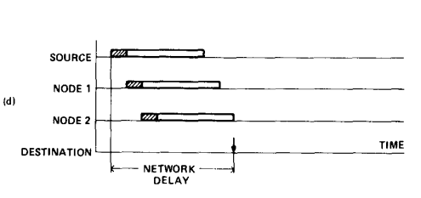
Routing
t_{s} + l(t_{h} + n/B)
t_{s} + l.t_{h} + n/B
Store-and-forward
Cut-through
Reference: Chapter 2 of “Introduction to Parallel Computing”, Ananth Grama et al.
(Optional) Virtual cut-through: A new computer communication switching technique, Computer Networks, 1976
Notes:
In store-and-forward routing, when a message is traversing a path with multiple links, each
intermediate node on the path forwards the message to the next node after it has received and
stored the entire message.
At each link, the message incurs a cost th for the header and twm for the rest
of the message to traverse the link. Since there are l such links, the total time is (th + twm)l.
Therefore, for store-and-forward routing, the total communication cost for a message of size
By forcing
all packets to take the same path, we can eliminate the overhead of transmitting routing
information with each packet. By forcing in-sequence delivery, sequencing information can be
eliminated.
original message is broken into two equal
sized parts before it is sent. In this case, an intermediate node waits for only half of the original
message to arrive before passing it on.
By forcing
all packets to take the same path, we can eliminate the overhead of transmitting routing
information with each packet. By forcing in-sequence delivery, sequencing information can be
eliminated. By associating error information at message level rather than packet level

Slide 10
Reference: “Parallel Computer Architecture”, Culler et al.

Slide 11
Hockney Model / Postal Model
Communication time = t_{s} + l.t_{h} + n/B
  Communicate in bulk
  Communicate over fewer hops
  Communicate less volume
Simplified model: T_{comm} = L + n/B
t_{s} high: multiple small messages
l.t_{h} high: large number of hops
n/B high: large messages
Q: What are the factors that may reduce the effective bandwidth?
Hint: (1) The three points mentioned above
(2) Network congestion (3) Network topology

Slide 12

A Realistic Cost Model
Difficult to analyse (Real-time network traffic unpredictable – depends on other jobs). An analogy is shown in the figure.
Effective communication time
L + n/B + contention
Reduce communication time by reducing
Overhead (per-hop time)
Contention
Simplified model (without congestion): T_{comm} = L + n/B
Simplified model (with congestion): T_{comm_congest} = L’ + n/B’
https://www.smartmotorist.com
Notes:
Pg 154

Slide 13
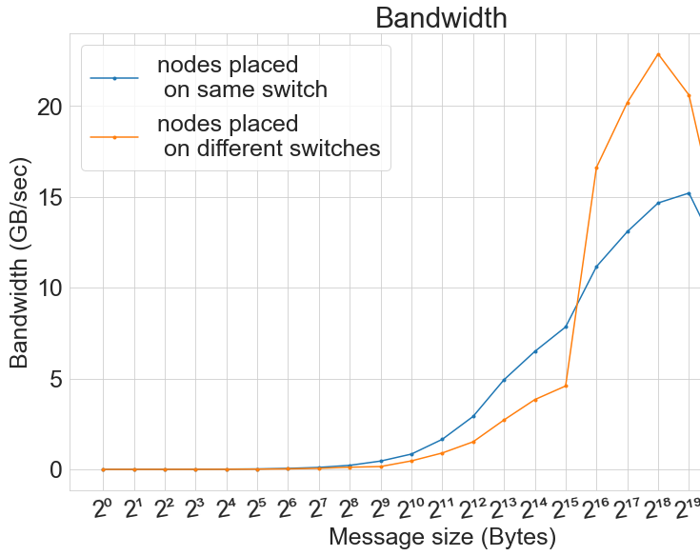
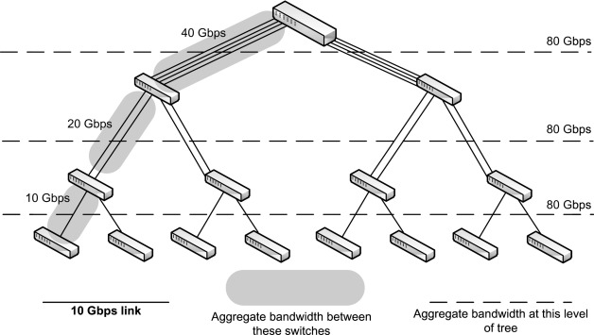
Bandwidth (PARAM Sanganak)
Fat-tree topology (also used in PARAM)
[www.sciencedirect.com]
All node-pairs communicate. Similar performance in case of latency-bound region; worse performance due to congestion in case of same switch case when the data size is large (note the cross-over point after 2^15 bytes)
Image Credit: S. Aggarwal

Slide 14

Effect of Network Topology
0
1
Switch
The topology on the left may incur slightly higher congestion for the given communication pattern. Reason: 0 -> 2 communication path overlaps partially with 1 -> 3 communication path in the mesh. In case of the right side topology, the switch has multiple ports to which each compute node is connected, and the communication paths may not necessarily overlap over a particular link (like in the case of a mesh).
0
1
2
3
3
2
Communication pattern: 0 -> 2, 1 -> 3 (N bytes)
Latency: L, Link bandwidth: b bytes/sec
Communication time comparison (ideal): ?

Slide 15

Effect of Node Allocation
Source: A Pal et al.
Assume that 4 ranks are placed on the 4 different enclosures (switches). 0 on 19, 1 and 2 on 21, and 3 on 22. If the communication pattern is all-to-all, what optimization can you think of, considering the above process placement and job allocation.
https://www.hpc.iitk.ac.in

Slide 16
Communicator
Object containing a group of processes
Representative of communication domain
Predefined:
  MPI_COMM_WORLD
Memory proportional to #processes in the group
Several communication contexts may co-exist within a single communicator
Notes:
MPI_COMM_SELF
Grouping logically related processes into communicators substantially reduces number of calling arguments
Distinct communicators in the same process have distinct contexts. A context is essentially a system-managed tag (or tags) needed to make a communicator safe for point-to-point and MPI-defined collective communication. Safety means that collective and point-to-point communication within one communicator do not interfere, and that communication over distinct communicators don’t interfere. (mpi31-report.pdF)
Contains a mapping from MPI process ranks to processor ids

Slide 17
Process Group
Ordered set of processes
Ranks are contiguous
Base group – associated with MPI_COMM_WORLD
  MPI_Comm_group (MPI_Comm comm, MPI_Group *group)
MPI_Group object
  MPI_Group_rank, MPI_Group_size
Operations: Unions and intersections of groups

Slide 18
MPI_COMM_WORLD

Slide 19
Intra-Communicators
- Logical subset
- Different contexts
Intra-communicator
Intra-communicator
Notes:
Time to complete collective op increases with #processes
Yields much better scaling behavior

Slide 20
Intra-Communicators
Group 1
Group 2
Intra-communicator
Intra-communicator
Notes:
Time to complete collective op increases with #processes
Yields much better scaling behavior

Slide 21
Inter-Communicators
Inter-communicator
between two groups
Intra-communicator
Intra-communicator
Notes:
Time to complete collective op increases with #processes
Yields much better scaling behavior

Slide 22
MPI_COMM_SPLIT
MPI_Comm_split (
MPI_Comm oldcomm, int color, int key,
MPI_Comm *newcomm
)
Collective call
Logically divides based on color
  Processes of same color form a group
Rank assignment based on key
Output: newcomm
Notes:
An MPI process may supply the color value MPI_UNDEFINED, in which case newcomm returns MPI_COMM_NULL (pg 371)

Slide 23
Logical Subsets
13
0 → 0
2 → 1
4 → 2
…
2
5
16
10
14
1
17
6
11
8
9
0
3
19
15
1 → 0
3 → 1
5 → 2
…
7
12
4
18
How do you assign one color to odd processes and another color to even processes ?
color = rank % 2

Slide 24
MPI_Comm_split Example Code
Output
for P=8
int newrank, newsize, color = myrank%2;
MPI_Comm newcomm;
MPI_Comm_split (MPI_COMM_WORLD, color, myrank, &newcomm);
MPI_Comm_rank (newcomm, &newrank);
MPI_Comm_size (newcomm, &newsize);
printf ("%d: %d of %d\n", myrank, newrank, newsize);
MPI_Comm_free (&newcomm);
0:
1:
2:
3:
4:
5:
6:
7:
0 of 4
0 of 4
1 of 4
1 of 4
2 of 4
2 of 4
3 of 4
3 of 4

Slide 25
MPI_Group
MPI_Group_incl (
MPI_Group g_group,
int N,
const int ranks[],
MPI_Group *new_group);
MPI_Comm_create_group (
MPI_Comm comm,
MPI_Group new_group,
int tag,
MPI_Comm *new_comm);
2
5
1
6
0
8
3
7
9
4
MPI_Group_incl
0
2
4
6
8
MPI_Group_excl
1
3
5
7
9
Notes:
MPI_COMM_CREATE_GROUP is similar to MPI_COMM_CREATE; however, MPI_COMM_CREATE must be called by all MPI processes in the group of comm, whereas MPI_COMM_CREATE_GROUP must be called by all MPI processes in group, which is a subgroup of the group of comm.

Slide 26
MPI_Group Example Code
int ranks[] = {0,2,4,6,8};
// Construct a group containing even ranks in g_group
MPI_Group new_group;
MPI_Group_incl (g_group, N, ranks, &new_group);
// Create a new communicator based on the group
MPI_Comm new_comm;
MPI_Comm_create_group (MPI_COMM_WORLD, new_group, tag, &new_comm);

Slide 27

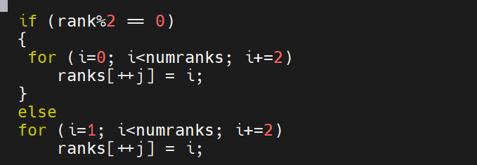
Code (group.c)

Slide 28
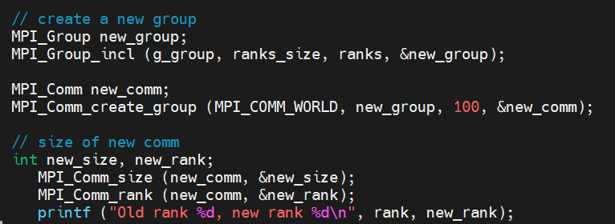
MPI_Group_incl code (group.c)

Slide 29
Homework
Q: Group every third process (2, 5, …) and create a sub-communicator using
  MPI_Comm_split
  MPI_Group_incl + MPI_Comm_create_group
// get number of processes
// get my rank
// get the world group
// create new group ranks array
// create a new group and communicator
// get size of new comm and new rank

Slide 30
Usage of Sub-communicators
Producer/client processes
Consumer/server processes

Slide 31
Producer-Consumer Example
Simulation
Analysis/visualization
Many-to-one
Many-to-one
Many-to-one
Many-to-one

Slide 32
Producer-Consumer Example

