Slide 1
Sub-communicators and Collectives
Lecture 12
February 17, 2025

Slide 2
Intra-Communicators
- Logical subset
- Different contexts
Intra-communicator
Intra-communicator
Notes:
Time to complete collective op increases with #processes
Yields much better scaling behavior

Slide 3
MPI_COMM_SPLIT – Recap
MPI_Comm_split (
MPI_Comm oldcomm, int color, int key,
MPI_Comm *newcomm
)
Collective call
Logically divides based on color
  Processes of same color form a group
Rank assignment based on key
Output: newcomm
Notes:
An MPI process may supply the color value MPI_UNDEFINED, in which case newcomm returns MPI_COMM_NULL (pg 371)

Slide 4
MPI_GROUP – Recap
MPI_Group_incl (
MPI_Group g_group,
int N,
const int ranks[],
MPI_Group *new_group);
MPI_Comm_create_group (
MPI_Comm comm,
MPI_Group new_group,
int tag,
MPI_Comm *new_comm);
2
5
1
6
0
8
3
7
9
4
MPI_Group_incl
0
2
4
6
8
MPI_Group_excl
1
3
5
7
9
Notes:
MPI_COMM_CREATE_GROUP is similar to MPI_COMM_CREATE; however, MPI_COMM_CREATE must be called by all MPI processes in the group of comm, whereas MPI_COMM_CREATE_GROUP must be called by all MPI processes in group, which is a subgroup of the group of comm.

Slide 5
Usage of Sub-communicators
Producer/client processes
Consumer/server processes

Slide 6
Producer-Consumer Example
Simulation
Analysis/visualization
Many-to-one
Many-to-one
Many-to-one
Many-to-one

Slide 7
Producer-Consumer Example
An example configuration: 28 simulation processes and 4 analysis processes.

Slide 8
Process Mapping – Recap
0
1
2
3
4
5
6
7
2 X 4 virtual topology
Physical topology
An user may place any rank on any node.

Slide 9
Process Placement
0
1
Many-to-one
Many-to-one
Many-to-one
Many-to-one
3
2
- How would the communicators be formed?
- What would be the rank placements?
8-core 4-node mini-cluster

Slide 10
Mapping File
0
1
Many-to-one
Many-to-one
Many-to-one
Many-to-one
Node0:7
Node1:7
Node2:7
Node3:7
Node0
Node1
Node2
Node3
An example is shown on the right, ranks 0 – 27 are simulation ranks, 28 – 32 are analysis ranks. One may place ranks 0 – 6 on node 0, ranks 7 – 13 on node 1, ranks 14 – 20 on node 2, ranks 21 – 27 on node 3 using the process mapping file (mapfile) shown on the left. Ranks 28 – 31 are placed on all 4 nodes. The sub-communicators are required to be created accordingly.
3
2
8-core 4-node mini-cluster

Slide 11
P2P and Collective

Slide 12
Collective Communication
Must be called by all processes that are part of the communicator
Types
Synchronization (MPI_Barrier)
Global communication (MPI_Bcast, MPI_Gather, …)
Global reduction (MPI_Reduce, ..)

Slide 13
Barrier
MPI_Barrier (comm)
Every rank needs to call this function (for true synchronization)
Caller returns only after all processes have entered the call
printf (“Before barrier”);
MPI_Barrier (MPI_COMM_WORLD);
printf (“After barrier”);

Slide 14
Barrier
n=4
if (myrank != 0)
MPI_Barrier (MPI_COMM_WORLD);
printf(“%d\n”, rank);

Slide 15
Gather
DATA
Gathers values from all processes to a root process
int MPI_Gather (sendbuf, sendcount, sendtype, recvbuf, recvcount, recvtype, root, comm)
Arguments recv* not relevant on non-root processes
recvcount → size of any (single) receive
Distinct values (may be same) received from non-root processes at the root process
Example: Reading multiple files (1 file per process)
Q: Equivalent point-to-point communications for the same?
MPI_Recv at root
MPI_Send at non-root
A0
A1
A2
PROCESSES
A0 | A1 | A2
A1
A2
Notes:
Thus, general datatypes are allowed and must match between sending and receiving processes as specified in Chapter 5. (pg 228)

Slide 16
Broadcast
X
X
X
X
X
X
X
X
X
Root process sends message to all processes
int MPI_Bcast (buffer, count, datatype, root, comm)
“count” is the number of elements in “buffer” – must match
  “message sizes do not match across processes in the collective routine: Received 400 but expected 4000”
“buffer” is input at root, output at non-root
Any process can be a root process but has to be the same process when MPI_Bcast is called
Notes:
All MPI routines (except MPI_Wtime and MPI_Wtick) return an error value; C routines as the value of the function and Fortran routines in the last argument

Slide 17
Broadcast
X
X
X
X
X
X
X
X
X
Q1: Point-to-point communication for the same?

Slide 18
Broadcast – Naïve Algorithm
Root process sends to every other process
Cons
Root is a bottleneck
Poor scalability
Idling processes
Communication links are under-utilized
0
7
6
5
4
3
2
1

Slide 19
MPI_Bcast Example
// … initialization tasks
int color=irand();
if (myrank != 3) MPI_Bcast (&color, 1, MPI_INT, 0, MPI_COMM_WORLD);
printf (“%d: %d\n”, myrank, color);
Output for n=4?
May succeed but not safe

Slide 20
Homework
Write a program to split the total #processes (P) into G groups {G₀, G₁, …}, and the rank (P/G-1) of each group should broadcast its global rank and the global rank of the local rank 0 (as a pair of integers) of the group to all its group members. Assume G is divisible by P.

Slide 21
Scatter
DATA
A0
A1
A2
Scatters values to all processes from a root process
int MPI_Scatter (sendbuf, sendcount, sendtype, recvbuf, recvcount, recvtype, root, comm)
Arguments send* irrelevant in non-root processes
sendcount – Number of elements sent to each process
Output parameter – recvbuf
PROCESSES
A0 | A1 | A2
0
1
2

Slide 22
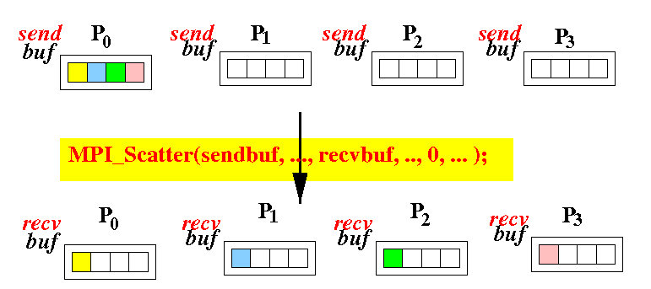
MPI_Scatter Illustration
Credit: Shun Yan Cheung

Slide 23
Bcast and Scatter Example
Q: Process 0 has read a file. The file size may vary across runs. Process 0 has to scatter the file content to all processes. How do we achieve this?
Buffer size of “buffer” array is not known apriori at non-root processes, how should root scatter the buffer?

Slide 24
Reduce
MPI_Reduce (inbuf, outbuf, count, datatype, op, root, comm)
Combines element in inbuf of each process
Combined value in outbuf of root
op: MIN, MAX, SUM, PROD, …
Example:
MPI_Reduce (…, 1, MPI_INT, MPI_MAX, …) Output: 21
MPI_Reduce (…, 1, MPI_INT, MPI_MIN, …) Output: 1
21
5
1
8
3
2
13
Notes:
The routine is called by all group members using the same arguments for count, datatype, op, root and comm. Thus, all processes provide input buffers of the same length, with elements of the same type as the output buffer at the root. Each process can provide one element, or a sequence of elements, in which case the combine operation is executed element-wise on each entry of the sequence.

Slide 25
Reduce
MPI_Reduce (inbuf, outbuf, count, datatype, op, root, comm)
21
5
1
8
3
2
13
1
15
4
81
30
22
33
MPI_Reduce (…, 2, MPI_INT, MPI_MAX, …)
MPI_Reduce (…, 2, MPI_INT, MPI_SUM, …)
Notes:
Inbuf address of send buffer
Outbuf address of receive buffer

Slide 26
Data Input Example – File read by 0
0 | 1 | 2 | 3 | 4 | 5 | 6 | 7
8 | 9 | 10 | 11 | 12 | 13 | 14 | 15
16 | 17 | 18 | 19 | 20 | 21 | 22 | 23
24 | 25 | 26 | 27 | 28 | 29 | 30 | 31
If (rank == 0)
read data
// bcast count per process
// scatter (use the above count)
int MPI_Scatter (sendbuf, sendcount, sendtype, recvbuf, recvcount, recvtype, root, comm)
4 x 8 2D virtual process topology

Slide 27
Parallel Sum
Core
Process
Memory
Alternately:
Process 0 can scatter the required part of the array
for i = 0 to N/P
sum += a[i] * a[i]
for i = N/P to 2N/P
sum += a[i] * a[i]
for i = 2N/P to 3N/P
sum += a[i] * a[i]
for i = 3N/P to N
sum += a[i] * a[i]
Rank = 0 Rank = 1 Rank = 2 Rank = 3

Slide 28
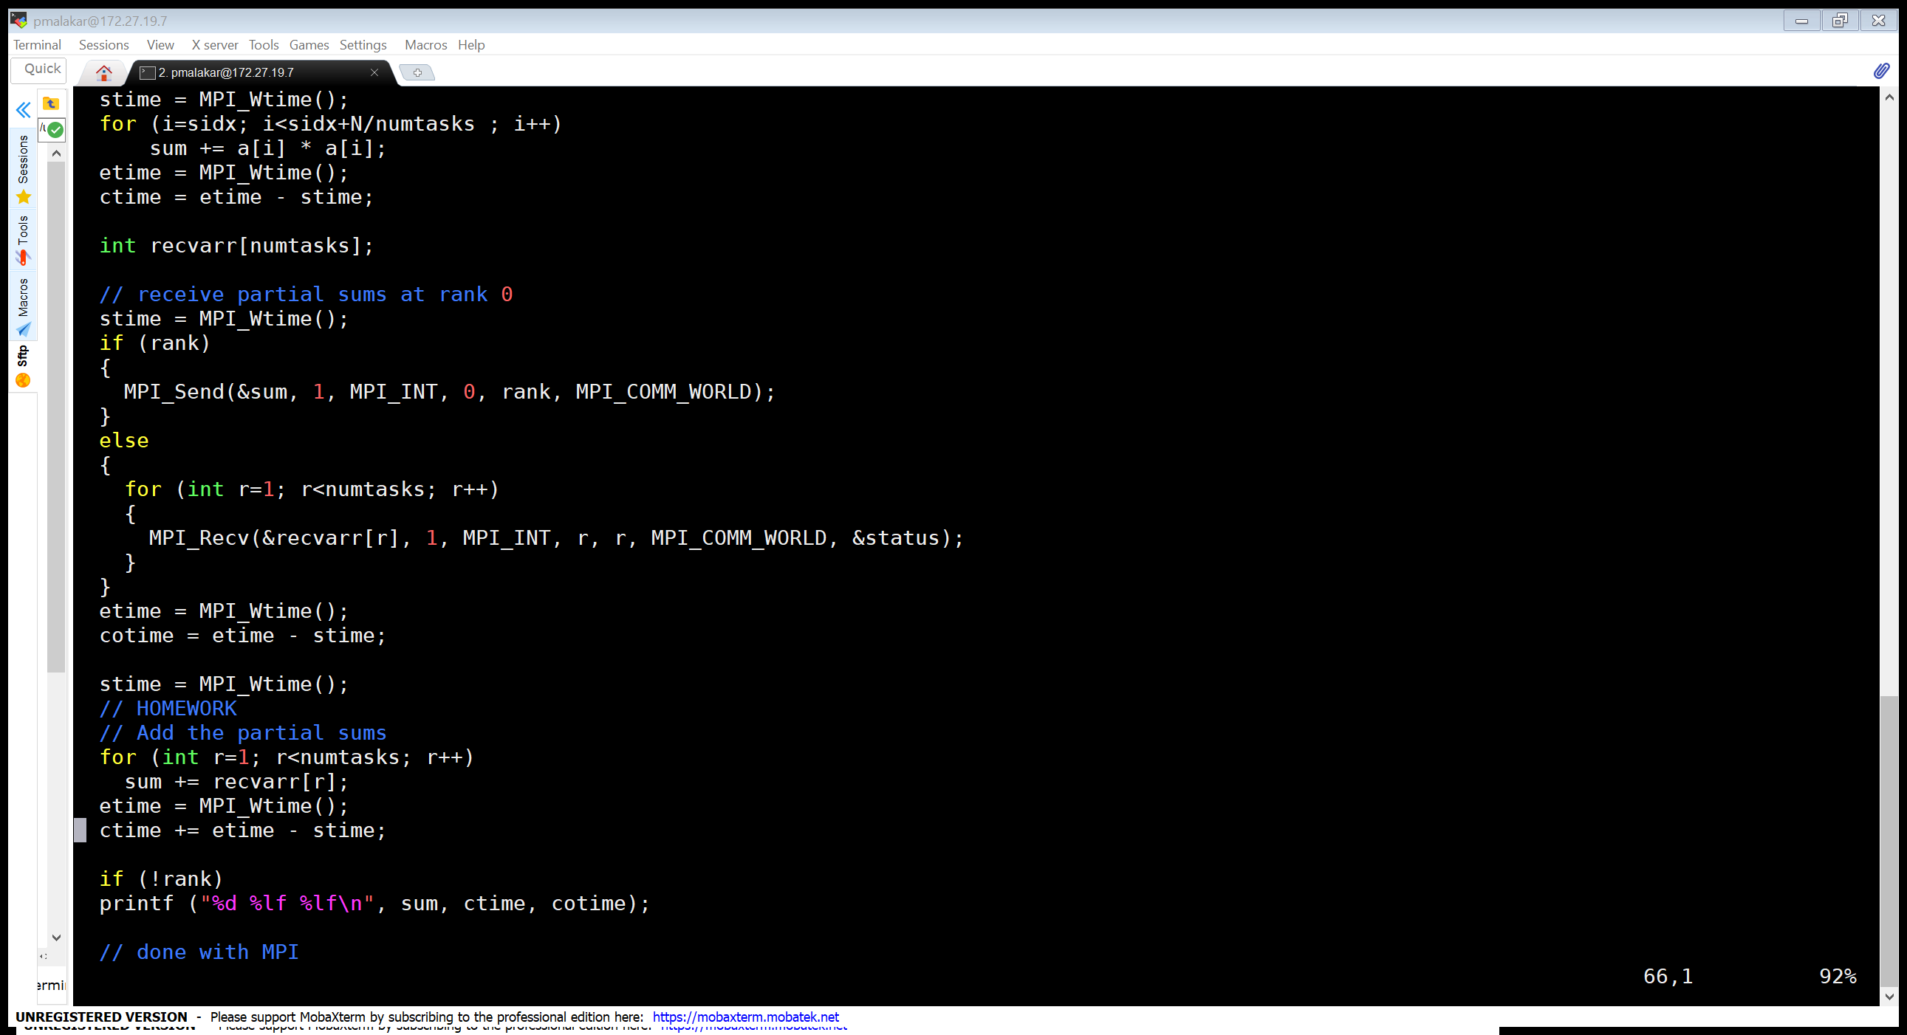
Using Send/Recv

Slide 29
Parallel Sum
// local computation at every process
for i = N/P * rank ; i < N/P * (rank+1) ; i++
localsum += a[i] * a[i]
// collect localsum, add up at one of the ranks
MPI_Reduce (&localsum, … , MPI_SUM, …)

Slide 30
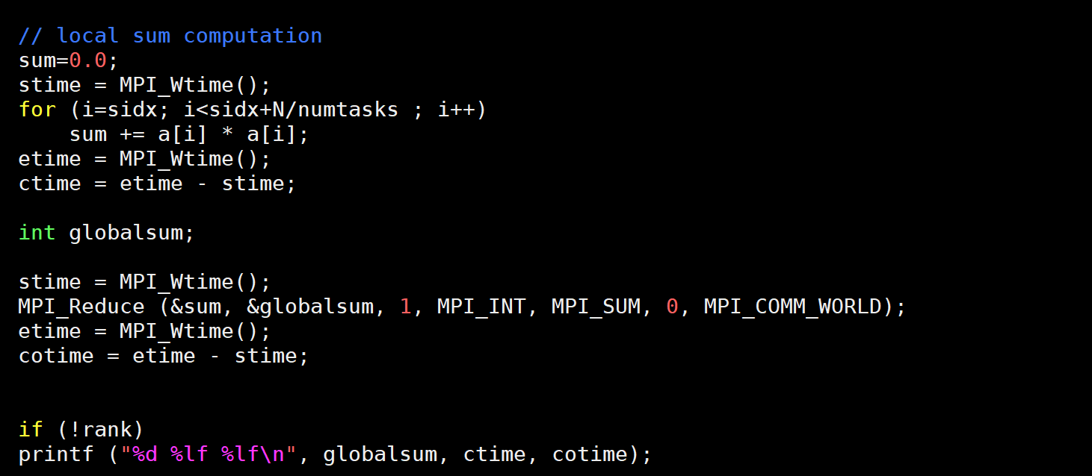
Using Reduce

Slide 31
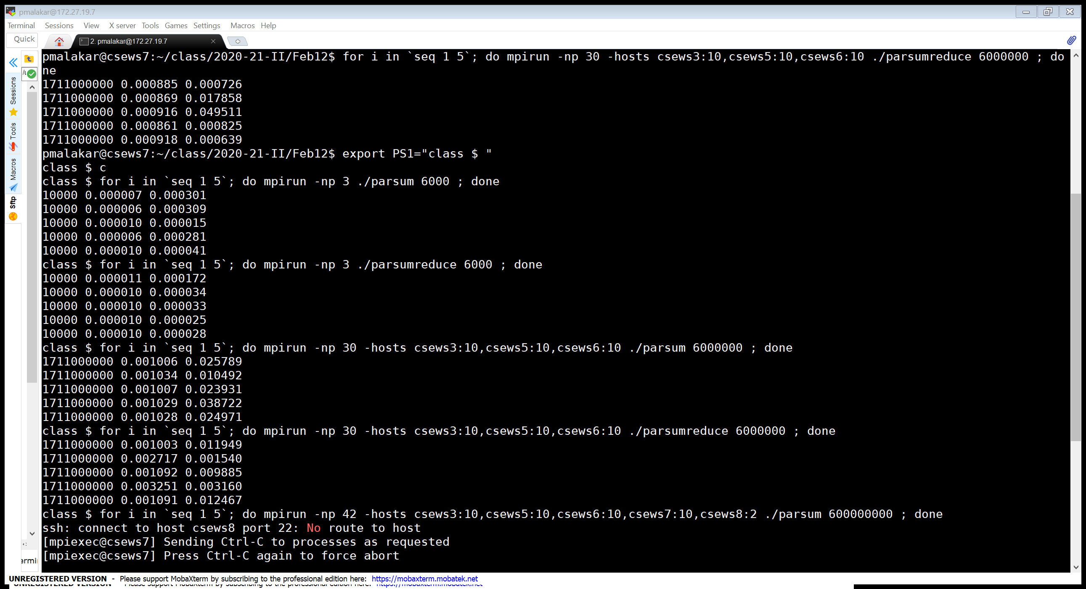
Timing

Slide 32
Timing
Lower
An efficient algorithm has been implemented for MPI_Reduce, which is better than naïve many-to-one followed by summation.

Slide 33
Allgather
DATA
A0
A1
A2
All processes gather values from all processes
int MPI_Allgather (sendbuf, sendcount, sendtype, recvbuf, recvcount, recvtype, comm)
No root process
PROCESSES
recvbuf = (int *) malloc (size*100*sizeof(int));
MPI_Allgather (sendbuf, 100, MPI_INT, recvbuf, 100, MPI_INT, comm);
A0 | A1 | A2
A0 | A1 | A2
A0 | A1 | A2

Slide 34
Allreduce
MPI_Allreduce (inbuf, outbuf, count, datatype, op, comm)
op: MIN, MAX, SUM, PROD, …
Combines element in inbuf of each process
Combined value in outbuf of each process
Equivalent collective?
MPI_Reduce followed by MPI_Bcast
Notes:
MPI_IN_PLACE

Slide 35
Alltoall
DATA
A0 | A1 | A2
B0 | B1 | B2
C0 | C1 | C2
Send data from all processes to all processes
int MPI_Alltoall (sendbuf, sendcount, sendtype, recvbuf, recvcount, recvtype, comm)
Output parameter – recvbuf
sendcount/recvcount – sent/received from each process
Equivalent collective?
PROCESSES
A0 | B0 | C0
A1 | B1 | C1
A2 | B2 | C2

Slide 36
Homework
Broadcast N doubles from rank 0 to all ranks. You can run on any number of processes. N = 10^3, 10^4, 10^5, 10^6, 10^7. Study the scalability.
Let total number of processses be P. Compare performance of MPI_Gather with P2P and MPI_Scatter with P2P on 2, 4, 8 processes.
Notes:
Let total number of processes be P. Compare performance of MPI_Scatter with P2P on 1, 2, 4, 8 nodes (with ppn=4).

Slide 37
Broadcast – Optimized?
Write the P2P code
0
1
2
3
4
5
6
7
0
1
2
3
4
2
1
2
3
3
#Steps for p (=2^{d}) processes?
  log p
Communication time for n bytes
  T(p) = log p * (L + n/B)
6
5
3
3
7
Binomial Tree

