Slide 1
Decomposition
Lecture 13
February 19, 2025

Slide 2
Blocking Collectives
MPI_Barrier
MPI_Bcast
MPI_Gather
MPI_Scatter
MPI_Reduce
MPI_Allgather
MPI_Allreduce
MPI_Alltoall

Slide 3
Recap
0
1
2
3
MPI_Bcast (root=0)
MPI_Bcast (root=0)
Time
MPI_Bcast (root=0)
MPI_Bcast (root=0)

Slide 4
Broadcast – Naïve Algorithm
Root process sends to every other process
0
7
6
5
4
3
2
1
#Steps for p (=2^{d}) processes?
  p-1
Communication time for n bytes
  T(p) = (p - 1) * (L + n/B)
  T(p²) = (p² - 1) * (L + n/B)

Slide 5
Communication Cost Model
Message transfer time is modeled as L+n/B, where L is the latency (or startup time) per message, and 1/B is the transfer time per byte, and n the message size in bytes
Optimization of Collective Communication Operations in MPICH
Rajeev Thakur, Rolf Rabenseifner, William Gropp
IJHPCA 2005
Notes:
All processes can send and receive one message at the same time

Slide 6
Broadcast – Binomial Algorithm
Write the P2P code
0
1
2
3
4
5
6
7
0
1
2
3
4
2
1
2
3
3
#Steps for p (=2^{d}) processes?
  log p
Communication time for n bytes
  T(p) = log p * (L + n/B)
  T(p²) = 2 log p * (L + n/B)
6
5
3
3
7
Binomial Tree

Slide 7
Broadcast
0
Q: Name one interconnect that may most likely exhibit minimum link contention for binomial tree broadcast algorithm?
Hypercube
1
2
3
4
2
1
2
3
3
6
5
3
3
7

Slide 8
Reduce
MPI_Reduce (inbuf, outbuf, count, datatype, op, root, comm)
Combines element in inbuf of each process
Combined value in outbuf of root
op: MIN, MAX, SUM, PROD, …
Note: The operation is done element-wise as shown in the below example
0
1
2
0
1
2
3
4
5
6
2
1
2
3
2
5
2
0
1
1
0
1
1
0
2
1
2
3
4
5
6
MAX at root

Slide 9
Reduce Algorithm
Recursive doubling
0
1
2
3
7
3
9
15
12
4
10
1
11
14
10
1
7
0
9
5
MPI_SUM
19
7
19
16
18
14
19
6
0
2
37
21
38
22
0
0
0
2
1
3
2
1
  Time: log p (L + n*(1/B) + n*c)
  L = latency, B = bandwidth
  c = compute cost per byte
  Used for short messages
2
1
4
2
1
1
2
1
1
3
6
5
3
1
p = 4
7
p = 8
Notes:
It is assumed further that all processes can send and receive one message at the same time with this cost model.

Slide 10
1D Domain Decomposition
N grid points
P processes
N/P points per process
Grid point
P1
P2
P3
P4
#Communications?
2
1D Process Decomposition
1D domain
N/P
#Computations?
Nearest neighbor communications
2 sends()
2 recvs()
Communication to computation ratio=2P/N
Reference: CSA Chapter 3

Slide 11
1D Domain Decomposition
N grid points
P processes
N/P points per process
Grid point
#Communications?
2√N (assuming square grid)
#Computations?
N/P (assuming square grid)
Communication to computation ratio=
2P/√N
2D domain (√N X √N)

Slide 12
2D Domain decomposition
Grid point
N grid points (√N x √N grid)
P processes (√P x √P grid)
N/P points per process
+ Several parallel communications
+ Lower communication volume/process

Slide 13
2D Domain decomposition
Grid point
2 Sends()
2 Recvs()
#Communications?
2√N/√P (assuming square grid)
#Computations?
N/P (assuming square grid)
Communication to computation ratio=
2√P/√N
Reference: CSA Chapter 3

Slide 14
Stencils
Five-point stencil
Notes:
Five-point stencil: Each grid point new value is the average of itself and its four neighbors’

Slide 15
2D Domain Decomposition
Grid point
4 Sends()
4 Recvs()
N grid points (√N x √N grid)
P processes (√P x √P grid)
N/P points per process
#Communications?
4√N/√P (assuming square grid)
#Computations?
N/P (assuming square grid)
Communication to computation ratio=
4√P/√N

Slide 16
Send / Recv
0
1
2
3
MPI_Send
4
5
6
7
MPI_Recv
0
1
2
3
4
5
6
7
Notes:
outbuf, int outcount, MPI_Datatype datatype, MPI_Comm comm)

Slide 17
Send / Recv
0
1
2
3
4
5
6
7
MPI_Pack (buf)
MPI_Send (buf)
MPI_Recv (buf)
MPI_Unpack (buf)
0
1
2
3
4
5
6
7
Notes:
outbuf, int outcount, MPI_Datatype datatype, MPI_Comm comm)

Slide 18
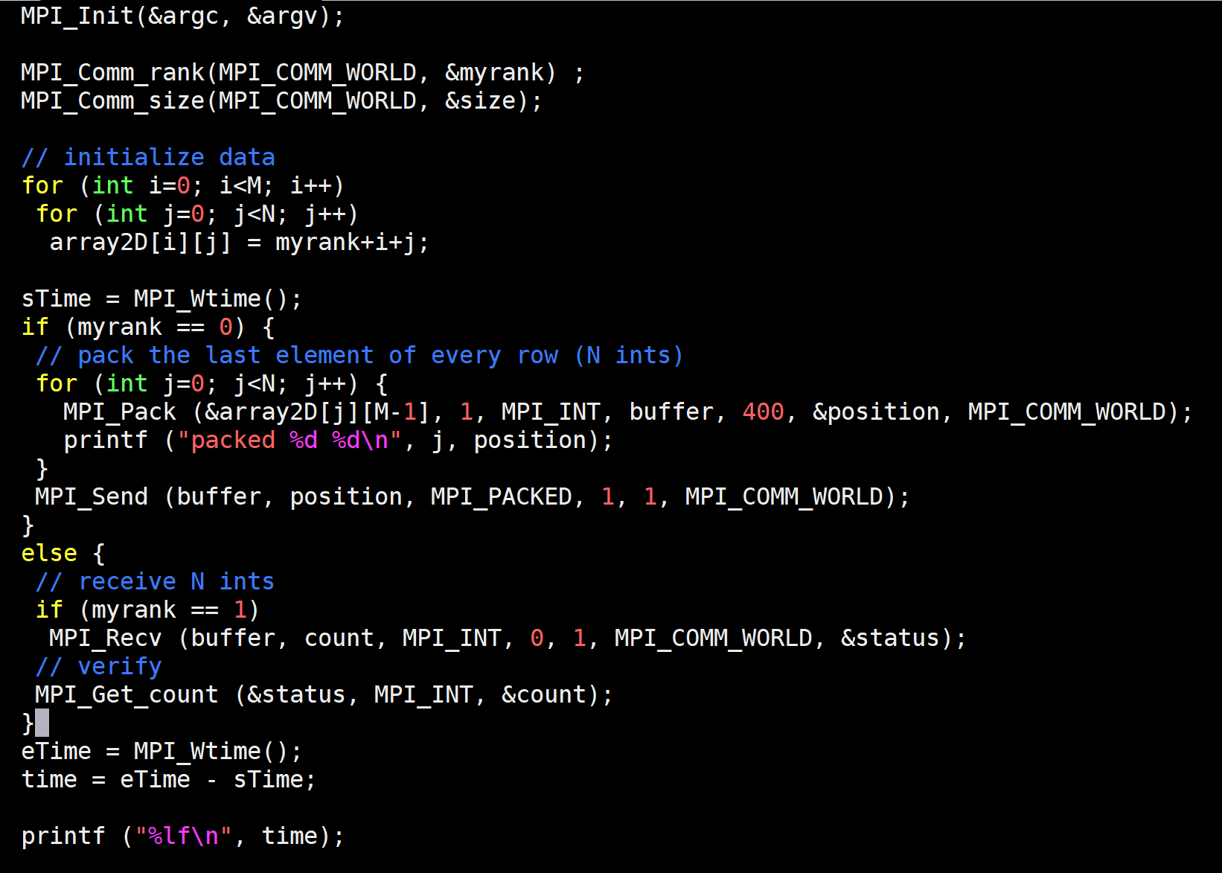
MPI_Pack
int MPI_Pack (const void *inbuf, int incount, MPI_Datatype datatype, void *outbuf, int outsize, int *position, MPI_Comm comm)
Notes:
int MPI_Pack(const void *inbuf, int incount, MPI_Datatype datatype, void *outbuf, int outsize, int *position, MPI_Comm comm)
The input value of position is the first location in the output buffer to be used for packing. position is incremented by the size of the packed message, and the output value of position is the first location in the output buffer following the locations occupied by the packed message.
int MPI_Unpack(const void *inbuf, int insize, int *position, void *outbuf, int outcount, MPI_Datatype datatype, MPI_Comm comm)

Slide 19
Virtual Topology
0 | 1 | 2 | 3 | 4 | 5 | 6 | 7
8 | 9 | 10 | 11 | 12 | 13 | 14 | 15
16 | 17 | 18 | 19 | 20 | 21 | 22 | 23
24 | 25 | 26 | 27 | 28 | 29 | 30 | 31
0 | 4 | 8 | 12 | 16 | 20 | 24 | 28
1 | 5 | 9 | 13 | 17 | 21 | 25 | 29
2 | 6 | 10 | 14 | 18 | 22 | 26 | 30
3 | 7 | 11 | 15 | 19 | 23 | 27 | 31
XY decomposition (2D)
YX decomposition (2D)
4 x 8 2D virtual process topology

Slide 20
Sub-communicator Example
0 | 1 | 2 | 3 | 4 | 5 | 6 | 7
8 | 9 | 10 | 11 | 12 | 13 | 14 | 15
16 | 17 | 18 | 19 | 20 | 21 | 22 | 23
24 | 25 | 26 | 27 | 28 | 29 | 30 | 31
Question:
Write the code to split row-wise
Input: 2D topology (rows, cols)
4 x 8 2D virtual process topology

Slide 21
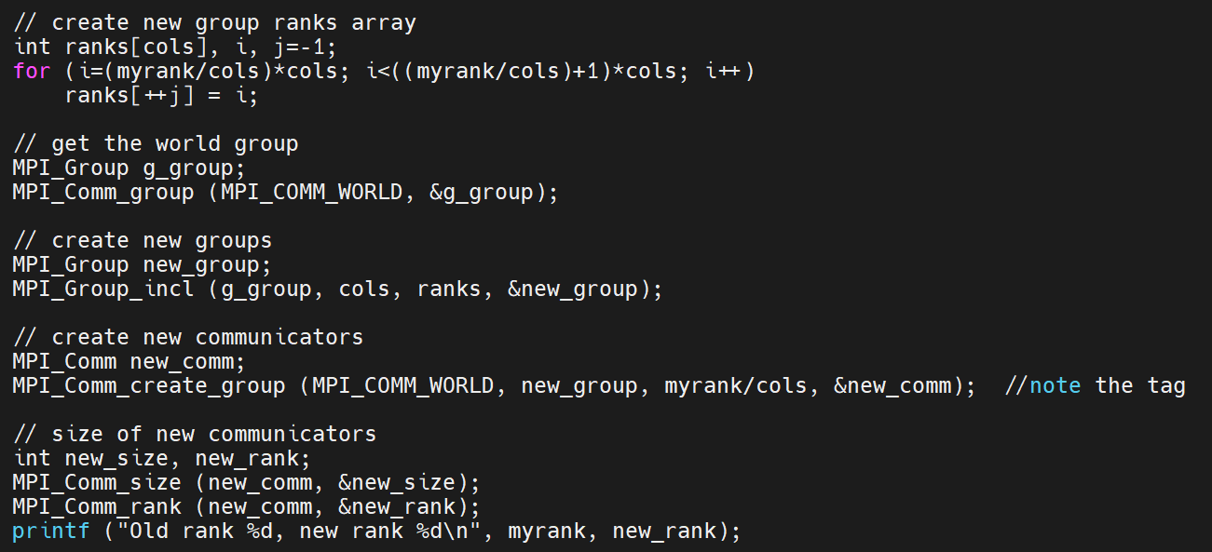

Slide 22
Sub-communicator Example
0 | 1 | 2 | 3 | 4 | 5 | 6 | 7
8 | 9 | 10 | 11 | 12 | 13 | 14 | 15
16 | 17 | 18 | 19 | 20 | 21 | 22 | 23
24 | 25 | 26 | 27 | 28 | 29 | 30 | 31
Question: Split column-wise
Input: 2D topology (rows, cols)
4 x 8 2D virtual process topology

Slide 23
Sub-communicator Example
0 | 1 | 2 | 3 | 4 | 5 | 6 | 7
8 | 9 | 10 | 11 | 12 | 13 | 14 | 15
16 | 17 | 18 | 19 | 20 | 21 | 22 | 23
24 | 25 | 26 | 27 | 28 | 29 | 30 | 31
Question: Every process computes local array statistics (sum/average).
Select 1 process per row to write row-wise cumulative statistics to a file.
Input: 2D topology (rows, cols)
4 x 8 2D virtual process topology

Slide 24
Example – Gather at 0
int MPI_Gather (sendbuf, sendcount, sendtype, recvbuf, recvcount, recvtype, root, comm)
Input: rows, cols
MPI_Comm_split (…, color=myrank%cols, …)
or
MPI_Comm_split (…, color=myrank/cols, …)
//newrank | newsize | newcomm
MPI_Gather (…., 0, … newcomm)
Next? (depends on comm_split)
MPI_Group_incl (…)
MPI_Comm_create_group
(comm, group, tag, collcomm)
column-wise sub-comms
0 | 1 | 2 | 3 | 4 | 5 | 6 | 7
8 | 9 | 10 | 11 | 12 | 13 | 14 | 15
16 | 17 | 18 | 19 | 20 | 21 | 22 | 23
24 | 25 | 26 | 27 | 28 | 29 | 30 | 31
row-wise sub-comms
Notes:
MPI_COMM_CREATE_GROUP is similar to MPI_COMM_CREATE; however, MPI_COMM_CREATE must be called by all processes in the group of comm, whereas MPI_COMM_CREATE_GROUP must be called by all processes in group, which is a subgroup of the group of comm.
The tag argument does not conflict with tags used in point-to-point communication and is not permitted to be a wildcard. If multiple threads at a given process perform concurrent MPI_COMM_CREATE_GROUP operations, the user must distinguish these operations by providing different tag or comm arguments.

Slide 25
Quiz 2 syllabus is till the previous slide.
Date and Venue will be notified via email by next week.

