Slide 1
Collectives Algorithms
Lecture 14
March 3, 2025

Slide 2
Blocking Collectives
MPI_Barrier
MPI_Bcast
MPI_Gather
MPI_Scatter
MPI_Reduce
MPI_Allgather
MPI_Alltoall
MPI_Allreduce

Slide 3
Communication Cost Model
Message transfer time is modeled as L+n/B, where L is the latency (or startup time) per message, and 1/B is the transfer time per byte, and n the message size in bytes
Optimization of Collective Communication Operations in MPICH
Rajeev Thakur, Rolf Rabenseifner, William Gropp
IJHPCA 2005
Optimization of Collective Reduction Operations
Rolf Rabenseifner
ICCS 2004
Notes:
All processes can send and receive one message at the same time

Slide 4
Scatter – Recursive Halving
0
1
2
3
4
5
6
7
Vector halving
Distance halving
Every step the message size halves: n/2, n/2², …, n/2^{(log p)}
Time for scatter of n bytes from root
  log p * L + (p-1)*(n/p)*(1/B)

Slide 5
Allgather
– Ring Algorithm
0
1
2
3
Every process sends to and receives from everyone else
Assume p processes and total n bytes
Every process sends and receives n/p bytes
Time
  (p – 1) * (L + n/p*(1/B))
How can we improve?
1
4
10
1
7
3
9
15
n/p
n/p
n/p
n/p
1
4
9
15
1
4
10
1
10
1
7
3
7
3
9
15

Slide 6
Allgather – Recursive Doubling
0
1
2
3
1
4
10
1
7
3
9
15
Every process sends and receives (2^{k-1})* n/p bytes at k^{th} step
Time
  (log p) * L + (p-1)*n/p*(1/B)
1
4
10
1
1
4
10
1
7
3
9
15
7
3
9
15
1
4
10
1
7
3
9
15
1
4
10
1
7
3
9
15
1
4
10
1
7
3
9
15
1
4
10
1
7
3
9
15

Slide 7
MPI_Allgather in MPICH
MPIR_CVAR_ALLGATHER_SHORT_MSG_SIZE=81920
MPIR_CVAR_ALLGATHER_LONG_MSG_SIZE=524288
  Bruck algorithm
  short messages (< 80 KB) and non-power-of-two numbers of processes
Recursive doubling
  (log p) * L + (p-1)*n/p*(1/B)
  power-of-two numbers of processes and short or medium-sized messages (< 512 KB)
Ring algorithm
  (p-1) * L + (p-1)*n/p*(1/B)
  long messages and any number of processes
  medium-sized messages and non-power-of-two numbers of processes
Notes:
In practice, we find that the Bruck algorithm is best for short messages and non-power-of-two numbers of processes; recursive doubling is best for power-of-two numbers of processes and short or medium-sized messages; and the ring algorithm is best for long messages and any number of processes and also for medium-sized messages and non-power-of-two numbers of processes.

Slide 8
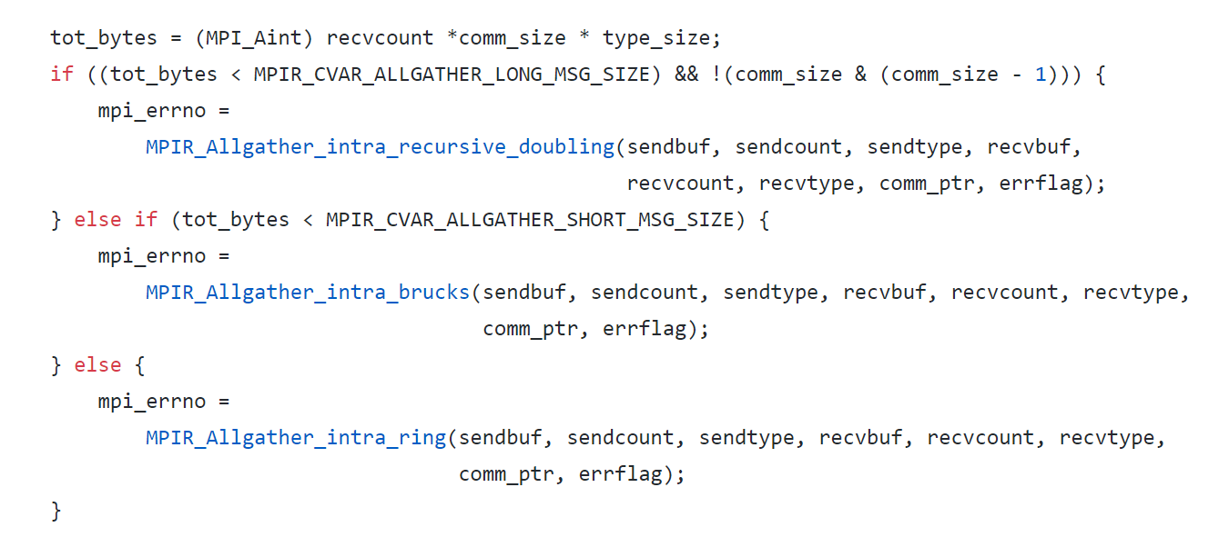
allgather.c

Slide 9
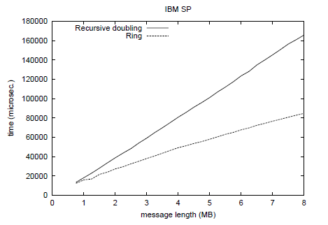
Performance Comparison on 64 nodes
  (log p) * L + (p-1)*n/p*(1/B)
  (p-1) * L + (p-1)*n/p*(1/B)
Why does ring perform better?
Notes:
64 nodes

Slide 10
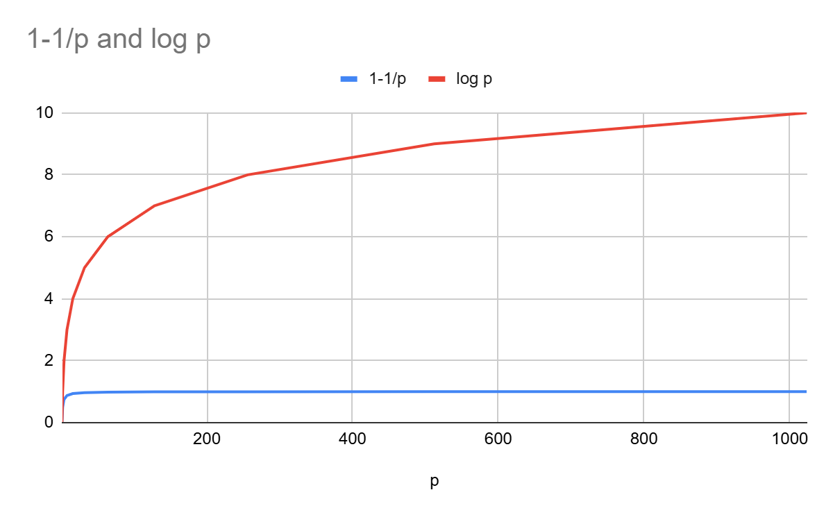
(p-1/p) vs. log p
p | 1-1/p | log p
1 | 0 | 0
2 | 0.5 | 1
4 | 0.75 | 2
8 | 0.875 | 3
16 | 0.9375 | 4
32 | 0.96875 | 5
64 | 0.984375 | 6
128 | 0.9921875 | 7
256 | 0.99609375 | 8
512 | 0.998046875 | 9
1024 | 0.9990234375 | 10

Slide 11
Broadcast – Binomial Tree (Recap)
0
1
2
3
4
5
6
7
0
1
2
3
4
2
1
2
3
3
6
5
3
#Steps for p (=2^{d}) processes?
  log p
Transfer time for n bytes
  T(p) = log p * (L + n/B)
3
7

Slide 12
Bcast – Van de Geijn et al.
Message is first scattered from the root
Scattered data is collected at all processes
MPI_Scatter
MPI_Allgather
0
1
2
3

Slide 13
Bcast – Time Analysis
Time for broadcasting n bytes from root (binomial tree)
  log p * (L + n/B)
Time for scatter of n bytes from root
  log p * L + (p-1)*(n/p)*(1/B)
Time for allgather (ring) of n/p bytes
  (p-1) * L + (p-1)*(n/p)*(1/B)
Time for allgather (recursive doubling) of n/p bytes
  (log p) * L + (p-1)*(n/p)*(1/B)
Time for broadcast of n bytes using scatter and allgather
  (log p + p-1) * L + 2((p-1)/p)*(n/B) OR
  (2 log p) * L + 2((p-1)/p)*(n/B)

Slide 14
Broadcast Algorithms in MPICH
Short messages
  < MPIR_CVAR_BCAST_SHORT_MSG_SIZE
  Binomial
Medium messages
  Scatter + Allgather (Recursive doubling)
Large messages
  > MPIR_CVAR_BCAST_LONG_MSG_SIZE
  Scatter + Allgather (Ring)

Slide 15
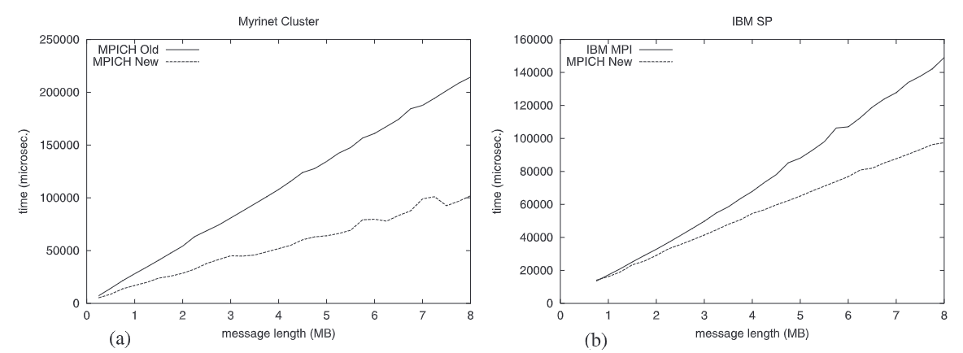
Old vs. New MPI_Bcast (64 nodes)
Van de Geijn
Van de Geijn
Notes:
check

Slide 16
Reduce Algorithm – Recursive doubling (Recap)
0
1
2
3
7
3
9
15
12
4
10
1
11
14
10
1
7
0
9
5
MPI_SUM
19
7
19
16
18
14
19
6
0
2
37
21
38
22
0
  Time: log p (L + n*(1/B) + n*c)
  L = latency, B = bandwidth
  c = compute cost per byte
  Used for short messages
0
2
1
2
1
1
3
Notes:
It is assumed further that all processes can send and receive one message at the same time with this cost model.

Slide 17
Reduce – Rabenseifner’s Algorithm
0
1
2
3
Recursive vector halving and distance doubling
7
3
9
15
12
4
10
1
11
14
10
1
7
0
9
5
19
7
19
16
18
14
19
6
37
38
21
22
Gather
37
21
38
22
  Time:
  log p * L + (p-1)/p*(n/B) + (p-1)/p*n*c (reduce-scatter) +
  log p * L + (p-1)/p*(n/B) (gather using binomial)
  n = data size L = latency
  p = #processes B = bandwidth
  c = compute cost per byte
Notes:
It is assumed further that all processes can send and receive one message at the same time with this cost model.

Slide 18
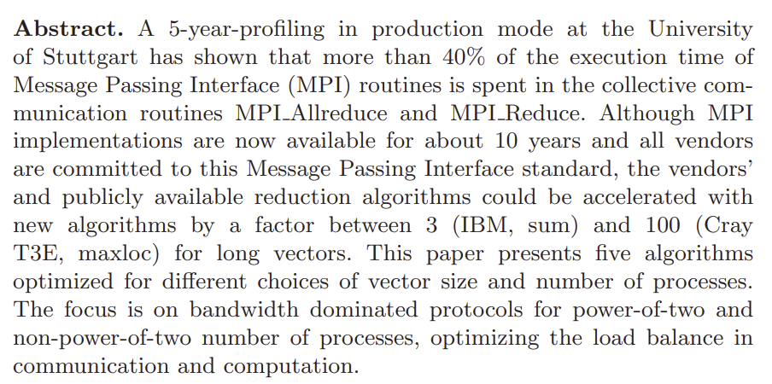
Reduce on 64 nodes

Slide 19
Allreduce – Rabenseifner’s Algorithm
0
1
2
3
Recursive vector halving and distance doubling
7
3
9
15
12
4
10
1
11
14
10
1
7
0
9
5
19
7
19
16
18
14
19
6
37
38
21
22
Allgather
37
21
38
22
37
21
38
22
37
21
38
22
37
21
38
22
  Time:
  log p * L + (p-1)/p*(n/B) + (p-1)/p*n*c (reduce-scatter) +
  log p * L + (p-1)/p*(n/B) (allgather using recursive vector doubling and distance halving)
  n = data size L = latency
  p = #processes B = bandwidth
  c = compute cost per byte
Notes:
It is assumed further that all processes can send and receive one message at the same time with this cost model.

Slide 20
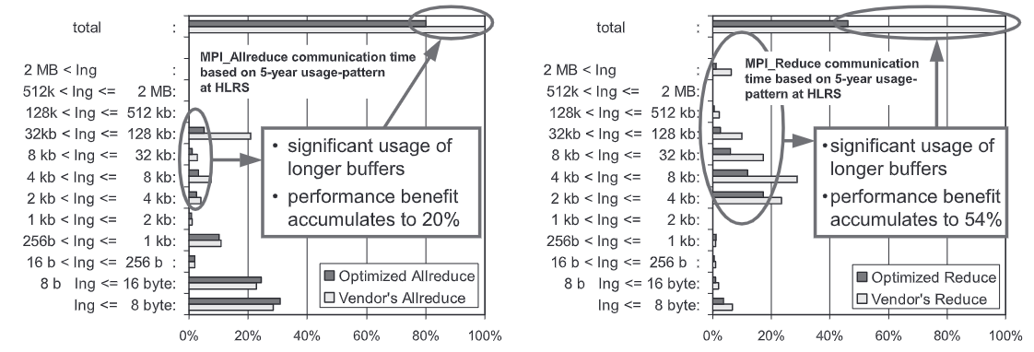
Benefit for Long Messages

Slide 21
Allreduce Algorithms – Summary
Short - Medium messages
Reduce (recursive doubling) followed by broadcast (binomial)
  [ log p (L + n*(1/B) + n*c) ] + [ log p (L + n*(1/B) ]
Long messages
Reduce-scatter followed by allgather (recursive doubling)
  2 * log p * L + 2(p-1)/p * (n/B) + (p-1)/p * n * c

