Slide 1
Derived Datatypes
Vector Variants
Lecture 15
March 17, 2025

Slide 2
Revision of Domain and Domain Decomposition

Slide 3
1D Domain
0
1
2
3
4
5
6
7
8
9
10
11
12
13
14
15
Grid point

Slide 4
1D Domain Decomposition of 1D Domain
P1
P2
P3
P4
P5
0
1
2
3
4
5
6
7
8
9
10
11
12
13
14
15

Slide 5
1D Domain decomposition of 2D Domain
P1
P2
P3
P4
Column-wise 1D decomposition
Possible formats to store data in memory of a process
Grid point
Data[12]
Row-major
Data[0] Data[1]
Data[2] Data[3]
Data[4] Data[5]
…
Data[10] Data[11]
Data[6][2]
Data[0][0] Data[0][1]
Data[1][0] Data[1][1]
Data[2][0] Data[2][1]
…
Data[5][0] Data[5][1]
8 X 6 2D Domain | 2 X 6 Sub-domain
(Sub-domain: part of the domain that is owned by a process)

Slide 6
Reading From/Writing To Persistent Storage
P1
P2
P3
P4
Grid point
File content: Entire domain in
row-major order (sequence of bytes)
Data[0] Data[1]
Data[2] Data[3]
Data[4] Data[5]
…
Data[10] Data[11]
Data[0] Data[1]
Data[2] Data[3]
Data[4] Data[5]
…
Data[10] Data[11]
Data[0] Data[1]
Data[2] Data[3]
Data[4] Data[5]
…
Data[10] Data[11]
Data[0] Data[1]
Data[2] Data[3]
Data[4] Data[5]
…
Data[10] Data[11]
6 rows, 8 columns (for this example)
8 X 6 2D Domain | 2 X 6 Sub-domain
(Sub-domain: part of the domain that is owned by a process)

Slide 7
1D Domain decomposition of 2D Domain
Row-wise 1D decomposition
Grid point
P1
Data[12] | Row-major (1D array)
Data[0] Data[1] Data[2] … Data[7]
Data[8] Data[9] Data[10] … Data[15]
P2
P3
8 X 6 2D Domain | 8 X 2 Sub-domain
(Sub-domain: part of the domain that is owned by a process)

Slide 8
Reading From/Writing To Persistent Storage
Row-wise 1D decomposition
Data distribution depends on decomposition strategy
Grid point
P1
File content: Entire domain in
row-major order (sequence of bytes)
P2
Data[0] Data[1] Data[2] Data[3] Data[4] Data[5] Data[6] Data[7]
Data[8] Data[9] Data[10] Data[11] Data[12] Data[13] Data[14] Data[15]
Data[0] Data[1] Data[2] Data[3] Data[4] Data[5] Data[6] Data[7]
Data[8] Data[9] Data[10] Data[11] Data[12] Data[13] Data[14] Data[15]
P3
Data[0] Data[1] Data[2] Data[3] Data[4] Data[5] Data[6] Data[7]
Data[8] Data[9] Data[10] Data[11] Data[12] Data[13] Data[14] Data[15]
2 rows, 8 columns per process (for this example)
8 X 6 2D Domain | 8 X 2 Sub-domain
(Sub-domain: part of the domain that is owned by a process)

Slide 9
2D Domain decomposition of 2D Domain
P1
P2
P3
P4
Grid point
XY process decomposition (default)
Possible formats to store data in memory of a process
P5
Data[4]
Row-major
Data[0] Data[1]
Data[2] Data[3]
Data[2][2]
Data[0][0] Data[0][1]
Data[1][0] Data[1][1]
P12
8 X 6 2D Domain
Note: Only some process IDs are shown to avoid clutter

Slide 10
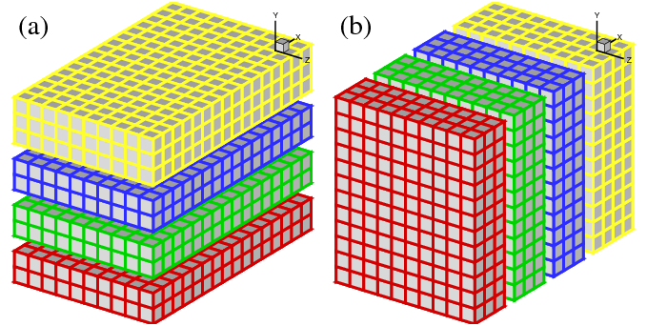
1D Domain Decomposition of 3D Domain
You can also decompose along the third dimension (not shown here)

Slide 11
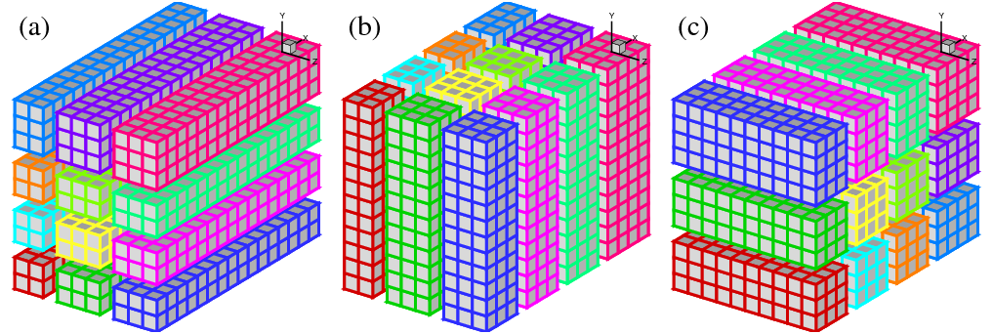
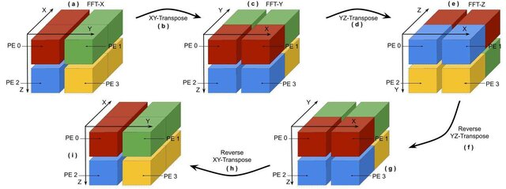
2D Domain Decomposition of 3D Domain
Figure source: hector.ac.uk

Slide 12
3D Domain Decomposition of 3D Domain
Input file description: Input file will contain the time series data (floats) of a 3D volume. The number of rows represent the total number of grid points in the 3D volume (nx * ny * nz). The 3D volume may not be a cube. The maximum total number of grid points = 1024^3, the maximum number of grid points in any dimension is 1024. The number of columns represent the number of time steps in the data (maximum = 1000). Data will be organized in XYZ dimension order in the input file. An example is provided next. Let nx = 2, ny = 3, nz = 2, and number of time steps = 2, then the values in the file will be in XYZ order: (0,0,0), (1,0,0), (0,1,0), (1,1,0), (0,2,0), (1,2,0), (0,0,1), (1,0,1), (0,1,1), (1,1,1), (0,2,1), (1,2,1).
Figure source: https://www.researchgate.net/

Slide 13
Halo Exchange
Sub-domain
0
1
2
3
4
5
6
7
Every simulation time step
  Computation
    Val_{t+1} = … (may need neighboring points)
  Communicate halo regions
8
9
10
11
12
13
14
15
Sub-domain
0
1
2
3
0
1
2
3
0
1
2
3
4
5
6
7
4
5
6
7
4
5
6
7
Multiple MPI_Sends
MPI_Pack + MPI_Send
MPI Derived datatype + MPI_Send
8
9
10
11
8
9
10
11
8
9
10
11
12
13
14
15
12
13
14
15
12
13
14
15
0
1
2
3
4
5
6
7
8
9
10
11
12
13
14
15

Slide 14
Send / Recv (Option 1)
0
1
2
3
4
5
6
7
MPI_Send
MPI_Recv
8
9
10
11
12
13
14
15
0
1
2
3
4
5
6
7
Notes:
outbuf, int outcount, MPI_Datatype datatype, MPI_Comm comm)

Slide 15
Pack/Unpack and Send / Recv (Option 2)
0
1
2
3
4
5
6
7
MPI_Pack (buf)
MPI_Send (buf)
MPI_Recv (buf)
MPI_Unpack (buf)
8
9
10
11
12
13
14
15
0
1
2
3
4
5
6
7
Notes:
outbuf, int outcount, MPI_Datatype datatype, MPI_Comm comm)

Slide 16
Derived Datatypes

Slide 17
MPI_Type_vector
count = #blocks
blocklength = #elements in each block
stride = #elements between start of each block
count = 3, blocklength = 1, stride = 4
count = 3, blocklength = 2, stride = 4
MPI_Type_vector (count, blocklength, stride, oldtype, newtype)
0
1
2
3
4
5
6
7
8
0
1
2
3
4
5
6
7
8
9

Slide 18
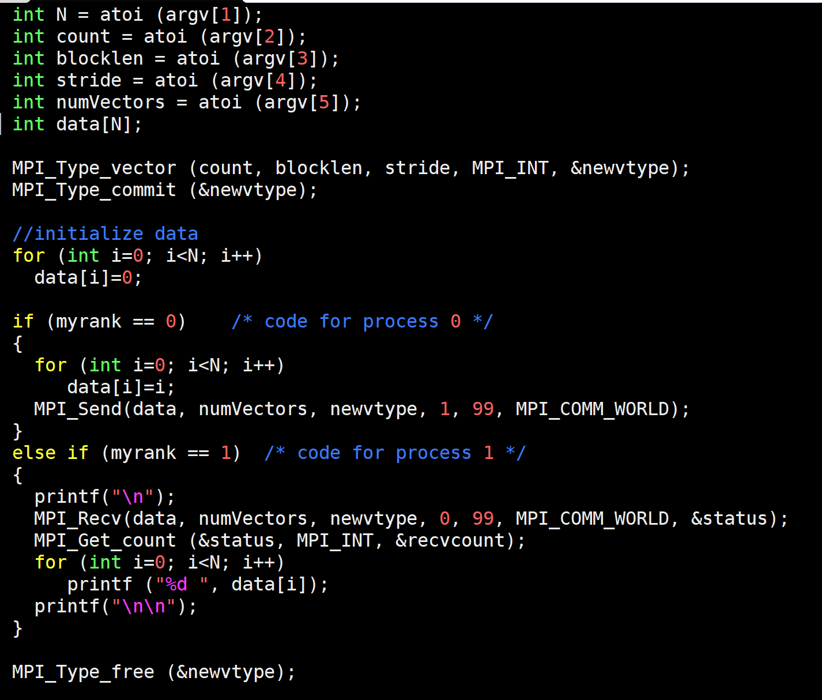
Code
vector.c
N = Size of array
mpirun -np 2 ./a.out 10 5 1 2 1
mpirun -np 2 ./a.out 20 5 1 2 2
0 2 0 4 0 6 0 8 0
0 2 0 4 0 6 0 8 9 0 11 0 13 0 15 0 17 0 0

Slide 19
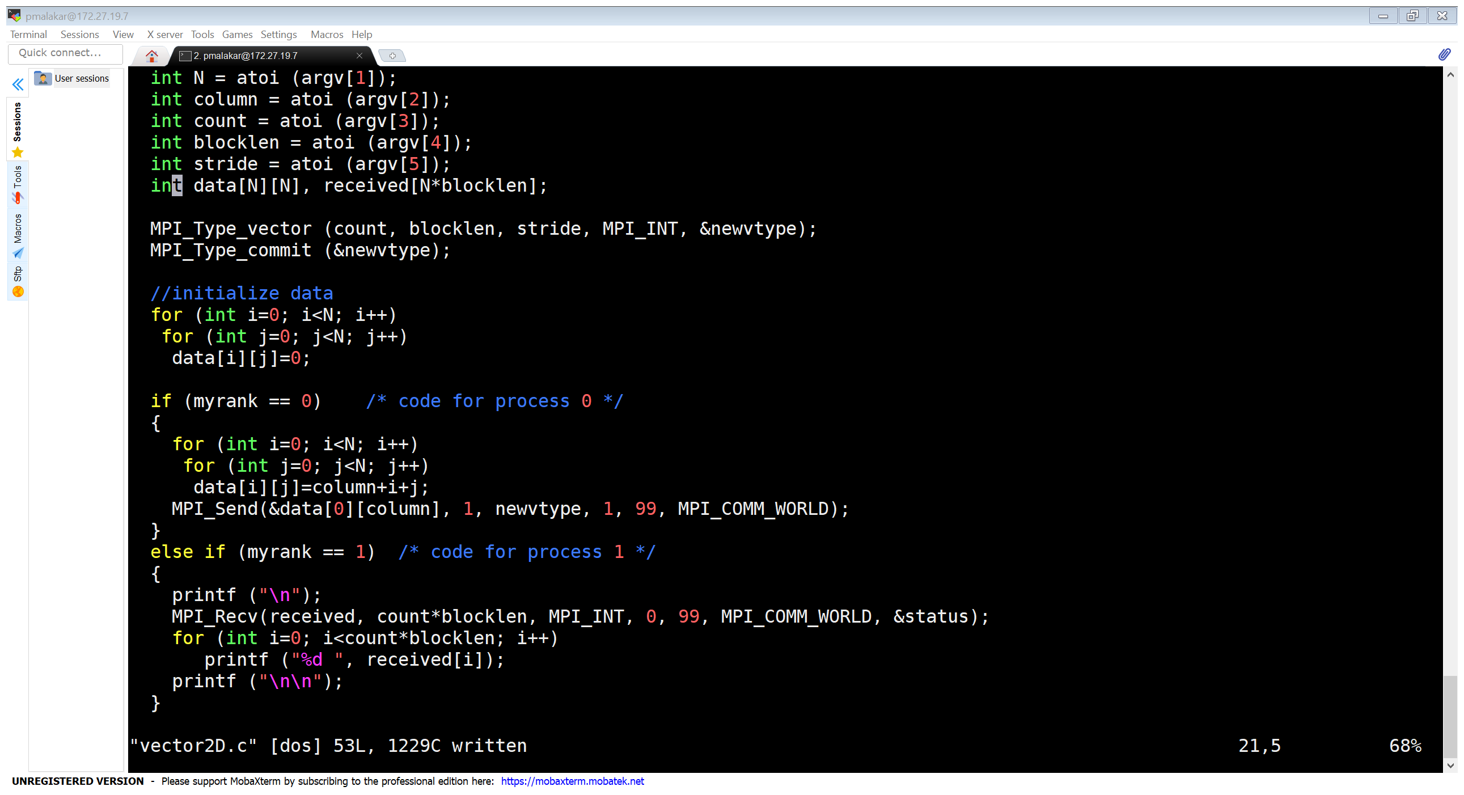
Code – Send Selected Columns
vector2D.c
0
1
2
3
4
5
6
7
8
9
10
11
12
13
14
15
?
?

Slide 20
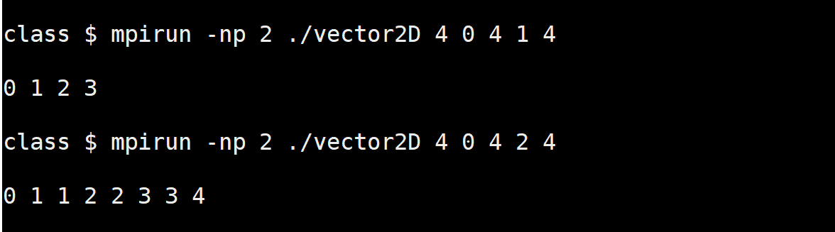
Examples
0
1
2
3
1
2
3
4
2
3
4
5
3
4
5
6
0
1
2
3
1
2
3
4
2
3
4
5
3
4
5
6
0
1
2
3
1
2
3
4
2
3
4
5
3
4
5
6

Slide 21
MPI_Type_indexed
count = #blocks
blocklengths = #elements in each block
displacements = displacement of start of each block
count = 3, blocklengths = 1,2,1 displacements = 0,4,8
count = 3, blocklengths = 2,4,1 displacements = 0,3,8
MPI_Type_indexed (count, blocklengths, displacements, oldtype, newtype)
0
1
2
3
4
5
6
7
8
0
1
2
3
4
5
6
7
8

Slide 22
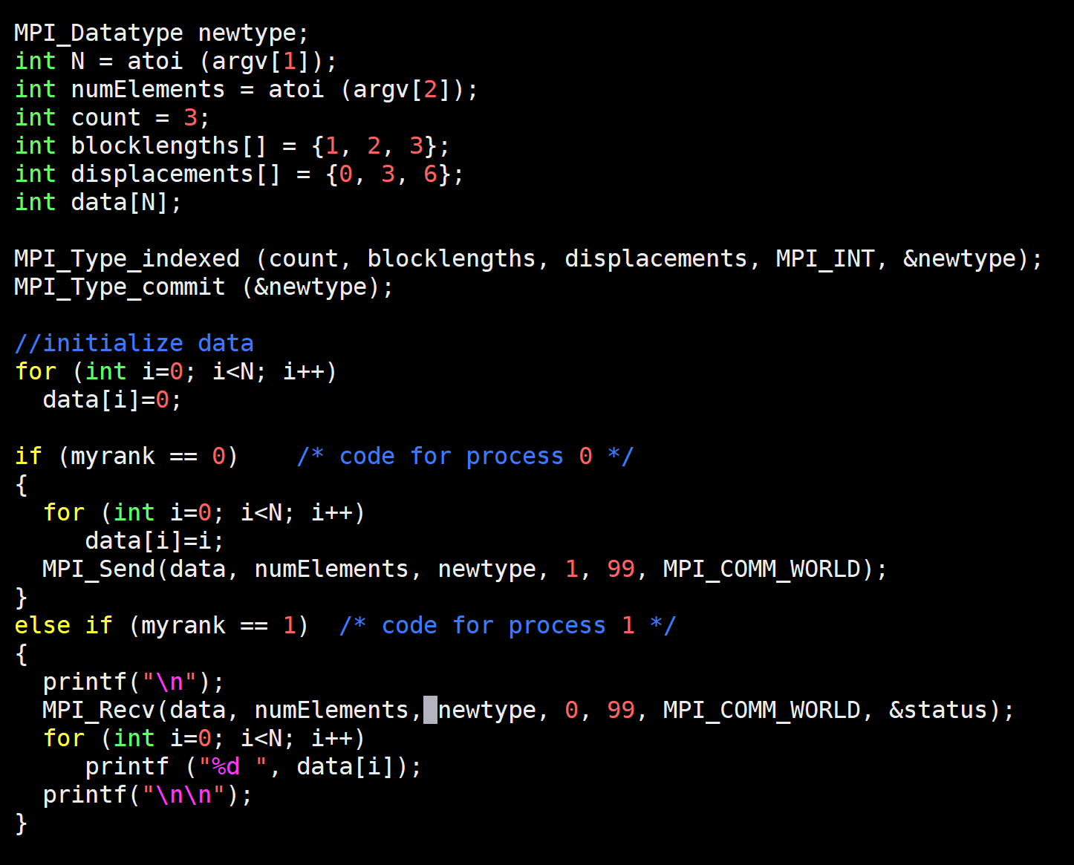
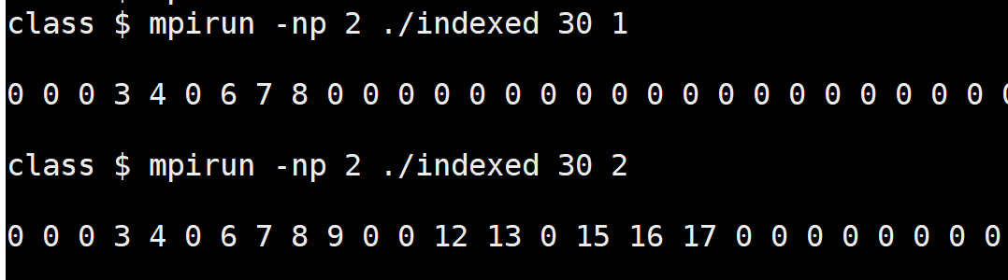
Code

Slide 23
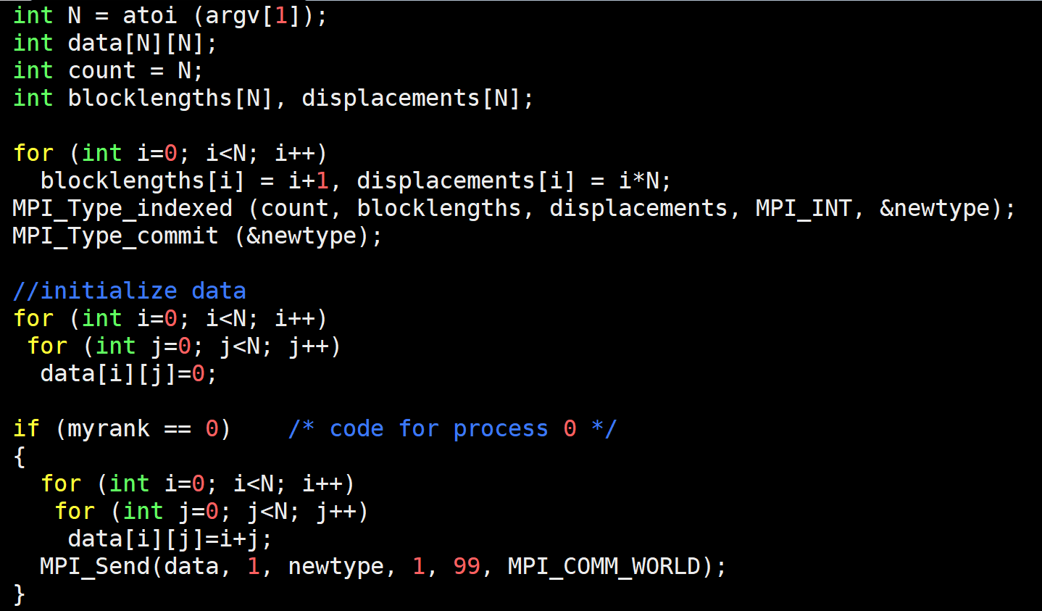
Lower Triangular Matrix
mpirun -np 2 ./indexed2D 4
0
1
2
3
1
2
3
4
2
3
4
5
3
4
5
6

Slide 24
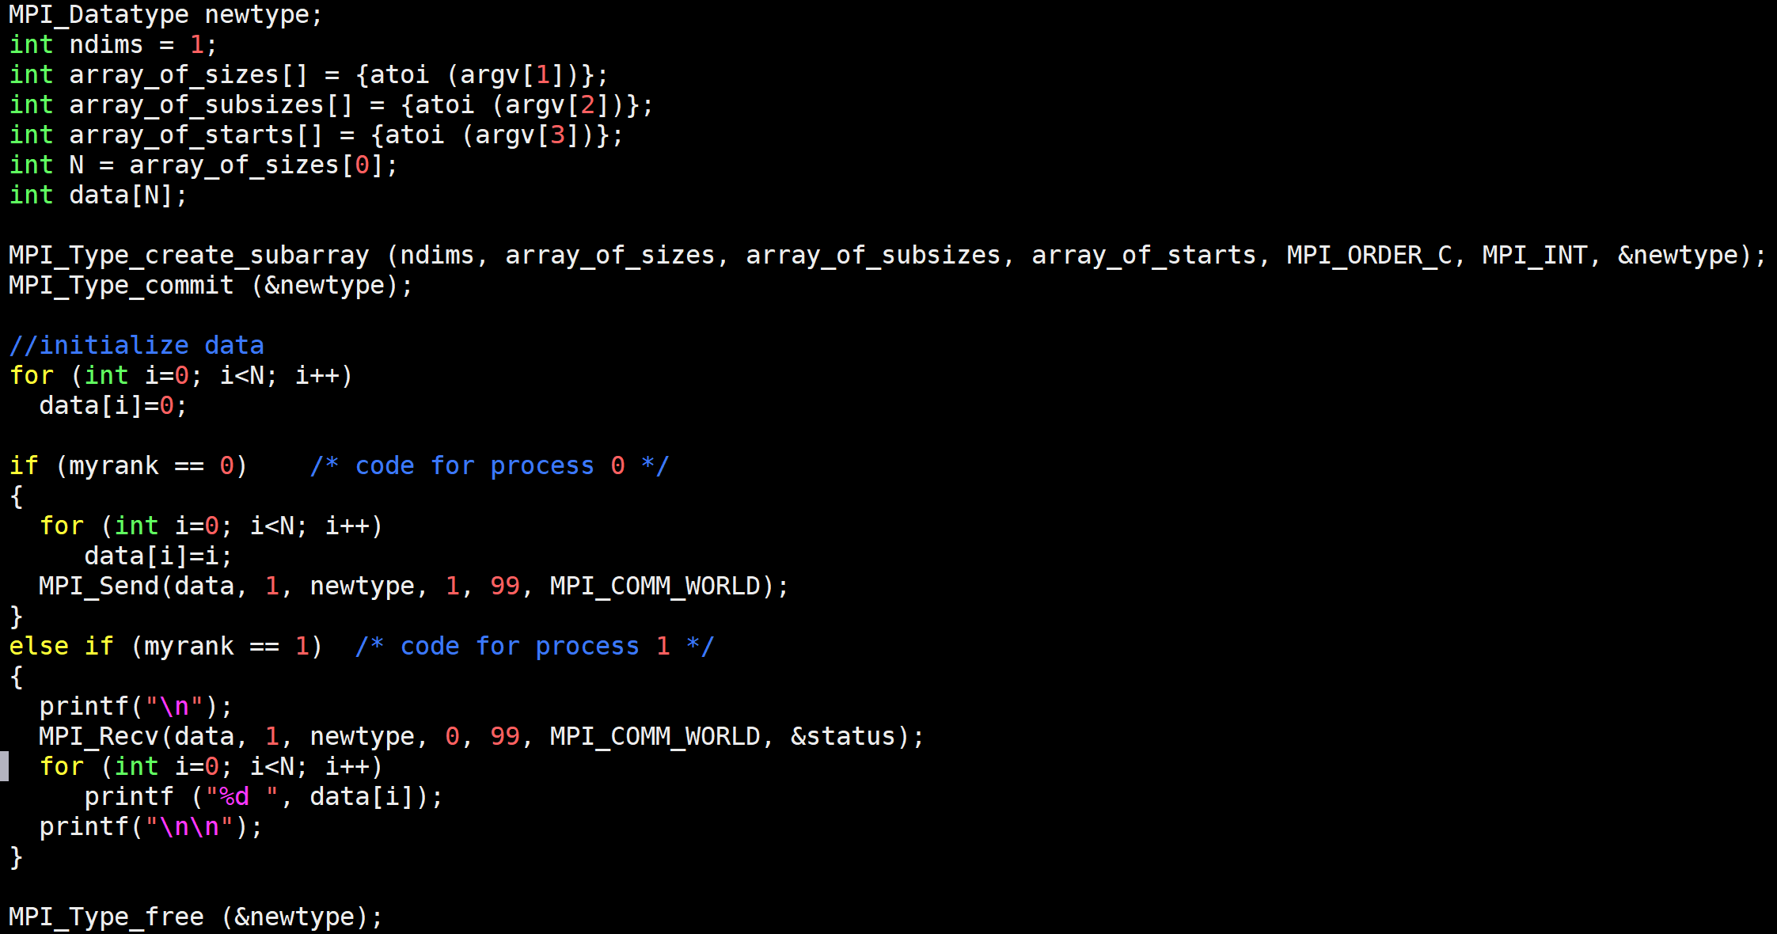
MPI_Type_create_subarray
0
1
2
3
4
5
6
7
8
0
1
2
3
1
2
3
4
2
3
4
5
3
4
5
6
Notes:
int MPI_Type_create_subarray(int ndims, const int array_of_sizes[], const int array_of_subsizes[], const int array_of_starts[], int order, MPI_Datatype oldtype, MPI_Datatype *newtype)

Slide 25
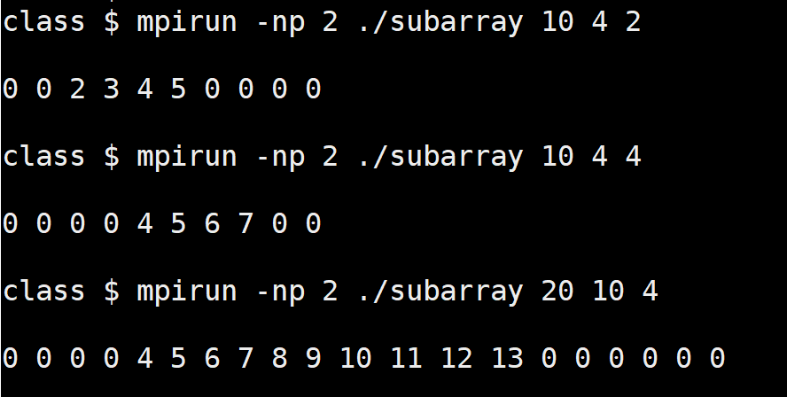
Example
0
1
2
3
4
5
6
7
8
9

Slide 26
Summary
MPI_Datatype newtype
MPI_Type_vector (count, blocklength, stride, oldtype, newtype)
MPI_Type_indexed (count, blocklengths, displacements, oldtype, newtype)
MPI_Type_create_subarray (ndims, array_of_sizes, array_of_subsizes, array_of_starts, order, oldtype, newtype)
MPI_Type_commit (newtype)
……
MPI_Type_free (newtype)

Slide 27
MPI Collectives Variants

Slide 28
Collectives – Variable Data
Communicate unequal amount of data to/from each process involved in the collective function call
2B
2B
2B
2B
3B
4B

Slide 29
Gather – Recap
DATA
Gathers values from all processes to a root process
int MPI_Gather (sendbuf, sendcount, sendtype, recvbuf, recvcount, recvtype, root, comm)
Arguments recv* not relevant on non-root processes
recvcount → size of any (single) receive
Distinct values (may be same) received from non-root processes at the root process
Example: Reading multiple files (1 file per process)
Q: Equivalent point-to-point communications for the same?
MPI_Recv at root
MPI_Send at non-root
A0
A1
A2
PROCESSES
A0 | A1 | A2
A1
A2
Notes:
Thus, general datatypes are allowed and must match between sending and receiving processes as specified in Chapter 5. (pg 228)

Slide 30
Gatherv
DATA
Root gathers different amounts of data from the other processes
int MPI_Gatherv (sendbuf, sendcount, sendtype, recvbuf, recvcounts, displs, recvtype, root, comm)
recvcounts – Number of elements to be received from each process
displs – Displacement at which to place received data
MPI_Recv (recvbuf+displs[i], recvcounts[i], recvtype, i, i, comm, &status) at root for i^{th} process
MPI_Send at non-root
2B
4B
4B
PROCESSES
2B | 4B | 4B

Slide 31
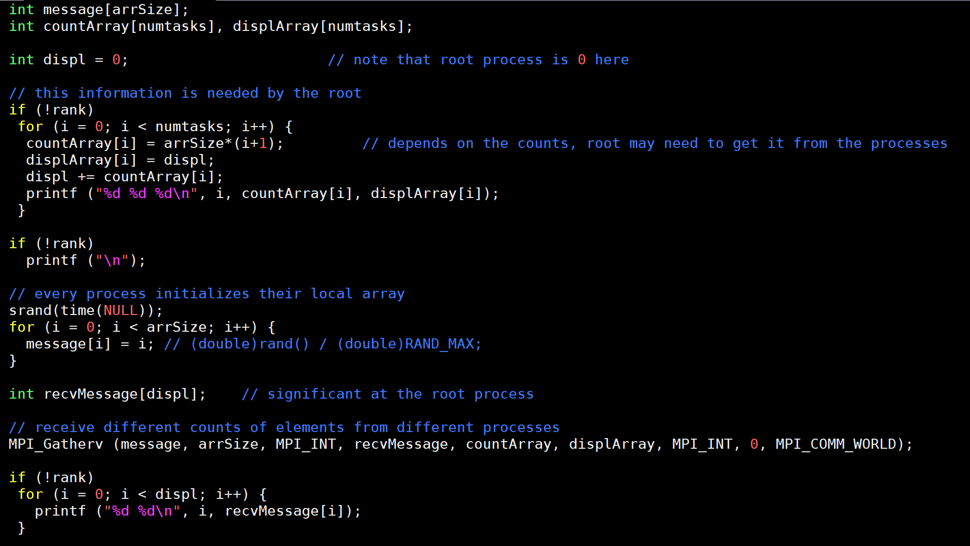
MPI_Gatherv Code

Slide 32
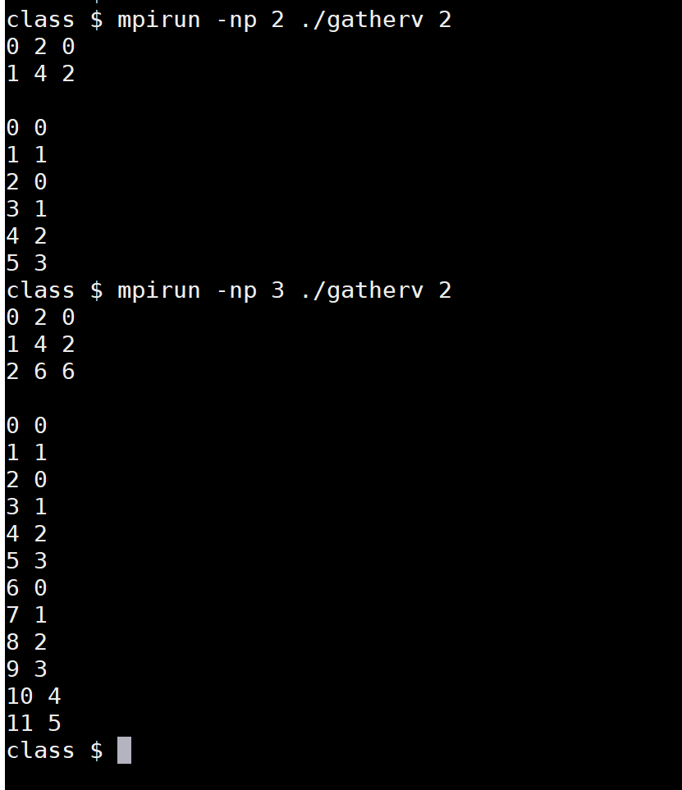
Demo

Slide 33
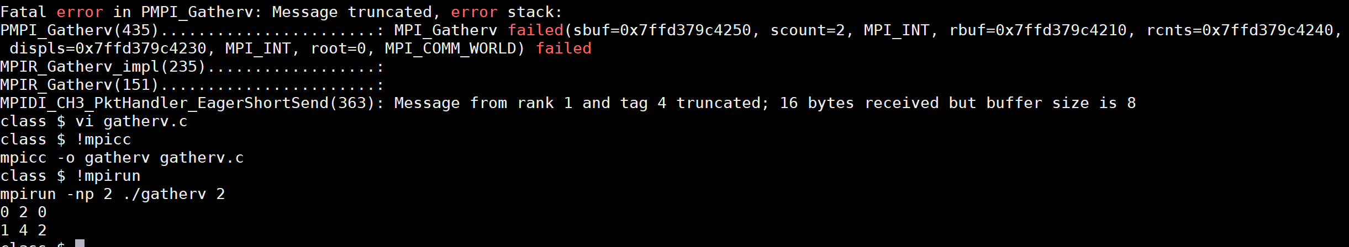
Bug

Slide 34
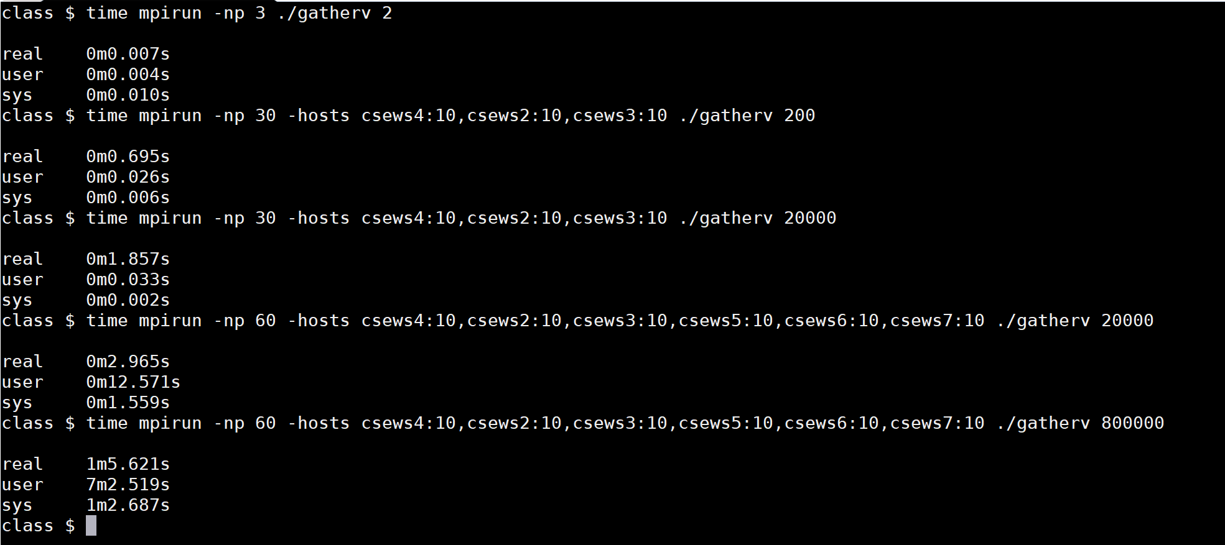
Example

Slide 35
MPI_Scatterv
DATA
Root scatters different amounts of data to the other processes
int MPI_Scatterv (const void *sendbuf, const int *sendcounts, const int *displs, MPI_Datatype sendtype, void *recvbuf, int recvcount, MPI_Datatype recvtype, int root, MPI_Comm comm)
sendcounts – Number of elements to be sent to each process
displs – Displacement (relative to sendbuf) at which the data to be sent resides
2B
4B
4B
PROCESSES
2B | 4B | 4B

Slide 36
Allgatherv
DATA
2B
4B
4B
All processes gather values of different lengths from all processes
int MPI_Allgatherv (sendbuf, sendcount, sendtype, recvbuf, recvcounts, displs, recvtype, comm)
recvcounts – Number of elements to be received from each process
displs – Displacement at which to place received data
PROCESSES
2B | 4B | 4B
2B | 4B | 4B
2B | 4B | 4B

Slide 37
Alltoallv
DATA
0 | 3B | 0
0 | 0 | 2B
4B | 0 | 0
Every process sends data of different lengths to other processes
int MPI_Alltoallv (sendbuf, sendcount, sdispls, sendtype, recvbuf, recvcount, rdispls, recvtype, comm)
Output parameter – recvbuf
It’s not necessary to receive some data from all processes, i.e. some entries of count and displs may be 0
PROCESSES
0 | 0 | 4B
3B | 0 | 0
0 | 2B | 0

