Slide 1
P2P Communication
Lecture 4
Jan 15, 2025

Slide 2
MPI Program Execution
Memory
Node/compute node/host/
system/machine
host1
host2
host3
host4
Intranode
Internode
mpiexec –n 8 –hosts host1,host2,host3,host4 ./exe

Slide 3
Execution on Beowulf/Unmanaged Cluster
How much load is there on each node?
host1
host2
host3
host4
Network and Load-Aware Resource Manager for MPI Programs
https://dl.acm.org/doi/10.1145/3409390.3409406

Slide 4
MPI Program Execution
hostfile
cn023
cn024
cn025
cn026
cn023
cn024
cn025
cn026
Memory
host1
host2
host3
host4
Intranode
Internode
mpiexec –n 8 –hosts host1,host2,host3,host4 ./exe

Slide 5
Homework
Analyze the communication endpoints for the optimized algorithm of parallel sum for round-robin and sequential placement of 8 and 16 processes.

Slide 6
Process Placement - Parallel Sum (Optimized)
host1
host2
host3
host4
0
2
4
6
Sequential placement
1
3
5
7
0
1
2
3
Round-robin placement
4
5
6
7

Slide 7
Parallel Sum (Optimized) on 4 Processes
Communication step 1: 1 -> 0, 3 -> 2
Communication step 2: 2 -> 0
host1
host2
0
2
Sequential placement
1
3
0
1
Round-robin placement
2
3

Slide 8
Number of Hops on 4 Processes
Communication step 1: 1 -> 0, 3 -> 2
Communication step 2: 2 -> 0
host1
host2
0
2
Sequential placement
1
3
Communication step 1 #hops: 0, 0
Communication step 2 #hops: 1
Max: 0
Max: 1
Sum: 1
0
1
Round-robin placement
2
3
Communication step 1 #hops: 1, 1
Communication step 2 #hops: 0
Max: 1
Max: 0
Sum: 1

Slide 9
Homework: Analyze #Hops
Analyze for
np = 8 and 16, ppn=4
for
Sequential placement
vs.
Round-robin placement
host1
host2
host3
host4

Slide 10
CSE Lab Beowulf Cluster
~ 30 nodes connected via Ethernet
Each node has 12/8/4 cores
Intel(R) Core(TM) i7-8700 CPU @ 3.20GHz
NFS filesystem
  Your home directories are NFS-mounted on all nodes
Login with CSE login credentials to any machine (IP address range 172.27.19.1 – 172.27.19.30)
  It’s possible that some machines are not reachable/usable, try some other IP

Slide 11
MPI Installation on CSE Cluster
Install MPICH 4.2.3 (https://www.mpich.org/static/downloads/4.2.3/) in your home directory (from any node)
Download mpich-4.2.3.tar.gz
Follow installation instructions from
https://www.mpich.org/static/downloads/4.2.3/mpich-4.2.3-installguide.pdf
DO NOT use /tmp
If mpirun is already installed locally on the system, do not use that node to install (check using which mpirun)
Verify after installation that `which mpirun` from any node points to your installation

Slide 12
MPI Installation – BYO Cluster
Install MPICH 4.2.3 (https://www.mpich.org/static/downloads/4.2.3/) in a directory (should have the same path on all your systems of interest)
Download mpich-4.2.3.tar.gz
Follow installation instructions from
https://www.mpich.org/static/downloads/4.2.3/mpich-4.2.3-installguide.pdf
Use the same installation path on all systems (e.g. /home/test)
Verify after installation that `which mpirun` from any node points to your installation
Create a user name and enable passwordless ssh (ssh-keygen)

Slide 13
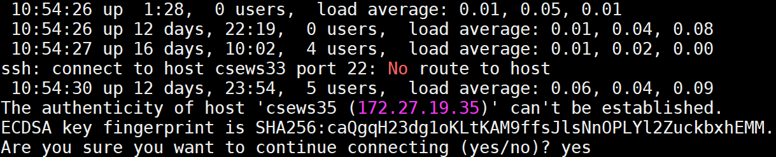
CSE Lab Cluster
Enable passwordless ssh (ssh-keygen)
ssh csewsX (from any csews*) passwordlessly
for i in `seq 1 20`; do ssh csews$i uptime ; done
“Are you sure you want to continue connecting?” yes

Slide 14
MPI Reference Material
Marc Snir, Steve W. Otto, Steven Huss-Lederman, David W. Walker and Jack Dongarra, MPI - The Complete Reference, Second Edition, Volume 1, The MPI Core.
William Gropp, Ewing Lusk, Anthony Skjellum, Using MPI: portable parallel programming with the message-passing interface, 3rd Ed., Cambridge MIT Press, 2014.
https://www.mpi-forum.org/docs/mpi-4.1/mpi41-report.pdf

Slide 15
P2P/Direct Communication
Blocking send and receive
MPI_Send
MPI_Recv
int MPI_Send (const void *buf, int count, MPI_Datatype datatype, int dest, int tag, MPI_Comm comm)
SENDER
Tags should match
int MPI_Recv (void *buf, int count, MPI_Datatype datatype, int source, int tag, MPI_Comm comm, MPI_Status *status)
RECEIVER

Slide 16
MPI_Send Parameters
buf
  initial address of send buffer (choice)
count
  number of elements in send buffer (non-negative integer)
datatype
  datatype of each send buffer element (handle)
dest
  rank of destination (integer)
tag
  message tag (integer)
comm
  communicator (handle)
https://www.mpich.org/static/docs/latest/www3/MPI_Send.html

Slide 17
MPI Data Types
MPI_BYTE
MPI_CHAR
MPI_INT
MPI_FLOAT
MPI_DOUBLE

Slide 18
Example
int MPI_Send (const void *buf, int count, MPI_Datatype datatype, int dest, int tag, MPI_Comm comm)
Send 1 INT from rank 0 to rank 1
// Initialization
if (myrank == 0)
MPI_Send (buf, 1, MPI_INT, 1, 1, MPI_COMM_WORLD);
else if (myrank == 1)
MPI_Recv (buf, 1, MPI_INT, 0, 1, MPI_COMM_WORLD, &status);

Slide 19
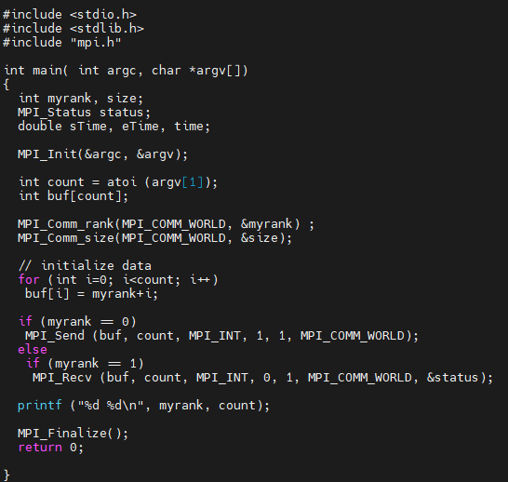
Code

Slide 20
Executing MPI programs
Check `which mpicc` and `which mpiexec`
  Update PATH environment variable
Compile
  mpicc –o filename filename.c
Run
  mpiexec –np 4 –f hostfile filename [Often “No such file” error]
  mpiexec –np 4 –f hostfile ./filename

Slide 21
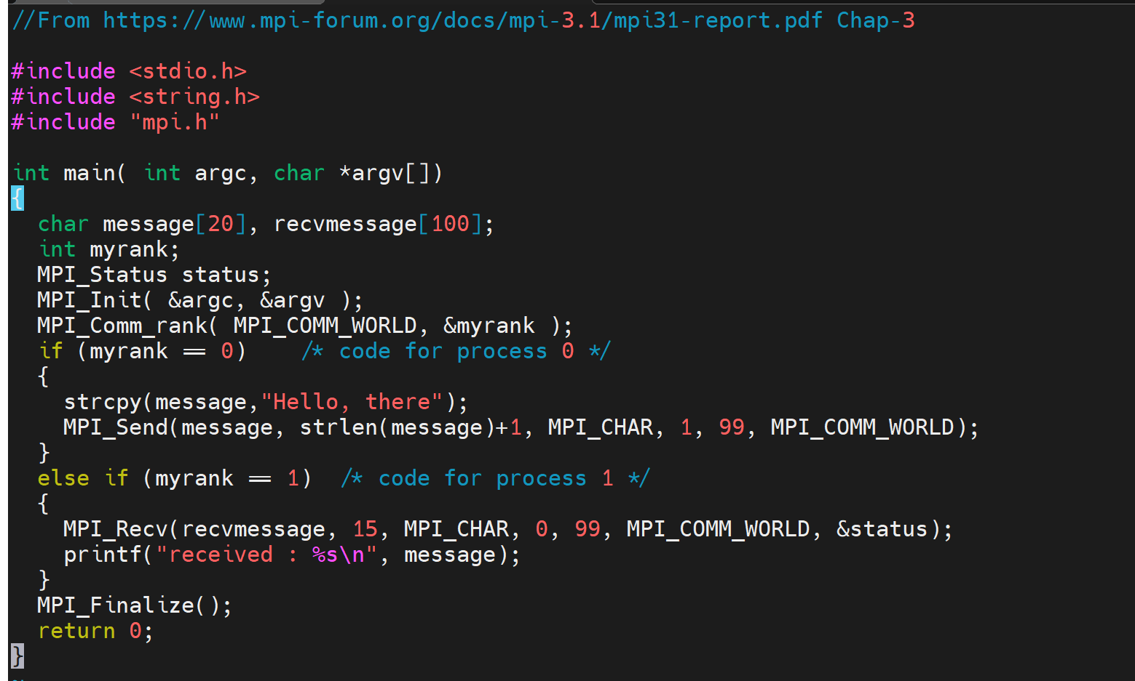
Simple Send/Recv Code (sendmessage.c)
No runtime or compile-time error

Slide 22
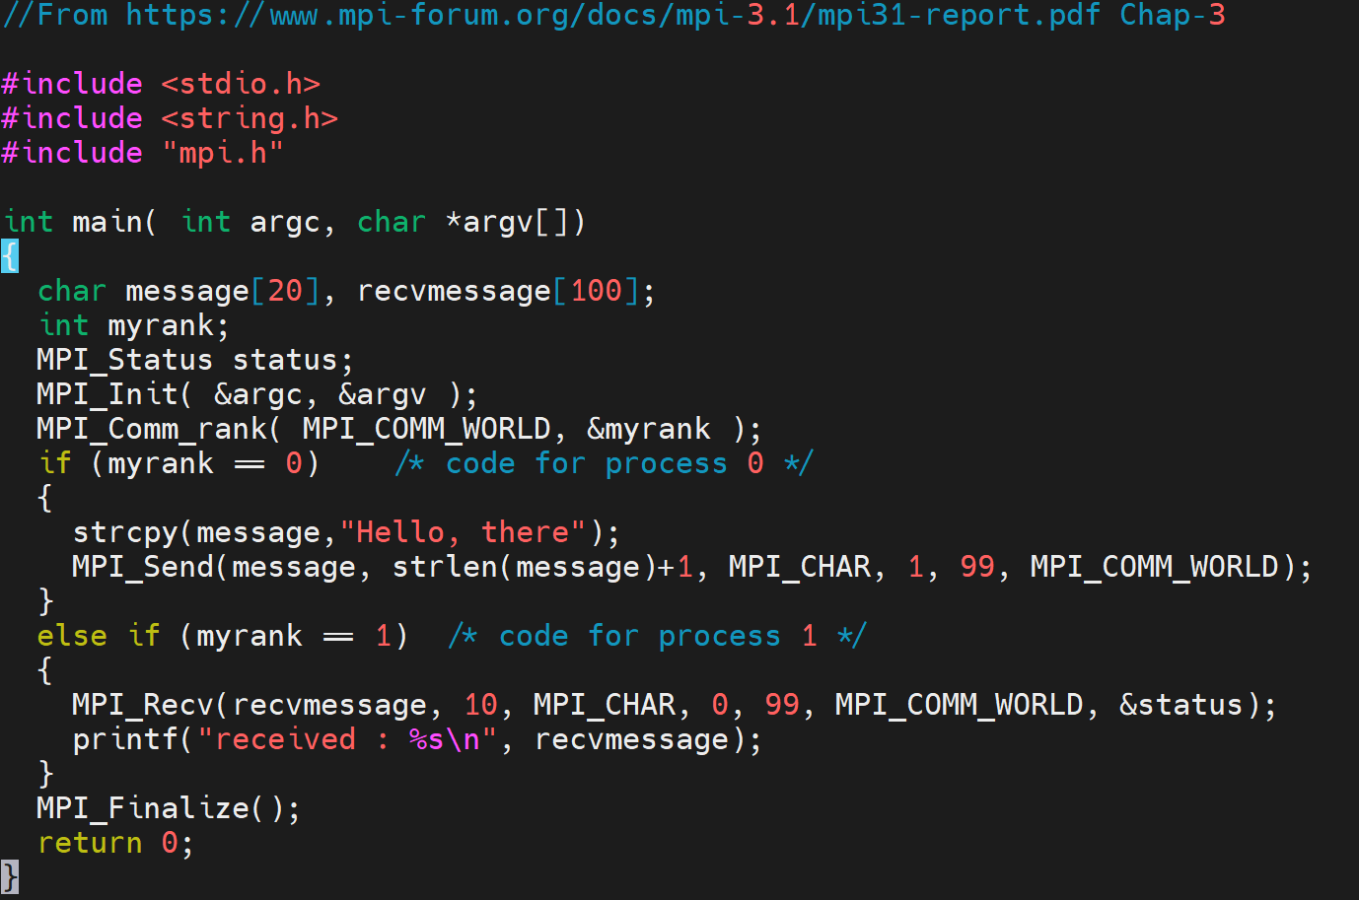
Runtime error

Slide 23
Message Size
Sender
message (13 bytes)
Receiver
Message (10 bytes)
Fatal error in MPI_Recv: Message truncated, error stack:
MPI_Recv(200)...........................: MPI_Recv(buf=0x7ffccc37c610, count=10, MPI_CHAR, src=0, tag=99, MPI_COMM_WORLD, status=0x7ffccc37c5d0) failed
MPIDI_CH3_PktHandler_EagerShortSend(363): Message from rank 0 and tag 99 truncated; 13 bytes received but buffer size is 10

Slide 24
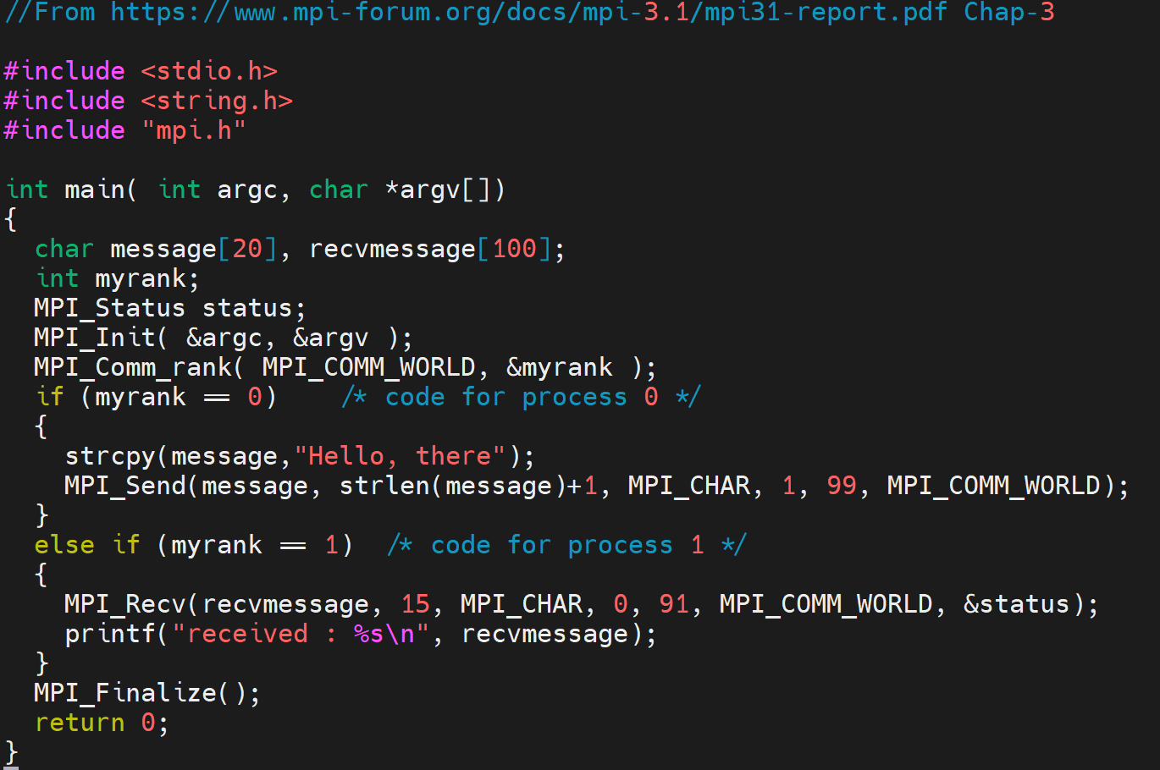
No runtime or compile-time error

Slide 25
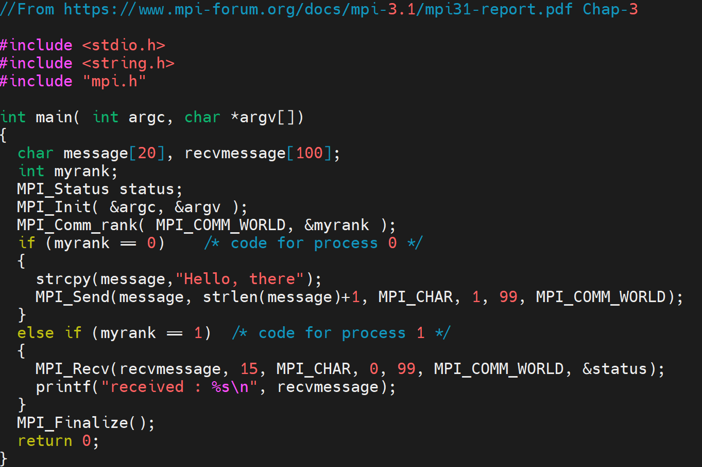
Simple Send/Recv Code (sendmessage.c)
received : Hello, there

Slide 26
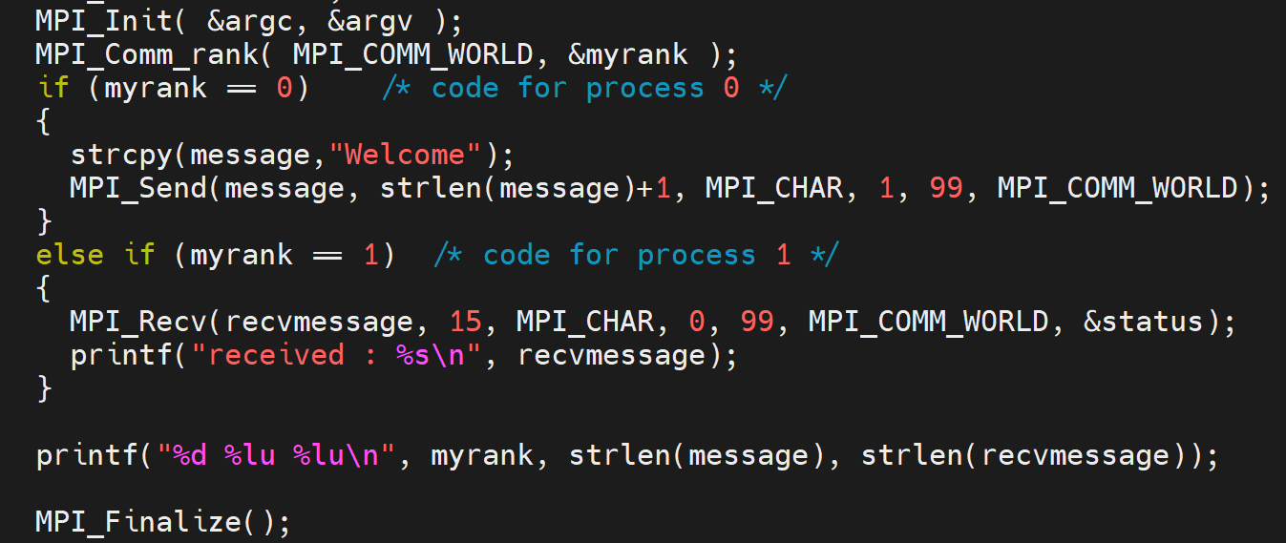
Output
0 7 0
Received: Welcome
1 0 7

Slide 27
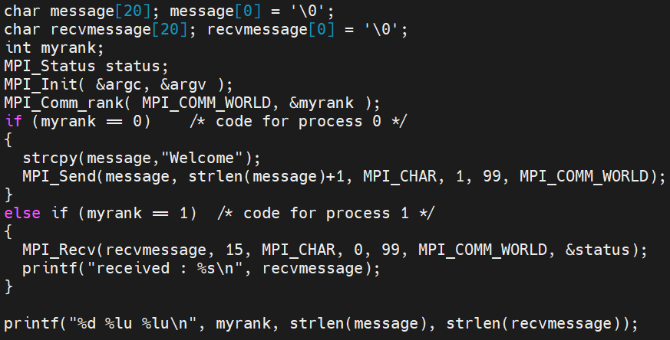
Output for 4 Processes
0 7 0
Received: Welcome
1 0 7
2 0 0
3 0 0

Slide 28
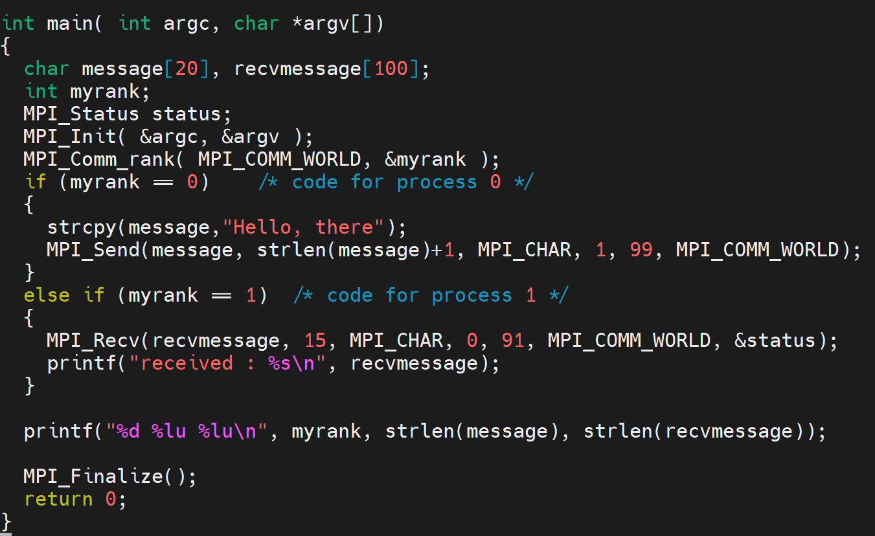
mpirun -np 2 ./send
0 12 0

Slide 29
Multiple Sends and Receives
if (myrank == 0)
MPI_Send (buf, count, MPI_INT, 1, 1, MPI_COMM_WORLD),
MPI_Send (buf, count, MPI_INT, 1, 2, MPI_COMM_WORLD);
else if (myrank == 1)
MPI_Recv (buf, count, MPI_INT, 0, 1, MPI_COMM_WORLD, &status),
MPI_Recv (buf, count, MPI_INT, 0, 2, MPI_COMM_WORLD, &status);
printf ("%d %d\n", myrank, count);
$ mpirun –np 2 ./send 10
0 10
1 10

Slide 30
Multiple Sends and Receives
$ mpirun –np 4 ./send 10
if (myrank == 0)
MPI_Send (buf, count, MPI_INT, 1, 1, MPI_COMM_WORLD),
MPI_Send (buf, count, MPI_INT, 1, 2, MPI_COMM_WORLD);
else if (myrank == 1)
MPI_Recv (buf, count, MPI_INT, 0, 1, MPI_COMM_WORLD, &status),
MPI_Recv (buf, count, MPI_INT, 0, 2, MPI_COMM_WORLD, &status);
printf ("%d %d\n", myrank, count);
0 10
1 10
2 10
3 10

Slide 31
Multiple Sends and Receives
if (myrank == 0)
MPI_Send (buf, count, MPI_INT, 1, 1, MPI_COMM_WORLD),
MPI_Send (buf, count, MPI_INT, 1, 2, MPI_COMM_WORLD);
else if (myrank == 1)
MPI_Recv (buf, count, MPI_INT, 0, 1, MPI_COMM_WORLD, &status),
MPI_Recv (buf, count, MPI_INT, 0, 1, MPI_COMM_WORLD, &status);
printf ("%d %d\n", myrank, count);
$ mpirun –np 2 ./send 10
0 10

Slide 32
Send and Receive
if (myrank == 0)
MPI_Send (buf, count, MPI_INT, 1, 1, MPI_COMM_WORLD);
else if (myrank == 1)
MPI_Recv (buf, count, MPI_INT, 0, 1, MPI_COMM_WORLD, &status);
printf ("%d %d\n", myrank, count);
$ mpirun –np 2 ./send 10
0 10
1 10

Slide 33
Multiple Sends and Receives
if (myrank == 0)
MPI_Send (buf, count, MPI_INT, 1, 1, MPI_COMM_WORLD),
MPI_Send (buf, count, MPI_INT, 1, 2, MPI_COMM_WORLD);
else if (myrank == 1)
MPI_Recv (buf, count, MPI_INT, 0, 2, MPI_COMM_WORLD, &status),
MPI_Recv (buf, count, MPI_INT, 0, 1, MPI_COMM_WORLD, &status);
printf ("%d %d\n", myrank, count);
$ mpirun –np 2 ./send 10
0 10
1 10

Slide 34
MPI_Send (Blocking, Standard Mode)
Does not return until buffer can be reused
Message buffering can affect this
Implementation-dependent
SENDER
RECEIVER

Slide 35
Buffering
[Source: Cray presentation]

Slide 36
Multiple Sends and Receives
if (myrank == 0)
MPI_Send (buf, count, MPI_INT, 1, 1, MPI_COMM_WORLD),
MPI_Send (buf, count, MPI_INT, 1, 2, MPI_COMM_WORLD);
else if (myrank == 1)
MPI_Recv (buf, count, MPI_INT, 0, 2, MPI_COMM_WORLD, &status),
MPI_Recv (buf, count, MPI_INT, 0, 1, MPI_COMM_WORLD, &status);
printf ("%d %d\n", myrank, count);
$ mpirun –np 2 ./send 1000000
Notes:
> 131072

Slide 37
Eager vs. Rendezvous Protocol
Eager
  Send completes without acknowledgement from destination
  MPIR_CVAR_CH3_EAGER_MAX_MSG_SIZE (check output of mpivars)
  Small messages, typically 128 KB (at least in MPICH)
Rendezvous
  Requires an acknowledgement from a matching receive
  Large messages

Slide 38
MPI_Status
int MPI_Recv (void *buf, int count, MPI_Datatype datatype, int source, int tag, MPI_Comm comm, MPI_Status *status)
Source rank
Message tag
Message length
  MPI_Get_count
typedef struct _MPI_Status {
int count;
int cancelled;
int MPI_SOURCE;
int MPI_TAG;
int MPI_ERROR;
} MPI_Status, *PMPI_Status;

Slide 39
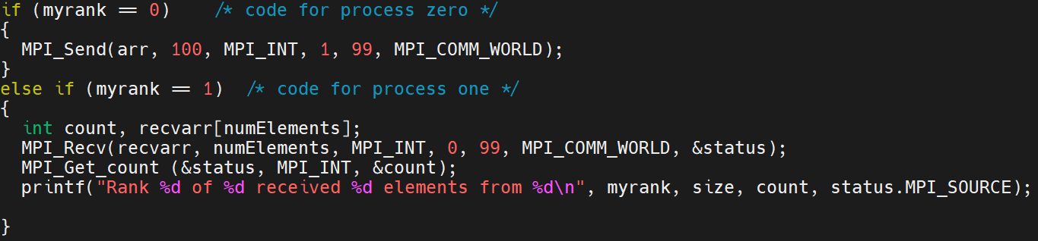
MPI_Get_count (status.c)
status.MPI_SOURCE
status.MPI_TAG
Rank 1 of 2 received 100 elements from 0

Slide 40
Communication – Message Passing
Process 0
Process 1

Slide 41
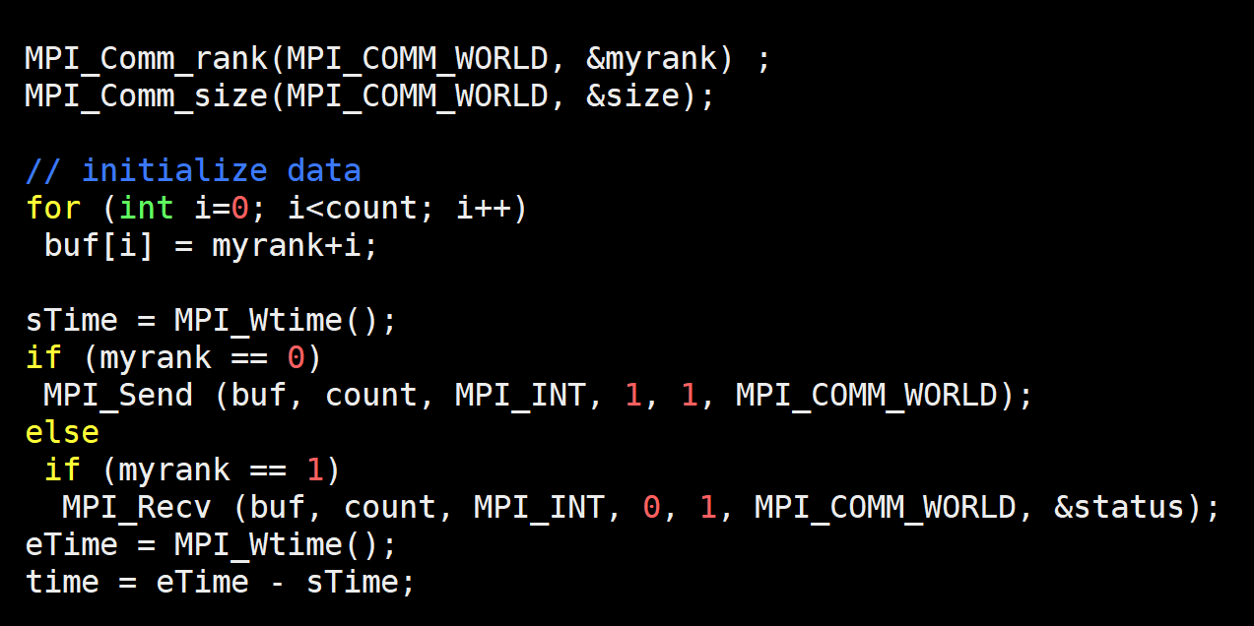
Timing Send/Recv (timingSend.c)

Slide 42
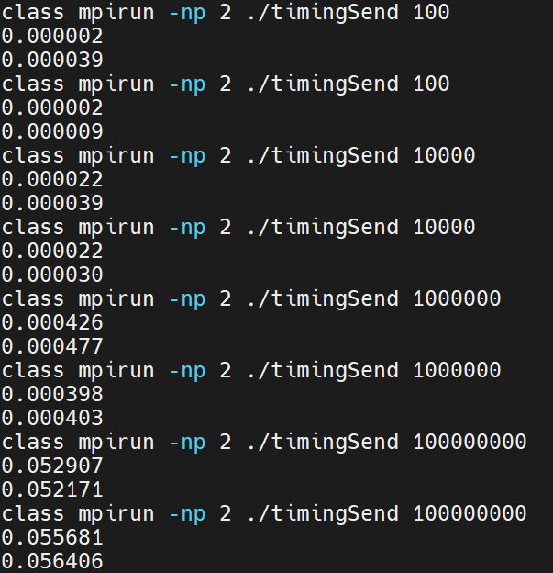
Timing Output
What is the total time?

