Slide 1
P2P - II
Lecture 5
January 20, 2025

Slide 2
MPI Program Execution
Memory
Node/compute node/host/
system/machine
host1
host2
host3
host4
Intranode
Internode
mpiexec –n 8 –hosts host1,host2,host3,host4 ./exe
mpiexec –n 8 –hosts host1:2,host2:2,host3:2,host4:2 ./exe

Slide 3
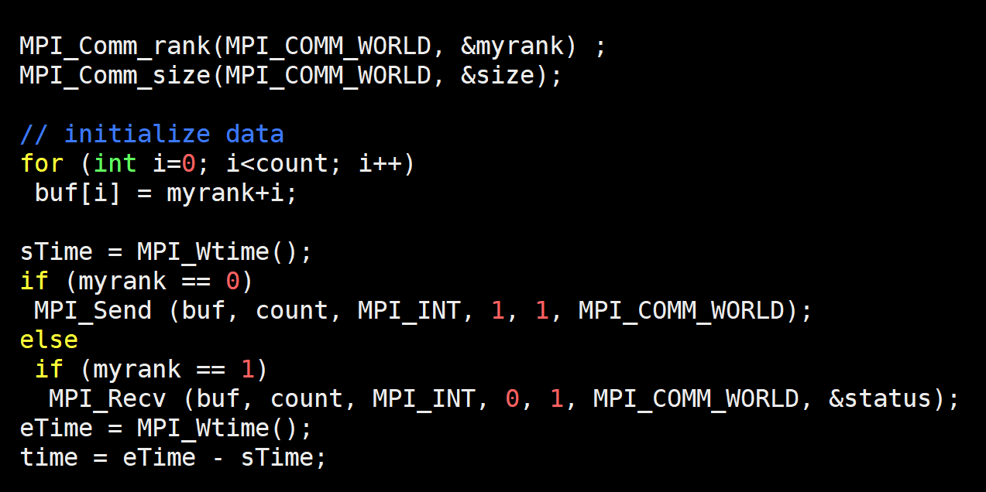
Timing Send/Recv (timingSend.c)

Slide 4
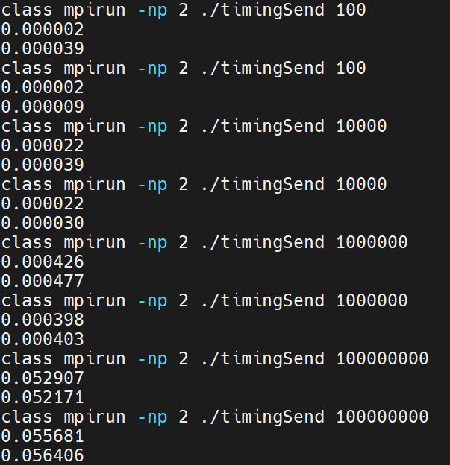
Timing Variation
What is the total time?

Slide 5
A Few Scenarios
0
MPI_Send
MPI_Send
MPI_Send
1
MPI_Recv
MPI_Recv
MPI_Recv
Inspiration: Slides of Prof. Dr. – Ing. Morris Riedel

Slide 6
Execution Profile
sTime = MPI_Wtime();
if (myrank == 0)
MPI_Send (buf, count, MPI_INT, 1, 1, MPI_COMM_WORLD);
else if (myrank == 1)
MPI_Recv (buf, count, MPI_INT, 0, 1, MPI_COMM_WORLD, &status);
eTime = MPI_Wtime();
Execution Profile of a Hypothetical Parallel Program
Source: GGKK Chapter 5

Slide 7
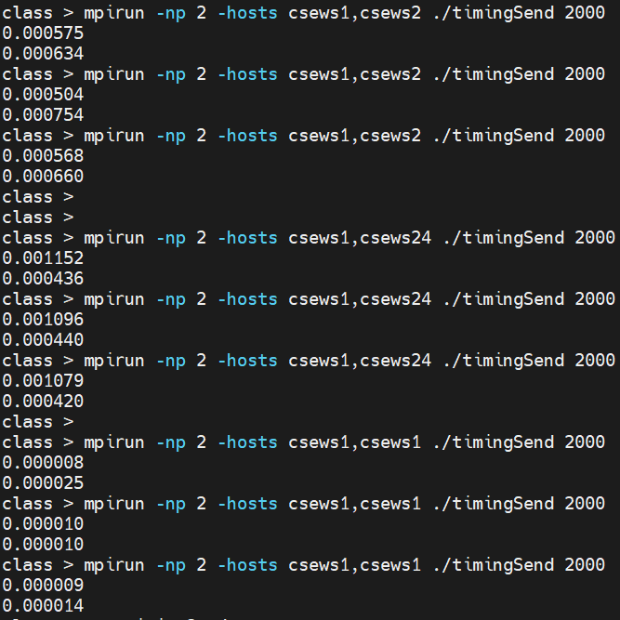
Variation
1. Node to node latency/bandwidth and hence communication time is different and varies
2. Intra-node communication is typically faster than inter-node communication

Slide 8
Sources of Variation
Memory
Node/compute node/host/
system/machine
host1
host2
host3
host4
Intranode
Internode
Network congestion/
background traffic
Other applications
OS noise

Slide 9
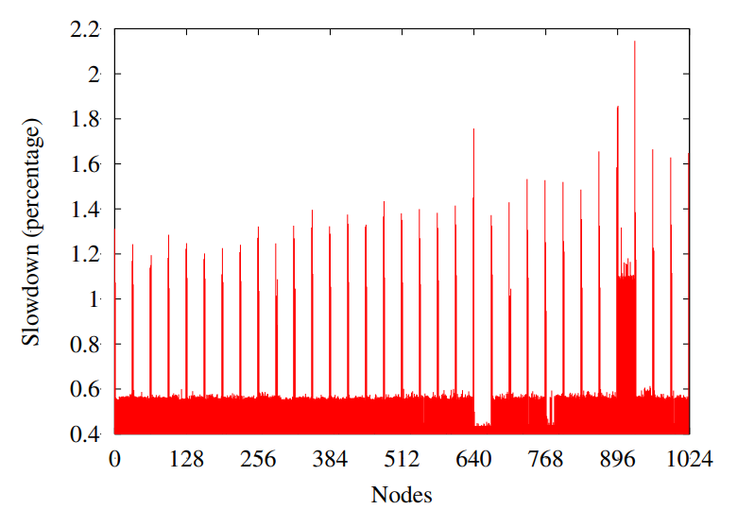
Variability
Interesting pattern of slowdown!
The Case of the Missing Supercomputer Performance: Achieving Optimal Performance on the 8,192 Processors of ASCI Q, IEEE CLUSTER 2010

Slide 10
Optional Reading
A Quantitative Analysis of OS Noise, IPDPS 2011

Slide 11
One-to-many Sends
0
s-1

Slide 12
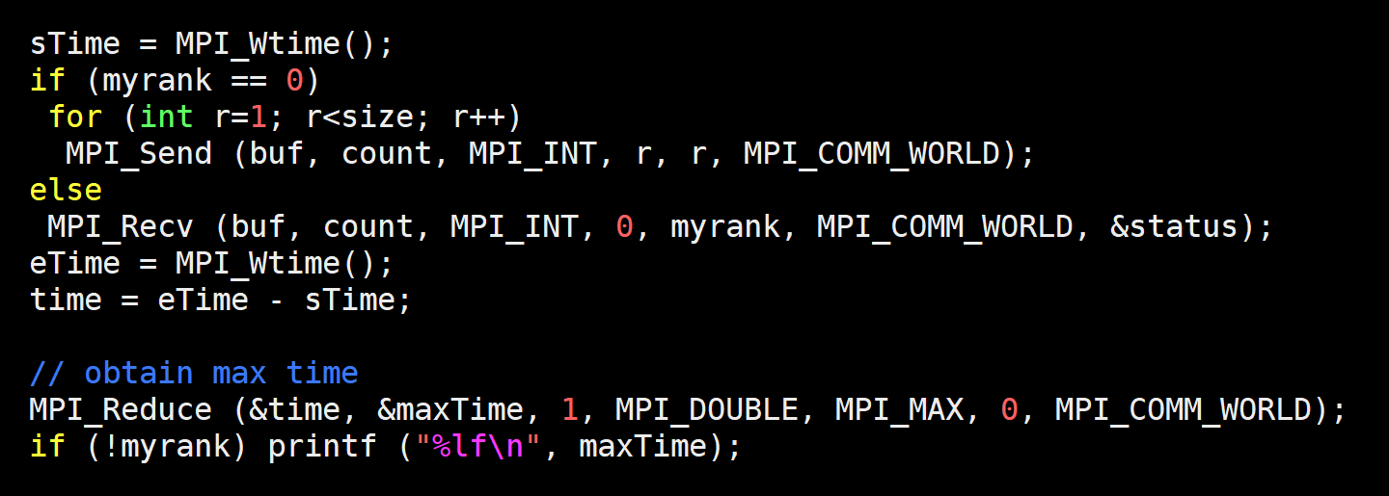
One-to-many Sends

Slide 13
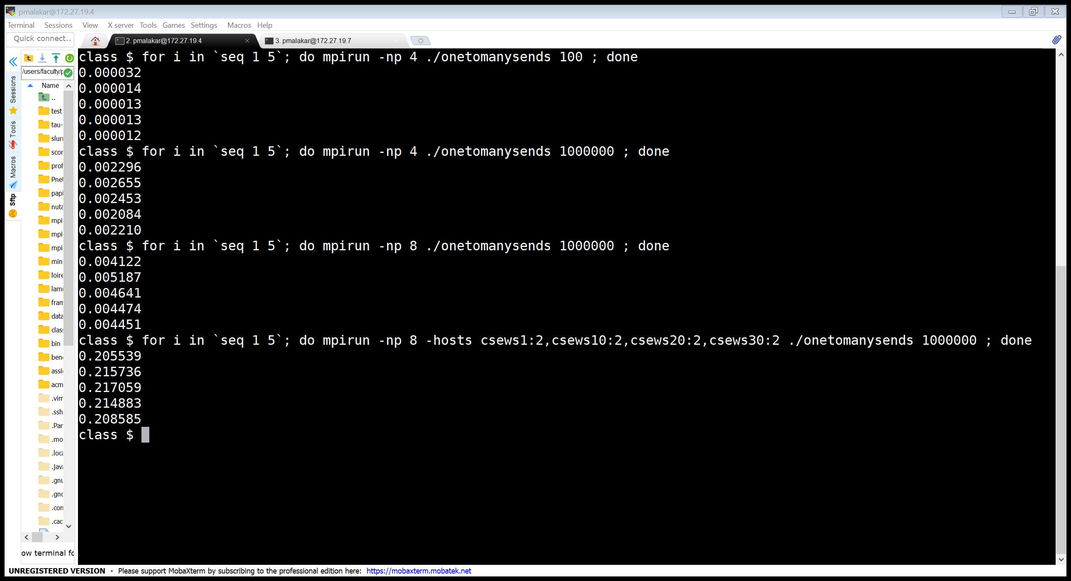
Timing
Variability

Slide 14
Execution Time Variability
Memory
Node/compute node/host/
system/machine
host1
host2
host3
host4
Intranode
mpiexec –n 4./exe
mpiexec –n 8./exe

Slide 15
Output

Slide 16
Execution Time Variation
Memory
Node/compute node/host/
system/machine
host1
host2
host3
host4
Intranode
Internode
mpiexec –n 8 ./exe
Intraconnect is faster typically
mpiexec –n 8 –hosts host1:2,host2:2,host3:2,host4:2 ./exe

Slide 17
Many-to-one Sends
0
s-1

Slide 18
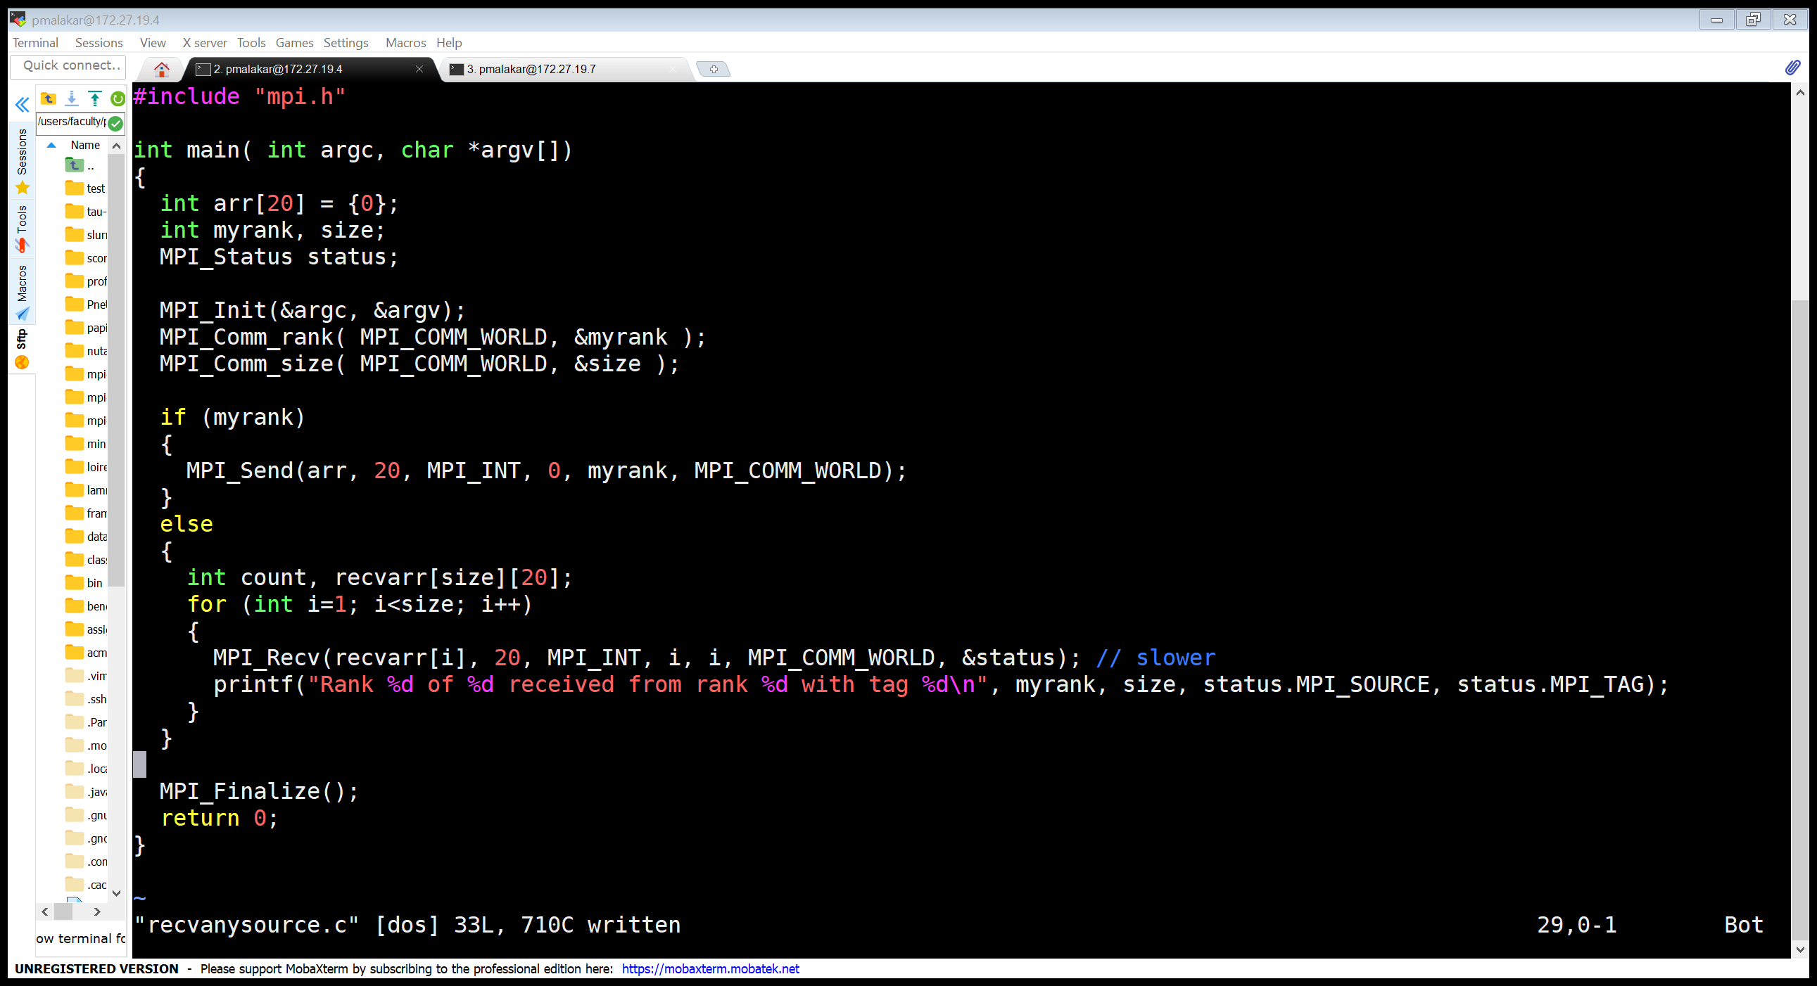
Many-to-one Sends
MPI_Send (Blocking send) MPI_Recv (Blocking receive)
Notes:
The status argument also returns information on the length of the message received. However, this information is not directly available as a field of the status variable and a call to MPI_GET_COUNT is required to ``decode'' this information.

Slide 19
MPI Program Execution Order
Memory
Node/compute node/host/
system/machine
host1
host2
host3
host4
Intranode
Internode
mpiexec –n 8 –hosts host1,host2,host3,host4 ./exe
mpiexec –n 8 –hosts host1:2,host2:2,host3:2,host4:2 ./exe

Slide 20
MPI Program Execution Order
Node/compute node/host/
system/machine
host1
host2
host4
host3

Slide 21
MPI_ANY_*
int MPI_Recv (void *buf, int count, MPI_Datatype datatype, int source, int tag, MPI_Comm comm, MPI_Status *status)
MPI_ANY_SOURCE
  Receiver may specify wildcard value for source
MPI_ANY_TAG
  Receiver may specify wildcard value for tag

Slide 22
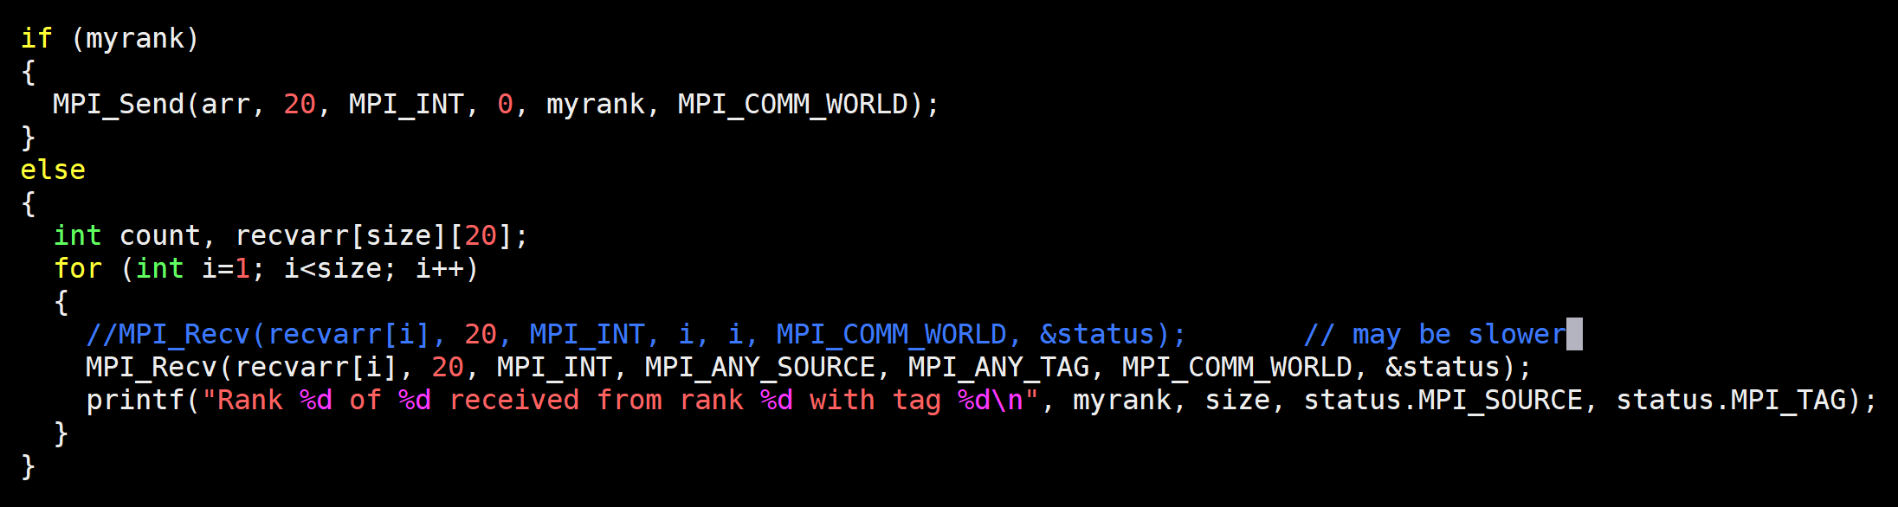
Receive Out-of-order
a send operation must specify a unique receiver
Rectify the receive buffer location
No specific order
Notes:
The status argument also returns information on the length of the message received. However, this information is not directly available as a field of the status variable and a call to MPI_GET_COUNT is required to ``decode'' this information.

Slide 23
Receive Out-of-order
This may result in similar performance if MPI implementation performs buffering at the receiver side
Design MPI implementation-agnostic code
Design network-agnostic code
Design configuration-agnostic code

Slide 24
Sum of Squares of N numbers
Serial
for i = 1 to N
sum += a[i] * a[i]
Parallel
for i = 1 to N/P
sum += a[i] * a[i]
collate result
P

Slide 25
Sum of Squares
for i = 1 to N/P
sum += a[i] * a[i]
for i = 1 to N/P
sum += a[i] * a[i]
for i = 1 to N/P
sum += a[i] * a[i]
for i = 1 to N/P
sum += a[i] * a[i]
Rank = 0 Rank = 1 Rank = 2 Rank = 3
Notes:
How does OS launch processes?

Slide 26
SIMD Parallelism
// Assume the large array is present in all ranks
for (; ; )
localsum += a[i] * a[i]
// Collect localsum, add up at one of the ranks
if (!rank)
recv from all ranks (…)
else
send (0)

