Slide 1
Point-to-Point – III
Lecture 6
January 22, 2025

Slide 2
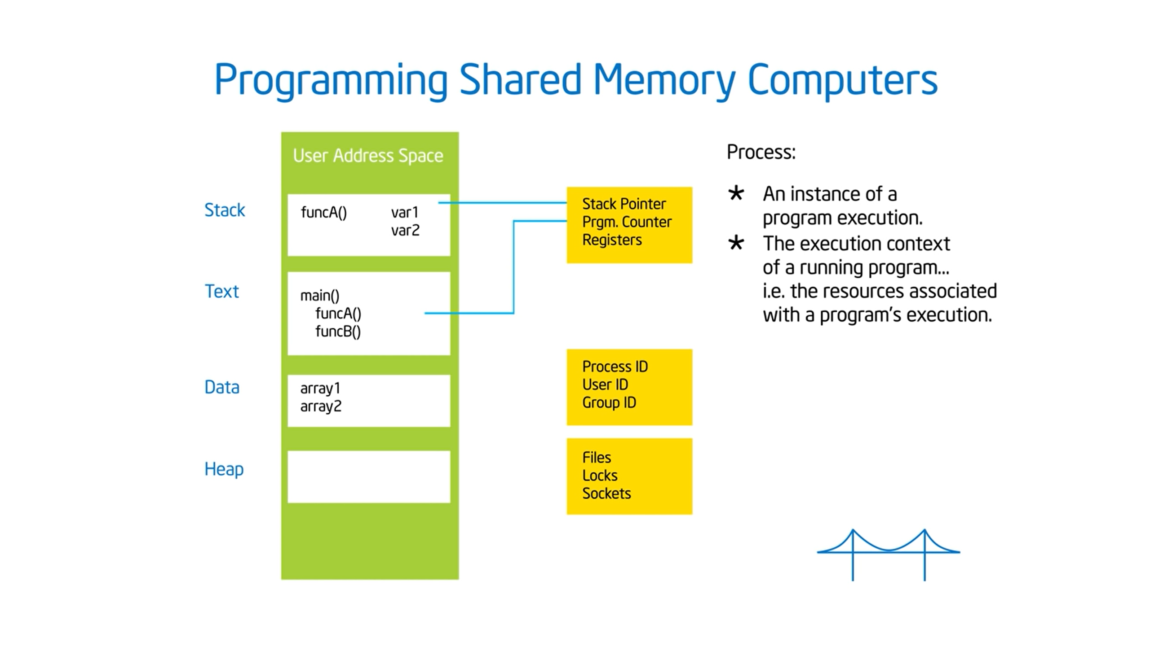
Process
Adapted from Tim Mattson’s slides

Slide 3
Processes 0 and 1 – Address Space

Slide 4
Parallel Sum Pseudocode
// Assume the large array is present in all ranks
for (; ; )
localsum += a[i] * a[i]
// Collect localsum, add up at one of the ranks
if (!rank)
recv from all ranks (…)
else
send (0)

Slide 5
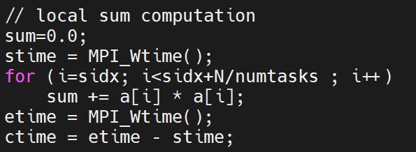
Partial Sum Code – Computation
// Initialization
sidx = rank*N/numtasks; //start index
end index
computation
computation time

Slide 6
Partial Sum Code – Example (2 processes)
N = 12
numtasks = 2
// Initialization
sidx = rank*N/numtasks;
0 1
0 6
5 11
start index
end index

Slide 7
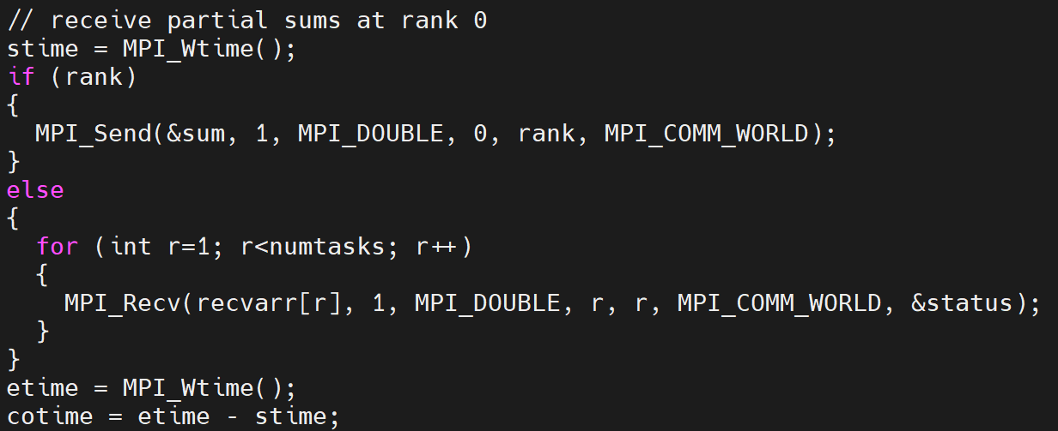
Partial Sum Code – Communication
double recvarr[numtasks][1];
communication time

Slide 8
Homework
Time the partial sum parallel code – report the compute and communication time
  Scale the data size
  Scale the process count

Slide 9
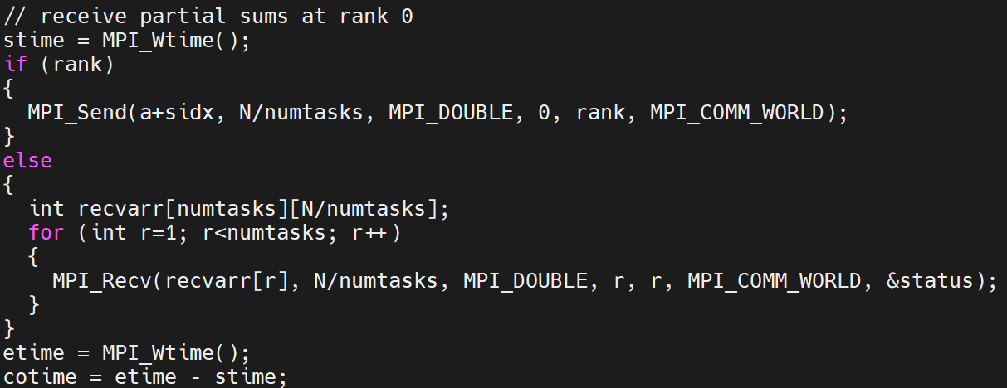
Receive Sub-array at Rank 0
communication time

Slide 10
Timing Results of Send/Recv Sub-array at Rank 0

Slide 11
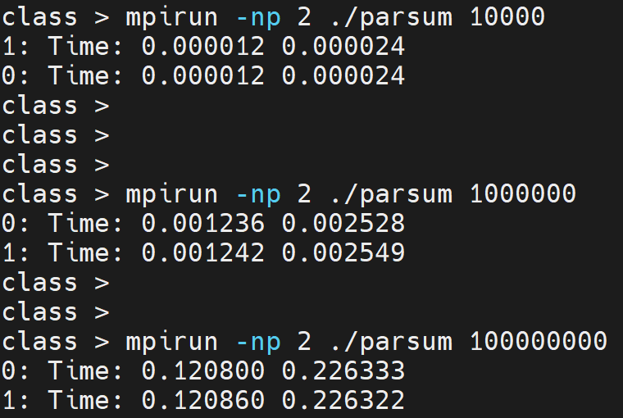
Timing
Compute time
Slowest
Communication time

Slide 12
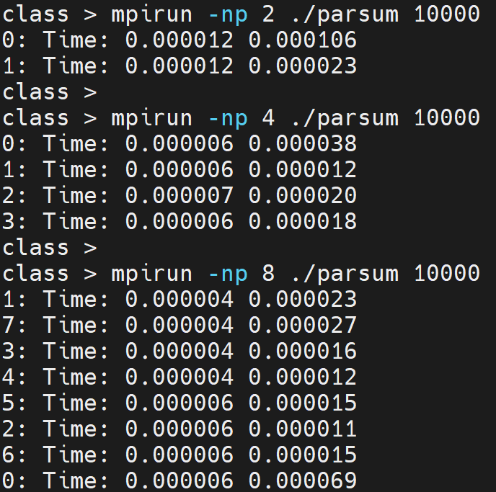
Timing
Over-decomposition
Communication time

Slide 13
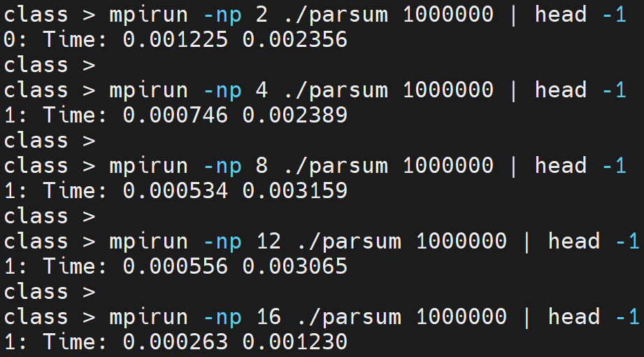
Timing (One randomly selected rank)

Slide 14
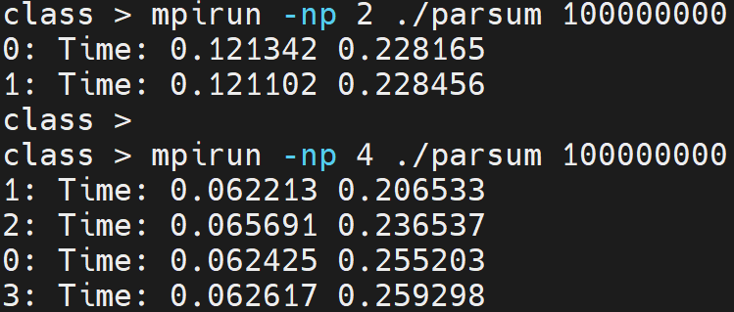
Timing

Slide 15
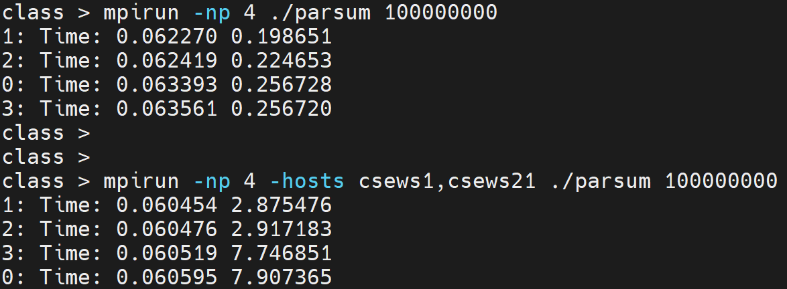
Timing

Slide 16
Timing – Factors
2 processes, 10000 doubles
0: Time: 0.000012 0.000068
2 processes, 100000 doubles
0: Time: 0.000113 0.000317
2 processes, 1000000 doubles
0: Time: 0.001250 0.001951
4 processes, 10000 doubles
0: Time: 0.000006 0.000814
4 processes, 100000 doubles
0: Time: 0.000075 0.000764
4 processes, 1000000 doubles
0: Time: 0.000662 0.002383
Data size impacts communication time
Compute time scales to a certain extent
Scalability saturation limits change

Slide 17
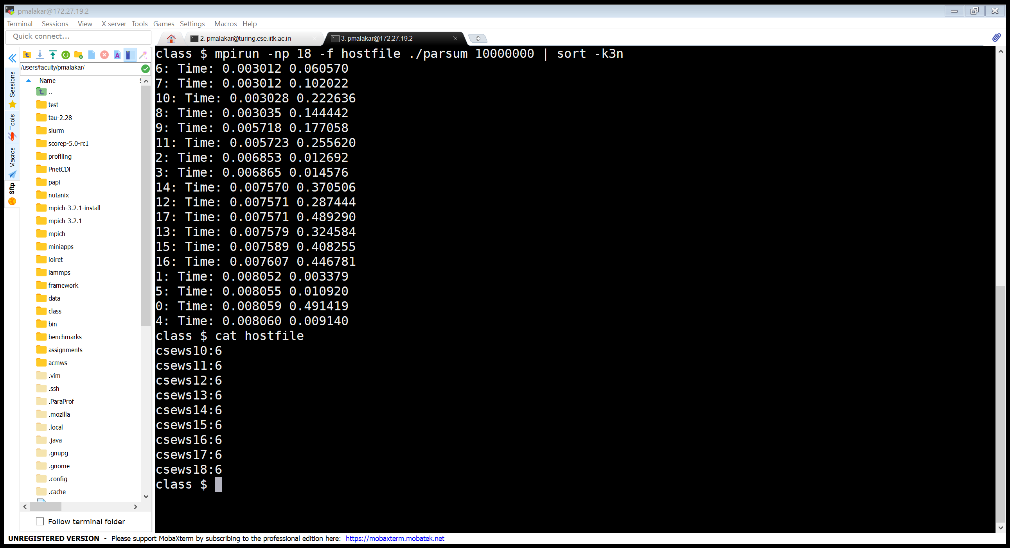

Output
Compute time
Communication time

Slide 18
Output
Compute time
Communication time
18 processes

Slide 19
Parallel Sum (Optimized)
Source: GGKK Chapter 5

Slide 20
Homework
Write the code for optimized parallel sum using MPI_Send and MPI_Recv
Hints:
Iterative code -- #steps = ?
Whether a rank is sender or receiver or none, depends on the rank and the step number
idle

Slide 21
Code Examples

Slide 22
Send/Recv Example
int count = atoi (argv[1]);
if (myrank == 0)
MPI_Send (buf, count, MPI_INT, 1, 1, MPI_COMM_WORLD);
else
if (myrank == 1)
MPI_Recv (buffer, count, MPI_CHAR, 0, 1, MPI_COMM_WORLD, &status);
mpirun –np 2 ./exe 10
Will this run/block/give compile-time error?

Slide 23
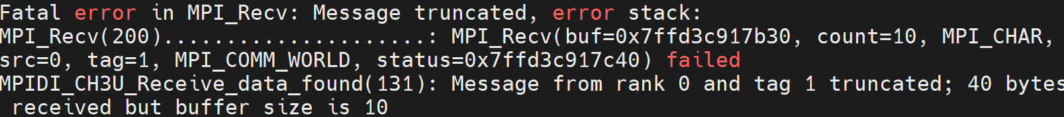
Send/Recv Example
int count = atoi (argv[1]);
if (myrank == 0)
MPI_Send (buf, count, MPI_INT, 1, 1, MPI_COMM_WORLD);
else
if (myrank == 1)
MPI_Recv (buffer, count, MPI_CHAR, 0, 1, MPI_COMM_WORLD, &status);

Slide 24
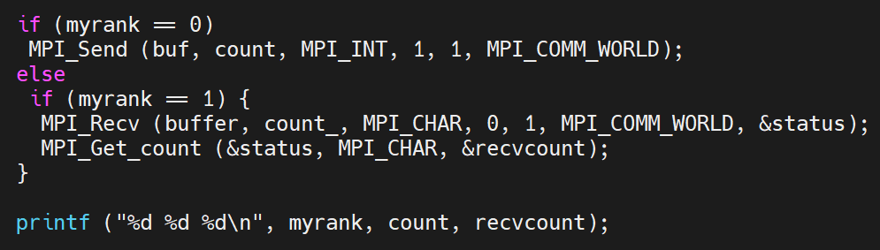
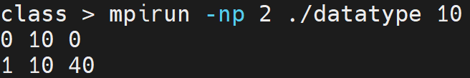
Example – Contd.
int count = atoi (argv[1]), recvcount = 0;

Slide 25
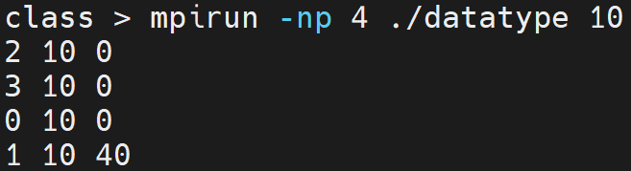
Example – Contd.
int count = atoi (argv[1]), recvcount = 0;

Slide 26
Send/Recv Example
int buf[100], count=10;
if (myrank == 0)
MPI_Send (buf, count, MPI_INT, 1, 1, MPI_COMM_WORLD);
else
if (myrank == 1)
MPI_Recv (&buf[10], count, MPI_INT, 0, 1, MPI_COMM_WORLD, &status);

Slide 27
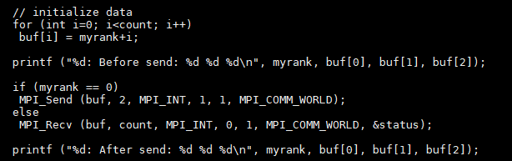
MPI_Recv Example
mpirun -np 2 ./a.out 100
0: Before send: 0 1 2
0: After send: 0 1 2
1: Before send: 1 2 3
1: After send: 0 1 3
Assume count >= 2
If send message size is smaller than the receive count, then only those locations corresponding to the (shorter) message are modified.

Slide 28
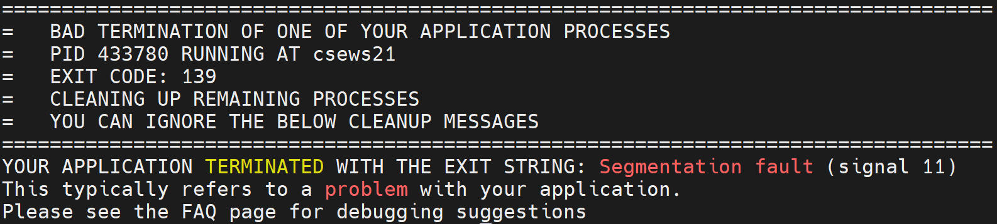
Find the bug, if any
https://cse.iitk.ac.in/users/cs633/2024-25-2/bug.c.txt

Slide 29
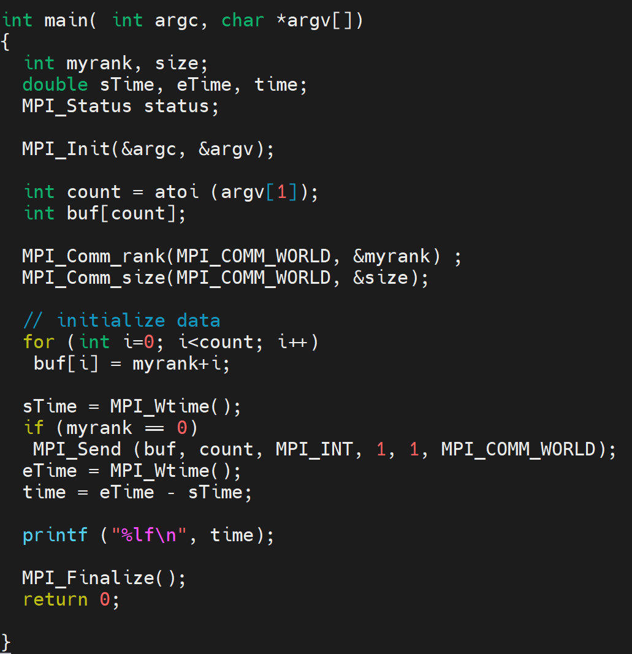
Is there a bug?
0.000000
0.000002

Slide 30
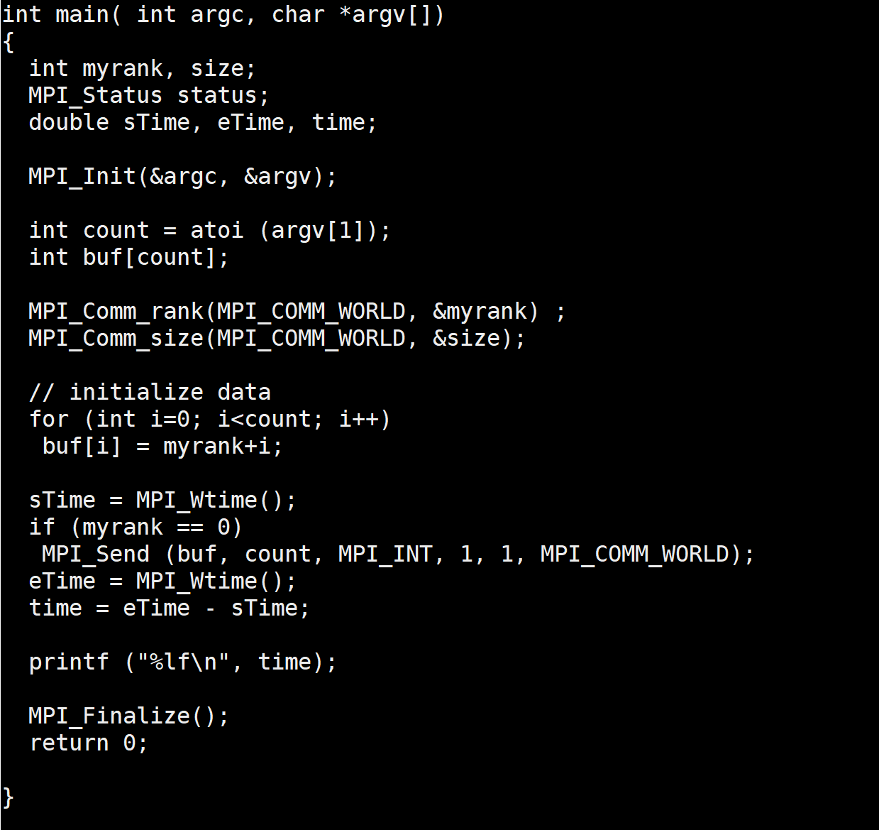
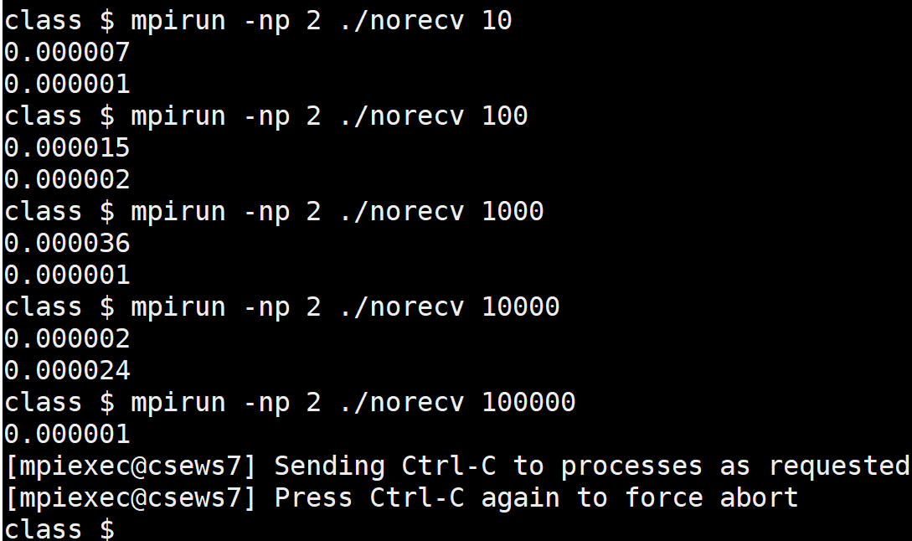
Matching MPI_Recv Not Posted
Unsafe code
norecv.c

Slide 31
There is a bug.
0.000000
0.000002
Programming bug, no runtime
Or compile-time error!

Slide 32
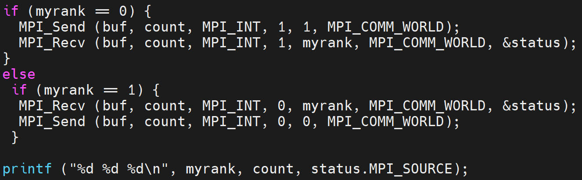
Send – Recv Example
mpirun -np 2 ./sendrecv 20
0 20 1
1 20 0

Slide 33
Send – Recv Example
if (myrank == 0) {
MPI_Recv (buf, count, MPI_INT, 1, myrank, MPI_COMM_WORLD, &status);
MPI_Send (buf, count, MPI_INT, 1, 1, MPI_COMM_WORLD);
}
else if (myrank == 1) {
MPI_Send (buf, count, MPI_INT, 0, 0, MPI_COMM_WORLD);
MPI_Recv (buf, count, MPI_INT, 0, myrank, MPI_COMM_WORLD, &status);
}
printf ("%d %d %d\n", myrank, count, status.MPI_SOURCE);

