Slide 1
Point-to-Point - IV
Lecture 7
January 27, 2025

Slide 2
Send – Recv Example (sendrecv1.c)
if (myrank == 0) {
MPI_Send (buf, count, MPI_INT, 1, 1, MPI_COMM_WORLD);
MPI_Recv (buf, count, MPI_INT, 1, myrank, MPI_COMM_WORLD, &status);
}
else if (myrank == 1) {
MPI_Recv (buf, count, MPI_INT, 0, myrank, MPI_COMM_WORLD, &status);
MPI_Send (buf, count, MPI_INT, 0, 0, MPI_COMM_WORLD);
}
printf ("%d %d %d\n", myrank, count, status.MPI_SOURCE);

Slide 3
Send – Recv Example (sendrecv2.c)
if (myrank == 0) {
MPI_Recv (buf, count, MPI_INT, 1, myrank, MPI_COMM_WORLD, &status);
MPI_Send (buf, count, MPI_INT, 1, 1, MPI_COMM_WORLD);
}
else if (myrank == 1) {
MPI_Send (buf, count, MPI_INT, 0, 0, MPI_COMM_WORLD);
MPI_Recv (buf, count, MPI_INT, 0, myrank, MPI_COMM_WORLD, &status);
}
printf ("%d %d %d\n", myrank, count, status.MPI_SOURCE);

Slide 4
Send – Recv Example
Incorrect code – relies on MPI implementation
if (myrank == 0) {
MPI_Send (buf, count, MPI_INT, 1, 1, MPI_COMM_WORLD);
MPI_Recv (buf, count, MPI_INT, 1, myrank, MPI_COMM_WORLD, &status);
}
else if (myrank == 1) {
MPI_Send (buf, count, MPI_INT, 0, 0, MPI_COMM_WORLD);
MPI_Recv (buf, count, MPI_INT, 0, myrank, MPI_COMM_WORLD, &status);
}
printf ("%d %d %d\n", myrank, count, status.MPI_SOURCE);

Slide 5
Order of Invocation Matters
Note:
0 sends to 1 and 1 sends to 0
0 receives from 1 and 1 receives from 0
0
1
MPI_Send
MPI_Recv
Safe
MPI_Send
MPI_Recv
MPI_Send
MPI_Send
Unsafe
MPI_Recv
MPI_Recv
MPI_Send
MPI_Recv
Safe
MPI_Recv
MPI_Send
MPI_Recv
MPI_Recv
Unsafe
MPI_Send
MPI_Send
Notes:
A program is “safe” if no message buffering is required for the program to complete.

Slide 6
Eager vs. Rendezvous Protocol
Eager
  Send completes without acknowledgement from destination
  MPIR_CVAR_CH3_EAGER_MAX_MSG_SIZE (check output of mpivars)
  Small messages, typically 128 KB (at least in MPICH)
    Not safe to use the send buffer if message size is small
Rendezvous
  Requires an acknowledgement from a matching receive
  Large messages

Slide 7
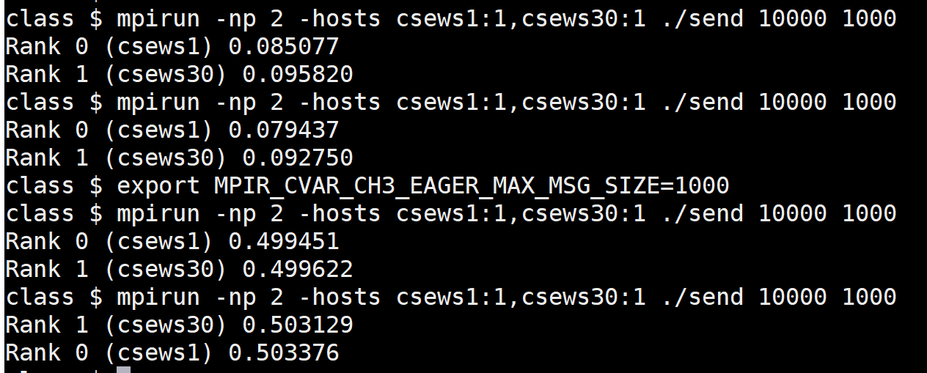
Eager vs. Rendezvous Example
Number of iterations
Number of bytes
Simple code: Rank 0 sends 10000 integers to rank 1 1000 times

Slide 8
Semantics of P2P
if (myrank == 0) {
MPI_Send (buf, count, MPI_INT, 1, 1, MPI_COMM_WORLD),
MPI_Send (buf, count, MPI_INT, 1, 1, MPI_COMM_WORLD);
}
else {
if (myrank == 1)
MPI_Recv (buf, count, MPI_INT, 0, 1, MPI_COMM_WORLD, &status),
MPI_Recv (buf, count, MPI_INT, 0, 1, MPI_COMM_WORLD, &status);
}
printf ("%d %d\n", myrank, count);
Messages are nonovertaking

Slide 9
Semantics of P2P
Order. Messages are nonovertaking:
If a sender sends two messages in succession to the same destination, and both match the same receive, then this operation cannot receive the second message if the first one is still pending.
If a receiver posts two receives in succession, and both match the same message, then the second receive operation cannot be satisfied by this message, if the first one is still pending.
-- MPI Report

Slide 10
Multiple Send/Recv
if (myrank == 0) {
buf[0] = 24;
MPI_Send (buf, 1, MPI_INT, 1, 1, MPI_COMM_WORLD);
buf[0] = 25;
MPI_Send (buf, 1, MPI_INT, 1, 1, MPI_COMM_WORLD);
}
else
if (myrank == 1)
MPI_Recv (buf, 1, MPI_INT, 0, 1, MPI_COMM_WORLD, &status);
printf ("%d %d\n", myrank, buf[0]);

Slide 11
Standard Mode Send (MPI_Send)
“blocking: it does not return until the message data and envelope have been safely stored away so that the sender is free to modify the send buffer”

Slide 12
Standard Mode Send
A standard mode send can be started whether or not a matching receive has been posted.
It may complete before a matching receive is posted.
It is up to MPI to decide whether outgoing messages will be buffered. MPI may buffer outgoing messages.
MPI takes the position that correct (and therefore, portable) programs do not rely on system buffering in standard mode.
Implementation-dependent

Slide 13
Other Send Communication Modes
MPI_Send Standard
  May complete before matching receive is posted (implementation dependent)
MPI_Bsend Buffered
  May complete before matching receive is posted
  Does not depend on the occurrence of a matching receive
Notes:
Semantics of the send operation (i.e. underlying transfer protocol) can be affected by choosing one of the modes.
Thus, a send in standard mode can be started whether or not a matching receive has been posted. It may complete before a matching receive is posted.
Bsend’s completion does not depend on the occurrence of a matching receive.
A send that uses the synchronous mode can be started whether or not a matching receive was posted. However, the send will complete successfully only if a matching receive is posted, and the receive operation has started to receive the message sent by the synchronous send. the completion of a synchronous send not only indicates that the send buffer can be reused, but it also indicates that the receiver has reached a certain point in its execution, namely that it has started executing the matching receive.
It is merely that the sender provides additional information to the system (namely that a matching receive is already posted), that can save some overhead.
A send that uses the ready communication mode may be started only if the matching receive is already posted. Otherwise, the operation is erroneous

Slide 14
Other Send Communication Modes
MPI_Send Standard
  May complete before matching receive is posted (implementation dependent)
MPI_Bsend Buffered
  May complete before matching receive is posted
  Does not depend on the occurrence of a matching receive
MPI_Ssend Synchronous
  Completes only if a matching receive is posted
MPI_Rsend Ready
  Started only if a matching receive is posted
Notes:
Semantics of the send operation (i.e. underlying transfer protocol) can be affected by choosing one of the modes.
Thus, a send in standard mode can be started whether or not a matching receive has been posted. It may complete before a matching receive is posted.
Bsend’s completion does not depend on the occurrence of a matching receive.
A send that uses the synchronous mode can be started whether or not a matching receive was posted. However, the send will complete successfully only if a matching receive is posted, and the receive operation has started to receive the message sent by the synchronous send. the completion of a synchronous send not only indicates that the send buffer can be reused, but it also indicates that the receiver has reached a certain point in its execution, namely that it has started executing the matching receive.
It is merely that the sender provides additional information to the system (namely that a matching receive is already posted), that can save some overhead.
A send that uses the ready communication mode may be started only if the matching receive is already posted. Otherwise, the operation is erroneous

Slide 15
MPI_BUFFER_ATTACH/DETACH
MPI_BUFFER_ATTACH (buffer_addr, size)
Provides to MPI a buffer in the user’s memory
Used by messages sent in buffered mode
Only one buffer can be attached to a process at a time
MPI_BUFFER_DETACH (buffer_addr, size)

Slide 16
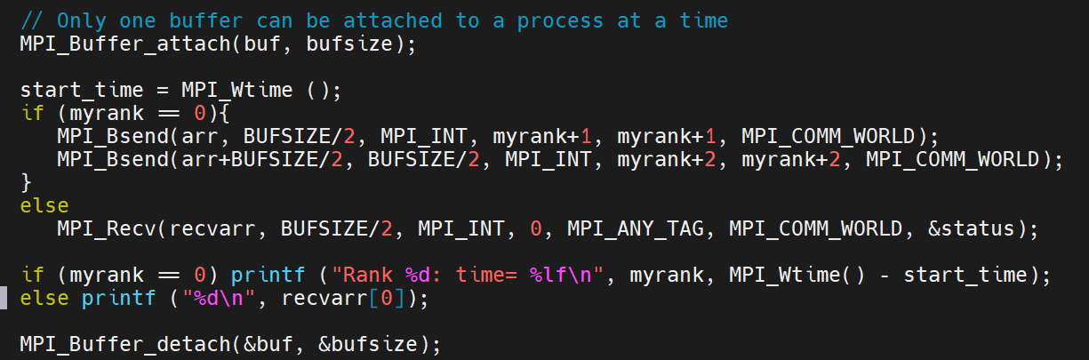
Bsend Example
bsend.c
mpirun -np 3 ./bsend 20000

Slide 17
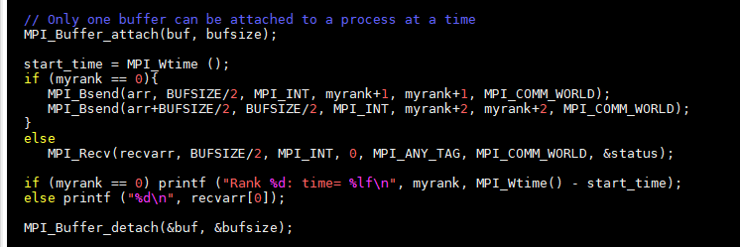
MPI_Bsend
The size given should be the sum of the sizes of all outstanding Bsends that you intend to have, plus 'MPI_BSEND_OVERHEAD' for each Bsend that you do.

Slide 18
Example

Slide 19
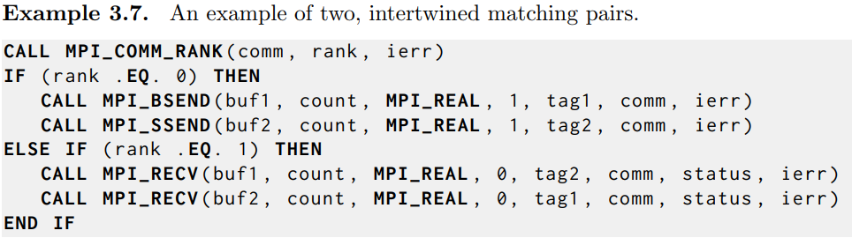
Example

Slide 20
Many-to-one Revision
All ranks send to the last rank
MPI_Comm_rank (MPI_COMM_WORLD, &myrank);
MPI_Comm_size (MPI_COMM_WORLD, &size);

Slide 21
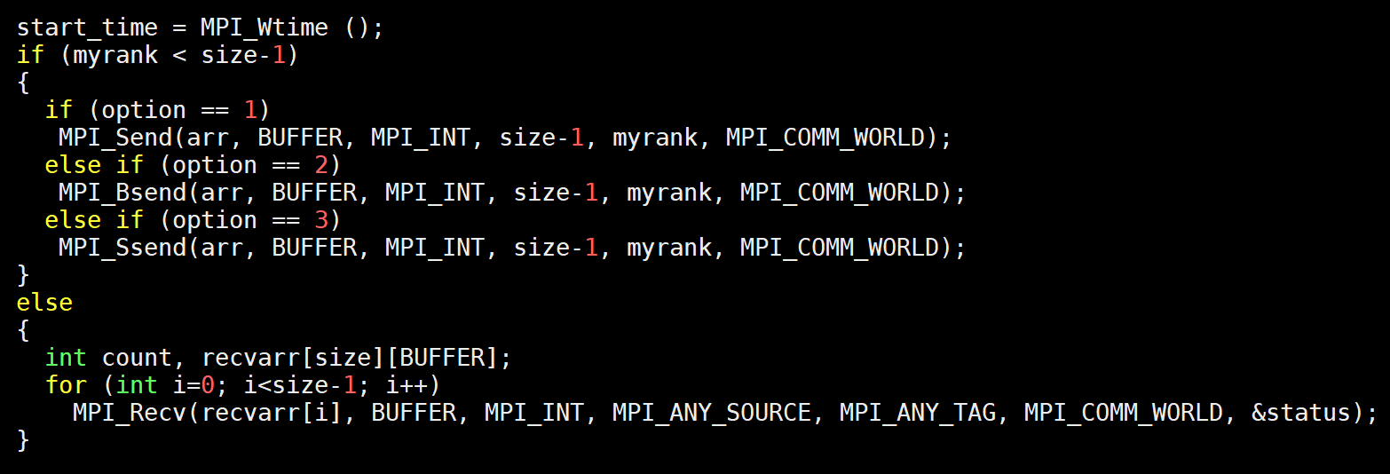
Code (Many-to-one, Receiver: Last rank)
sendmodes.c

Slide 22
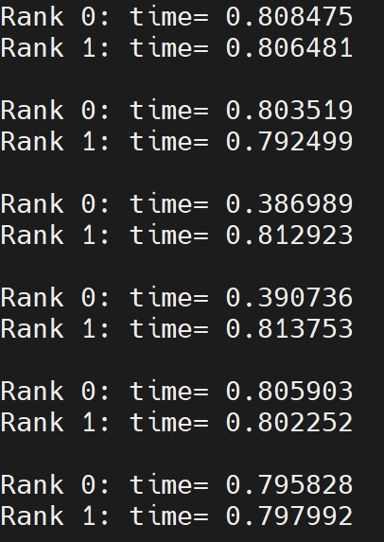
Timing (Send Modes)
MPI_Send
MPI_Bsend
MPI_Ssend
Data size:
200000000 integers

Slide 23
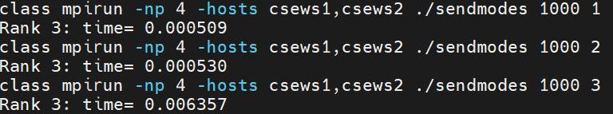
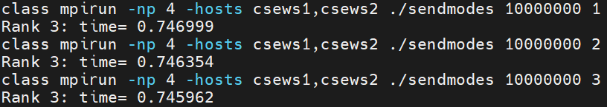
Performance of Send Modes (Many-to-one)
MPI_Send
MPI_Bsend
MPI_Ssend

Slide 24
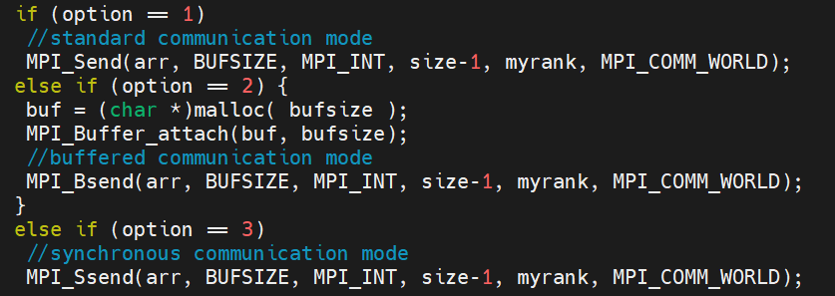
Timing – What to include and when?

Slide 25
Safety
0
1
MPI_Ssend
MPI_Recv
Safe
MPI_Ssend
MPI_Recv
MPI_Ssend
MPI_Ssend
Unsafe/Deadlock
MPI_Recv
MPI_Recv
MPI_Ssend
MPI_Recv
Safe
MPI_Recv
MPI_Ssend
Note:
0 sends to 1 and 1 sends to 0
0 receives from 1 and 1 receives from 0
Notes:
A program is “safe” if no message buffering is required for the program to complete.

Slide 26
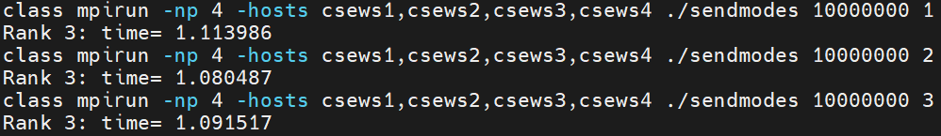
Performance of Send Modes
MPI_Send
MPI_Bsend
MPI_Ssend
Rendezvous
Explicit buffering
Explicit synchronization

Slide 27
Nearest Neighbor (NN) Exchange
0
P-1

