Slide 1
MPI Programming
Lecture 8
January 29, 2025

Slide 2
Send-Recv Example (2*P/2 pairwise communications)
Figure shows the communication pattern
0 sends to 3 and receives from 3
1 sends to 4 and receives from 4
2 sends to 5 and receives from 5
0
P-1
How many destinations does each process have?
How many senders does each process have?
A process communicates with which process?

Slide 3
Complete the Code
if (?) {
MPI_Send (data, count, MPI_INT, ________, ________, MPI_COMM_WORLD);
MPI_Recv (recvbuf, count, MPI_INT, ________, ________, MPI_COMM_WORLD, &status);
}
else {
MPI_Recv (recvbuf, count, MPI_INT, _______,_______, MPI_COMM_WORLD, &status);
MPI_Send (data, count, MPI_INT, _______, _______, MPI_COMM_WORLD);
}

Slide 4
Code (one of the versions)
if (myrank < P/2) {
MPI_Send (data, count, MPI_INT, myrank+P/2, myrank+P/2, MPI_COMM_WORLD);
MPI_Recv (recvbuf, count, MPI_INT, myrank+P/2, myrank, MPI_COMM_WORLD, &status);
}
else {
MPI_Recv (recvbuf, count, MPI_INT, myrank-P/2, myrank, MPI_COMM_WORLD, &status);
MPI_Send (data, count, MPI_INT, myrank-P/2, myrank-P/2, MPI_COMM_WORLD);
}

Slide 5
Nearest Neighbor (NN) 1D Exchange
0
P-1
Arrows show the communication pattern

Slide 6
Pseudocode
if (myrank < P-1) {
// Send/recv right neighbor
MPI_Send (data, count, MPI_DOUBLE, myrank+1, myrank+1, MPI_COMM_WORLD);
}
if (myrank > 0) {
// Send/recv left neighbor
MPI_Recv (recvbuf, count, MPI_DOUBLE, myrank-1, myrank, MPI_COMM_WORLD, &status);
printf ("%d received from %d\n", myrank, myrank-1);
}

Slide 7
Nearest Neighbor (NN) 2D Exchange
0
P-1
Arrows show the communication pattern

Slide 8
Nearest Neighbor Pseudocode
Tags?
Performance?
Option 1: Schedule right sends followed by left sends
if (myrank < P-1)
{
// Send/recv right neighbor
MPI_Send (data, myArraySize, MPI_DOUBLE, myrank+1, myrank+1, MPI_COMM_WORLD);
MPI_Recv (recvbuf, myArraySize, MPI_DOUBLE, myrank+1, myrank, MPI_COMM_WORLD, &status);
}
?
?

Slide 9
Nearest Neighbor Pseudocode
Tags?
Performance?
Option 1: Schedule right sends followed by left sends
if (myrank > 0)
{
// Send/recv left neighbor
MPI_Recv (recvbuf, myArraySize, MPI_DOUBLE, myrank-1, myrank, MPI_COMM_WORLD, &status);
MPI_Send (data, myArraySize, MPI_DOUBLE, myrank-1, myrank-1, MPI_COMM_WORLD);
}
?
?

Slide 10
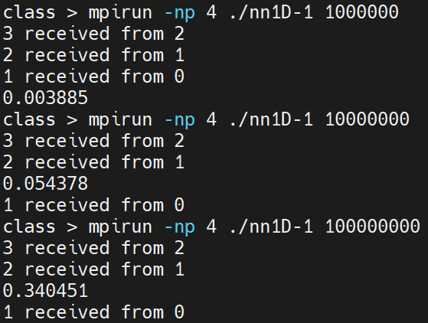
Output (1D NN exchange)

Slide 11
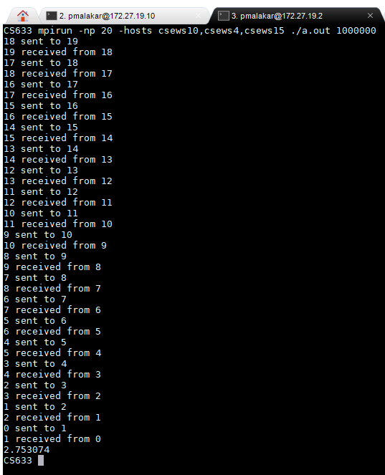


Output (2D NN)

Slide 12
Nearest Neighbor Pseudocode
Option 2: Schedule odd and even ranks alternately
if (?) {
MPI_Send (data, myArraySize, MPI_DOUBLE, ?, ?, MPI_COMM_WORLD);
MPI_Recv (recvbuf, myArraySize, MPI_DOUBLE, ?, ?, MPI_COMM_WORLD, &status);
}
else if (?) {
MPI_Recv (recvbuf, myArraySize, MPI_DOUBLE, ?, ?, MPI_COMM_WORLD, &status);
MPI_Send (data, myArraySize, MPI_DOUBLE, ?, ?, MPI_COMM_WORLD);
}

Slide 13
Nearest Neighbor Pseudocode
Option 2: Schedule odd and even ranks alternately
if (myrank % 2 == 0 && myrank < P-1) {
// Send/recv right neighbour from even ranks
MPI_Send (data, myArraySize, MPI_DOUBLE, myrank+1, myrank+1, MPI_COMM_WORLD);
MPI_Recv (recvbuf, myArraySize, MPI_DOUBLE, myrank+1, myrank, MPI_COMM_WORLD, &status);
}
else if (myrank % 2 != 0 && myrank > 0) {
// Send/recv left neighbor
MPI_Recv (recvbuf, myArraySize, MPI_DOUBLE, myrank-1, myrank, MPI_COMM_WORLD, &status);
MPI_Send (data, myArraySize, MPI_DOUBLE, myrank-1, myrank-1, MPI_COMM_WORLD);
}

Slide 14
Nearest Neighbor Pseudocode
Option 2: Schedule odd and even ranks alternately
if (?)
{
// Send/recv right neighbor from odd ranks
MPI_Send (data, myArraySize, MPI_DOUBLE, ?, ?, MPI_COMM_WORLD);
MPI_Recv (recvbuf, myArraySize, MPI_DOUBLE, ?, ?, MPI_COMM_WORLD, &status);
}
else if (?)
{
// Send/recv left neighbor
MPI_Recv (recvbuf, myArraySize, MPI_DOUBLE, ?, ?, MPI_COMM_WORLD, &status);
MPI_Send (data, myArraySize, MPI_DOUBLE, ?, ?, MPI_COMM_WORLD);
}

Slide 15
Nearest Neighbor Pseudocode
Option 2: Schedule odd and even ranks alternately
if (myrank % 2 != 0 && myrank < P-1)
{
// Send/recv right neighbor from odd ranks
MPI_Send (data, myArraySize, MPI_DOUBLE, myrank+1, myrank+1, MPI_COMM_WORLD);
MPI_Recv (recvbuf, myArraySize, MPI_DOUBLE, myrank+1, myrank, MPI_COMM_WORLD, &status);
}
else if (myrank % 2 == 0 && myrank > 0)
{
// Send/recv left neighbor
MPI_Recv (recvbuf, myArraySize, MPI_DOUBLE, myrank-1, myrank, MPI_COMM_WORLD, &status);
MPI_Send (data, myArraySize, MPI_DOUBLE, myrank-1, myrank-1, MPI_COMM_WORLD);
}

Slide 16
Same Host (Option 1 vs. 2)
for i in `seq 1 5` ; do mpirun -np 4 ./nn-1 1000000 ; done
0.006751
0.006896
0.006518
0.006310
0.006356
for i in `seq 1 5` ; do mpirun -np 4 ./nn-2 1000000 ; done
0.006183
0.017730
0.006718
0.006862
0.006701

Slide 17
Two Hosts (Option 1 vs. 2)
for i in `seq 1 5` ; do mpirun -np 4 -hosts csews1,csews10 ./nn-1 1000000 ; done
0.450281
0.426031
0.419316
0.445110
0.416786
or i in `seq 1 5` ; do mpirun -np 4 -hosts csews1,csews10 ./nn-2 1000000 ; done
0.405743
0.423926
0.410813
0.420823
0.430066

Slide 18
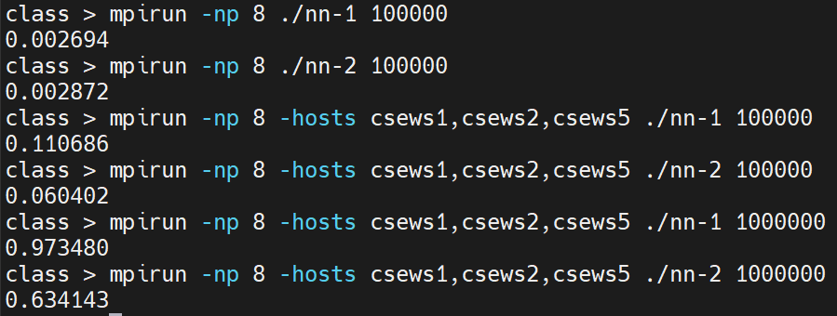
Three Hosts (Option 1 vs. 2) Run 1

Slide 19
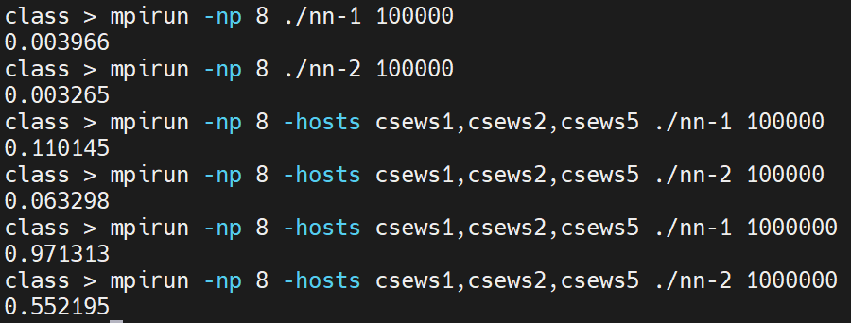
Three Hosts (Option 1 vs. 2) Run 2

Slide 20
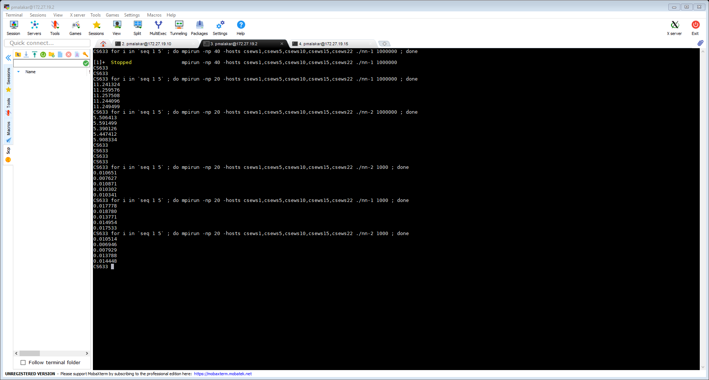
Timing Option 1 vs. Option 2

Slide 21
Timing Option 1 vs. Option 2

Slide 22
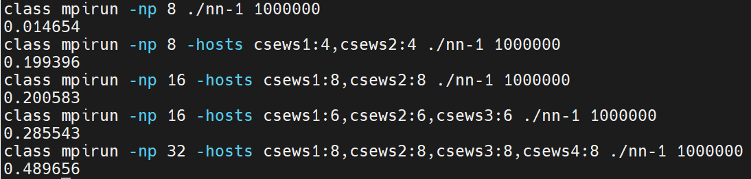
Timing NN (Option 1)

Slide 23
P2P Blocking – Performance Bottleneck
MPI_Send (buf, count, datatype, dest, tag, comm)
MPI_Recv (buf, count, datatype, source, tag, comm, status)
0
1
MPI_Send (1)
Safe but may delay sender
MPI_Recv (0)
Notes:
Send blocks until corr. Recv is posted for large messages

Slide 24
Computation Communication Overlap
0
1
compute
Send
compute
Time
compute
Recv
Wait
compute
compute

Slide 25
Non-blocking Point-to-Point
MPI_Isend (buf, count, datatype, dest, tag, comm, request)
MPI_Irecv (buf, count, datatype, source, tag, comm, request)
MPI_Wait (request, status)
MPI_Waitall (count, request, status)

Slide 26
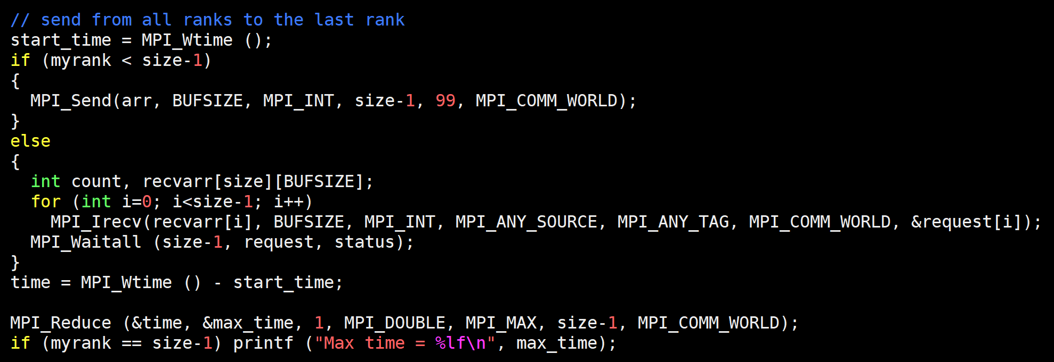
Many-to-one Non-blocking P2P

Slide 27
Homework: NN 1D using Non-blocking
0
P-1

