Slide 1
Communication
Lecture 9
February 3, 2025

Slide 2
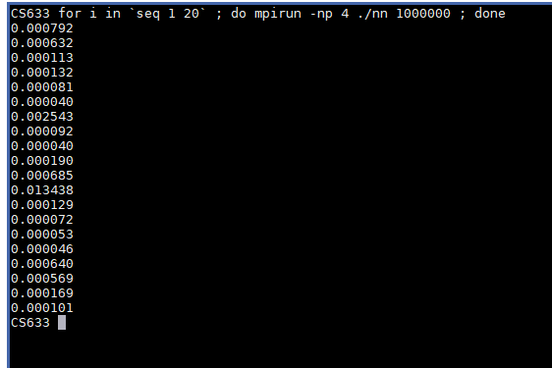
Output
Outlier
Variability

Slide 3
Non-blocking Point-to-Point
MPI_Isend (buf, count, datatype, dest, tag, comm, request)
MPI_Irecv (buf, count, datatype, source, tag, comm, request)
MPI_Wait (request, status)
MPI_Waitall (count, request, status)

Slide 4
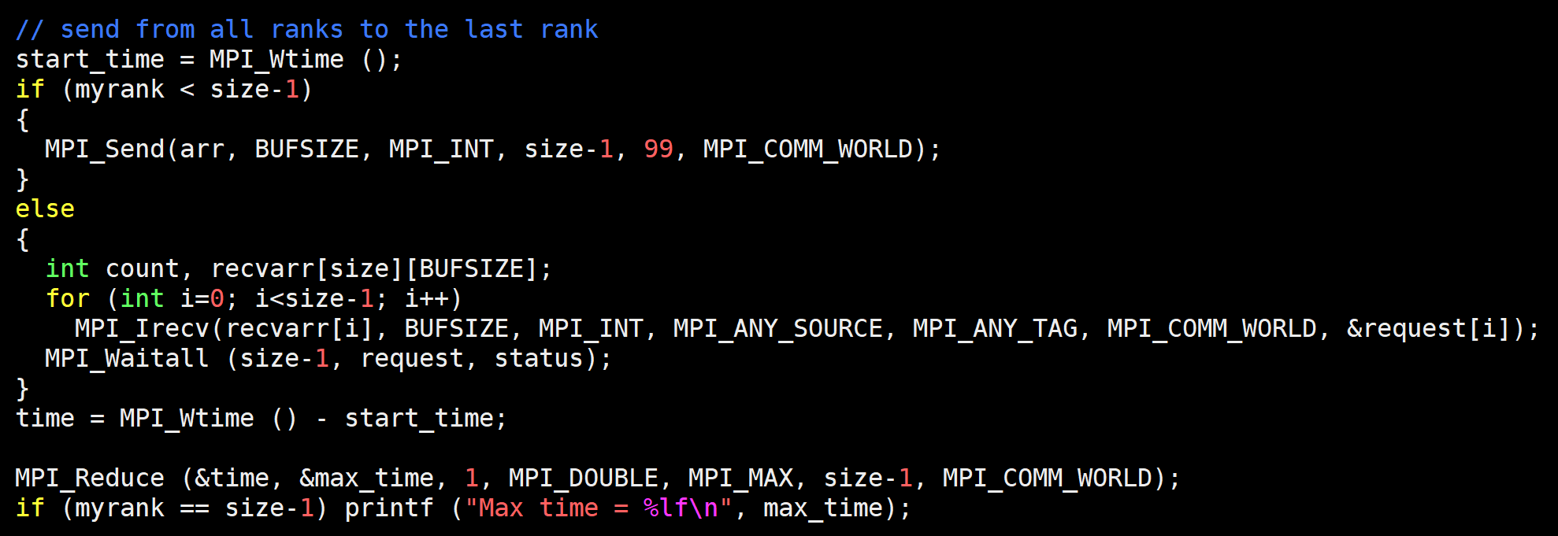
Many-to-one Non-blocking P2P

Slide 5
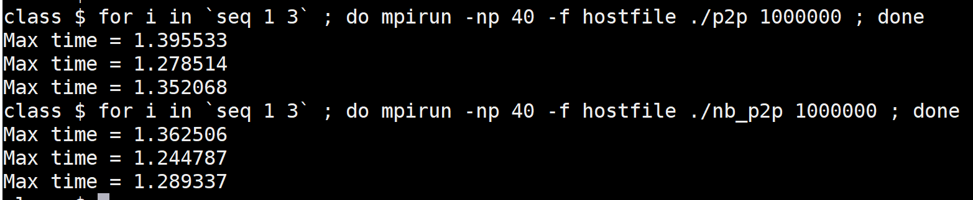
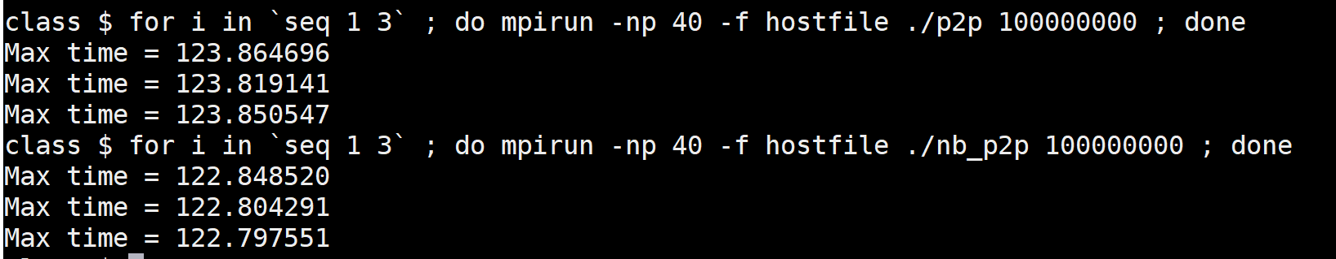
Output

Slide 6
Non-blocking Performance
Standard does not require overlapping communication and computation
Implementation may use a thread to move data in parallel
Implementation can delay the initiation of data transfer until “Wait”
MPI_Test – non-blocking, tests completion, starts progress
MPIR_CVAR_ASYNC_PROGRESS (MPICH) ensures progress

Slide 7
Non-blocking Point-to-Point Safety
MPI_Isend (buf, count, datatype, dest, tag, comm, request)
MPI_Irecv (buf, count, datatype, source, tag, comm, request)
MPI_Wait (request, status)
0
1
MPI_Isend
MPI_Isend
Safe
MPI_Recv
MPI_Recv

Slide 8
Homework: NN 1D using Non-blocking
0
P-1

Slide 9
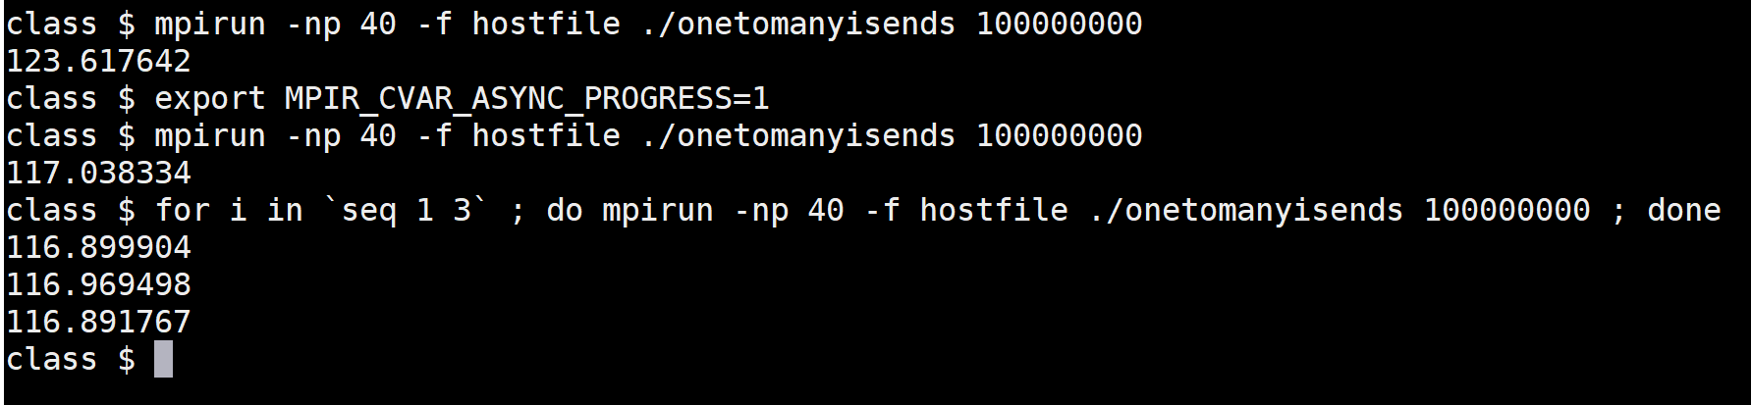
Asynchronous Communication Progress
One to many (using isend)

Slide 10
Communication Graph/Matrix
64, 256, 512 bytes (lighter to darker shade)
1
 | 512 | 64 | 256
512 |  |  |  | 64 | 256
64 |  |  | 512 |  | 64
256 |  | 512 |  | 512
 | 64 |  | 512 |  | 64
 | 256 | 64 |  | 64
0
4
2
3
5

Slide 11
HW: Communication Matrix
0
P-1
512 bytes

Slide 12
Process Mapping/Allocation
0
1
10
11
0
1
2
3
4
7
8
11
Network 1
Network 2

Slide 13
Process Mapping/Allocation
0
1
10
11
0
1
2
This network may result in less average number of hops for the above communication pattern
This network has higher cost than the other network (had fewer links)
3
4
7
8
11

Slide 14
Process Mapping/Allocation
0
1
2
9
10
11
0
1
2
3
4
7
Communication Pattern 1 -> 0, 3 ->2, …
Maximum number of hops? 1
Average number of hops? 1
8
11

Slide 15
Process Mapping/Allocation
0
1
2
9
10
11
0
1
2
3
4
7
Communication Pattern 2 -> 0, 6 -> 4, …
Maximum number of hops? 2
Average number of hops? 2
8
11

Slide 16
Process Mapping/Allocation
0
1
2
9
10
11
0
1
2
3
Maximum number of hops?
4
7
8
11

Slide 17
Revision for Quiz 1

