Slide 1
Chhatrapati Sambhajinagar
Taluka Delivery Analysis — F23 to F26
Village-level performance intelligence
6
22
950
2,686
TALUKAS
SALESMEN
VILLAGES
TOTAL DELIVERIES
Prepared for Rajwardhan Pawar • Confidential

Slide 2
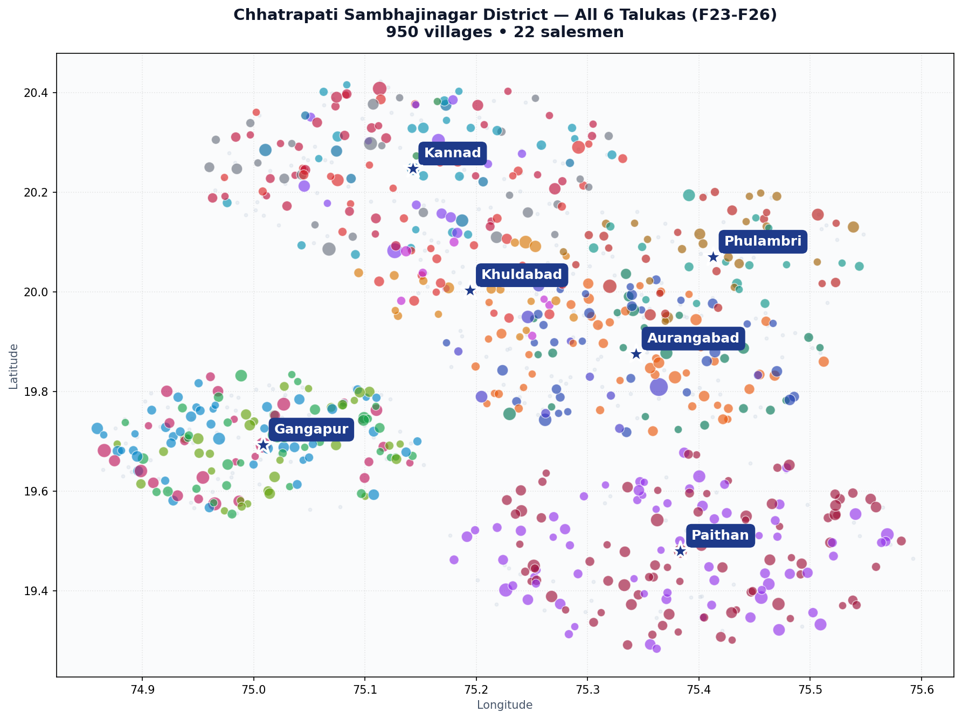
Executive Summary
2,686
1,059
+29%
507
TOTAL DELIVERIES F23-F26
F26 DELIVERIES
F25 → F26 GROWTH
ZERO-F26 VILLAGES (OPPORTUNITY)
Key takeaways from the F23-F26 analysis: • Paithan is the largest taluka by volume (679 total, 25% of district); Gangapur (639) is a close second. • F25 → F26 saw +29% growth district-wide, driven largely by Paithan (+50%) and Kannad (+31%). • 53% of villages received zero F26 tractors — a sizable expansion opportunity. • Pravin Chavan (Gangapur) leads by coverage at 91%; Vishwas (Paithan) leads by volume at 362 deliveries. • Mahesh Jadhav (82% cov in Khuldabad) and Dinesh (81% in Paithan) are the most efficient deployments. Note: F23 data is only available for Aurangabad and Gangapur; other talukas start from F24.
District overview — all 6 talukas

Slide 3
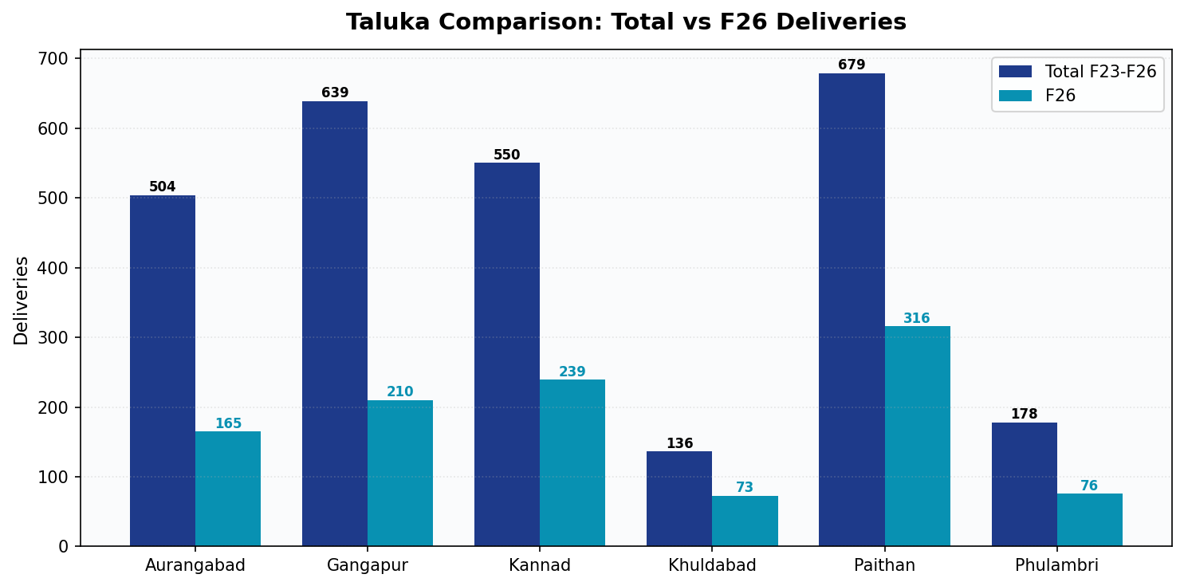
Taluka Performance Comparison
Ranking by Total
1
Paithan
679
192 vil • 2 sm
F26: 316
2
Gangapur
639
214 vil • 5 sm
F26: 210
3
Kannad
550
207 vil • 7 sm
F26: 239
4
Aurangabad
504
183 vil • 4 sm
F26: 165
5
Phulambri
178
89 vil • 3 sm
F26: 76
6
Khuldabad
136
65 vil • 3 sm
F26: 73

Slide 4
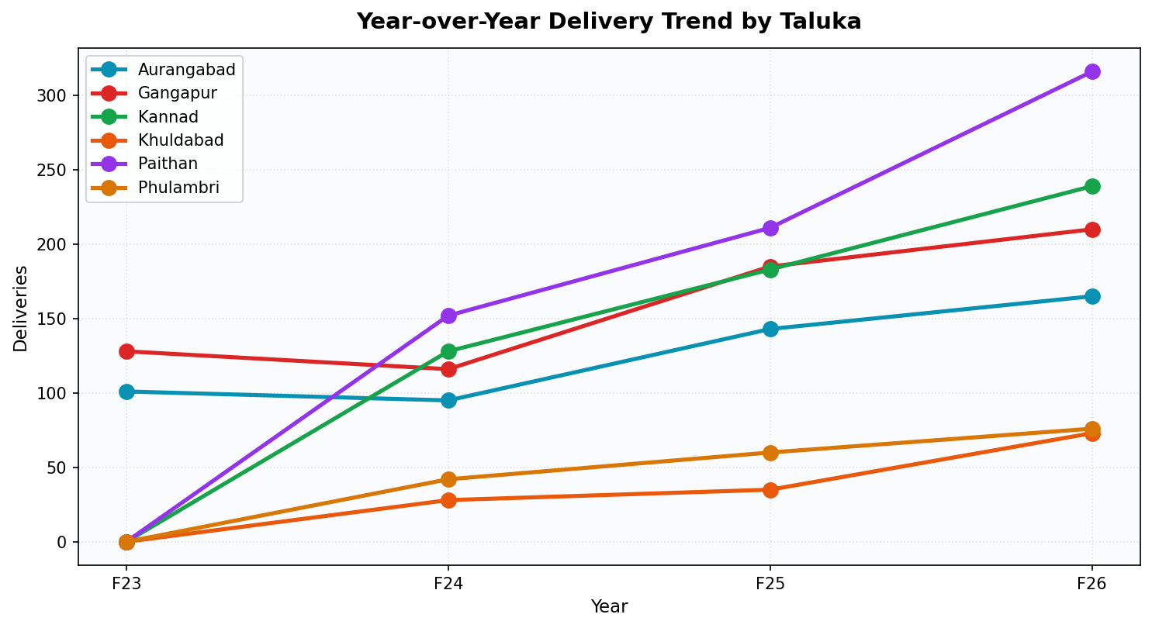
Year-over-Year Trend
Key Observations
• F25 → F26 growth is strongest in Paithan (+50%) and Kannad (+31%) • Aurangabad and Gangapur show steady ~63% growth across the full 4-year window • No taluka has declined YoY • F23 baseline missing for 4 talukas — recommend backfill for like-for-like comparison • F26 district total (1,059) is the highest year on record

Slide 5
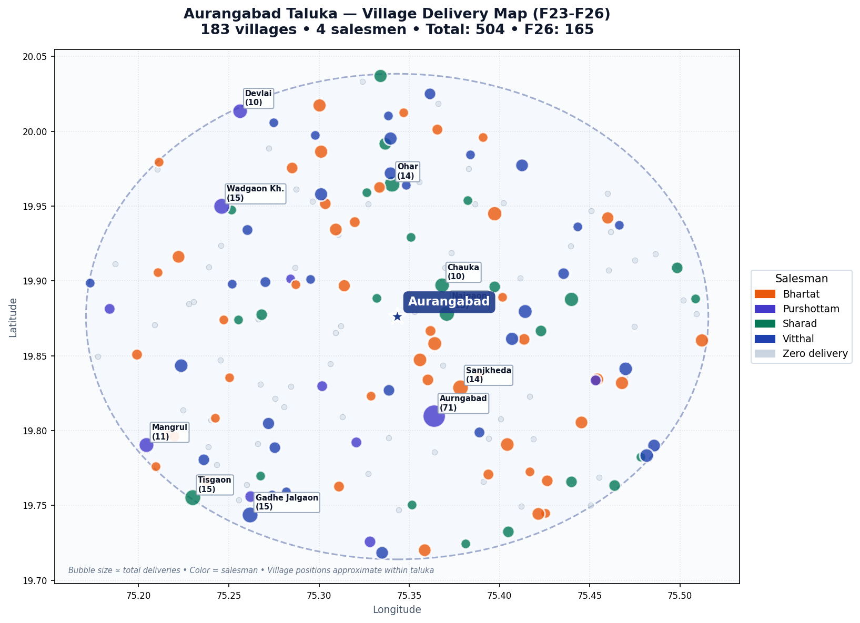
Aurangabad Taluka
183 villages • 4 salesmen • 504 total deliveries (F23-F26)
504
165
TOTAL F23-F26
F26
63%
7.6%
COVERAGE
PENETRATION
116
2.8
ZERO F26
AVG / VILLAGE
Salesman Performance
Name
Vil
Cov%
F26
Total
Bhartat
65
71%
60
156
Purshottam
16
69%
36
122
Vitthal
65
52%
47
122
Sharad
37
68%
22
104

Slide 6
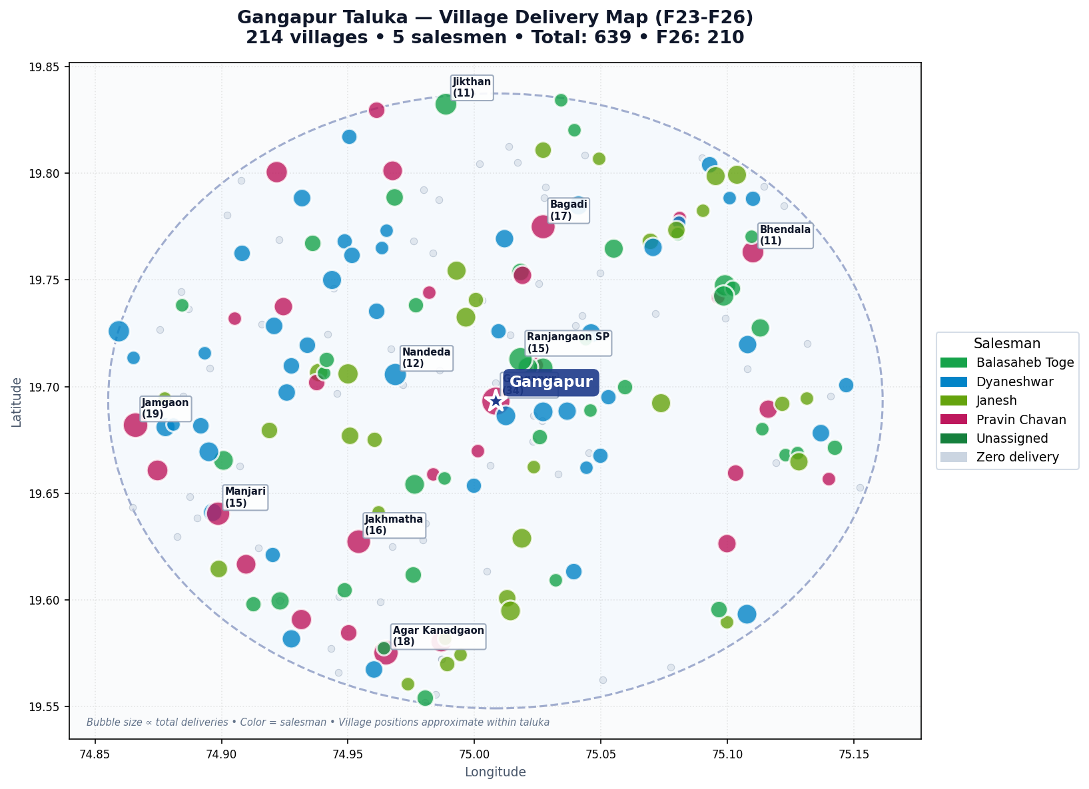
Gangapur Taluka
214 villages • 5 salesmen • 639 total deliveries (F23-F26)
639
210
TOTAL F23-F26
F26
68%
0.0%
COVERAGE
PENETRATION
125
3.0
ZERO F26
AVG / VILLAGE
Salesman Performance
Name
Vil
Cov%
F26
Total
Pravin Chavan
32
91%
83
221
Dyaneshwar
77
60%
52
174
Balasaheb Toge
56
70%
31
138
Janesh
44
70%
44
106
Unassigned
5
0%
0
0

Slide 7
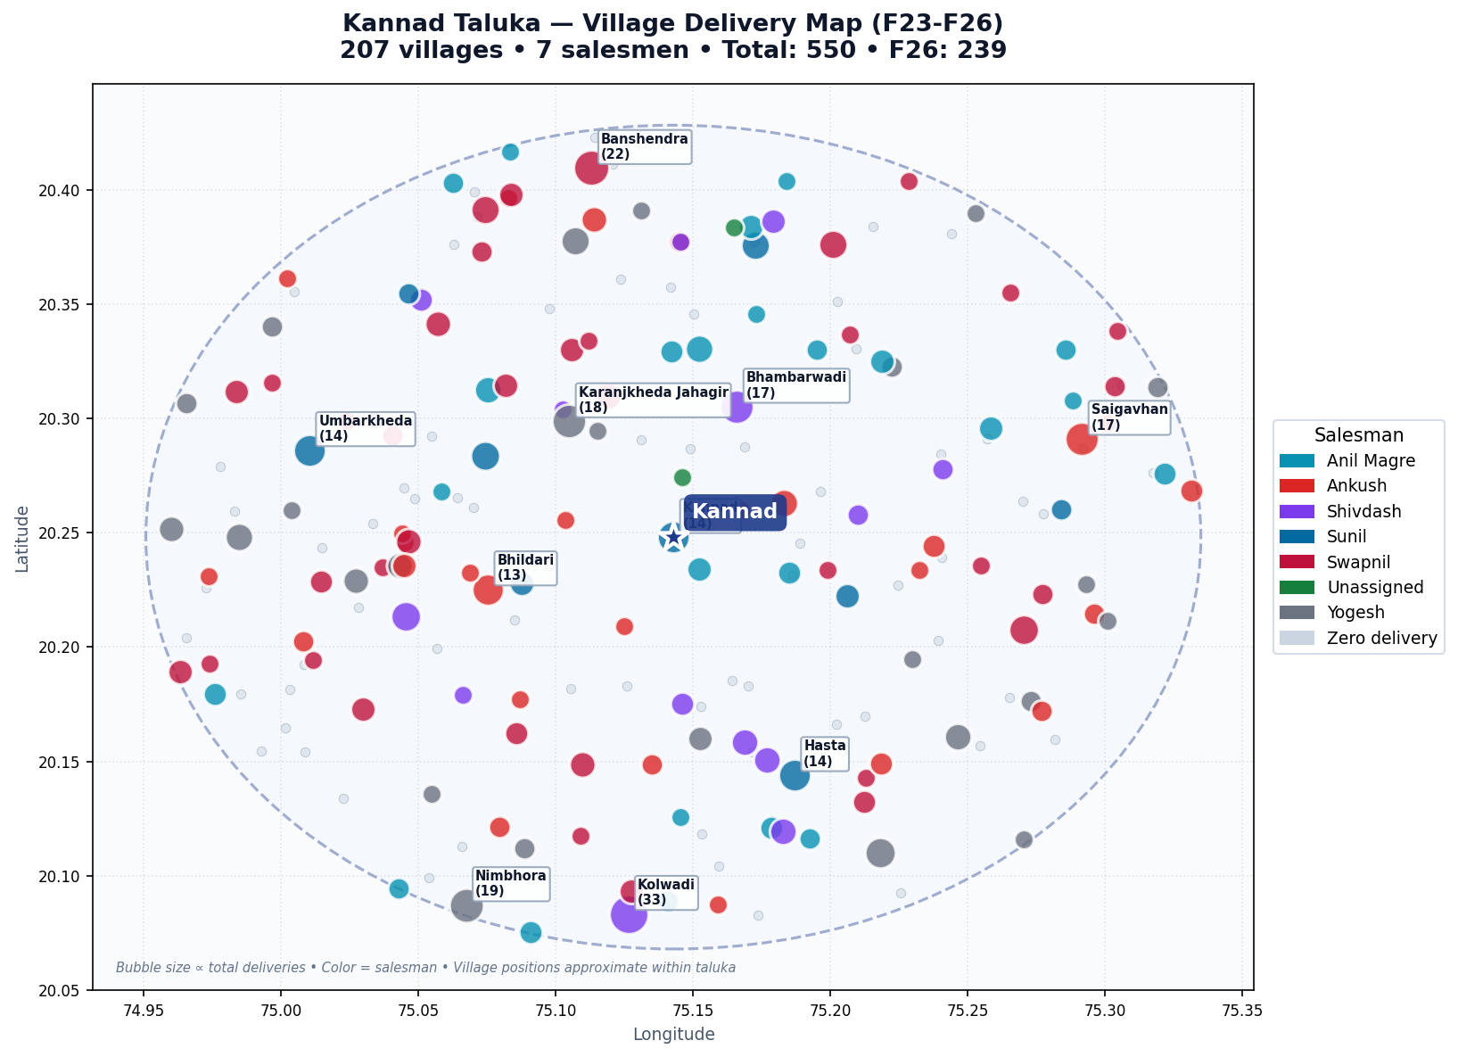
Kannad Taluka
207 villages • 7 salesmen • 550 total deliveries (F23-F26)
550
239
TOTAL F23-F26
F26
67%
0.0%
COVERAGE
PENETRATION
107
2.7
ZERO F26
AVG / VILLAGE
Salesman Performance
Name
Vil
Cov%
F26
Total
Swapnil
50
72%
57
127
Yogesh
34
76%
44
110
Shivdash
21
67%
46
95
Ankush
49
55%
38
80
Sunil
13
69%
31
71
Anil Magre
34
71%
22
65
Unassigned
6
33%
1
2

Slide 8
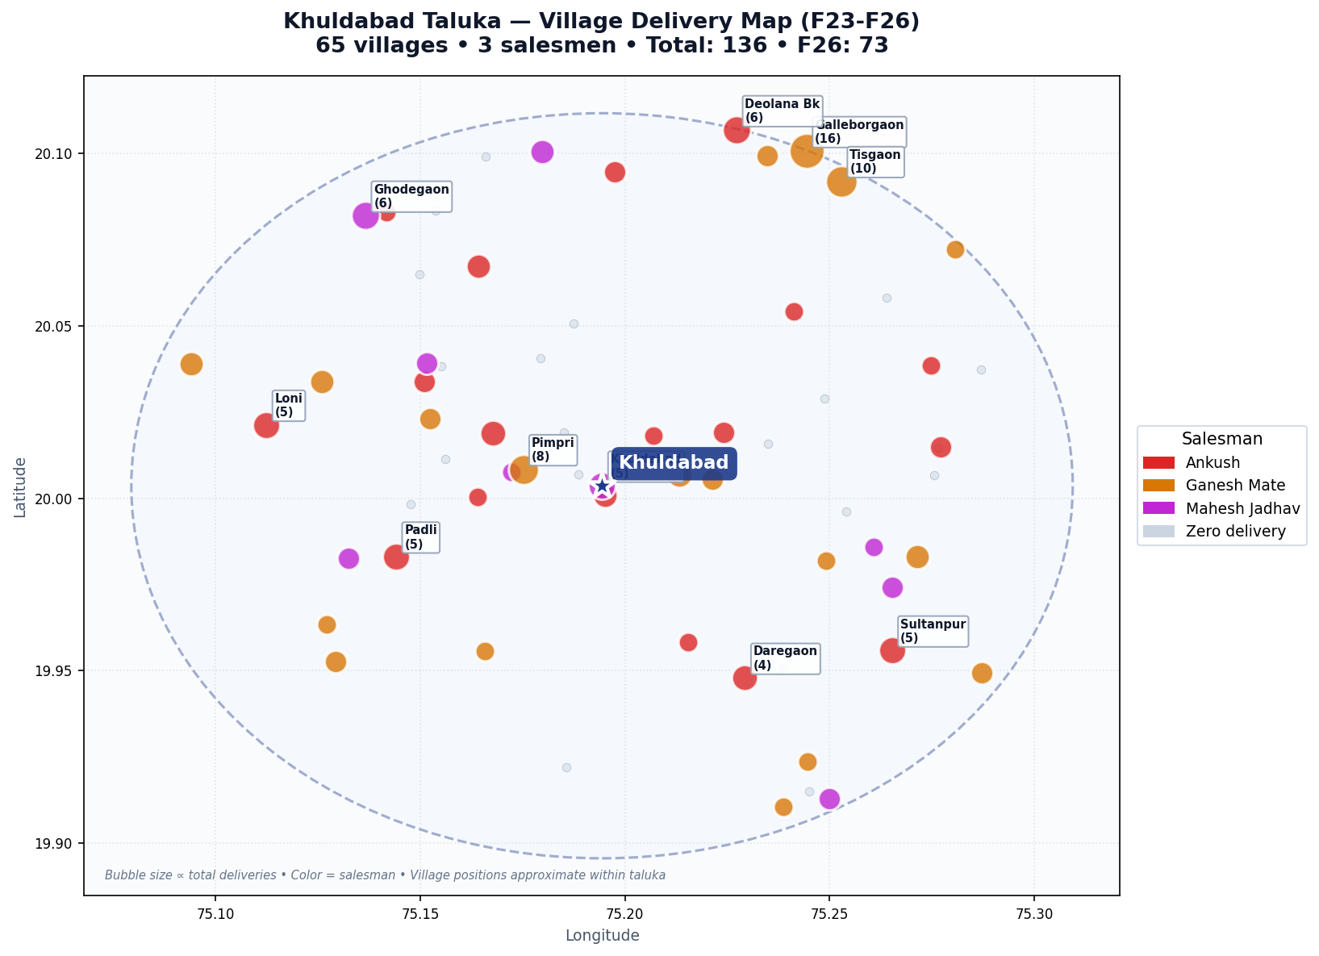
Khuldabad Taluka
65 villages • 3 salesmen • 136 total deliveries (F23-F26)
136
73
TOTAL F23-F26
F26
69%
8.6%
COVERAGE
PENETRATION
27
2.1
ZERO F26
AVG / VILLAGE
Salesman Performance
Name
Vil
Cov%
F26
Total
Ganesh Mate
29
62%
27
63
Ankush
25
72%
33
49
Mahesh Jadhav
11
82%
13
24

Slide 9
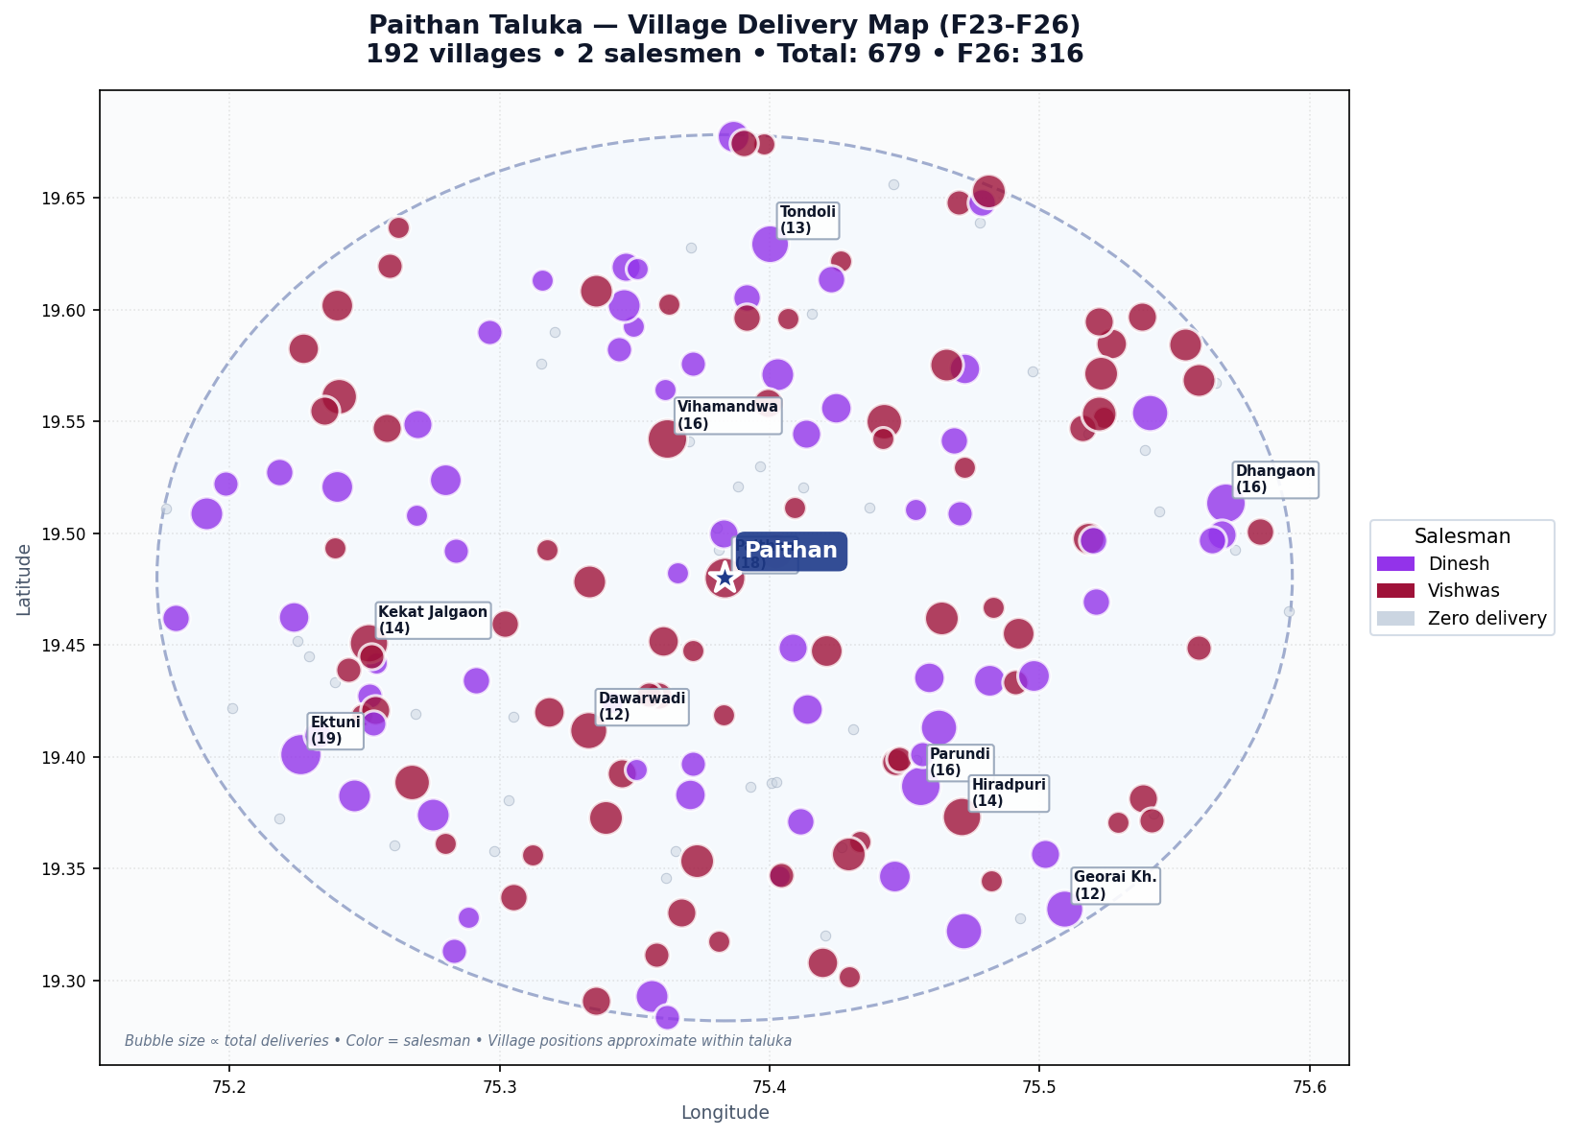
Paithan Taluka
192 villages • 2 salesmen • 679 total deliveries (F23-F26)
679
316
TOTAL F23-F26
F26
78%
0.0%
COVERAGE
PENETRATION
77
3.5
ZERO F26
AVG / VILLAGE
Salesman Performance
Name
Vil
Cov%
F26
Total
Vishwas
107
76%
162
362
Dinesh
85
81%
154
317

Slide 10
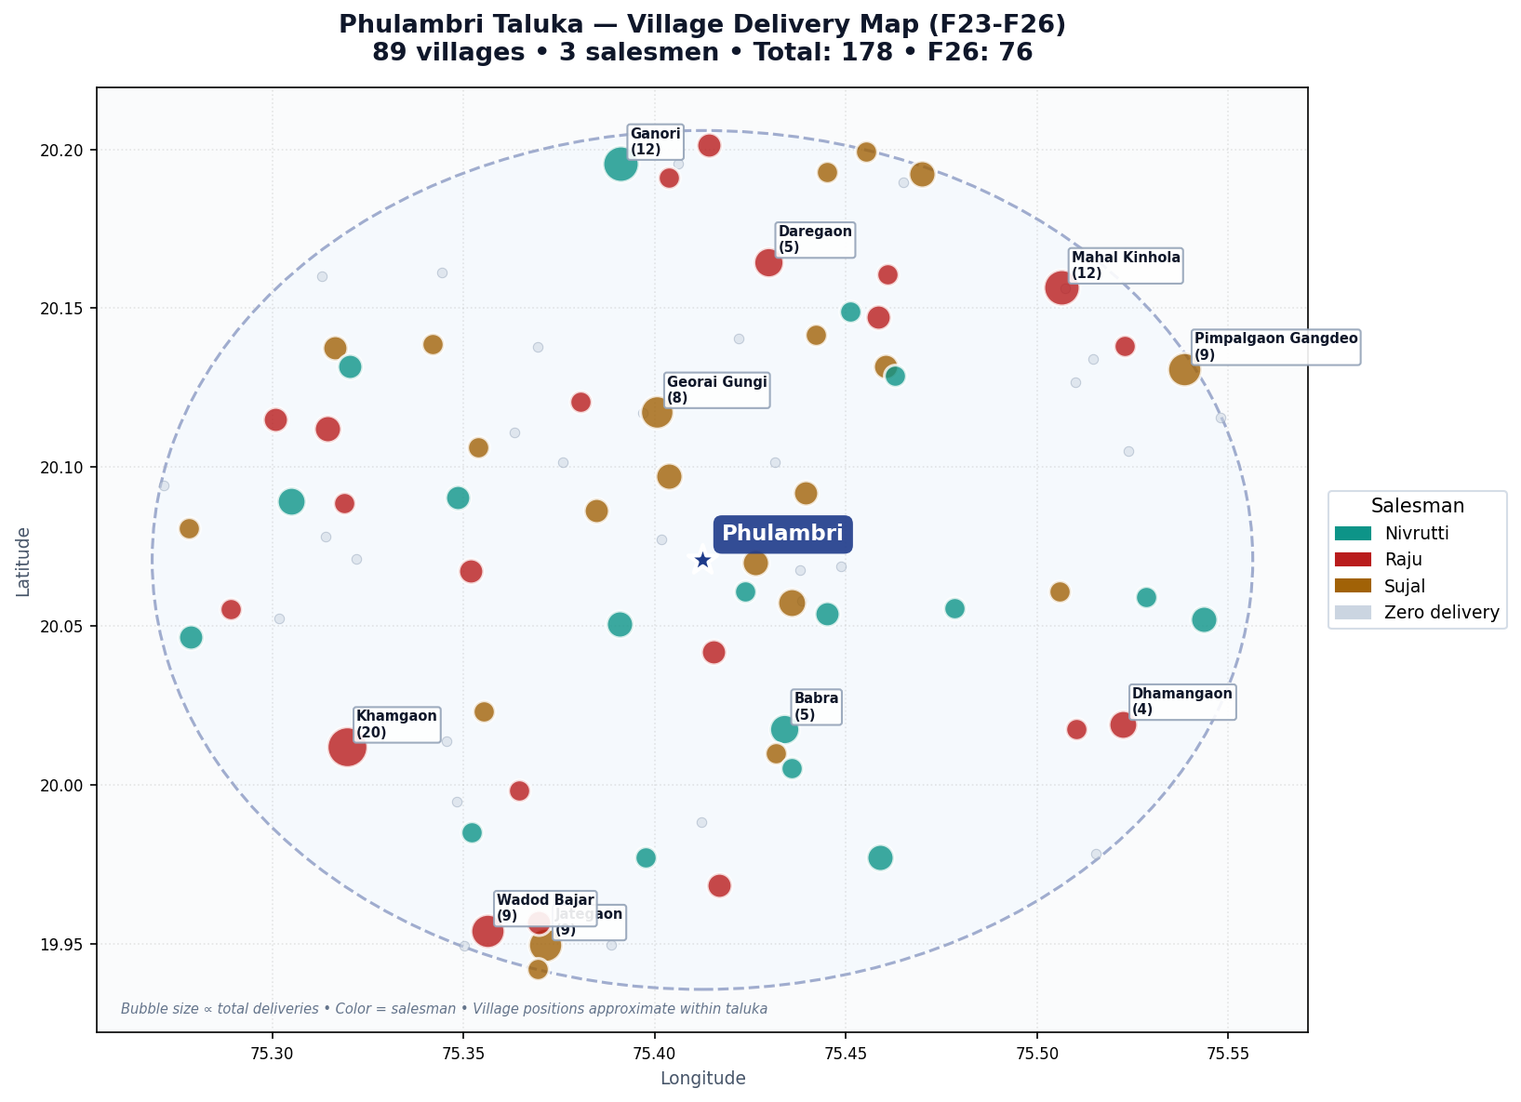
Phulambri Taluka
89 villages • 3 salesmen • 178 total deliveries (F23-F26)
178
76
TOTAL F23-F26
F26
67%
4.4%
COVERAGE
PENETRATION
55
2.0
ZERO F26
AVG / VILLAGE
Salesman Performance
Name
Vil
Cov%
F26
Total
Raju
28
75%
34
75
Sujal
29
72%
21
57
Nivrutti
32
56%
21
46

Slide 11
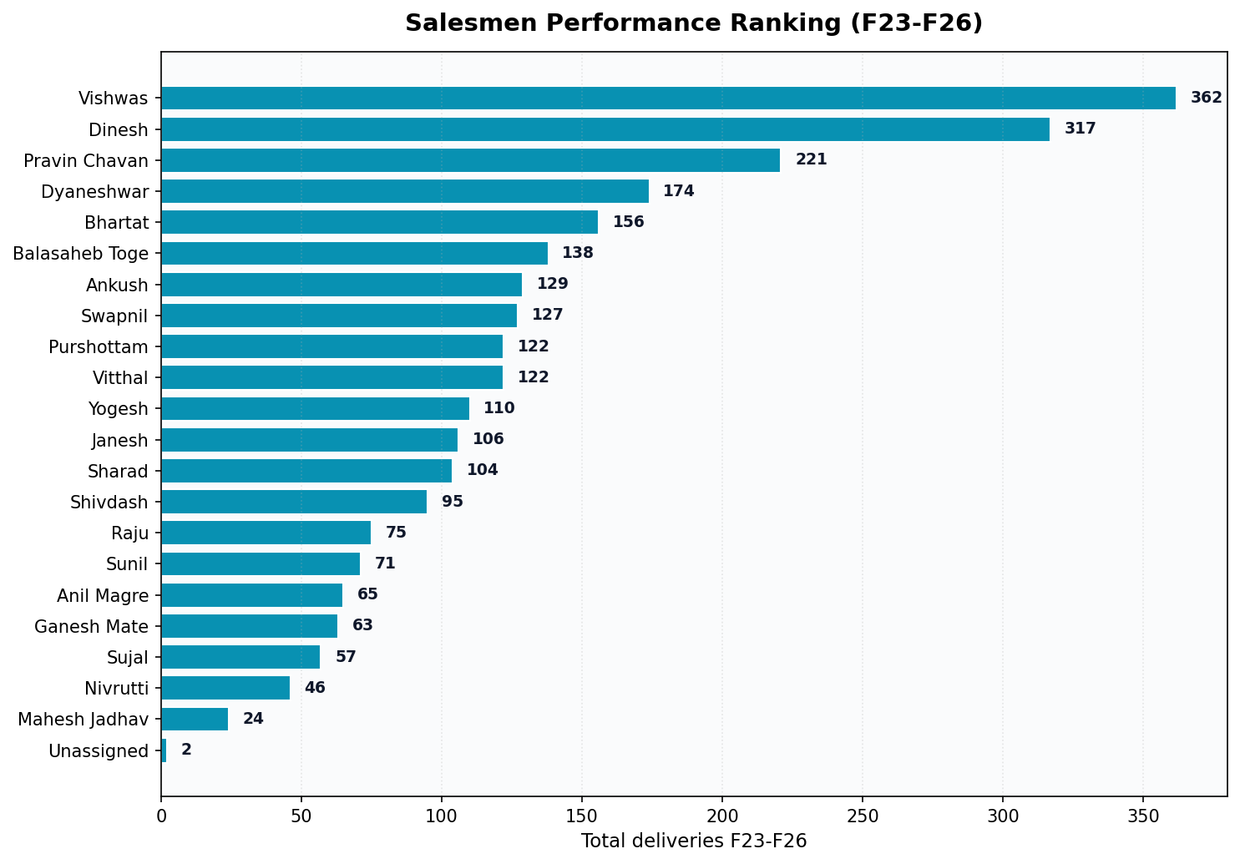
Salesmen Performance Ranking
Ranked by total F23-F26 deliveries
Top 5 by Coverage %
1.
Pravin Chavan
91%
29/32 villages • 221 deliveries
2.
Mahesh Jadhav
82%
9/11 villages • 24 deliveries
3.
Dinesh
81%
69/85 villages • 317 deliveries
4.
Yogesh
76%
26/34 villages • 110 deliveries
5.
Vishwas
76%
81/107 villages • 362 deliveries

Slide 12
Expansion Opportunities — Zero-F26 Villages
507 villages (53% of total) had zero F26 deliveries. Top opportunities by population below.
Aurangabad
116 zero-F26 villages
Gangapur
125 zero-F26 villages
Kannad
107 zero-F26 villages
Village
Salesman
Pop
Village
Salesman
Pop
Village
Salesman
Pop
Ladsawangi
Vitthal
7281
Jogeshwari
Balasaheb Toge
8272
Chincholi
Yogesh
6434
Daulatabad
Sharad
6096
Turkabad Kharadi
Balasaheb Toge
6017
Kunjkheda
Anil Magre
6095
Pimpri Bk
Bhartat
5566
Katepimpalgaon
Dyaneshwar
3896
Digar
Yogesh
5511
Sawangi
Sharad
4727
Shendurwada
Balasaheb Toge
3729
Karanjkheda Khalsa
Yogesh
5146
Maliwada
Sharad
4403
Maliwadgaon
Janesh
2853
Ghatshendra
Yogesh
3919
Khuldabad
27 zero-F26 villages
Paithan
77 zero-F26 villages
Phulambri
55 zero-F26 villages
Village
Salesman
Pop
Village
Salesman
Pop
Village
Salesman
Pop
Bazar Sawangi
Ankush
4461
Nilajgaon
Dinesh
2846
Pal
Raju
4339
Gadana
Ankush
2688
Shekta
Dinesh
2241
Alad
Raju
3967
Tajnapur
Ankush
2115
Apegaon
Vishwas
2204
Kingaon
Nivrutti
3205
Bodkha
Ankush
2013
Sonwadi Kh.
Vishwas
1985
Bilda
Sujal
2555
Nirgudi Bk
Ganesh Mate
1716
Dabhrul
Dinesh
1868
Pimpalgaon Walan
Nivrutti
2382

Slide 13
Next Steps
1. Focus F27 expansion on the 507 zero-F26 villages (prioritized by population) 2. Leverage the interactive HTML app to drill down by salesman / year / taluka 3. Backfill F23 data for Kannad, Khuldabad, Paithan, Phulambri for complete YoY analysis 4. Replicate Paithan's acceleration model (+50% F25→F26) in lagging talukas 5. Review salesmen with <60% coverage for territory redesign or training

