Slide 1
bikeshare_da_dashboard
File created on: 10/7/2020 4:23:03 PM

Slide 2
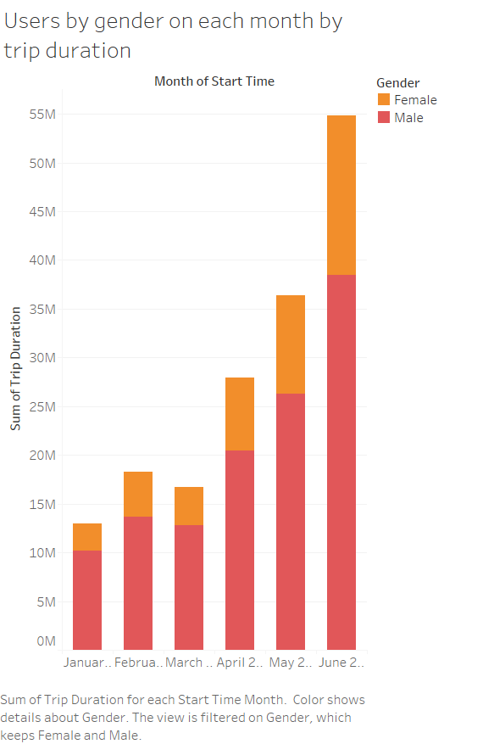

Slide 3
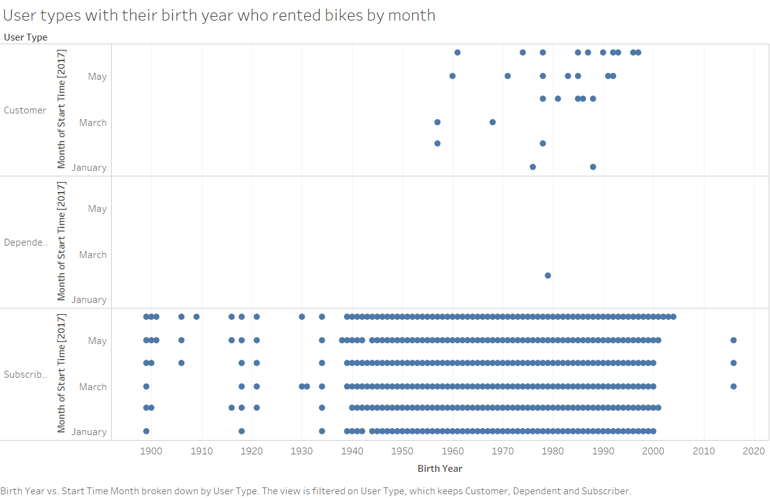

Slide 4
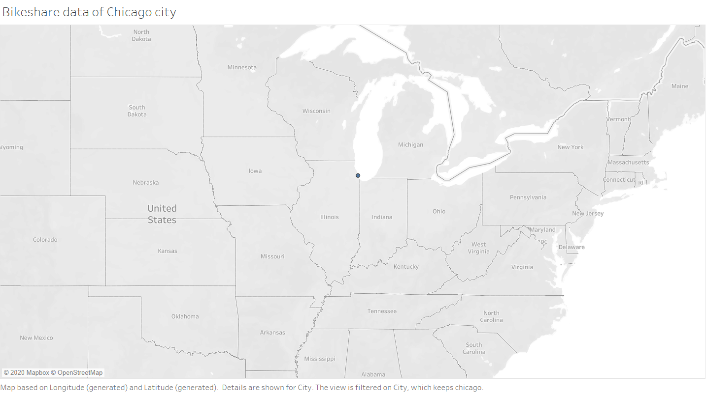

Slide 5


Slide 6
