Slide 1

Project Title -
Seasonal Agriculture Performance Analysis
Name – Raj Yadav
College – Anand Engineering College Agra
AICTE STU ID : STU68318fe14770b1748078561

Slide 2

PROBLEM STATEMENT
Agricultural performance changes across different seasons, crops, irrigation methods, and regions.
It is difficult to understand these changes using raw agricultural data.
This project aims to:
Analyze agricultural data using Python.
Compare crop performance across seasons.
Study irrigation and water efficiency.
Compare agricultural profit across states.
Find useful patterns and insights from the data.

Slide 3
Project Description
Seasonal Agriculture Performance Analysis is a data analytics project that studies agricultural performance using a dataset of 4,000 farm records.
The project analyzes:
Different agricultural seasons
Crop yield and production
Irrigation methods
Water efficiency
Agricultural cost, revenue and profit
State-wise performance
Python libraries such as Pandas, NumPy, Matplotlib and Seaborn are used for analysis and visualization.

Slide 4

WHO ARE THE END USERS?
👨‍🌾 Farmers – understand crop and irrigation performance.
🏛️ Agricultural Planners – support better planning.
📊 Researchers – study agricultural patterns.
🌾 Agricultural Organizations – compare regional performance.
🏢 Policy Makers – use data-based insights for agriculture planning.

Slide 5

Technology Used
Programming Language
Python
Libraries
Pandas
NumPy
Matplotlib
Seaborn
Development Environment
Jupyter Notebook

Slide 6
Technology Used
Dataset
CSV Dataset
Analysis Type
Descriptive Data Analysis
Statistical Analysis
Data Visualization

Slide 7
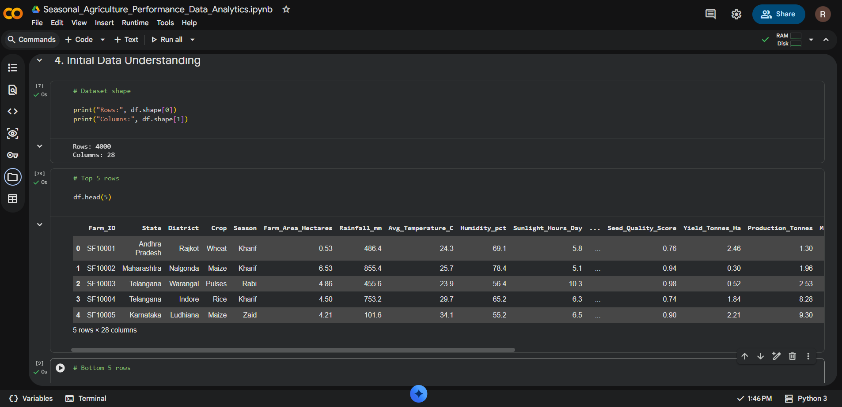
RESULTS
The dataset provides information about environmental conditions, farming inputs, yield, water usage and economic performance.

Slide 8
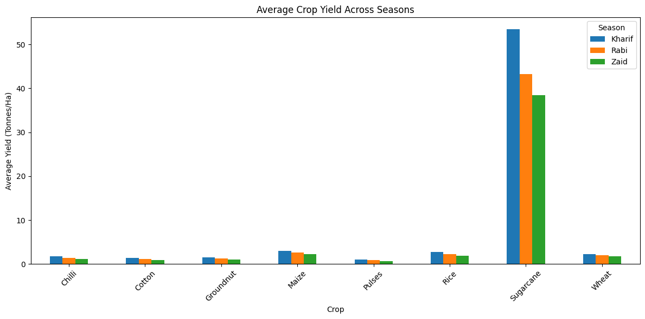
RESULTS
[Add screen shots of your code ]
Key Findings:
Kharif generally shows higher yield than Rabi and Zaid.
Sugarcane has the highest yield among the crops.
Yield varies depending on crop and season.
Crop-specific seasonal differences can help in better crop planning.

Slide 9
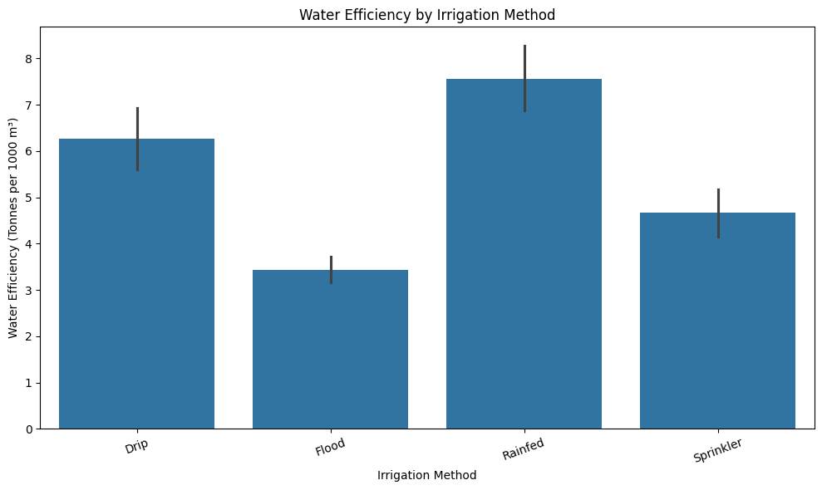
RESULTS
[Add screen shots of your code ]
Key Findings:
Rainfed farming shows the highest average water efficiency.
Drip irrigation has better efficiency than flood irrigation.
Flood irrigation shows the lowest water efficiency.
Irrigation method has an important relationship with water use and yield.

Slide 10
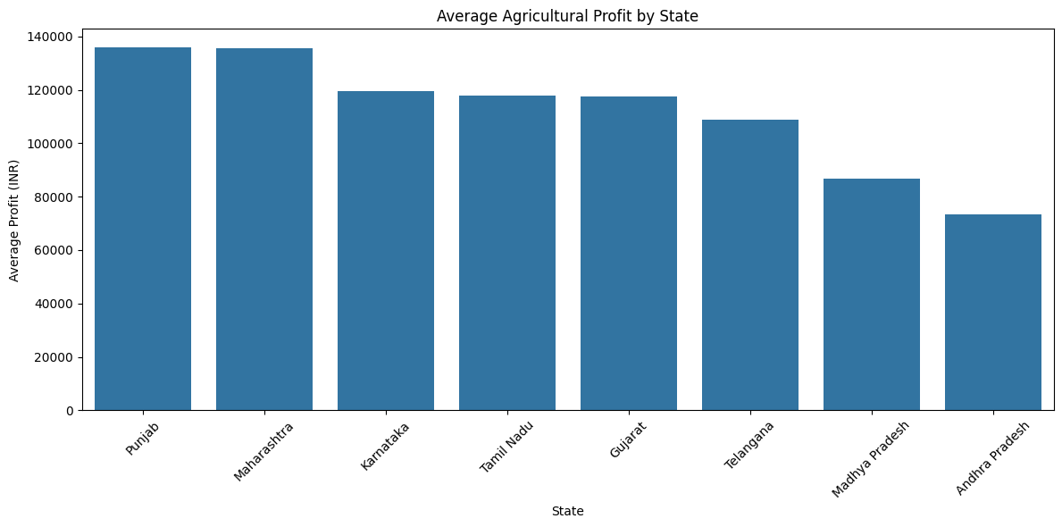
RESULTS
[Add screen shots of your code ]
Key Findings:
Punjab has the highest average profit.
Maharashtra has almost similar average profit.
Karnataka, Tamil Nadu and Gujarat show moderate performance.
Andhra Pradesh has the lowest average profit among the analyzed states.
Agricultural profitability differs across states.

Slide 11
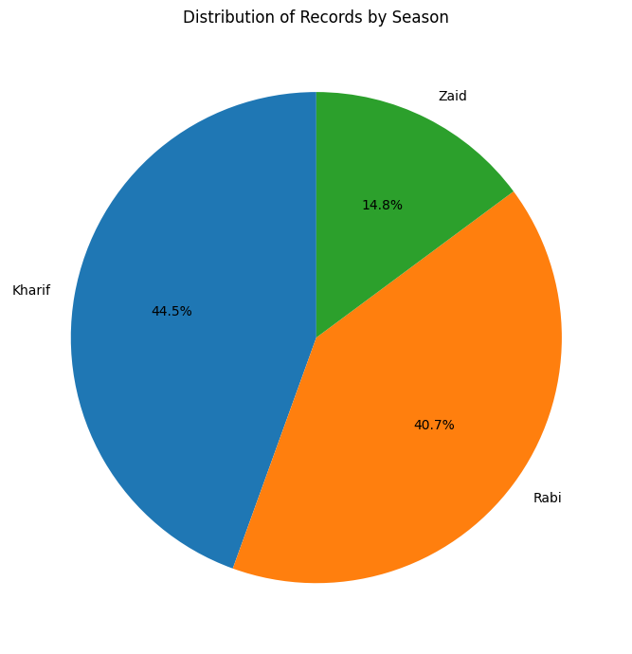
RESULTS
Key Findings:
Kharif has the highest number of records (44.5%).
Rabi represents 40.7% of the records.
Zaid has the lowest share (14.8%).
The dataset contains more records for Kharif and Rabi seasons than Zaid.
[Add screen shots of your code ]

Slide 12
Future scope
Future Scope
The project can be improved in the future by:
Adding more recent agricultural data.
Including more states and crops.
Adding weather and market-price data.
Building an interactive dashboard.
Adding Machine Learning for yield prediction.
Developing a system for crop and irrigation recommendations.

Slide 13
GitHub Link
Github Repo Link :-
https://github.com/rajyadav-590/Seasonal-Agriculture-Performance-Analysis.git

Slide 14
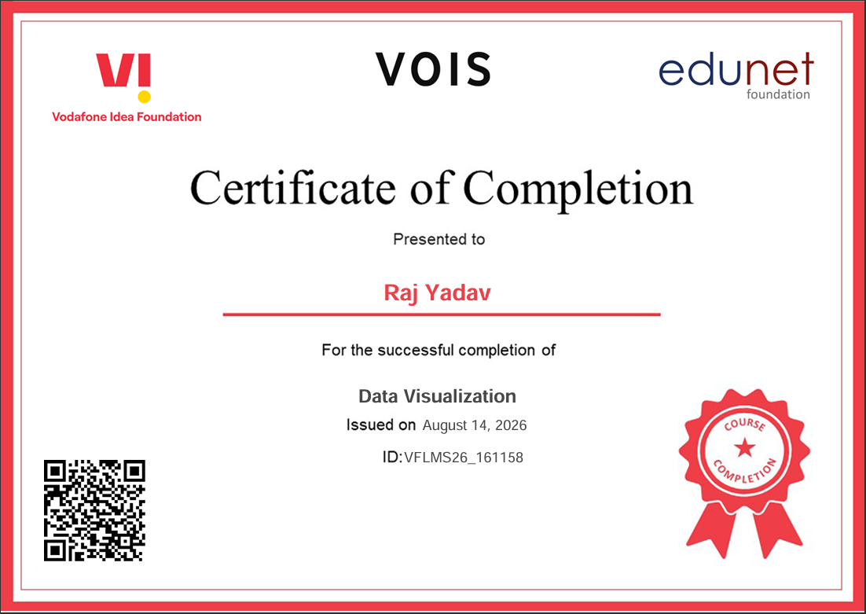
VOIS Course completion certificate - Course name- Data Visualization

Slide 15
Thank you
Seasonal Agriculture Performance Analysis
Raj Yadav B.Tech CSE (AI & ML) Anand Engineering College, Agra
.
.

