Slide 1
PROJECT INTRODUCTION · DIFFERS FROM THE STANDARD BRIEF
ShelfBound
A full-stack online bookstore — built from scratch instead of the batch's standard food-delivery app.
Discover
Browse books by category with search, ratings, and live pricing.
Engage
Wishlist, cart, and a WELCOME20 coupon flow tuned like a real storefront.
Manage
A dedicated admin panel for books, orders, and customer replies.
ShelfBound
01

Slide 2
THE BUILD
Tech Stack
01
Language & Backend
02
Database
Java — Jakarta Servlets, JSP (MVC / DAO architecture)
MySQL — 9 relational tables with foreign-key constraints
03
Server
04
Frontend
Apache Tomcat
JSP, CSS, JavaScript, AJAX (Fetch API) for dynamic UI updates
05
Build Tool
06
IDE
Maven
Eclipse
ShelfBound
02

Slide 3
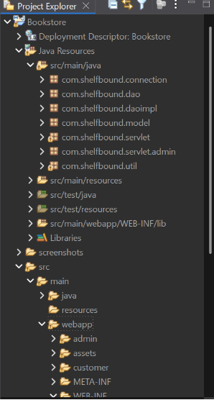
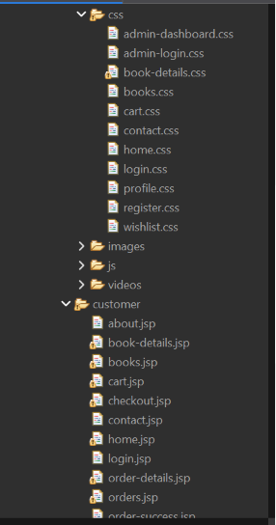
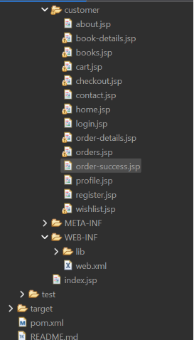
UNDER THE HOOD
Project Structure
MVC / DAO layered architecture — Java packages on the backend, role-split JSP views on the frontend, standard Maven packaging.
Java Resources — com.shelfbound.* (connection, dao, daoimpl, model, servlet, servlet.admin, util)
webapp/ — css/ · images/ · js/ · videos/ · customer/
customer/ views · META-INF/ · WEB-INF/ (lib, web.xml)
MVC + DAO — servlets as controllers, DAO/DAOImpl for data access
One servlet per feature — Cart, Wishlist, Order, Admin*
Per-page CSS — isolates styling bugs instead of one shared file
ShelfBound
03

Slide 4
DATABASE DESIGN
ER Diagram
9 tables · lines mark foreign-key relationships · ● one ○ many · orange field = primary key, blue field = foreign key
users
cart
categories
STANDALONE
user_id (PK)
username
email
phone
cart_id (PK)
user_id (FK)
book_id (FK)
quantity
category_id (PK)
category_name
admin
admin_id (PK)
username
password
books
book_id (PK)
category_id (FK)
title, author
price, stock_qty
contact_messages
message_id (PK)
name, email
message
reply_status
orders
wishlist
order_items
order_id (PK)
user_id (FK)
total_amount
order_status
wishlist_id (PK)
user_id (FK)
book_id (FK)
added_at
order_item_id (PK)
order_id (FK)
book_id (FK)
quantity, price
ShelfBound
04

Slide 5

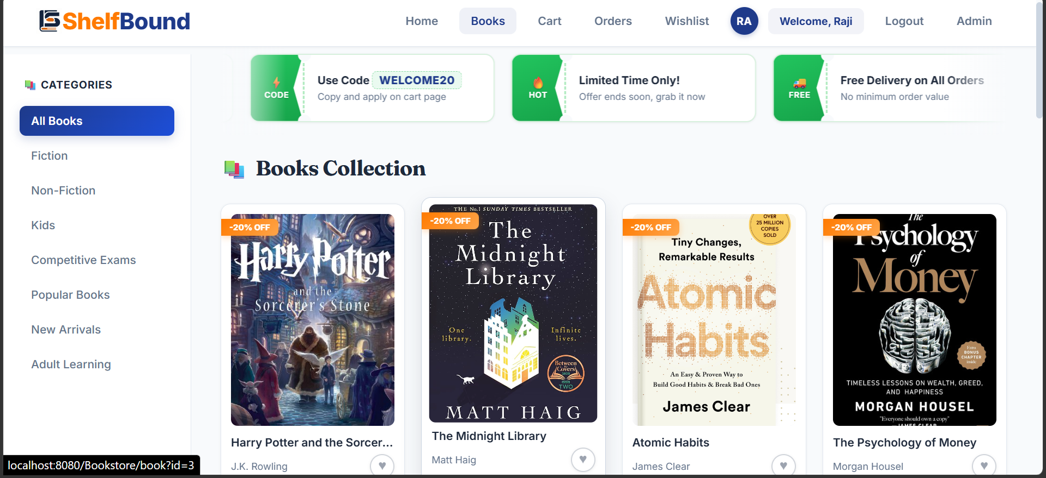
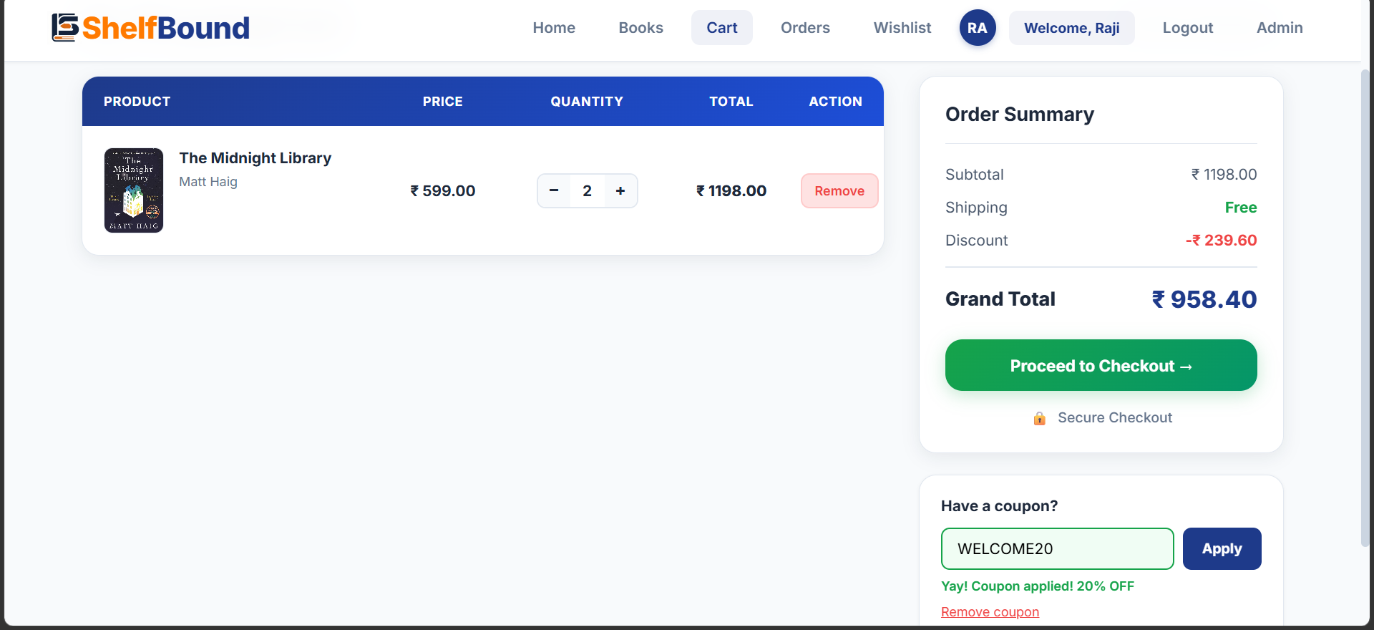
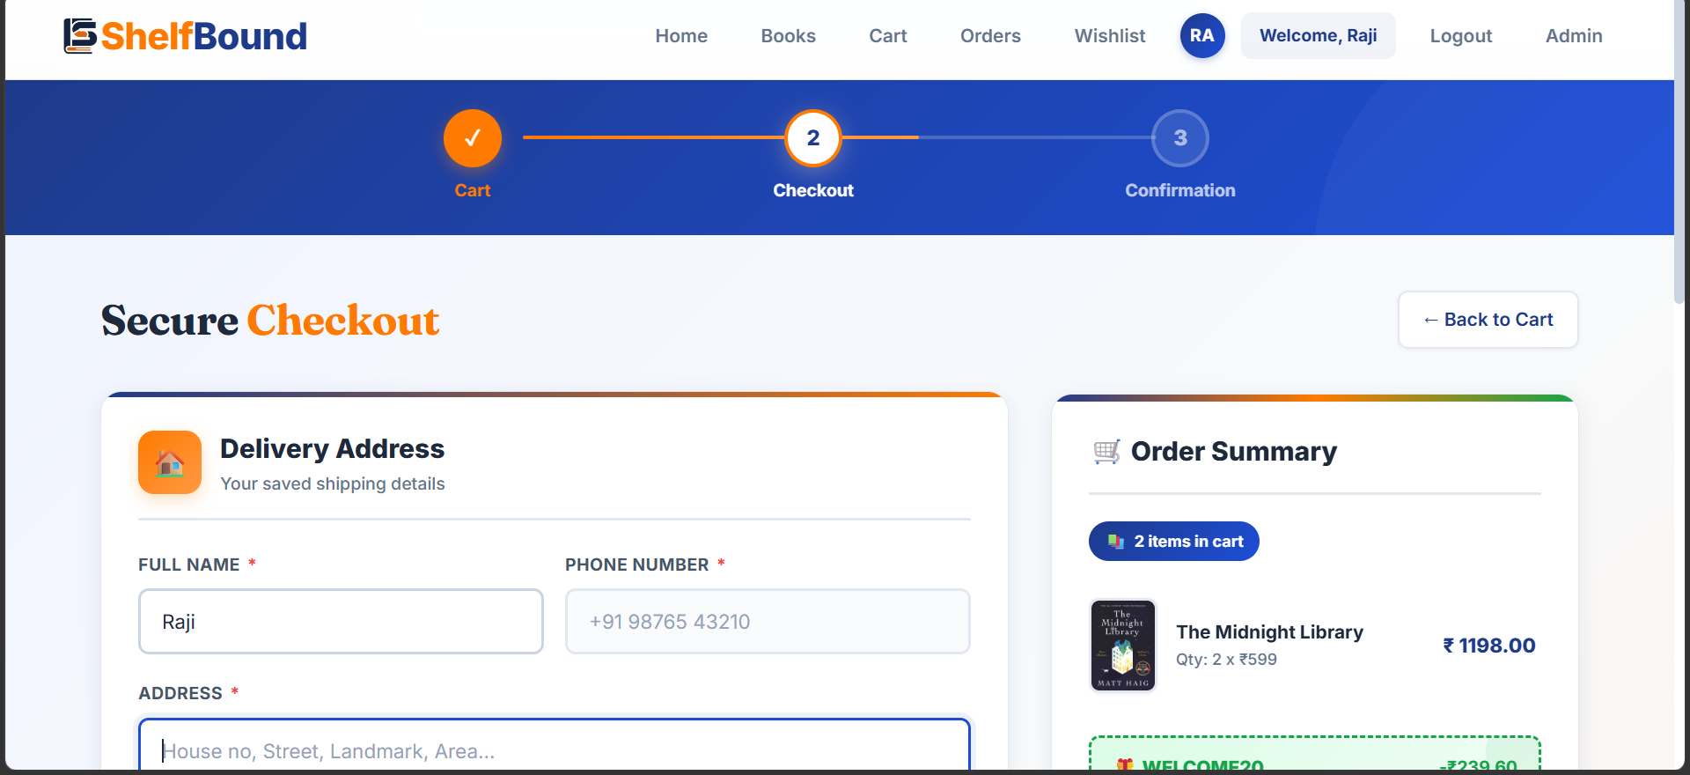
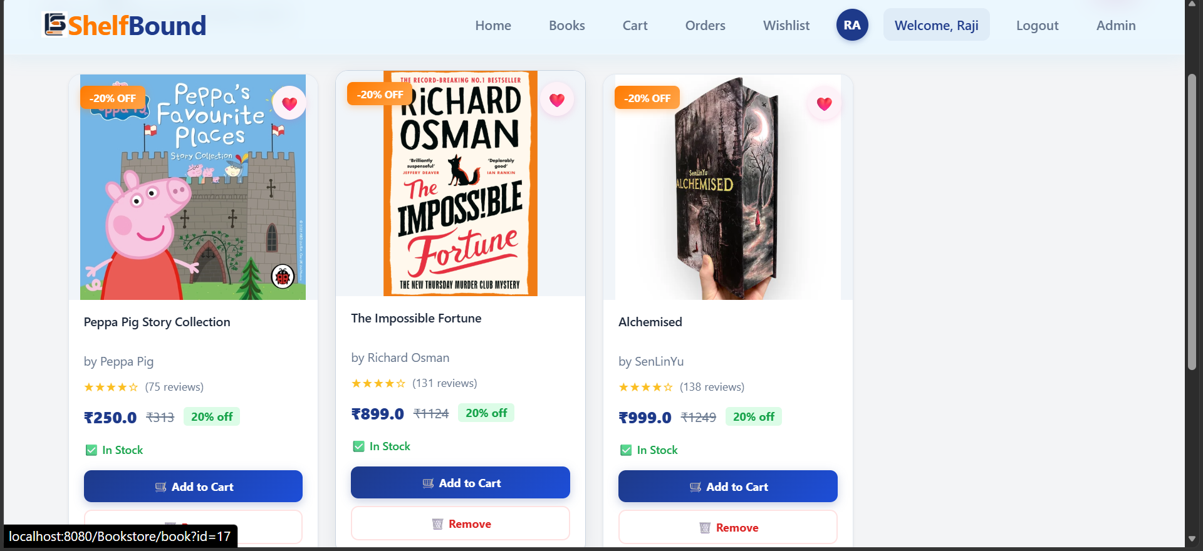
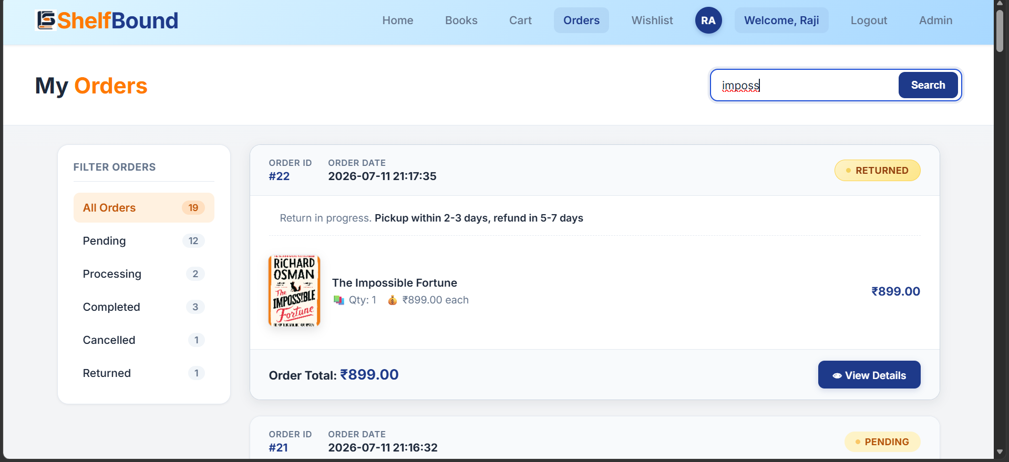
WALKTHROUGH
Page Screenshots
In the order a shopper moves through the store — browse, decide, buy, track.
Home
Books
Cart
Checkout
Wishlist
My Orders
ShelfBound
05

Slide 6
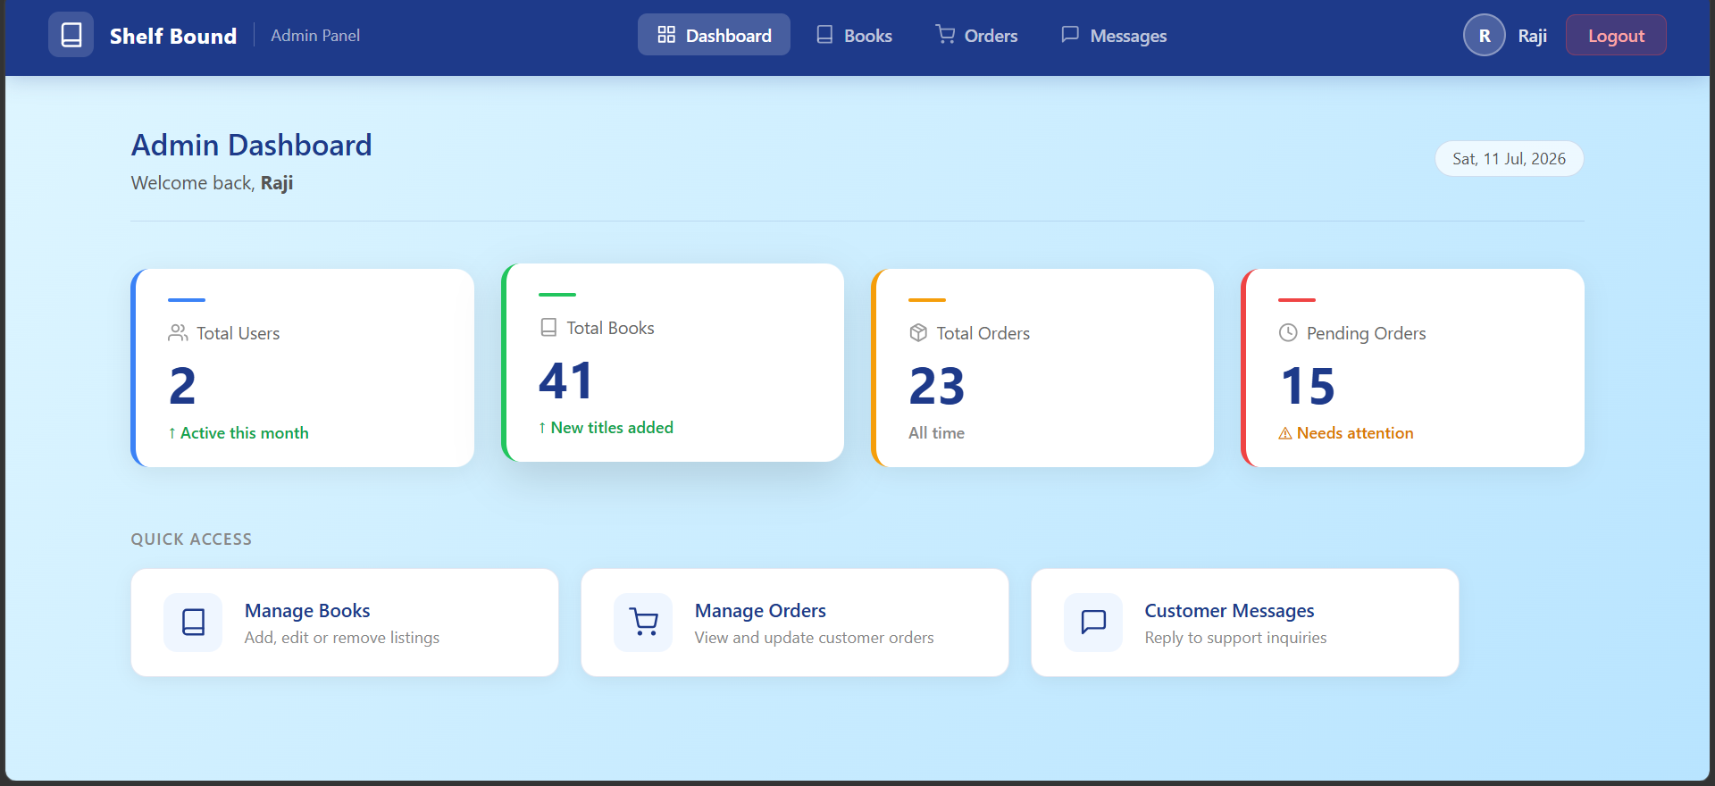
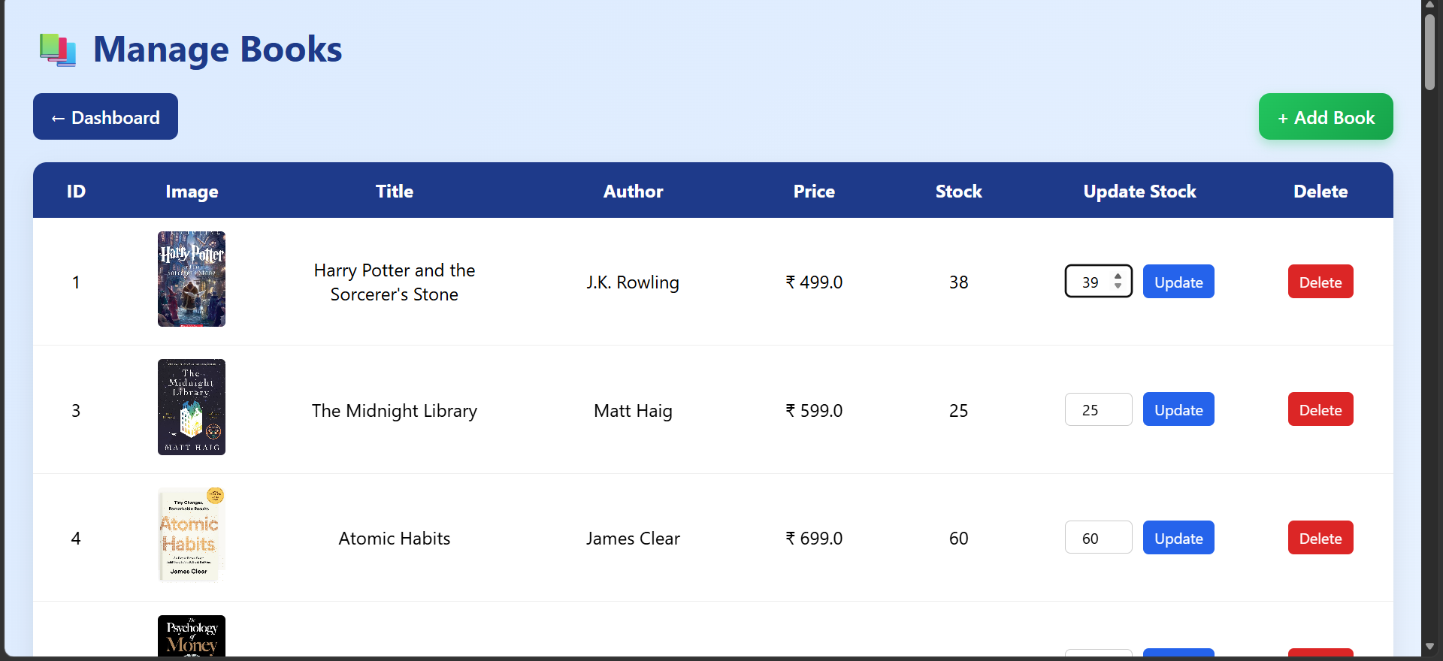
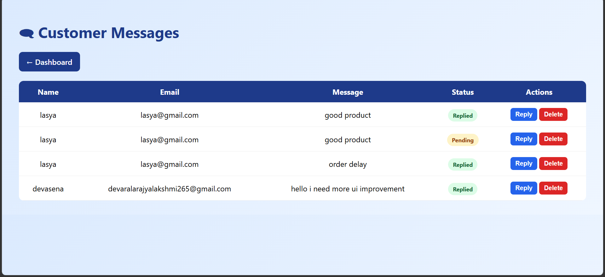
BUILT BEYOND THE BASICS
New Features Added
%
Coupon Engine — WELCOME20
A
Admin Control Panel
Applies a flat 20% discount on subtotal, live in both the cart and checkout order summary.
Manage books & stock, update order status, and reply to customer messages.
Dashboard
Manage Books
Customer Replies
ShelfBound
06

Slide 7
THE CLEVER PART
Coupon Discount Calculation
Applying WELCOME20 recalculates subtotal, discount, and grand total in one pass — kept in sync across cart and checkout.
// CartServlet — applyCoupon()
double subtotal = cartDao.getSubtotal(userId);
String coupon = request.getParameter("coupon");
double discount = 0.0;
if ("WELCOME20".equalsIgnoreCase(coupon)) {
discount = subtotal * 0.20;
} else {
session.setAttribute("couponError",
"Invalid or expired code");
}
double shipping = 0.0; // free shipping, always
double grandTotal = subtotal - discount + shipping;
session.setAttribute("discount", discount);
session.setAttribute("grandTotal", grandTotal);
response.sendRedirect("cart");
Single source of truth
Discount is recomputed from the live subtotal, not stored as a fixed value — stays correct even if quantities change after the coupon is applied.
Session-scoped
Discount & grand total live in session, so cart and checkout always show the same numbers without recalculating twice.
Verified against UI
₹1198 subtotal × 20% = ₹239.60 discount — matches exactly what renders on the cart and checkout screenshots.
ShelfBound
07

Slide 8
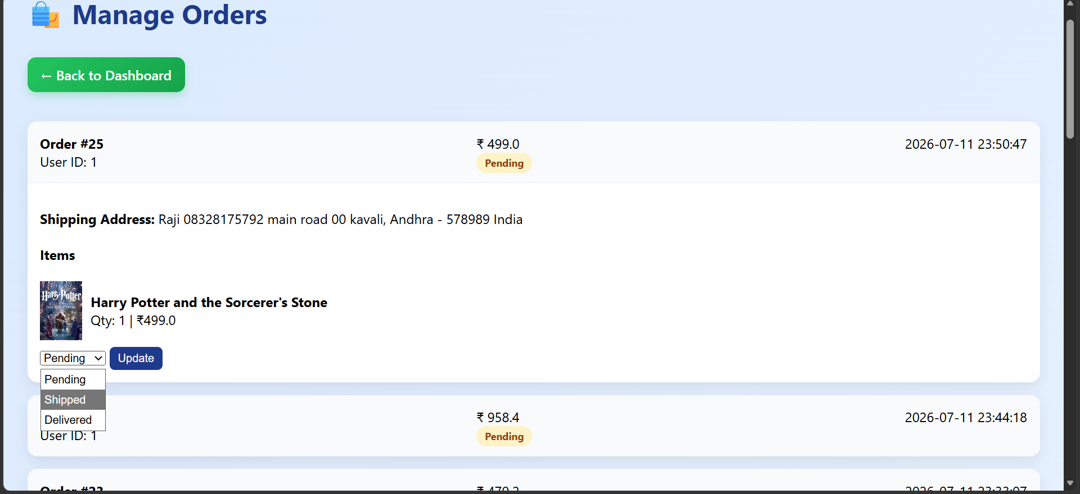
DEBUGGING UNDER PRESSURE
Major Challenge Faced
THE PROBLEM
When the admin updated an order's status from the Manage Orders panel, the change wasn't reliably reflected back on the customer's My Orders page — the status shown to the user lagged behind what the admin had just set.
THE FIX
Traced it to the order list being served from a stale query result on the same request cycle as the update.
Split the flow: AdminOrderServlet handles the status UPDATE, then does a redirect (not a forward) back to the orders view.
The redirect forces a fresh GET + fresh SELECT, so both admin and customer views always read the current row.
ShelfBound
Manage Orders — status dropdown (Pending → Shipped → Delivered)
08

Slide 9
ROADMAP
What You'll Add Next
1
Order Tracking
2
OTP Verification
Live map navigation showing delivery progress, from dispatch to doorstep.
Phone/email OTP at login & checkout for stronger identity verification.
3
Payment Gateway
4
Email Replies
Real online payments (cards / UPI) alongside the current Cash-on-Delivery flow.
Admin replies to contact messages sent straight to the user's registered email, not just shown in-app.
ShelfBound
09

