Slide 1
EARTHQUAKE PREDICTION WITH ARTIFICIAL INTELLIGENCE
Team Members
RAJESH A
HARISH U
VIJAYARAGAV L G
SHANMUGAPANDI A
THIRUNAVUKKARASU S T
THANTHAI PERIYAR GOVERNMENT
INSTITUTION OF TECHNOLOGY, VELLORE.

Slide 2
Project analysis slide 2
ABSTRACT:
earthquake prediction is a challenging task, but it can be improved using machine learning techniques. Python is a popular programming language for machine learning, and it can be used to develop earthquake prediction systems.
One approach to earthquake prediction using python is to use a supervised learning algorithm, such as support vector machines or random forests. These algorithms can be trained on historical data of earthquakes and their precursors to learn how to predict future earthquakes
.Another approach is to use an unsupervised learning algorithm, such as clustering or anomaly detection. These algorithms can be used to identify patterns in the data that may be indicative of upcoming earthquakes.
This paper proposes a methodology for earthquake prediction using hyperparameter tuning and feature engineering in Python. The goal is to develop a deep learning-based technique that can accurately predict seismic activity.
The proposed methodology is based on the latest research in the field of earthquake prediction using machine learning. It aims to improve the accuracy of seismic activity prediction and provide early warning systems for natural disasters.
In this phase we’ll learn how to loading and preprocessing earthquake data with Python and Matplotlib.The visual representation of data is more readily incorporated by human brains than the verbal representation of data.

Slide 3
INTRODUCTION:
Machine Learning for Earthquake Prediction Machine learning algorithms can be trained on historical data of earthquakes and their precursors to learn how to predict future earthquakes.
Once a model has been trained, it can be used to predict the probability of an earthquake occurring in a given location and time period.
an Earthquake Prediction System using Python To develop an earthquake prediction system using Python, you will need to Collect data. The first step is to collect a dataset of historical earthquakes and their precursors.
Earthquake prediction is a challenging task in machine learning, and it requires the use of advanced techniques such as hyperparameter tuning and feature engineering to improve the performance of models.
Python is a popular programming language for earthquake prediction because it is free, open-source, and has a large community of developers. It also has a number of libraries and tools that are specifically designed for machine learning and data science, which are essential for earthquake prediction
In this phase we’ll learn how to loading and preprocessing earthquake data with Python and Matplotlib. The visual representation of data is more readily incorporated by human brains than the verbal representation of data.
When something is pictured for us, we have an easier time understanding it. Datasets are the raw collection of information about a particular topic. In this article, we have an earthquake dataset that is in the form of a CSV file.
We need to loading and preprocessing the dataset to know the trends and patterns in the dataset so that we can make a prediction of what could happen in the future.
For loading and preprocessing the dataset we use a Python library called Matplotlib. We will discuss in detail what matplotlib is and how it is used to loading and preprocessing the dataset.

Slide 4
Project analysis slide 3
Data collection and preparation:-
Collecting and preparing a high-quality dataset of historical earthquakes and their precursors is essential for training a reliable machine learning model. This dataset should be as large and diverse as possible, and it should be carefully cleaned and preprocessed to remove noise and outliers.
The dataset can be downloaded from various sources such as Kaggle, GitHub, or other online repositories. Once the dataset is downloaded, the necessary libraries such as pandas, num py, matplotlib, and seaborn need to be imported to preprocess and visualize the data.
The dataset can be loaded into a pandas data frame using the `read_csv()` function. Exploring the dataset using functions such as `head()`, `tail()`, `info()`, and `describe()` can provide a summary of the dataset. Cleaning the dataset by removing any missing or duplicate values, and converting the data types of the columnsif necessary is essential.
Splitting the dataset into training and testing sets using functions such as `train_test_split()` is necessary to train and evaluate the machine learning models. Ø Normalizing the data using functions such as `Standard Scaler()` or `MinMax Scaler()` ensures that all the features are on the same scale.
Finally, the preprocessed data can be saved to a file for future use using functions such as `to _csv()`. Machine learning has the ability to advance our knowledge of earthquakes and enable more accurate fore casting and catastrophe response. By training the neural network on historical earthquake data, it can acquire the ability to identify precursor signals and patterns that indicate the probability of an upcoming earthquake.
The random forest method performs best in classifying large earthquake occurrences, while the LSTM method provides a rough estimation of the earthquake. The best algorithm was taken into consideration after a review of a number of attributes. The model based on a graph convolutional neural network with batch normalization and attention mechanism techniques can successfully predict earthquakes from seismic data.

Slide 5
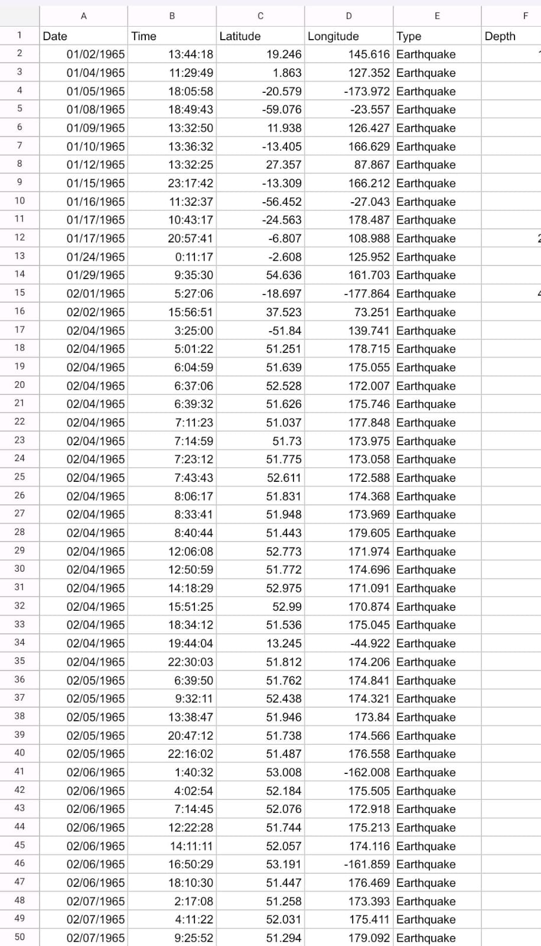
DATA SHEET
Python for earthquake prediction:-
Python is a powerful and versatile language that can be used to develop a wide range of machine learning models for earthquake prediction.
Python libraries such as scikit-learn and TensorFlow make it easy to train and deploy machine learning models

Slide 6
Steps to document the preprocessing and loading of the dataset for earthquake prediction using Python:-
Import the necessary libraries: - Pandas: This library helps to load the data frame in a 2Darrayformatand perform loading and preprocessing the dataset - Matplotlib/Seaborn: These libraries are used to draw dataset .
Load the dataset: - Use the Pandas library to load the earthquake dataset into a data frame. Explore the dataset: - Check the shape of the data frame to see the number of rows and columns. –Use the `info()` function to see the data types and non-null values in each column. - Use the `describe()`function to get descriptive statistical measures of the dataset.
Preprocess the dataset:- Handle missing values, outliers, and other data quality issues as needed. -Perform feature engineering, such as creating new variables or transforming existing ones, to improve the predictive power of the dataset.
Split the dataset into training and testing sets:- Divide the dataset into a training set, which will be used to train the machine learning model, and a testing set, which will be used to evaluate the model’s performance.
Normalize or scale the dataset:- Depending on the machine learning algorithm used, it maybe

Slide 7
Project analysis slide 4
PROBLEM STATEMENT OF EARTHQUAKE PREDICTION MODEL USING PYTHON :
Problem 2:Data Noise and Quality
Problem: Seismic data often contains noise and artifacts, making it challenging to identify true earthquake signals.
SOLUTION:-
Apply signal processing techniques like filtering and denoising to clean the data.
Implement data quality checks to filter out unreliable data points.
Use advanced preprocessing methods to remove instrument-specific noise.
Problem 1: Data Collection and Availability
Problem: Acquiring a reliable and sufficient amount of seismic data can be challenging.
SOLUTION: -
Collaborate with government agencies and research institutions that provide access to seismic data.
Use APIs like the USGS Earthquake API to access real-time and historical seismic data.
Deploy seismic sensors if possible to collect data locally.

Slide 8
Project analysis slide 5
Problem 3: Imbalanced Data
Problem: Earthquakes are rare events compared to non-earthquake signals, leading to imbalanced datasets.
SOLUTION:-
Employ techniques like oversampling or under sampling to balance the dataset.
Utilize anomaly detection algorithms to focus on identifying rare seismic events.
Experiment with cost-sensitive learning to assign different misclassification cost
Problem4:Feature Engineering
Problem: Selecting relevant features from seismic data can be complex and domain-specific.
SOLUTION:-
Collaborate with domain experts (seismologists) to identify crucial features.
Use automatic feature selection techniques like feature importance from tree-based models.
Experiment with time-domain, frequency-domain, and wavelet-based features.

Slide 9
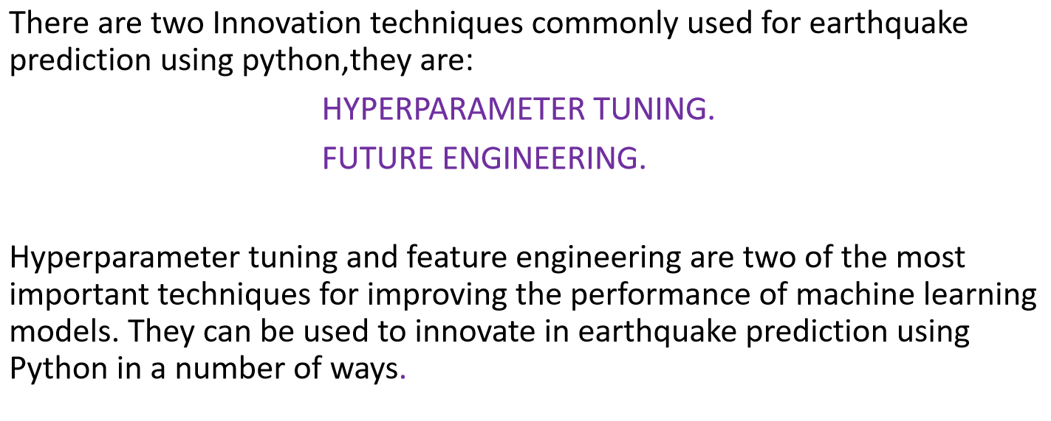
Innovations For Earthquake Prediction Using Python:-

Slide 10
1 HYPERPARAMETER TUNING:-
Hyperparameter tuning involves adjusting the parameters of a machine learning algorithm to improve its performance on a given dataset.
For example, the hyperparameters of a support vector machine (SVM) algorithm include the kernel function and the regularization parameter.
Hyperparameter tuning can be used to improve the performance of earthquake prediction models in a number of ways.
or example, hyperparameter tuning can be used to Reduce the overfitting of the model to the training data.
Improve the generalization performance of the model on new data.
Identify the most important features for predicting earthquakes.
Fine-tune the model parameters to improve the model's performance.
Use techniques such as grid search and halving search to optimize the hyperparameters.
Experiment with different combinations of hyperparameters to find the best configuration.

Slide 11
2 FUTURE ENGINEERING:-.
Feature engineering is the process of creating new features from existing data. This can be done by combining existing features, transforming existing features, or creating new features from other sources of data.
This new feature could be used to improve the accuracy of a machine learning algorithm for predicting earthquakes.
Feature engineering can be used to improve the performance of earthquake prediction models in a number of ways.
For example, a feature engineer might create a new feature that represents the average magnitude of all earthquakes that have occurred in a given area within the past 10 years. For example, feature engineering can be used to Reduce the dimensionality of the data, which can make the model more efficient to train and deploy.
Create more informative features that are better correlated with the target variable (i.e., whether or not an earthquake will occur).
Identify hidden patterns in the data that may be useful for predicting earthquakes.

Slide 12
METHODOLOGY:
Hyperparameter Tuning and Feature Engineering for Earthquake Prediction using Python. Earthquake prediction is a challenging task in machine learning, and it requires the use of advanced techniques such as hyperparameter tuning and feature engineering to improve the performance of models.
Here's how these techniques can be applied to earthquake prediction using Python. Feature engineering is an essential step in earthquake prediction using machine learning. It involves transforming raw seismic data into features that better represent the underlying problem to the predictive models3.Feature engineering techniques such as Fourier transforms, wavelet transforms, and time-frequency analysis can be used to extract useful features from seismic data.
Python libraries such as ObsPy, NumPy, and SciPy can be used to perform feature engineering on seismic data. Hyperparameter tuning is a crucial step in improving the performance of machine learning models for earthquake prediction.
It involves selecting the best values of hyperparameters to improve the performance of a mode. Hyperparameters such as learning rate, batch size, number of epochs, and activation functions can be tuned to improve the performance of models. Python libraries such as Keras , Scikit-learn, and TensorFlow can be used to perform hyperparameter tuning on machine learning models
hyperparameter tuning and feature engineering are essential techniques in earthquake prediction using machine learning. Python libraries such as ObsPy, NumPy, SciPy, Keras, Scikit-learn, and TensorFlow can be used to perform these techniques on seismic data.

Slide 13
TRAINING A MACHINE LEARNING MODEL FOR EARTHQUAKE PREDICTION INVOLVES SEVERAL KEY STEPS:
1. Feature Engineering: Identifying significant features or variables that are likely to have an impact on earthquake prediction. This may include the velocity of seismic waves, the depth of seismic activity, and the location of faults.
2. Model Selection: Selecting appropriate machine learning models for prediction. Common algorithms used in earthquake prediction include Support Vector Machines (SVM), Neural Networks, Random Forests, and Gradient Boosting.
3. Data Preparation: Collecting and cleaning data, and splitting it into training and testing sets. Hyperparameter tuning and cross-validation can help in selecting the best model.
4. Training: Training the selected model on the training data. During training, the input and target data are used to construct the machine learning model.
5. Evaluation: Evaluating the model using metrics like accuracy, precision, recall, and F1 score to assess its effectiveness in predicting earthquakes.
6. Prediction: Using the trained model to predict the likelihood of an earthquake in the given area. The output can be a binary classification (earthquake/no earthquake) or a continuous value representing the probability.

Slide 14
TRAINING MACHINE LEARNING MODELS CHALLENGING TASK DUE TO SEVERAL REASONS:
• Here are some of the challenges:- Lack of data: Earthquakes are rare events, and collecting sufficient data to train machine learning models can be challenging. Moreover, the data may be imbalanced, making it difficult to train models that can accurately predict earthquakes.
• Earthquakes are complex phenomena that involve multiple factors, such as the location, depth, and magnitude of the earthquake.
• Identifying the most significant features and variables that impact earthquake prediction is not straightforward.- Limited understanding of the underlying physics: The underlying physics of earthquakes is not fully understood, and there may be many unknown factors that contribute to earthquake occurrence. This makes it challenging to develop accurate models that can predict earthquakes with high precision.
• Overfitting occurs when a model is too complex and fits the training data too closely, resulting in poor generalization performance on new data. This is a common problem in machine learning, and it can be particularly challenging in earthquake prediction due to the limited amount of data available.
• Selecting the appropriate machine learning model for earthquake prediction is not straightforward. There are many algorithms to choose from, and each has its strengths and weaknesses.

Slide 15
HANDLING IMBALANCED DATASETS IS CRUCIAL IN EARTHQUAKE PREDICTION:
Here are some techniques to handle imbalanced datasets in earthquake prediction:
• Random Under sampling and Oversampling: Randomly removing some negative examples (under sampling) or
duplicating positive examples (oversampling) can balance the dataset.
• Synthetic Minority Oversampling Technique (SMOTE): SMOTE generates synthetic positive examples by
interpolating between existing positive examples. This technique can balance the dataset and reduce overfitting.
• Adaptive Synthetic Sampling (ADASYN): ADASYN generates synthetic positive examples in regions where the
density of positive examples is low. This technique can handle datasets with severe class imbalance.
• Cost-Sensitive Learning: Assigning different costs to misclassification of positive and negative examples can help
in handling imbalanced datasets.
• Ensemble Methods: Combining multiple models trained on different subsets of the data can improve the
performance of the model on imbalanced datasets. Ensemble methods like Bagging, Boosting, and Stacking can
be used for this purpose.

Slide 16
PYTHON CODE FOR PROJECT :
I will start this task to create a model for earthquake prediction by importing the necessary python libraries:
import numpy as np
import pandas as pd
import matplotlib.pyplot as plt
Now let’s load and read the dataset. The dataset that I am using here can be easily downloaded here:
data = pd.read_csv("database.csv")
data.columns
Index(['Date', 'Time', 'Latitude', 'Longitude', 'Type', 'Depth', 'Depth Error',
'Depth Seismic Stations', 'Magnitude', 'Magnitude Type',
'Magnitude Error', 'Magnitude Seismic Stations', 'Azimuthal Gap',
'Horizontal Distance', 'Horizontal Error', 'Root Mean Square', 'ID',
'Source', 'Location Source', 'Magnitude Source', 'Status'],
dtype='object')
Now let’s see the main characteristics of earthquake data and create an object of these characteristics, namely, date, time, latitude, longitude, depth, magnitude:
data = data[['Date', 'Time', 'Latitude', 'Longitude', 'Depth', 'Magnitude']]
data.head()

Slide 17
date Time Latitude Longitude Depth Magnitude
0 01-02-1965 13:44:18 19.246 145.62 6
1 01-04-1965 11:29:49 1.863 127.35 5.8
2 01-05-1965 18:05:58 -20.579 -173.97 6.2
3 01-08-1965 18:49:43 -59.076 -23.557 5.8
4 01-09-1965 13:32:50 11.938 126.43 5.8
Since the data is random, so we need to scale it based on the model inputs. In this, we
 | import datetime
 | import time
 | timestamp = []
 | for d, t in zip(data['Date'], data['Time']):
 | try:
 | ts = datetime.datetime.strptime(d+' '+t, '%m/%d/%Y %H:%M:%S')
 | timestamp.append(time.mktime(ts.timetuple()))
 | except ValueError:
 | # print('ValueError')
 | timestamp.append('ValueError')
 | timeStamp = pd.Series(timestamp)
 | data['Timestamp'] = timeStamp.values
 | final_data = data.drop(['Date', 'Time'], axis=1)
 | final_data = final_data[final_data.Timestamp != 'ValueError']
 | final_data.head()
convert the given date and time to Unix time which is in seconds and a number. This can be easily used as an entry for the network we have built:

Slide 18
Data Visualization
Now, before we create the earthquake prediction model, let’s visualize the data on a world map
that shows a clear representation of where the earthquake frequency will be more:
 | from mpl_toolkits.basemap import Basemap
 | m = Basemap(projection='mill',llcrnrlat=-80,urcrnrlat=80, llcrnrlon=-180,urcrnrlon=180,lat_ts=20,resolution='c')
 | longitudes = data["Longitude"].tolist()
 | latitudes = data["Latitude"].tolist()
 | #m = Basemap(width=12000000,height=9000000,projection='lcc',
 | #resolution=None,lat_1=80.,lat_2=55,lat_0=80,lon_0=-107.)
 | x,y = m(longitudes,latitudes)
 | fig = plt.figure(figsize=(12,10))
 | plt.title("All affected areas")
 | m.plot(x, y, "o", markersize = 2, color = 'blue')
 | m.drawcoastlines()
 | m.fillcontinents(color='coral',lake_color='aqua')
 | m.drawmapboundary()
 | m.drawcountries()
 | plt.show()

Slide 19
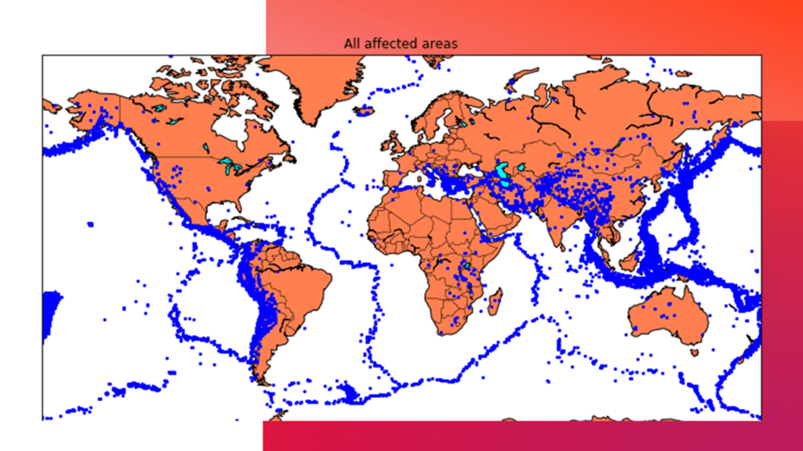
Splitting the Dataset
Now, to create the earthquake prediction model, we need to divide the data into Xs and ys which respectively will be entered into the model as inputs to receive the output from the model.
Here the inputs are TImestamp, Latitude and Longitude and the outputs are Magnitude and Depth. I’m going to split the xs and ys into train and test with validation. The training set contains 80% and the test set contains 20%:

Slide 20
X = final_data[['Timestamp', 'Latitude', 'Longitude']]
y = final_data[['Magnitude', 'Depth']]
from sklearn.cross_validation import train_test_split
X_train, X_test, y_train, y_test = train_test_split(X, y, test_size=0.2, random_state=42)
print(X_train.shape, X_test.shape, y_train.shape, X_test.shape)
(18727, 3) (4682, 3) (18727, 2) (4682, 3)
Neural Network for Earthquake Prediction
Now I will create a neural network to fit the data from the training set. Our neural network will consist of three
dense layers each with 16, 16, 2 nodes and reread. Relu and softmax will be used as activation functions:
 | from keras.models import Sequential
 | from keras.layers import Dense
 | def create_model(neurons, activation, optimizer, loss):
 | model = Sequential()
 | model.add(Dense(neurons, activation=activation, input_shape=(3,)))
 | model.add(Dense(neurons, activation=activation))
 | model.add(Dense(2, activation='softmax'))
 | model.compile(optimizer=optimizer, loss=loss, metrics=['accuracy'])
return model

Slide 21
ow I’m going to define the hyperparameters with two or more options to find the best fit:
 | from keras.wrappers.scikit_learn import KerasClassifier
 | model = KerasClassifier(build_fn=create_model, verbose=0)
 | # neurons = [16, 64, 128, 256]
 | neurons = [16]
 | # batch_size = [10, 20, 50, 100]
 | batch_size = [10]
 | epochs = [10]
 | # activation = ['relu', 'tanh', 'sigmoid', 'hard_sigmoid', 'linear', 'exponential']
 | activation = ['sigmoid', 'relu']
 | # optimizer = ['SGD', 'RMSprop', 'Adagrad', 'Adadelta', 'Adam', 'Adamax', 'Nadam']
 | optimizer = ['SGD', 'Adadelta']
 | loss = ['squared_hinge']
 | param_grid = dict(neurons=neurons, batch_size=batch_size, epochs=epochs, activation=activation, optimizer=optimizer, loss=loss)
Now we need to find the best fit of the above model and get the mean test score and standard deviation of the best fit model:
grid = GridSearchCV(estimator=model, param_grid=param_grid, n_jobs=-1)
grid_result = grid.fit(X_train, y_train)

Slide 22
print("Best: %f using %s" % (grid_result.best_score_, grid_result.best_params_))
means = grid_result.cv_results_['mean_test_score']
stds = grid_result.cv_results_['std_test_score']
params = grid_result.cv_results_['params']
for mean, stdev, param in zip(means, stds, params):
 | print("%f (%f) with: %r" % (mean, stdev, param))
Best: 0.957655 u'activation': 'relu', 'batch_size': 10, 'epochs': 10, 'loss': 'squared_hinge', 'neurons': 16, 'optimizer': 'SGD'} 0.333316 (0.471398)
with: {'activation': 'sigmoid', 'batch_size': 10, 'epochs': 10, 'loss': 'squared_hinge', 'neurons': 16, 'optimizer': 'SGD'} 0.000000 (0.000000) with:
{'activation': 'sigmoid', 'batch_size': 10, 'epochs': 10, 'loss': 'squared_hinge', 'neurons': 16, 'optimizer': 'Adadelta'} 0.957655 (0.029957) with:
{'activation': 'relu', 'batch_size': 10, 'epochs': 10, 'loss': 'squared_hinge', 'neurons': 16, 'optimizer': 'SGD'} 0.645111 (0.456960) with: {'activation
n': 'relu', 'batch_size': 10, 'epochs': 10, 'loss': 'squared_hinge', 'neurons': 16, 'optimizer': 'Adadelta'}
In the step below, the best-fit parameters are used for the same model to calculate the score with the training data and the test data:
sing {
 | model = Sequential()
 | model.add(Dense(16, activation='relu', input_shape=(3,)))
 | model.add(Dense(16, activation='relu'))

Slide 23
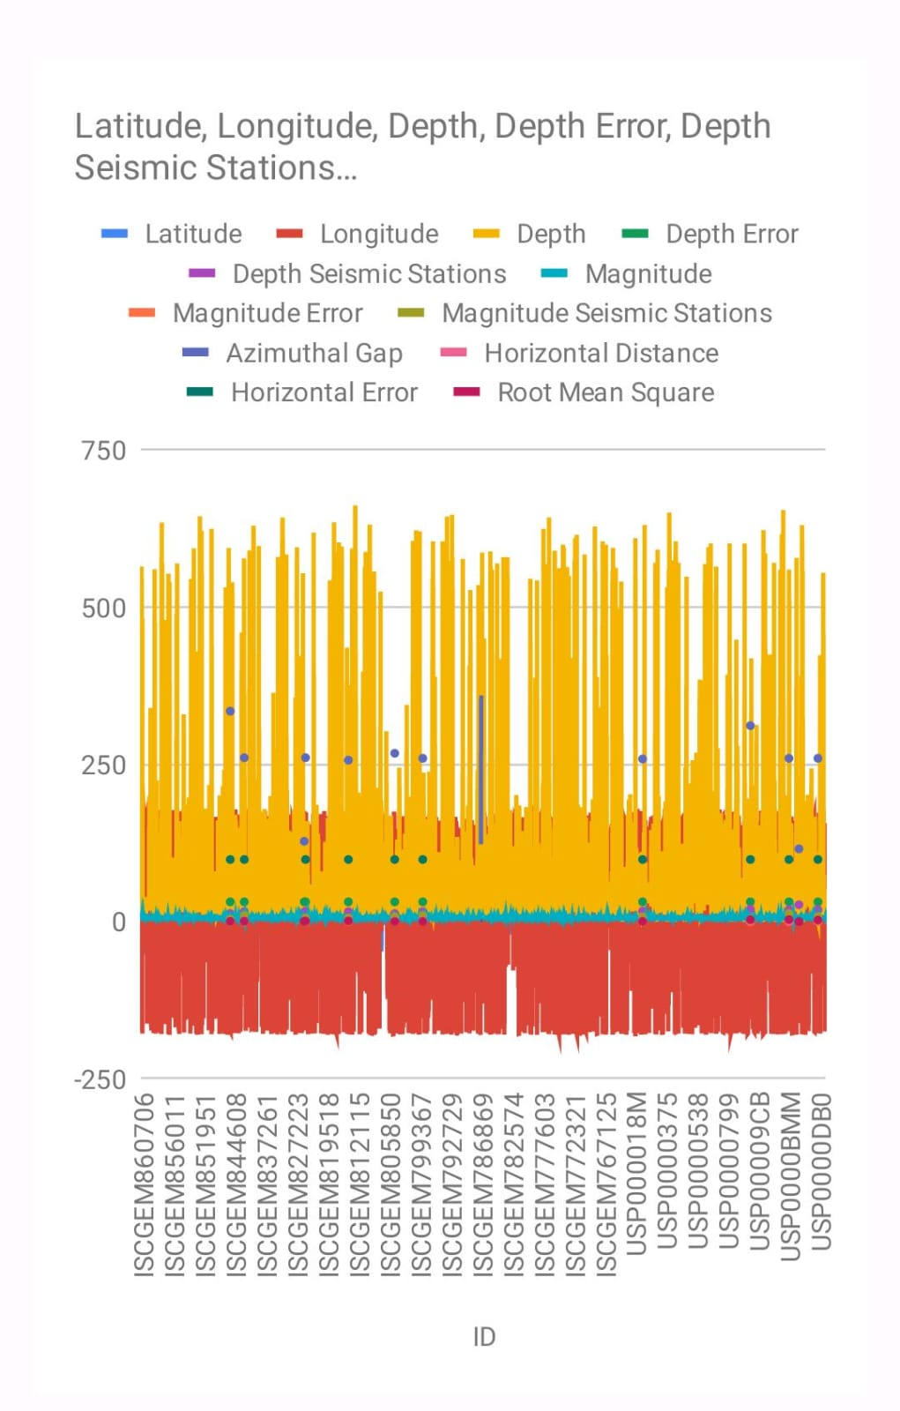
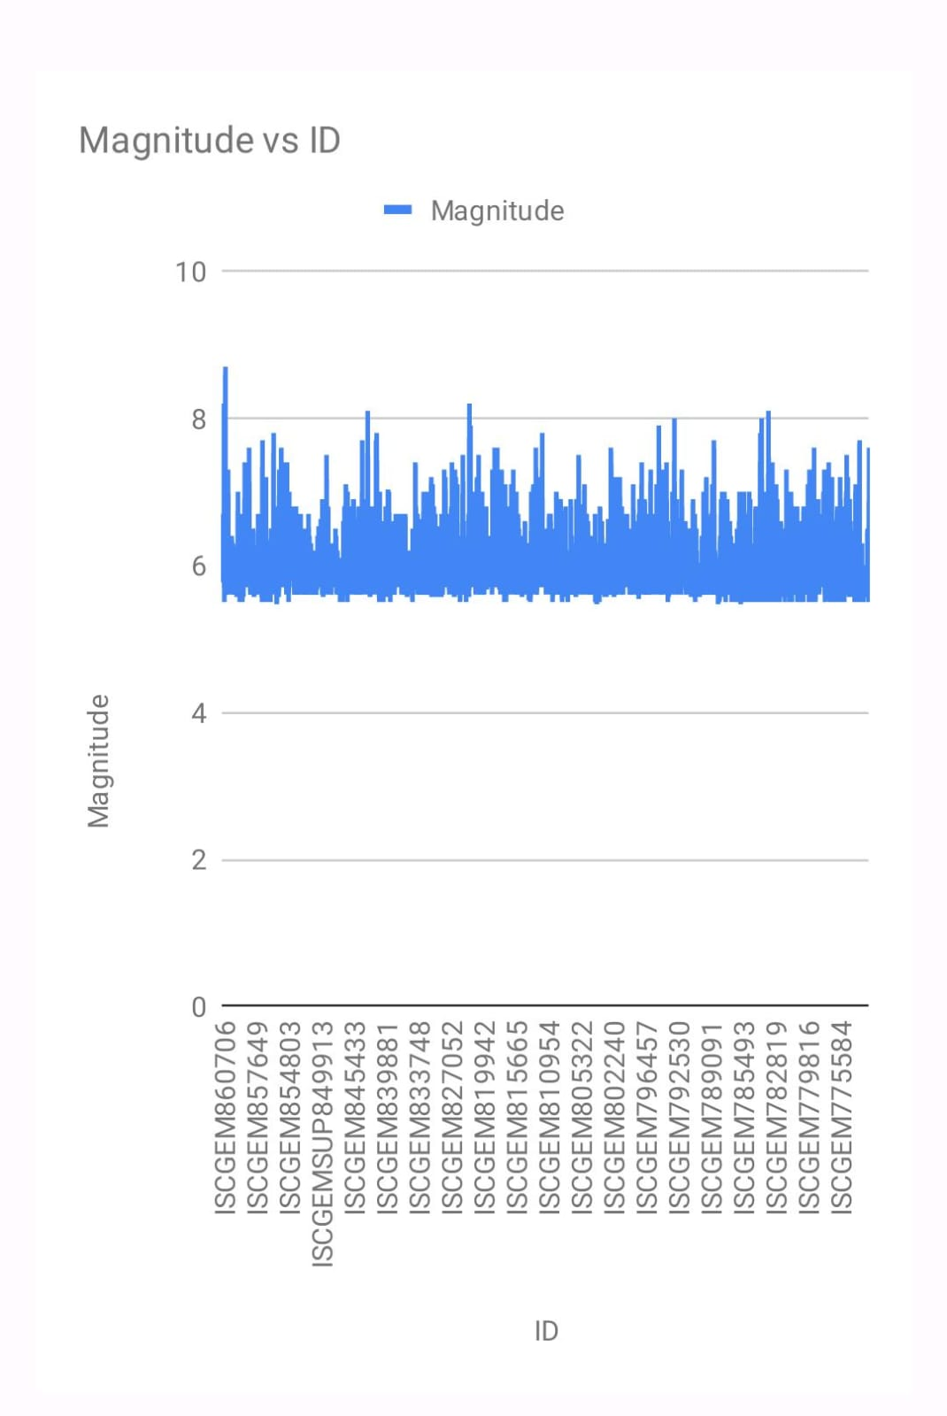
model.add(Dense(2, activation='softmax'))
model.compile(optimizer='SGD', loss='squared_hinge', metrics=['accuracy'])
model.fit(X_train, y_train, batch_size=10, epochs=20, verbose=1, validation_data=(X_test, y_test))
[test_loss, test_acc] = model.evaluate(X_test, y_test)
print("Evaluation result on Test Data : Loss = {}, accuracy = {}".format(test_loss, test_acc))
Evaluation result on Test Data : Loss = 0.5038455790406056, accuracy = 0.9241777017858995

Slide 24


Slide 25
Project analysis slide 6
The expected outcomes for earthquake
prediction using Python :-
Identify patterns and trends in earthquake data. Python can be used to analyze large datasets of earthquake data to identify patterns and trends that may be indicative of future earthquakes. For example, researchers may use Python to look for changes in seismic activity, ground deformation, or other factors that have been linked to past earthquakes.
Suggestions for future research Develop :-
new machine learning algorithms that are specifically designed for earthquake prediction . Use larger and more diverse datasets to train machine learning models. Explore the use of deep learning for earthquake prediction. Develop methods to incorporate uncertainty into earthquake predictions . Collaborate with seismologists to validate and improve earthquake prediction systems.
.

Slide 26
Conclusion:
Python is a good choice for developing earthquake prediction systems. It is a powerful and versatile language with a wide range of libraries and tools available for machine learning. However, it is important to keep in mind that earthquake prediction is still a challenging task, and no system is perfect
Hyperparameter Tuning and Feature Engineering for Earthquake Prediction using Python. Earthquake prediction is a challenging task in machine learning, and it requires the use of advanced techniques such as hyperparameter tuning and feature engineering to improve the performance of models.
Here's how these techniques can be applied to earthquake prediction using Python. Feature engineering is an essential step in earthquake prediction using machine learning. It involves transforming raw seismic data into features that better represent the underlying problem to the predictive models3.Feature engineering techniques such as Fourier transforms, wavelet transforms, and time-frequency analysis can be used to extract useful features from seismic data.
Various machine learning algorithms can be applied to earthquake prediction, such as linear regression, decision trees, and k-nearest neighbors. These models are trained on the training set and then used to make predictions on the testing set. Once the initial models are built and evaluated, This may involve feature selection techniques or more advanced machine learning algorithms. Other research papers and articles can provide insights into the latest advancements in earthquake prediction using machine learning.
For training and testing of earthquake prediction using python based on the search results, it is possible to use
Python programming language and machine learning models to predict earthquakes. be taken to train and test an earthquake prediction system using Python
Test the prediction system using test data and evaluate its performance using metrics such as accuracy score, confusion matrix, and classification report.

Slide 27
THANK YOU

