Slide 1
Agentic RAG Chatbot for Multi-Format Document QA using MCP
Coding Round Submission
Rakshitha Valipireddy
rakshithavalipireddy@gmail.com
GitHub Link: https://github.com/rak-shi
Date : 8 July 2025

Slide 2
Tech Stack
Content Used
✅ Languages & Frameworks
Python
Gradio
✅ Vector Store:
FAISS
✅ Embeddings:
Hugging Face sentence-transformers
✅ LLM:
OpenAI GPT
✅ Parsing Libraries:
PyMuPDF
python-docx
python-pptx
pandas
✅ Environment:
Google Colab

Slide 3
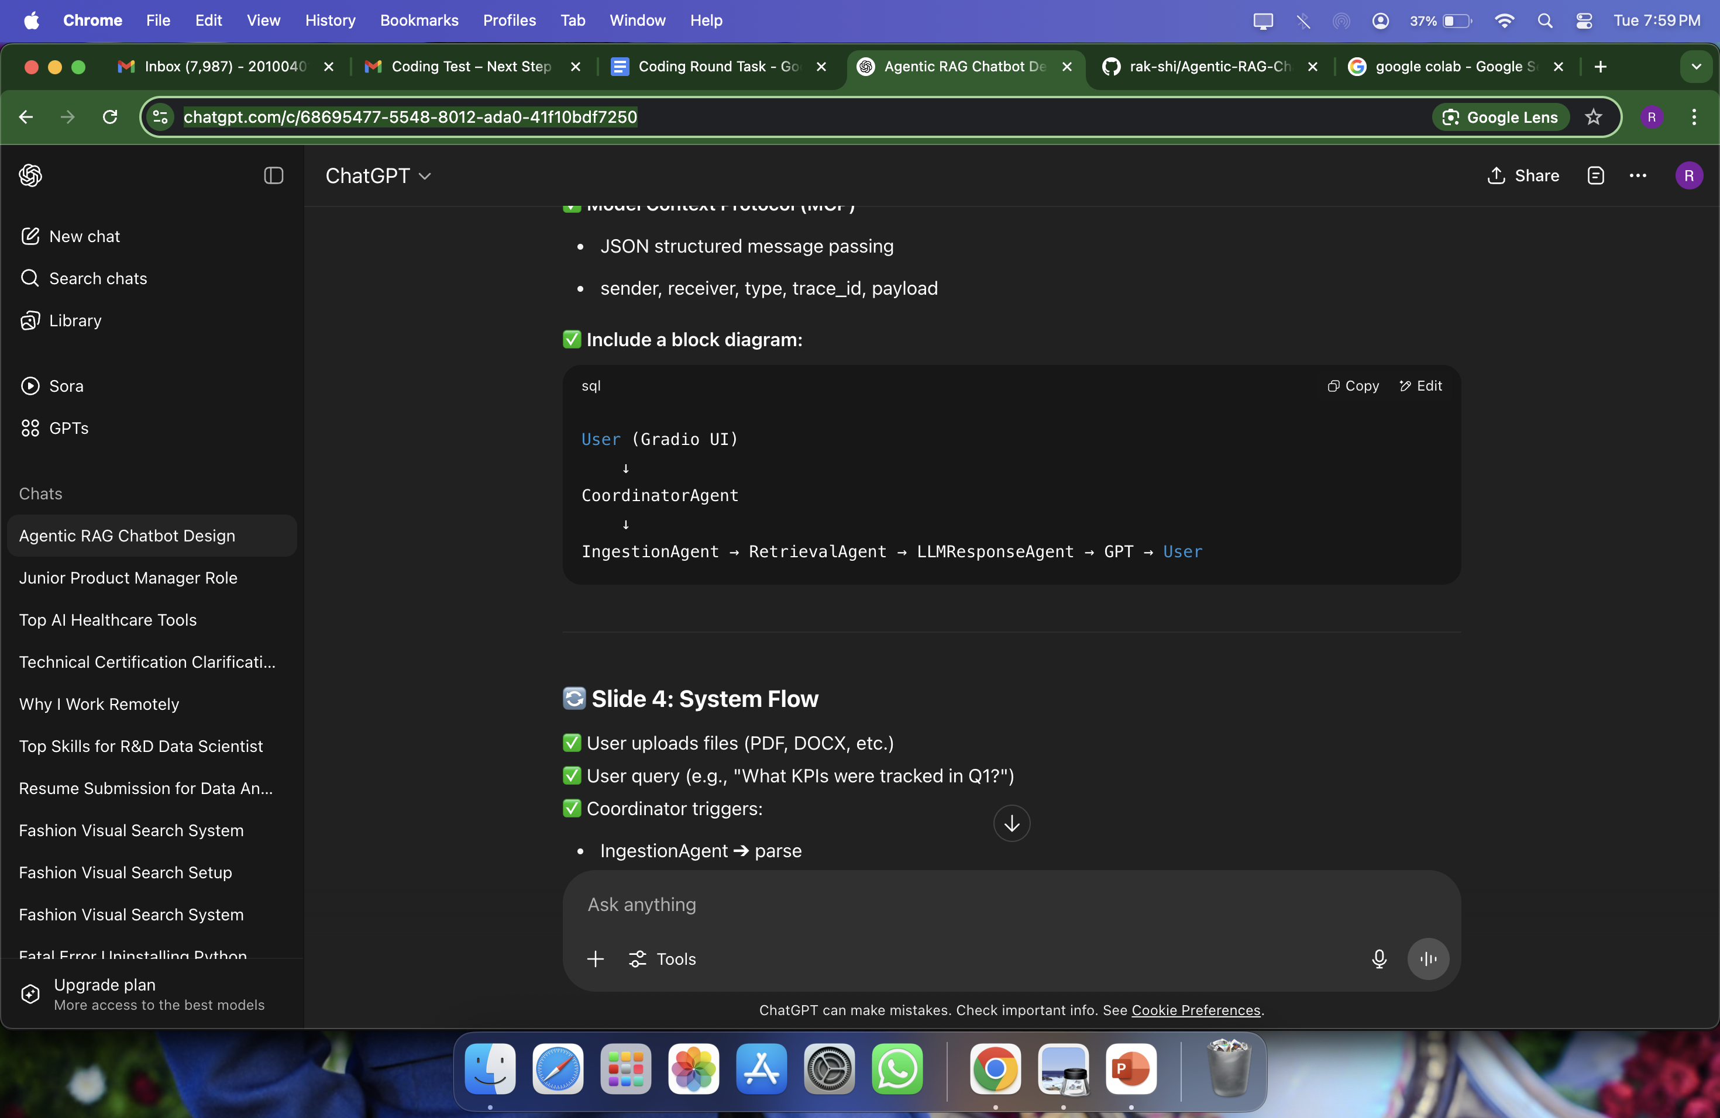
Agent-Based Architecture with MCP
IngestionAgent (parsing)
RetrievalAgent (embedding + retrieval)
LLMResponseAgent (format + GPT call)
Model Context Protocol (MCP)
JSON structured message passing
sender, receiver, type, trace_id, payload
Block Diagram

Slide 4
System Flow
User uploads files (PDF, DOCX, etc.)
✅ User query (e.g., "What KPIs were tracked in Q1?") ✅ Coordinator triggers:
IngestionAgent ➔ parse
RetrievalAgent ➔ retrieve chunks
LLMResponseAgent ➔ query GPT
✅ Output: GPT answer + relevant snippets.

Slide 5
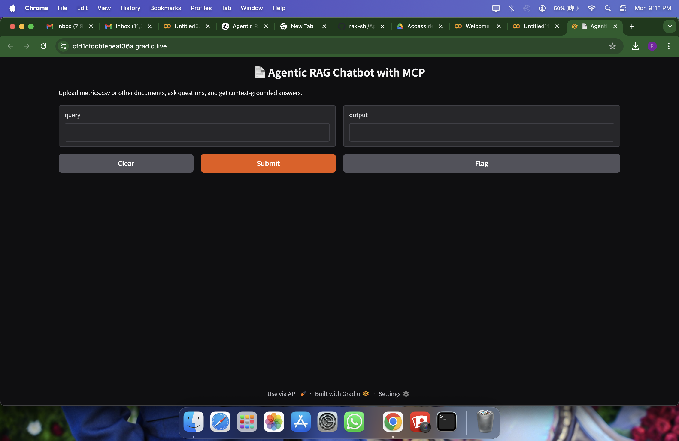
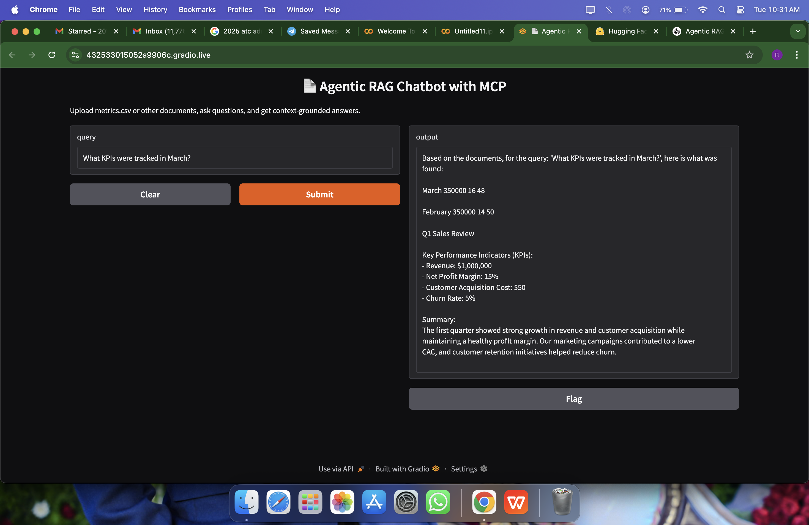
UI Screenshots

Slide 6
Challenges & Future Scope
✅ Challenges Faced:
Parsing diverse file formats
Managing context chunking for retrieval
Keeping system lightweight for Colab
✅ Future Scope:
REST API endpoints
Multi-turn memory
Highlight source in GPT answers
Offline embedding generation for cost reduction

