Slide 1
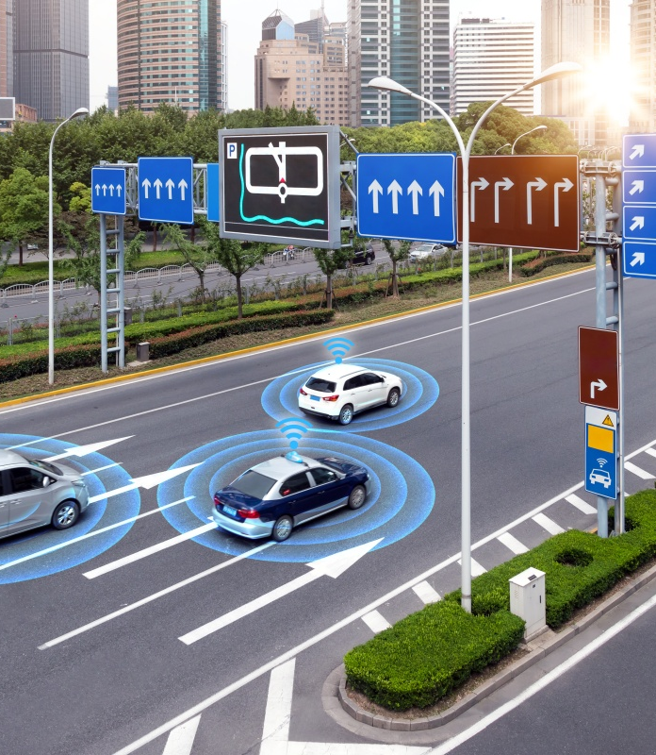
NeurofleetX :Fleet Management Dashboard AI- Driven Mobility Optimization for Smarter Cities

Slide 2
Problem Statement
Rapid urbanization is increasing traffic congestion, fuel consumption, and carbon emissions.
Fleet operators struggle with inefficient route planning, unpredictable demand, and high operational costs.
Lack of real-time data integration (traffic, weather, demand) hinders smart decision-making.
Cities need AI-driven solutions to optimize fleet movement, reduce costs, and improve sustainability.
High traffic density increases delivery times and reduces service reliabilty
Poor fleet management leads to customer dissatisfaction and resource waste
2

Slide 3
Objective
To design and implement a secure, real-time fleet management dashboard for smarter urban mobility.
Enable fleet managers to monitor vehicle locations, status, and analytics seamlessly.
Integrate real-time data (traffic, vehicle, demand) to improve route planning and decision-making.
Reduce operational costs and improve sustainability with AI-driven insights.
Provide actionable KPIs and alerts to optimize efficiency and reliability.

Slide 4
Technology Stack
Layer | Technology Used
Frontend | React.js (UI Framework)
Backend | Java Spring Boot (REST APIs)
Database | MySQL (Relational Database)
AI/ML | Weka (Java-based Machine Learning Library)

Slide 5
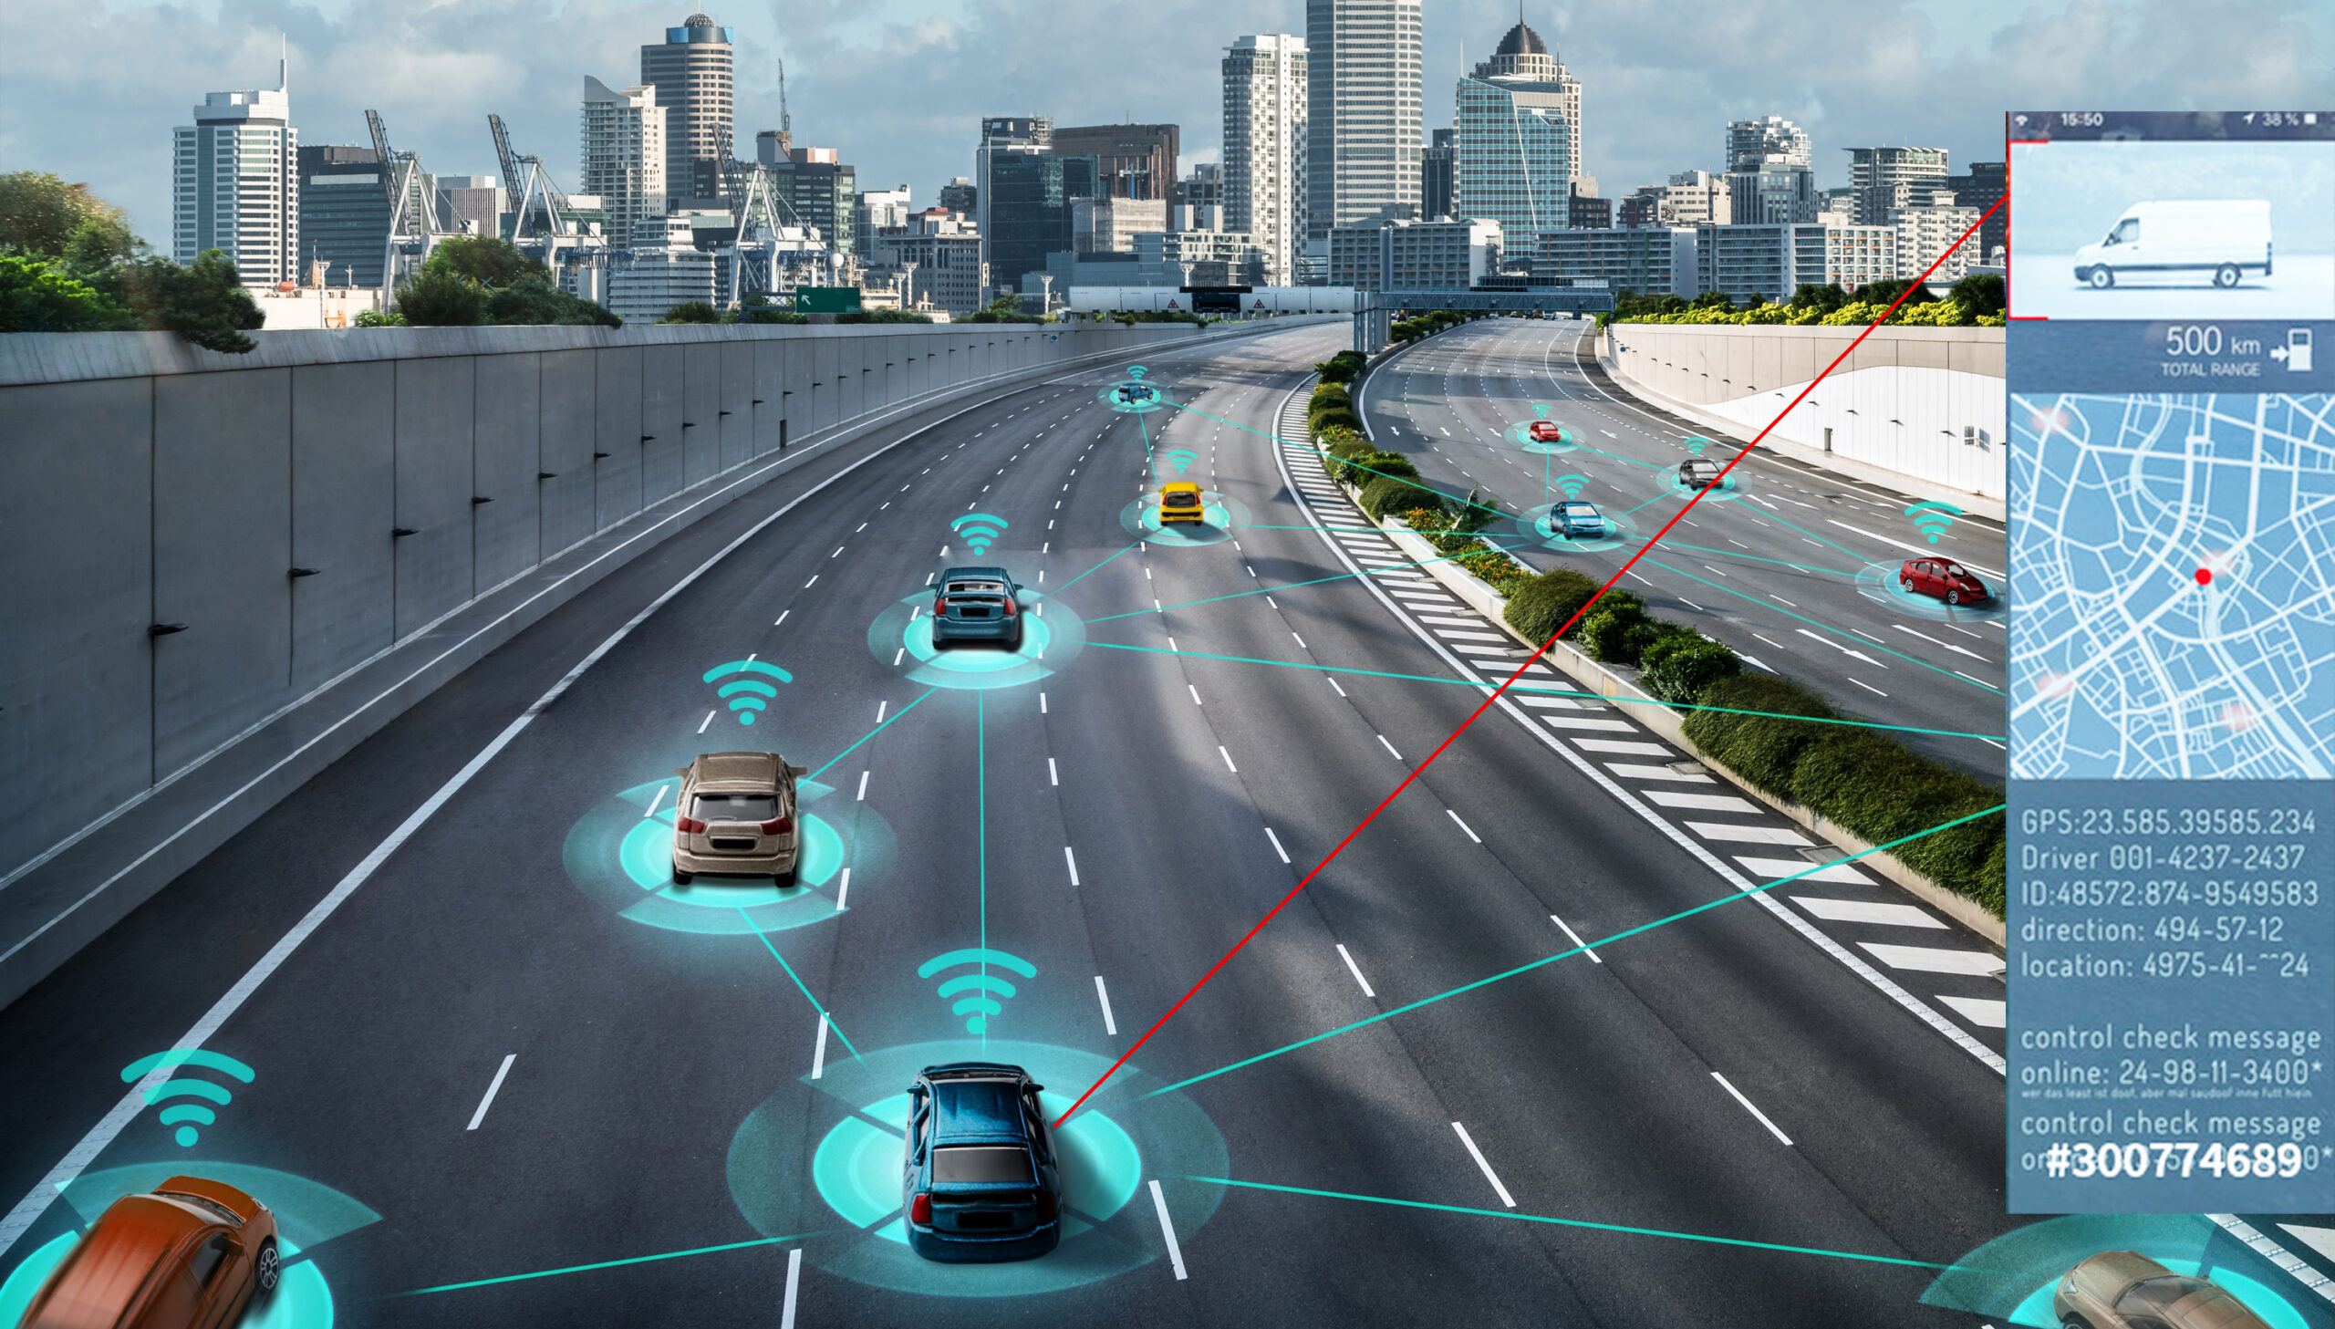
Architecture Overview Frontend : Responsive dashboard, cards, table, live map, analytics Backend : REST API with protected routes, serves data and authentication Database : Stores vehicle, trip, and user info

Slide 6
Key Use Cases
Use Case | Primary Actor | Description
View Dashboard | Fleet Manager | See key fleet metrics ,alerts , live data
Track Vehicles | Manger/User | See vehicle markers and details on map
Add/Edit Vehicles | Fleet Manager | Register and manage fleet from dashboard
Analytics Review | Fleet Manager | Status breakdown: active, idle, maintenance
Secure Access | User | JWT-protected data access

Slide 7
Test Case
Dashboard Loads
Input : Login , visit dashboard
Expected Result : Fleet stats, list, map, analytics load
2 . Unauthorized API Request
Input : Remove/expire JWT, call /API /dashboard
Expected Result : 401 Unauthorized
3. Add Vehicle Validation
Input : Submit Vehicle Form missing license plate
Expected Result : Error shown, not added

Slide 8
4. Map Renders Markers
Input : Vehicles supplied (with location)
Expected Result : Markers visible, status in tooltip
5. Live Update
Input : Backend sends vehicle change (WebSocket)
Expected Result : Map/table update in real-time
6. DB Setup
Input : Run CREATE DATABASE in MySQL shell
Expected Result : Neurofleetx DB created
7. Error Handling
Input : Stop backend, load dashboard
Expected Result : Friendly error, app does not crash

Slide 9
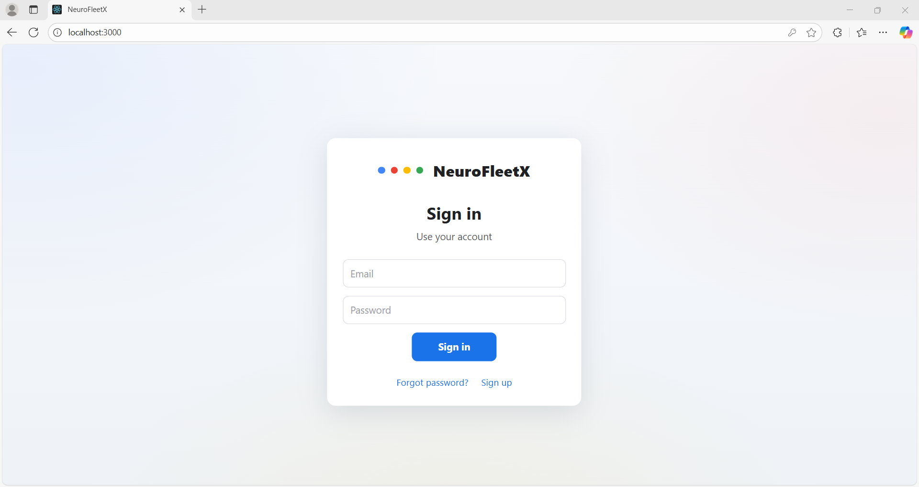
Module 1 : sign in page

Slide 10
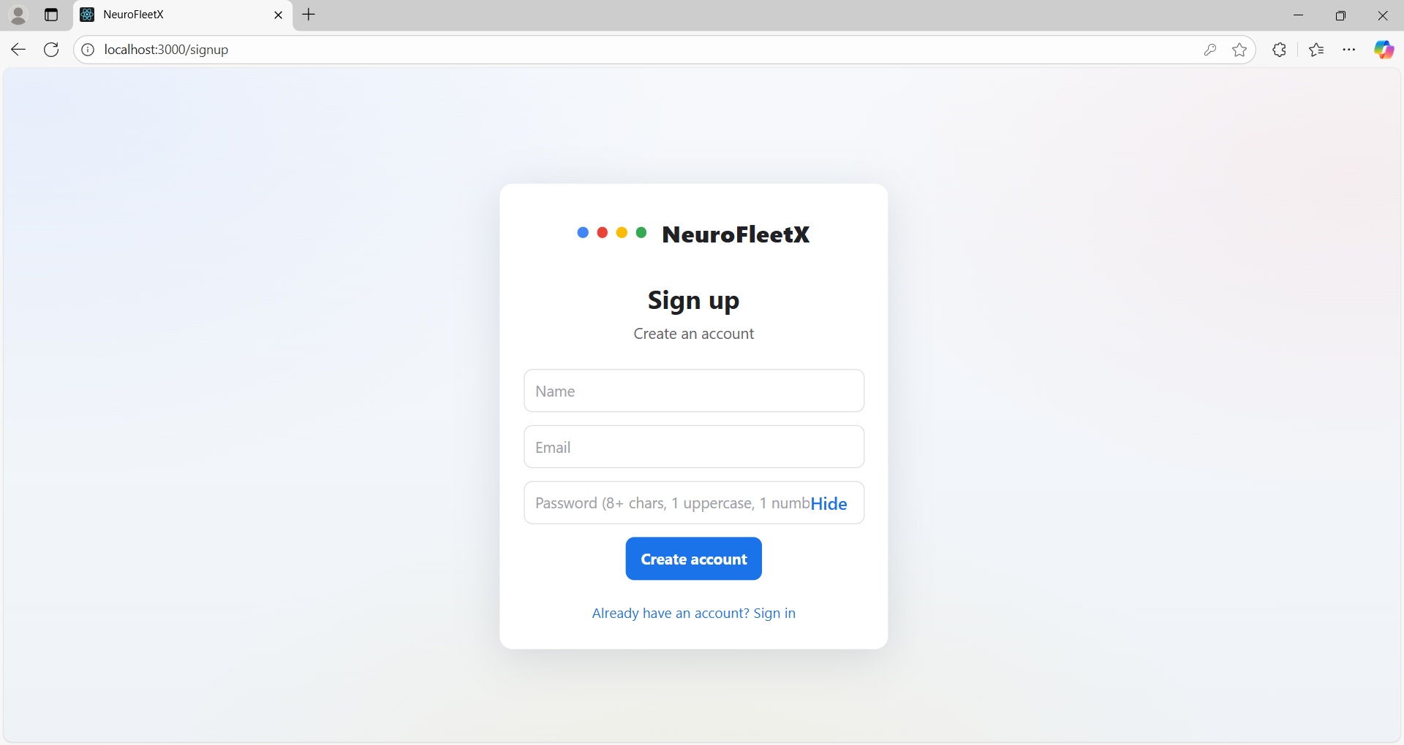
Module 2 : sign up page

Slide 11
Challenges & Solutions
MySQL service issues: Fixed with PATH/my.ini checks, initialization, and Windows service management
Authentication: JWT integration with Express middleware
Map integration: Frontend/maps render live vehicle markers with error handling for invalid data
Improvements/Future Work
Admin roles, automated alerts, deeper analytics
Deployment and CI/CD
Mobile support

