Slide 1
BTN
Laporan Performa
Penjualan Mingguan
Banking Sales Command Center
Sales Leader [NAMA_SALES_LEADER]
Periode [PERIODE_LAPORAN]
Didukung oleh Kerangka A.C.T — Action · Control · Track
Tanggal Generate [TANGGAL_GENERATE]

Slide 2
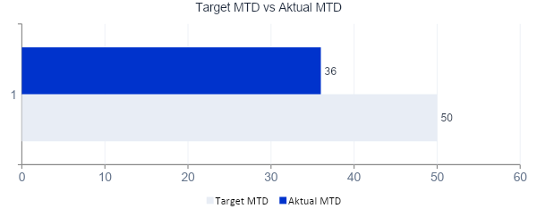
INDIKATOR KINERJA UTAMA (KPI)
[NAMA_SALES_LEADER]
Total Lead Tim
Conversion Rate
Gap ke Target
Lead Prioritas Tinggi
[TOTAL_LEAD]
[CONVERSION_RATE]
[GAP_TARGET]
[LEAD_PRIORITAS]
⚠ [STATUS_KPI]
MTD
Target
vs
Aktual

Slide 3
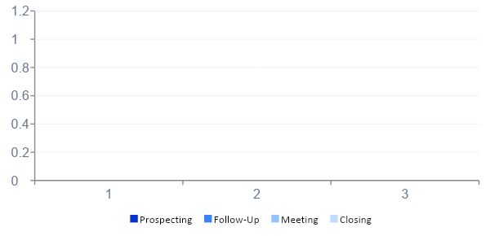
PERFORMA AKTIVITAS HARIAN PER RM
[NAMA_SALES_LEADER]
Nama RM | Prospecting | Follow-Up | Meeting | Closing | Status
[RM1_NAMA] | [RM1_PROSPECTING] | [RM1_FOLLOWUP] | [RM1_MEETING] | [RM1_CLOSING] | [RM1_STATUS]
[RM2_NAMA] | [RM2_PROSPECTING] | [RM2_FOLLOWUP] | [RM2_MEETING] | [RM2_CLOSING] | [RM2_STATUS]
[RM3_NAMA] | [RM3_PROSPECTING] | [RM3_FOLLOWUP] | [RM3_MEETING] | [RM3_CLOSING] | [RM3_STATUS]
⭐ TOP PERFORMER
[TOP_PERFORMER_NAMA]
[TOP_PERFORMER_DESC]
⚠ PERLU PERHATIAN
[NEED_ATTENTION_NAMA]
[NEED_ATTENTION_DESC]

Slide 4
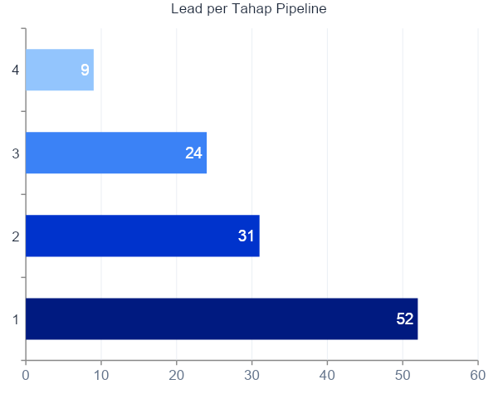
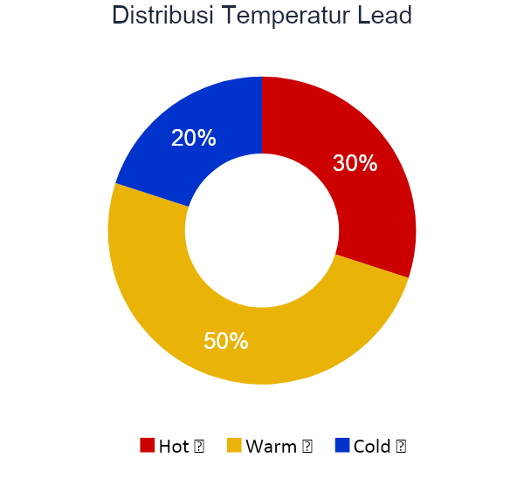
PIPELINE DAN PELACAKAN PROGRES
[NAMA_SALES_LEADER]
Follow-Up Jatuh Tempo
[JUMLAH_FOLLOWUP_DUE] lead perlu tindakan segera

Slide 5
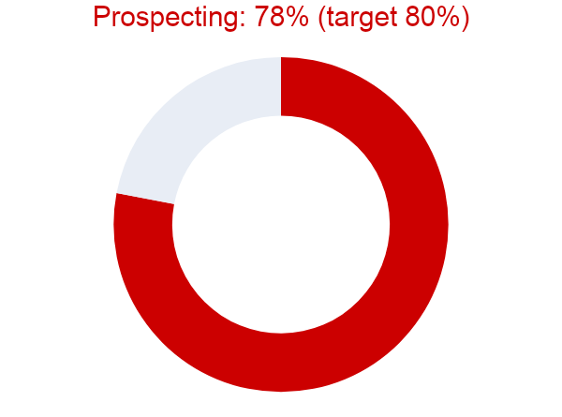
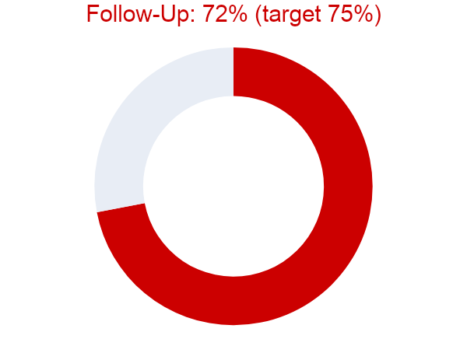
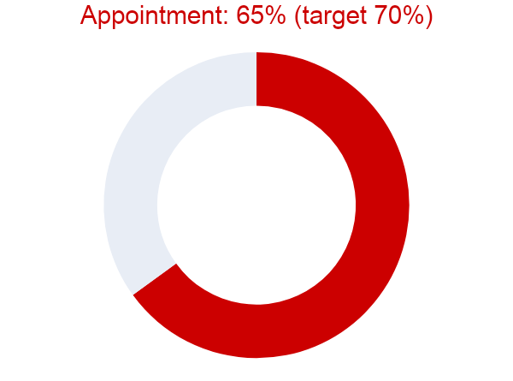

EFEKTIVITAS MANAJEMEN AKTIVITAS
[NAMA_SALES_LEADER]
78%
72%
65%
Skor Efektivitas Keseluruhan: 72% — Tren: [TREN_EFEKTIVITAS]

Slide 6
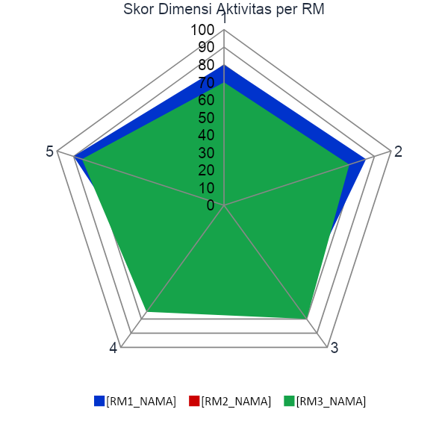
SISTEM PERINGATAN DINI & COACHING
[NAMA_SALES_LEADER]
⚠ Peringatan 1
[PERINGATAN_1_DESC]
⚠ Peringatan 2
[PERINGATAN_2_DESC]
🎯 Prioritas Coaching
Perlu Remedial: [REMEDIAL_NAMA] ([REMEDIAL_TOPIK])
Fokus Coaching: [COACHING_FOKUS]
Gap Alignment: [GAP_ALIGNMENT] area perlu sinkronisasi

Slide 7
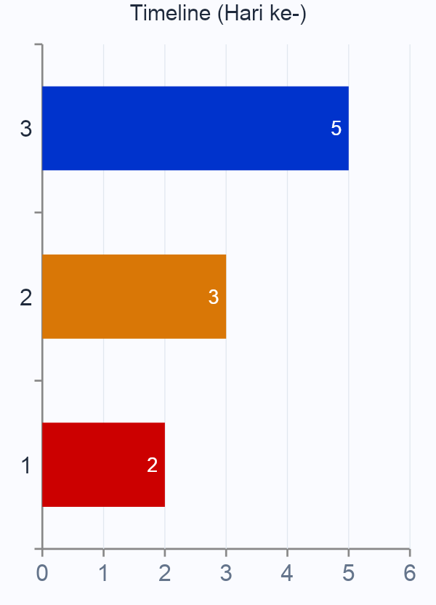
RENCANA AKSI MINGGU DEPAN
[NAMA_SALES_LEADER]
Prioritas 1 — TINGGI
[AKSI_1]
PIC: [PIC_1] | Tenggat: [DEADLINE_1]
Prioritas 2 — SEDANG
[AKSI_2]
PIC: [PIC_2] | Tenggat: [DEADLINE_2]
Prioritas 3 — RUTIN
[AKSI_3]
PIC: [PIC_3] | Tenggat: [DEADLINE_3]
📅 Review berikutnya: [TANGGAL_REVIEW]

Slide 8
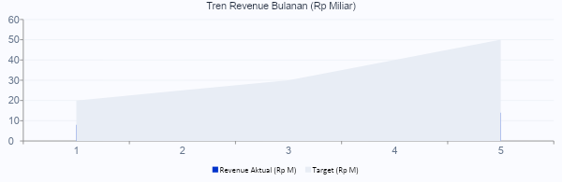
AREA HASIL — KERANGKA A.C.T
[NAMA_SALES_LEADER]
Revenue
Engagement
Pertumbuhan
Leadership
Rp [REVENUE_AKTUAL] M
[ENGAGEMENT_PERSEN]%
+[GROWTH_PERSEN]%
[LEADERSHIP_STATUS]
vs Target Rp [REVENUE_TARGET] M
Aktivitas vs ekspektasi
vs periode sebelumnya
[COACHING_TERPENUHI]/[TOTAL_RM] RM di-review

Slide 9
RINGKASAN EKSEKUTIF
[NAMA_SALES_LEADER]
1
[RINGKASAN_1]
Terima Kasih
2
[RINGKASAN_2]
Terima kasih atas dedikasi
dan kerja keras seluruh tim.
3
[RINGKASAN_3]
BTN
✅ Pencapaian Terbaik
🎯 Area Fokus
[HIGHLIGHT_POSITIF]
[AREA_FOKUS]
A.C.T Sales CRM
Dibuat otomatis — [TANGGAL_GENERATE]
Dibuat otomatis oleh A.C.T Sales CRM — BTN | Data bersumber dari dashboard real-time

