Slide 1
Assignment-1

Slide 2
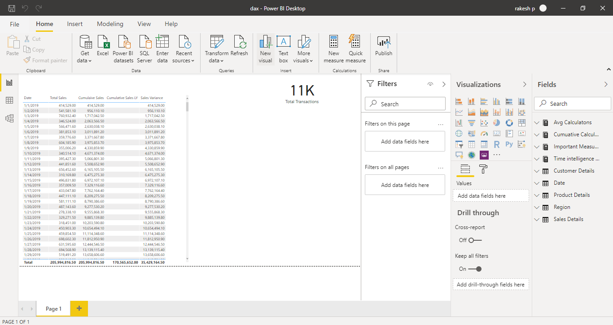
Q1.Report View page

Slide 3
Q2a.Report View page

Slide 4
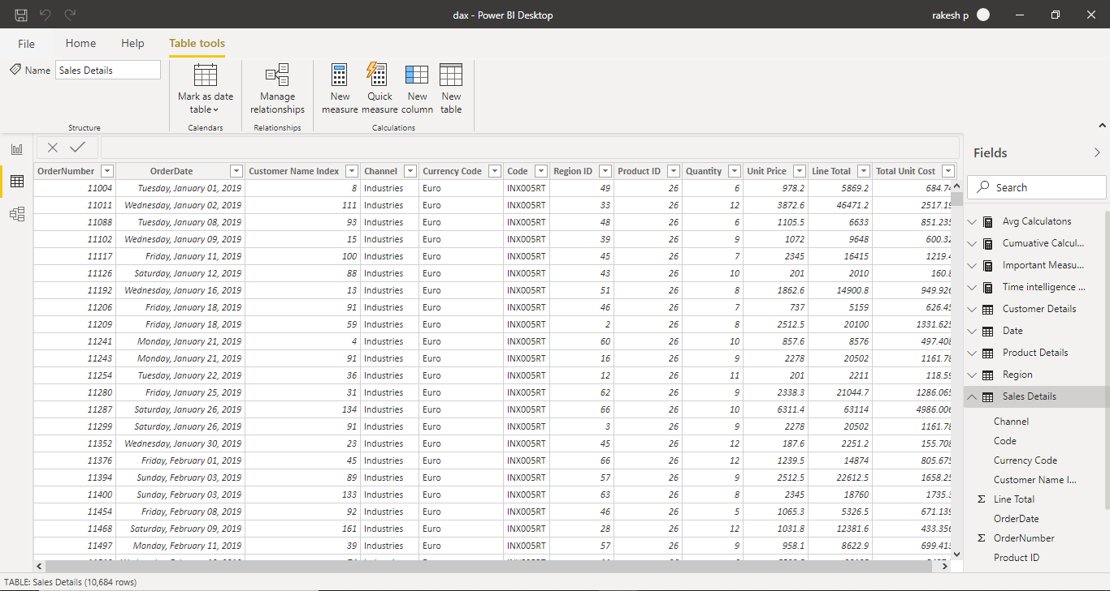
Q2b.Data View

Slide 5
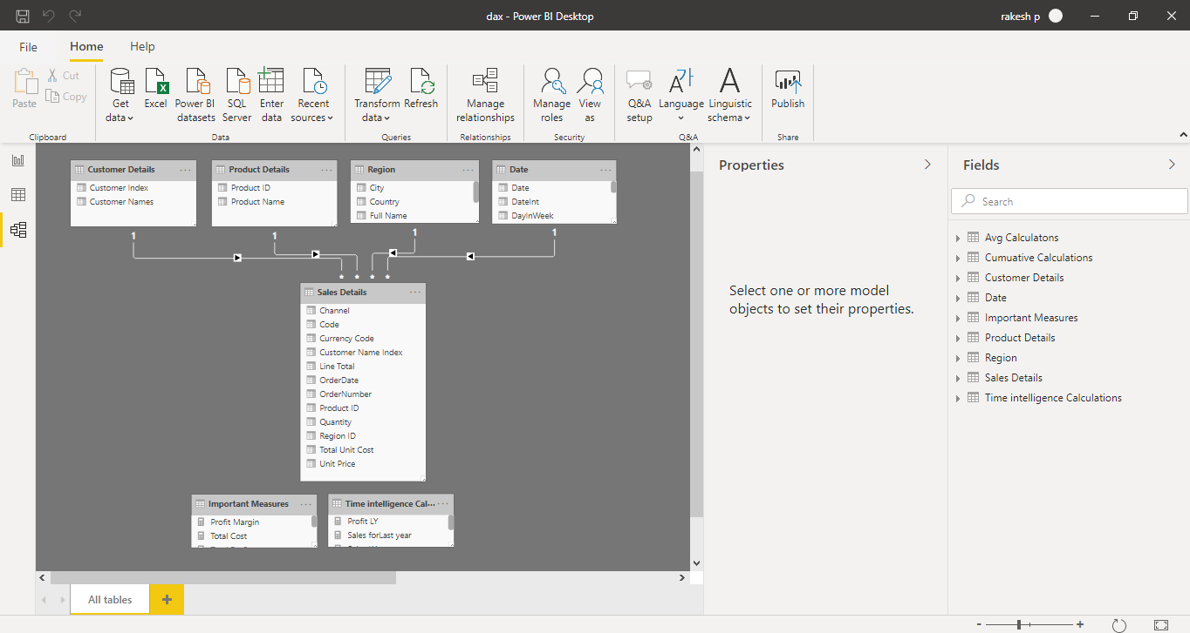
Q2c.Model View

Slide 6
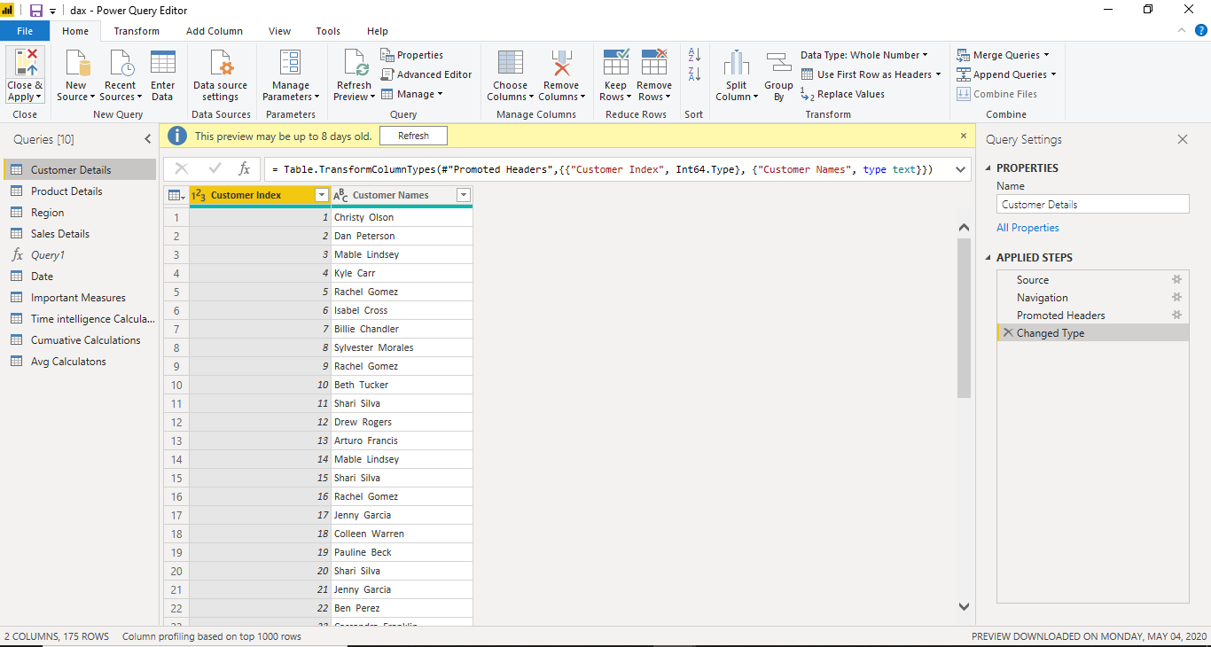
Q2d.Power Query Editor

Slide 7
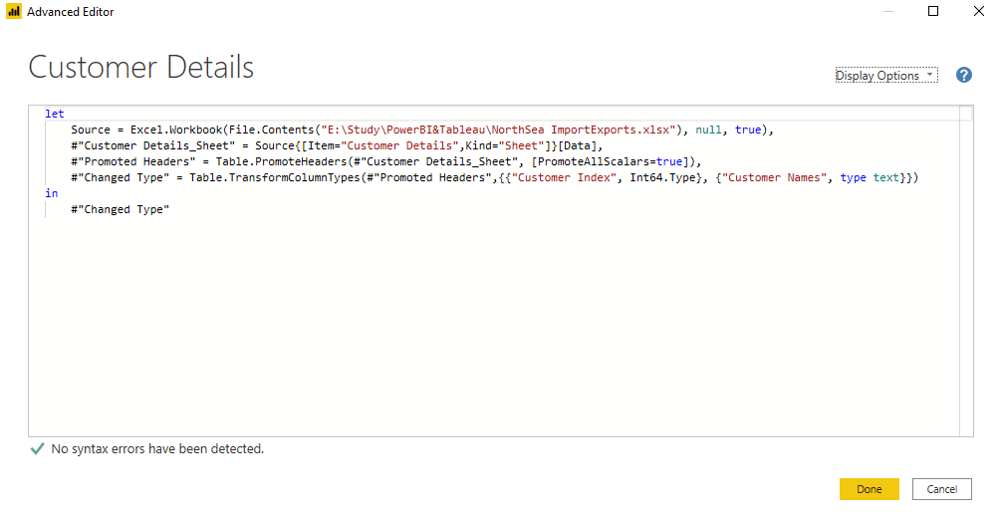
Q2e.Advance Editor

Slide 8
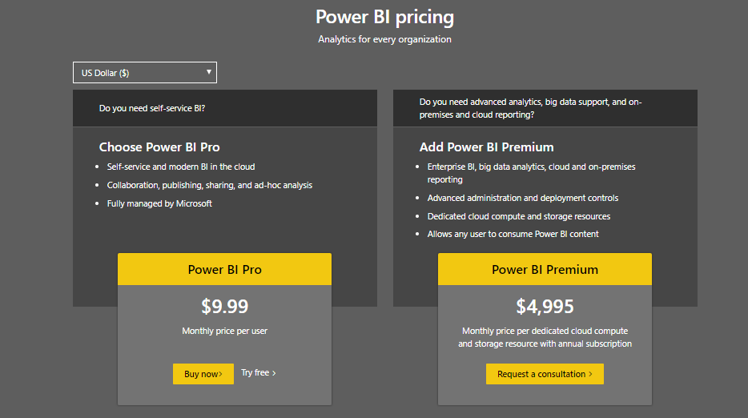
Q3.Power BI Pricing
Power BI comes in three levels – Desktop, Pro, and Premium. The Desktop level is free
for individual users, while the Pro plan costs $9.99 per user per month. The Premium
plan starts at $4,995 a month per dedicated cloud compute and storage resource.

