Slide 1
Lending Club Case Study
Kavya Marigowda
Rakesh Krishnamurthy
Note: please refer to the Jupyter notebook more detailed analysis, observations & conclusions
8th May 2023

Slide 2
Business Objectives
The Lending club is the largest online loan marketplace, facilitating personal loans, business loans, and financing of medical procedures.
Company needs the strong driving factors behind loan default and then precisely make decision on loan lending

Slide 3
Data Understanding
The loan data from lending club has 111 variables and 39717 in data volume
Few variables are missing in data compared to data dictionary such as
There are 54 variables with all the values missing.
Loan_status gives us key information whether the customer defaulted or not
fico_range_high
fico_range_low
last_fico_range_high
last_fico_range_low

Slide 4
Data Extraction, Cleaning & typing
Dropped 66 variables based on all missing values, high proportions of nulls, having same zero/same percentiles.
No duplicates found in the data based on member_id and/or id variables
Removed special char like % from percentage columns
Converted variables date with value into datetime
Imputed variables with data when % nan’s less than 3 (eg: pub_rec_bankruptcies)

Slide 5
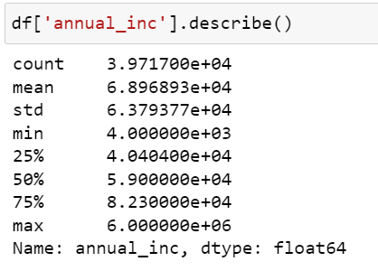
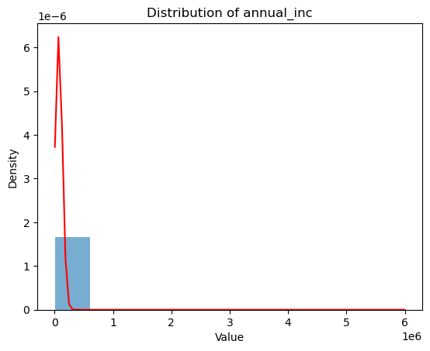
Outlier detection
Std div is very high and there is huge difference in 75 quantile and max
Out of the all the variables annual_inc seems to have outliers and data is highly skewed

Slide 6
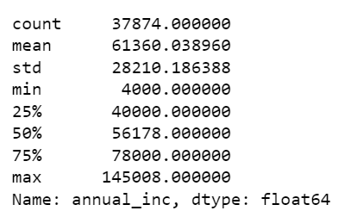
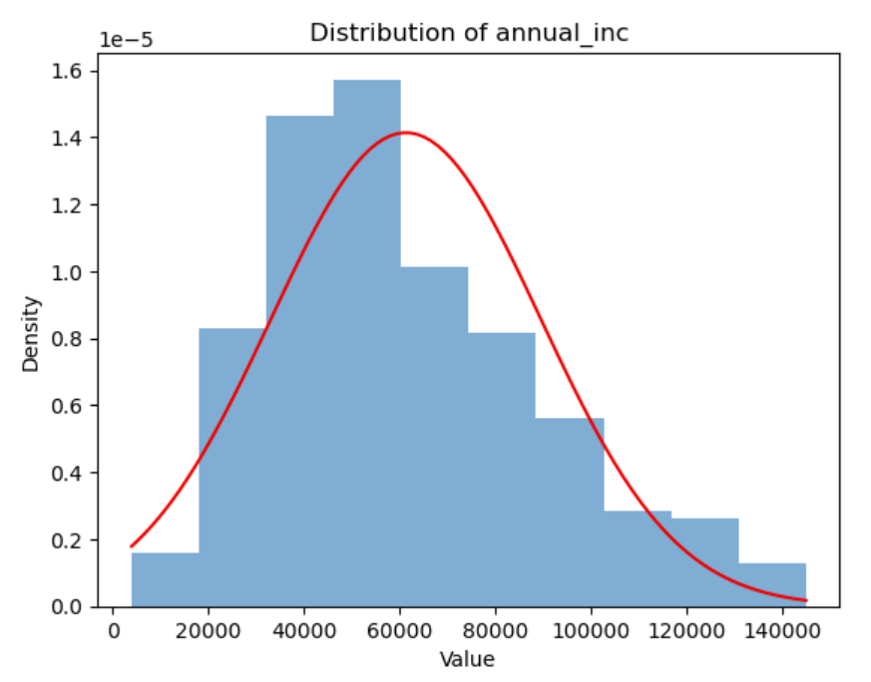
Outlier Removal
As annual_inc is highly skewed, outliers removal using Interquartile ranges (IQR) is recommended
Post outlier removal, the graph as attained bell curve

Slide 7
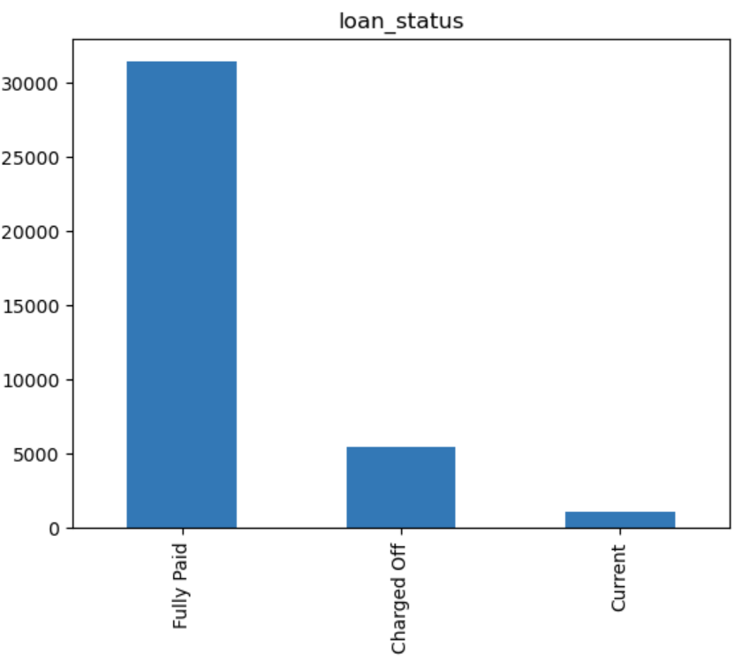
Univariate Analysis
The key variable in the data loan_status has 3 unique values : full paid, charged off and current.
Out of the total population approx. 14.33 have defaulted
There are no unknowns

Slide 8
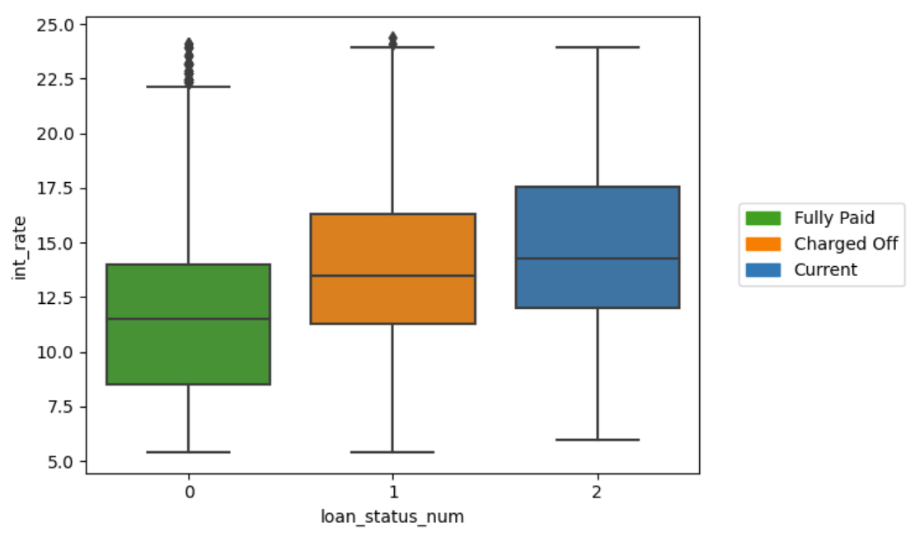
Bivariate Analysis
There are few variables which are highly correlated like loan_amt and funded_amt
We can see that as the interest rate increase the members defaulting increased

Slide 9
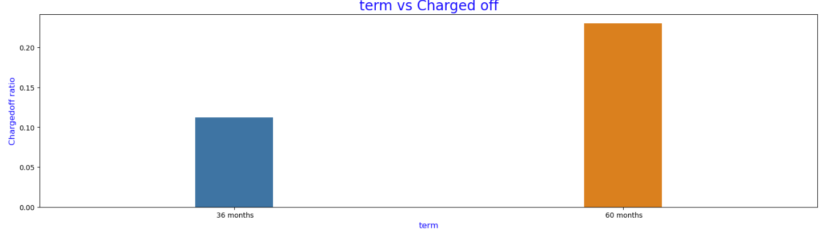
Key Analysis – Driving factors [term]
We can see that customers who took 60 month term loan defaulted twice than who did 36 months term

Slide 10
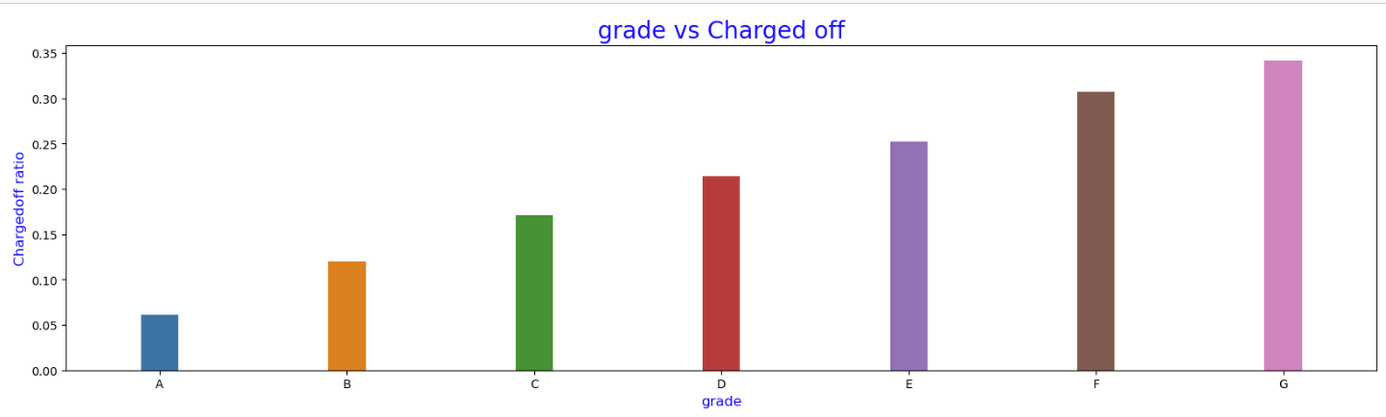
Key Analysis – Driving factors [grade]
We can see that customers whose grade increased from ‘A’ through ‘G’ , there is a linear increase in the default cases, G being the highest.
Customers in ‘G’ grade are likely to default 6 times more than the one’s in grade ‘A’
There is 34% and 30% chances that Customers in ‘G’ & ‘F’ respectively are likely to default

Slide 11
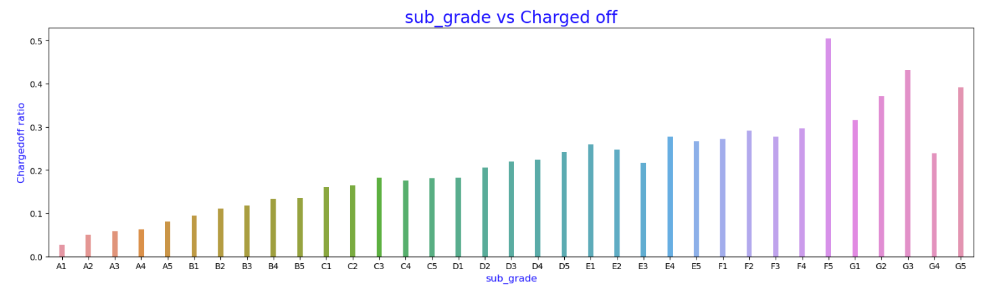
Key Analysis – Driving factors [sub grade]
We can see that customers whose grade increased from ‘A-X’ through ‘G-X’ , there is (close to) linear increase in the default cases, F5 being the highest, similar to grade
Customers in ‘F5’ grade are likely to default 25 times more than the one’s in grade ‘A1’
There is 50% chances that Customers in ‘F5’ are likely to default

Slide 12
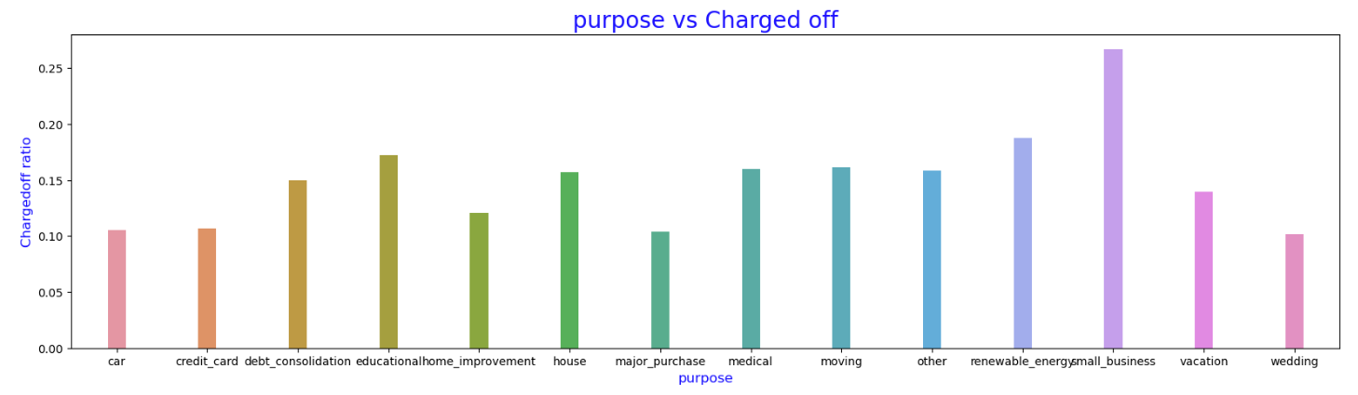
Key Analysis – Driving factors [purpose]
We can see that customers whose purpose of loan was small_business tend to default
There 26% chances that Customers with small business are likely to default which is highest among all other purposes

Slide 13
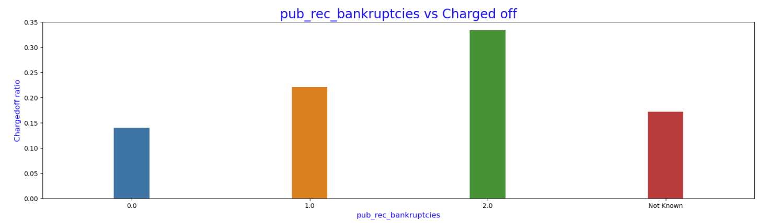
Key Analysis – Driving factors [public record bankruptcies ]
We can see that customers who are having public record bankruptcies are likely to default
There is > 22% chances that Customers with public record bankruptcies are likely to default.

