Slide 1

Implementing
GlobalPlatform™ Standards to Ensure Smart Card Success
Jim Harper
Datacard Group
August 2002
Notes:
Smart cards are transforming the way the world lives and works. Whether it is placing phone calls, logging in at a workstation, making online purchases, or accessing government benefits, smart cards provide us with entirely new levels of speed, convenience and security.
The greatest opportunities, however, await card issuers who harness the full power of multi-application smart cards. To do this you will need a secure and highly productive infrastructure based on ‘open’ standards for smart card personalization, delivery and the management of multi-application smart cards issued and in cardholders’ hands. The data management and card life cycle requirements will simply overwhelm any card program without a world-class solution based on open standards.

Slide 2
Topics
Smart Cards before Standards
Key Considerations for Issuing Multi-application Smart Cards
  Smart Card (Chip) Operating System
  Smart Card Personalization Process
  Smart Card Management System and Post Issuance Personalization Process
  Smart Card Terminals/Devices
Implement GP Standards for Control, Reliability and Value

Slide 3
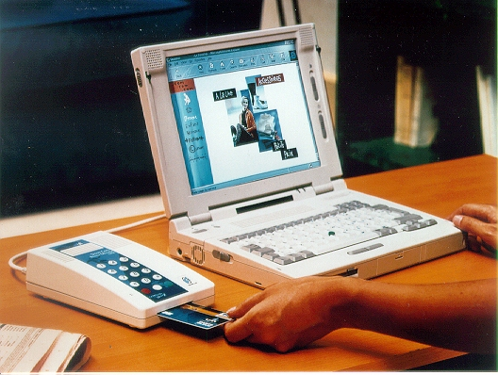

The “Traditional” Smart Card Industry
N E W
LOTSA CREDIT
LOTSA CREDIT
LOTSA CREDIT
LOTSA CREDIT
LOTSA CREDIT
Print & Laminate
(Sheets)
Die Cut
Mill
Standards-based
Personalization
Proprietary
Personalization
Application
Silicon/Chip
Prop.“O/S” Prop. Apps
Standards-
based O/S
LOTSA CREDIT
LOTSA
CREDIT
1234 5678 9012 3456
Patty Doe – Exp 13/999
Embed
Initialize
Personalize
Standards-based
Card Management
LOTSA
CREDIT
1234 5678 9012 3456
Patty Doe – Exp 13/999
1234 5678 9012 3456
Patty Doe – Exp 13/999
Deliver
Use
Post Issuance Update

Slide 4
Before Standards
Single application, proprietary smart cards (operating systems)
  Lack of interoperability
    increased time to market
    costs to change cards/applications
  Consumer: single use, no choice, lessening card value over time
  No cross-marketing or “pull” from other applications on card
  Proprietary “issuance” systems
Notes:
Today, smart cards with 64K and 128K of memory and a lot of computing power and standard operating systems (e.g., Java) are emerging. Ample memory and standard platform operating systems now allow smart cards to store and process multiple applications, much like today’s desktop computer systems.
This holds tremendous promise for both consumers and consumer marketers. For example, a financial institution may offer consumers a smart card with credit, debit, e-purse and loyalty capabilities all on a single card. Because the card offers so much memory and computing power, the financial institution can allow other businesses - such as telecommunications companies, airlines and healthcare enterprises - to put their applications on the card as well. This has created a demand for a multi-application smart card infrastructure that makes the personalization and life cycle management of these cards fast, easy and cost-effective.
From a consumer perspective, this means more choice and more power. In ideal cases a consumer will be able to choose from a variety of companies and applications for their card, so the card they use every day best suits their particular need. Multi-application smart cards and smart card management systems will allow these same consumers to now add or delete applications from their cards, the same way they add and delete applications on their desktop computers at home.
To the card issuer, this new dynamic multi-application smart card ‘product’ becomes the ultimate marketing tool. New products and services can now be offered to cardholders on a whim, and the cardholders can start using the new products (applications) or services as soon as they can be downloaded onto their cards, using their home PC over the internet, through a mobile handset, at an ATM or kiosk, or elsewhere.
From a consumer marketer's point of view multi-application smart cards will create a whole new world of business opportunities. Multi-application cards also open the door to profitable business partnerships that otherwise may not have been considered.

Slide 5
Where Standards Matter
Smart Card (Chip) Operating System
Smart Card Personalization Process
Smart Card Management System Interface to “Bureau” Environments
Smart Card Terminals/Devices
Notes:
The first step towards successfully issuing multi-application smart cards is selecting the right solutions provider. While planning and implementation of a smart card program is a complex undertaking, there are three vital decisions that must be made early in the process:
Smart card operating systems — Multi-application smart cards require security and seamless interoperability.
Card personalization process — Data generation, data encryption, key management and application loading are critical steps in the card personalization process. Secure, productive and fully integrated smart card personalization infrastructure to efficiently manage these tasks is critical to the success of the program.
Post-issuance card management — If you plan to issue multi-application smart cards, you will want to give customers the ability to add or delete applications quickly and easily to the cards they already have.
GlobalPlatform™ (ref: www.globalplatform.org) is an organization that has developed standards to address these three important considerations.

Slide 6

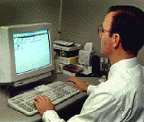

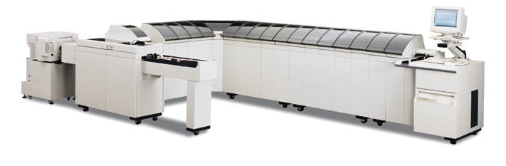
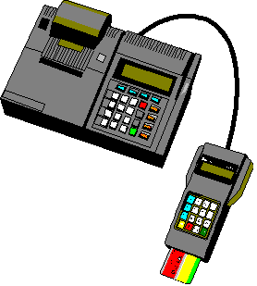
Where Standards Matter
“Standard”
Development
---
“Standard”
Development
Smart Card Management System
---
2
Standards-based Data Generation and Card Personalization Process (using GP Profiles and Scripts)
3
2
Standards-based SCMS
to “Bureau” Interface
VPN
Card Usage
ATMs
POSs
Home PCs
Kiosks
Mobile
Devices
Chip Data Generation Process
Loading and Personalization Process
Personalization System(s)
Delivered Card
Fully Automated
Processes!
Chip
Applet(s)
4
1
Standards-based Terminal to Terminal Application Interface
“Standard” I/F
Standards-based Chip Application
to Chip Operating System Interface
Chip O/S
---
---
Smart cards
to be used
“Standard”
Development
“Standard”
Development

Slide 7
Key Consideration #1:
Smart Card Operating System
Standard interface between chip operating system and chip “applets”
  “Write Once/Run Anywhere”
Common approach to loading, deleting and changing applications on cards
Standard security scheme
Allows for “standard” personalization and post-issuance personalization processes to be used
Notes:
Ultimately, multi-application smart cards must be able to run applications from a variety of providers — smoothly, seamlessly and securely. GlobalPlatform has created a set of specifications around how card operating systems should interface with applications from multiple vendors, while creating a standard security scheme and a common approach for adding, deleting and changing applications that run on these cards.
Software operating systems such as Datacard’s ApturaTM smart card operating system, which is a straightforward implementation of Java CardTM and GlobalPlatform standards, are the foundation for a secure, high-performance ‘open’ multi-application smart card program.
Implementing GlobalPlatform standards simplifies the loading of applications to a smart card, and enables secure dynamic in-field updates to the applications on the card. This is an invaluable feature to card issuers as it offers them the power and flexibility to update the application suite on cards without the need to reissue smart cards already in use (again, much like the PC model here Windows applications can easily be added/deleted from a desktop computer).

Slide 8
Key Consideration #2:
Smart Card Personalization Process
New “challenges”
  Data generation (“disintermediate”)
  Data encryption
  Key management
  Application loading
  Card personalization
  Card life cycle management
GlobalPlatform response…
  A “script-driven” data generation and personalization process
  Simplifies the updating of single and multi-application smart cards
  Moves responsibility to application developer
Notes:
Personalizing smart cards is similar to personalizing magnetic stripe cards, as both require data elements to be gathered and formatted and specific, documented processes must be followed. Given the complexity of smart card personalization, however, the similarity ends there.
New challenges — such as data generation, data encryption, key management, application loading, card personalization and card life cycle management — must be handled flawlessly in order to successfully launch a smart card program with minimal risk and cost. To help issuers accomplish this, GlobalPlatform has developed a script-driven data generation and personalization process that can simplify and streamline the issuance of single- or multi-application smart cards.
Data for a smart card is a complex series of data elements, both cryptographic and clear text, that must be generated, assembled and formatted in such a way as to be understood by a smart card chip and its associated application. Implementing GlobalPlatform standards makes it possible to generate this data without having prior knowledge of the application and without human intervention in the process.
The GlobalPlatform scripting process can be thought of as an “install wizard” - much like the install wizard you use to install Windows-based applications on a PC. This standards-based process dramatically reduces time-to-market, minimizes operator-training costs, and simplifies the transition to smart cards by providing a generic personalization process that can personalize any application without unique knowledge of the application and without custom software development

Slide 9
Key Consideration #3:
Smart Card Management System
Standards-based interface between SCMS and existing issuance/bureau environments
  Independent of personalization hardware
Card activity must be tracked and managed with great precision
You must have confidence that a card’s suite of applications and contents (data) can be re-created
Simplify post-issuance personalization and re-issuance (using Profiles and Scripting)
SCMS becomes a powerful marketing tool
Notes:
A key benefit of multi-application smart cards is the ability to add or delete applications initially offered on the card by the issuer. This is referred to as “post-issuance personalization.” Post issuance personalization allows a cardholder — using a PC, or a mobile handset device, or other — to select an available financial, telecommunications, healthcare and possibly even transportation applications from a variety of companies that are in partnership with the card issuer, to add these new applications to his/her card which they have in their purse or wallet.
To help issuers manage cards already issued, GlobalPlatform has developed a set of standards that defines how a smart card management system interfaces with an existing issuance environment, as well as with various application providers. In this dynamic multi-application example, a cardholder can change the state of the card many times over the course of its service life. If during the course of the card’s life the card is lost, damaged or stolen, there needs to be a way to reissue the card to the cardholder with confidence that the data on the card represents the most current suite and status of applications. The adding, deleting, updating and blocking of applications, therefore, must be tracked and managed with great precision. Business rules can also be executed to customize the card upon re-issuance.
Complete card life cycle management systems that provides card issuers with the solution they need to facilitate and simplify post-issuance, multi-application smart card re-issuance and the management of smart card populations of all sizes, must be managed by a GlobalPlatform-compliant card life cycle management system such as Datacard’s AffinaTM platform management architecture.
Such software will execute in a secure manner, and the remote loading, changing, blocking and deleting of applications on the issued cards across a distributed multi-application card base can be efficiently managed while keeping tight control over the state of each card in use. This accurate, real-time information paints a clear profile of the applications held by the cardholder, making this a powerful tool for customer relationship management and marketing.

Slide 10
Key Consideration #4:
Smart Card Terminals/Devices
Standards-based interface between a terminal and it’s applications
Common approach to adding, deleting and changing applications on a terminal device/reader
Well defined interface for terminal application development and testing
Standards-based management interface
Notes:
A key benefit of multi-application smart cards is the ability to add or delete applications initially offered on the card by the issuer. This is referred to as “post-issuance personalization.” Post issuance personalization allows a cardholder — using a PC, or a mobile handset device, or other — to select an available financial, telecommunications, healthcare and possibly even transportation applications from a variety of companies that are in partnership with the card issuer, to add these new applications to his/her card which they have in their purse or wallet.
To help issuers manage cards already issued, GlobalPlatform has developed a set of standards that defines how a smart card management system interfaces with an existing issuance environment, as well as with various application providers. In this dynamic multi-application example, a cardholder can change the state of the card many times over the course of its service life. If during the course of the card’s life the card is lost, damaged or stolen, there needs to be a way to reissue the card to the cardholder with confidence that the data on the card represents the most current suite and status of applications. The adding, deleting, updating and blocking of applications, therefore, must be tracked and managed with great precision. Business rules can also be executed to customize the card upon re-issuance.
Complete card life cycle management systems that provides card issuers with the solution they need to facilitate and simplify post-issuance, multi-application smart card re-issuance and the management of smart card populations of all sizes, must be managed by a GlobalPlatform-compliant card life cycle management system such as Datacard’s AffinaTM platform management architecture.
Such software will execute in a secure manner, and the remote loading, changing, blocking and deleting of applications on the issued cards across a distributed multi-application card base can be efficiently managed while keeping tight control over the state of each card in use. This accurate, real-time information paints a clear profile of the applications held by the cardholder, making this a powerful tool for customer relationship management and marketing.

Slide 11
Implement GlobalPlatform
Standards for…
Control
GP standards enables issuers to quickly capitalize on the power and promise of new technology
GP standards allow issuers to maintain control of their suppliers and supplies
Interoperability

Slide 12
Implement GlobalPlatform
Standards for…
Reliability
Standard interfaces and processes simplify development and testing
High quality
Vendors held accountable
Datacard has a wide variety of GP-compliant systems in place today, from desktop to high volume central issuance and smart card management systems

Slide 13
Implement GlobalPlatform
Standards for…
Value
GP systems can exchange data with other systems that use GP methods and specifications
  Interoperability
  Vendor and hardware independence
Costs can be reduced, reuse is higher, and testing can be handled in the same way (using GP scripts/profiles)

Slide 14
Datacard’s commitment to GlobalPlatform™ standards
Jerry Johnson,
Datacard President & CEO
GlobalPlatform Board
Card
Committee
System
Committee
Marketing
Committee
Planning
Committee
Bill
Reding
Stuart
Miller
Bob Beer,
Chairperson
Pete
Thorsen
Christophe Biehlmann
Lorna Williamson
Chris
Lomax
Brendan Jones

Slide 15
Datacard’s contributions to GlobalPlatform efforts
Development of new Profiles and Scripts
  XML data with Java Script
Interface Specifications
  SCMS to Bureau Environment
Card Specifications
  Open Kernel (OCAPI)

Slide 16
Datacard and Smart Cards
Datacard solutions personalize more than 90% of the worlds financial cards (7MM every day, 2.5B annually)
Datacard has nearly 1000 high volume personalization systems installed worldwide
Experts in “chip” consulting, EMV migration, and systems integration
Only vendor with true production level Smart Card Management Systems in operation
Watch for Datacard MAXSYS™ and Syntera – Coming Soon!

Slide 17
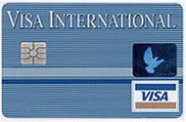
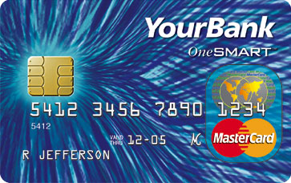


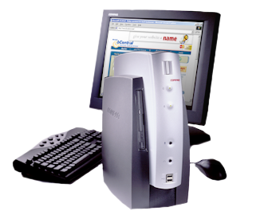
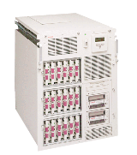
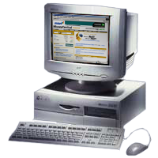
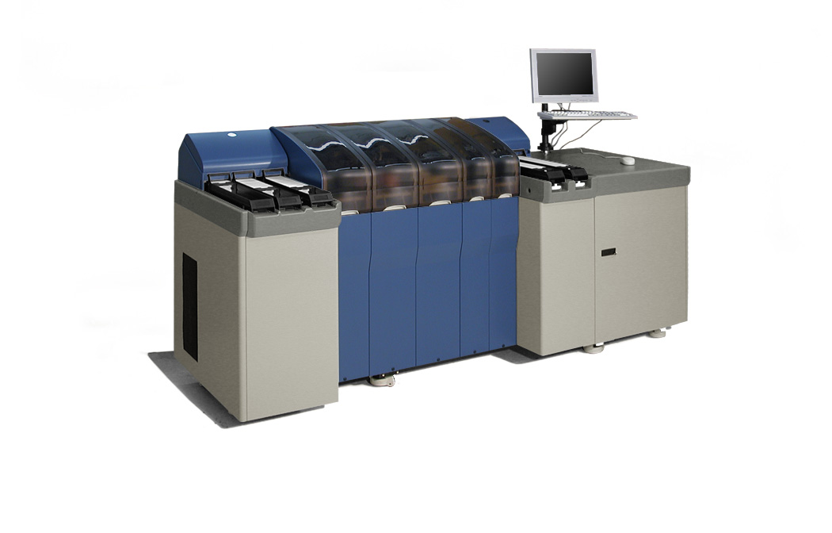

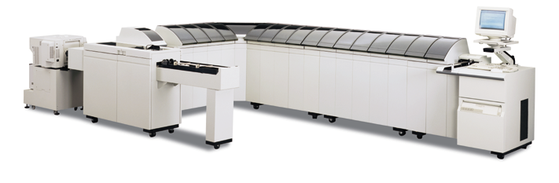
Datacard Smart Card MAP™ Architecture
(Multi-application Architecture for Personalization)
GlobalPlatform™/Java™
MULTOS™
Proprietary
CARD PLATFORM
ENVIRONMENT
SOFTWARE AND
SOLUTIONS
ENVIRONMENT
Smart Card Personalization Manager (SCPM™)
and P3™
Smart Card
Management System
(Affina™)
Shared Cryptographic
Resources and
Certificate Authorities
PRODUCTION
ENVIRONMENT
Low Volume
Issuance
9000/7000/500
Maxsys

Slide 18

Datacard Smart Card MAP™ Architecture
(Multi-application Architecture for Personalization)
GlobalPlatform™/Java™
Standard
Open
Customizable
MULTOS™
Proprietary
CARD PLATFORM
ENVIRONMENT
Modular
Flexible
Scalable
SOFTWARE AND
SOLUTIONS
ENVIRONMENT
Smart Card Personalization Manager (SCPM™)
and P3™
Smart Card
Management System
(Affina™)
Shared Cryptographic
Resources and
Certificate Authorities
Full Range
Investment Protection
Future Proof
PRODUCTION
ENVIRONMENT
Low Volume
Issuance
9000/7000/500
Maxsys

Slide 19
Summary
Choose your smart card solution partner carefully
  Your partner and solutions should “future proof” your investments (i.e., flexible, scalable, extensible)
Request GP standards in your:
  Cards
  Personalization Systems (Processes)
  Smart Card Management System
  Terminals
Enjoy…
  Control
  Reliability
  Value
Notes:
Many issuers who are considering rolling out a smart card program are wondering how they can “make the business case” for smart cards and dynamic smart card management. Building a business case for smart cards is not a trivial effort, but when all costs and benefits are calculated, smart cards have proven time and time again they can offer significant economic value to an issuer’s bottom line, compared to the issuance of a similar magnetic stripe card.
The economics of a chip-based card program will be the sum of the revenues gained from the new program minus the cost/expenses of the program. Cost avoidance must also be factored into the equation. Increased marketing capabilities and cardholder retention will also be important considerations. A few additional business drivers for making the business case are shown in the illustration below.
Now is the time for issuers to move to multi-application smart cards, to reduce losses and operational costs, and to enjoy new revenues and gain new and loyal customers because of the highly customized applications that can be offered to cardholders. Implementing GlobalPlatform standards will assure the smart card program implemented is built on a firm foundation, with standards for interoperability, standards for smart card operating systems, standards for smart card loading and personalization, and standards for post-issuance personalization and card life cycle management.

Slide 20
For More Information…
White Papers on www. datacard.com:
“Implementing GlobalPlatform™ Standards to Ensure Smart Card Success”
“The Transition from Magnetic Stripe to EMV Chip (Smart) Cards”
“The Transition to Multi-application Smart Cards with Post Issuance Personalization Capabilities”
“Datacard MAP™ Smart Card Architecture”

Slide 21
For More Information…
Brochures on www. datacard.com:
Smart Card Issuance and Management
Datacard Smart Card Solutions
Datacard Smart Card Infrastructure
Datacard Smart Card Personalization Manager (SCPM)
Datacard Desktop Smart Card Issuance Solutions
Datacard Smart Card Consulting Services

Slide 22
For More Information…
Presentation on www. datacard.com:
“Datacard products which implement GlobalPlatform™ methods”

Slide 23
Thank You!
Jim Harper
Director, Smart Card Solutions Marketing
Datacard Group
jim_harper@ datacard.com
Office 952-988-1179
Mobile (1) 612-229-1179

Slide 24
Additional Slides

Slide 25
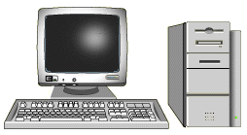
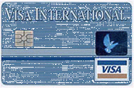
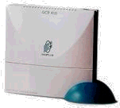

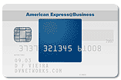

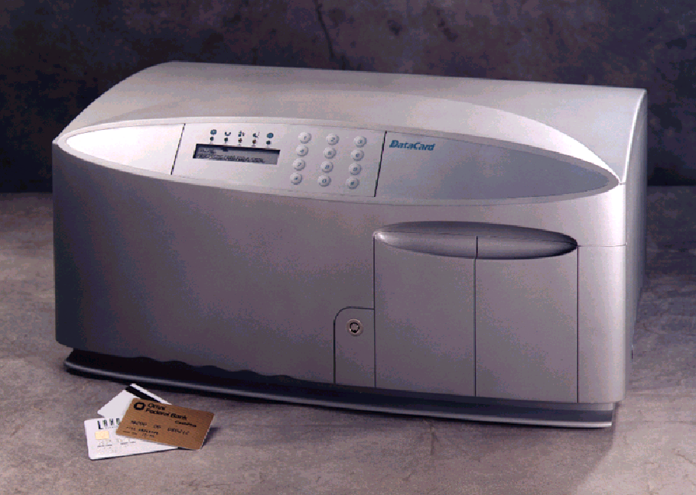
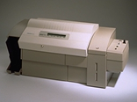
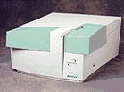

How Datacard’s Smart Card Solutions Relate to Each Other
P3
Generate Chip Data Process
(Fully Automated Operation)
Affina
Card Life Cycle Management
(Card Data Warehouse)
Call Center
Card Data File (from host)
Customer Support
Marketing
Data File
with Chip Data
New Card Products
Store Issuance Data
Issue,
Re-issue
Cards
CSM/
Syntera
SCPM SDK
Smart Card Loading and Personalization Development and Test Systems
Central Smart
Card Issuance
Download new apps and update existing apps over the internet or other secure “channels”
Internet
or VPN
Gen 2E smart
card module
Move perso apps to production after fully tested
Home PCs
Kiosks
Mobile
Handsets
High Speed Smart Card Issuance
Deliver
Smart Card Personalization Manager
Test the loading and personalization of the new chip applets
Move chip applets to production after fully tested
Low Volume Smart
Card Issuance
Aptura ADK
Smart Card Applet Developers Kit
Several card delivery solutions are available from Datacard. Ask your sales rep. for more info.
Aptura
(Java/GP
cards)
Move cards to production after fully tested

Slide 26

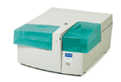
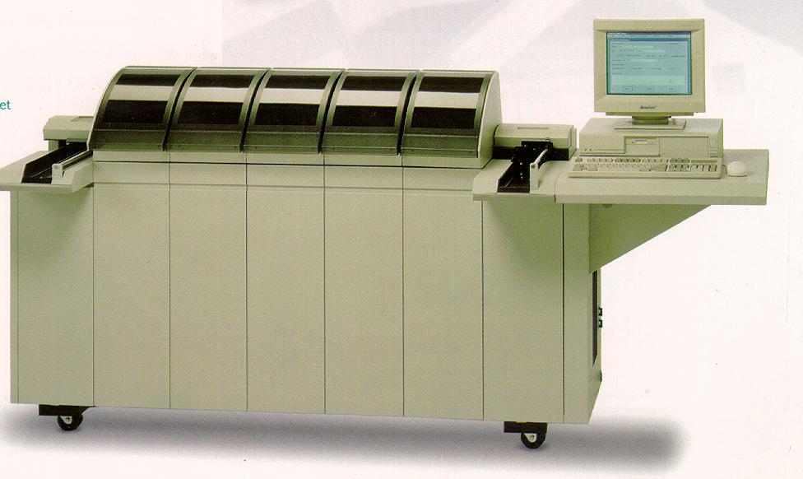
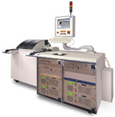


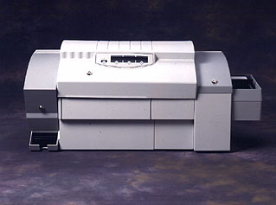
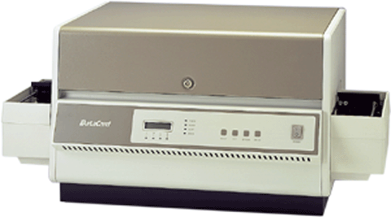
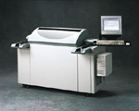
Datacard Smart Card Personalization Systems
Affina Card Life Cycle Management System
Dev.
& Test
ID Works with SCPM*
Dev.
& Test
SCPM*
Select
Magna
IC-IV
150i
280/295
450
500
7000
9000
DCL3000
MAXSYS
SCPM*
X
X
X
X
X
X
X
X
X
Custom
X
1
1
1
1
1
1
3
7
14
8
100+
Cards Pgmmed Simult.
Embossing
X
X
X
X
X
X
X
Graphics Printing
X
X
X
X
X
X
X
X
Laser
X
X
X
X
Inkjet
X
Color Printing/Photo
X
X
X
X
X
X
Mag Stripe
X
X
X
X
X
X
X
X
X
X
X
Contactless SC
X
X
X
X
X
X
P3 Desktop
P3 Advance
P3 Server
Aptura**
SCPM* - supports loading and personalization of Multos, Java, Open Platform, TIBC, VC, VSDC, M/Chip, Mondex, UKIS and other cards. Many proprietary single application smart cards also supported. SCPM also has an SDK for custom application development of industry-specific cards (e.g., for Transit, Health, Telecom, Government, other). Users can migrate from one Datacard hardware system above to another and the SCPM loading and personalization process and applications remain unchanged.
Aptura** - Datacard’s industry standard Java Card/GlobalPlatform Card - portable Java operating system.

