Slide 1
Smart Card Contact based communication protocol Basics
Amritraj Ugranimane (IFIN CCS TI SWP)
19-Jan-2018

Slide 2
Agenda
Basic Startup sequence
APDU Cases
APDU vs TPDU
Importance of Procedure Bytes
T=0 Protocol and its TPDU’s
T=1 Protocol and its TPDU’s

Slide 3
Basic Start-up Sequence
Terminal
Reset
Card
ATR
PPS Request
PPS Response
APDU Command
APDU Response

Slide 4
PPS –Protocol and Parameter Selection
Terminal
Card
PPSS | PPS0 | PPS1 | PPS2 | PPS3 | PCK
PPS Request
PPSS | PPS0 | PPS1 | PPS2 | PPS3 | PCK
PPS Response
 |  | Higher Nibble |  | Lower Nibble
 |  | b8 to b5 |  | b4 to b1
PPSS | Mandatory | FF
PPS0 | Mandatory | P/A | T (Protocol
PPS1 | Optional | F/D (Baudrate)
PPS2 | Optional | RFU
PPS3 | Optional | RFU
PCK | Mandatory | Checksum

Slide 5
APDU Command Response Pair
Terminal
Card
Header
CLA | INS | P1 | P2 | Lc | Command Data | Le
APDU Request
Response Data | SW1 | SW2
APDU Response
 | Cmd Data | Resp Data
Case 1 | 0 | 0
Case 2 | 0 | 1
Case 3 | 1 | 0
Case 4 | 1 | 1
Legends
0 | Absent
1 | Present

Slide 6
APDU Cases
Terminal
Card
CLA | INS | P1 | P2
Case 1
SW1 | SW2
CLA | INS | P1 | P2 | Le
Case 2
Response Data | SW1 | SW2
CLA | INS | P1 | P2 | Lc | Command Data
Case 3
SW1 | SW2
CLA | INS | P1 | P2 | Lc | Command Data
Case 4
Response Data | SW1 | SW2

Slide 7
APDU vs TPDU
APDU - Application Protocol Data Unit
TPDU – Transport Protocol Data Unit
Terminal
Card
Application Layer
Transport Layer
Physical Layer
Application Layer
Transport Layer
Physical Layer
APDU
TPDU
IO Line
Communication Channel

Slide 8
Procedure Bytes
INS
Instruction Byte
INS
Inverse Instruction Byte (Deprecated)
Null
Wait Extension (60)
SW1
6X or 9X except 60

Slide 9
T=0 Case 1 TPDU
Terminal
Card
CLA | INS | P1 | P2 | P3 = 00
SW1 | SW2

Slide 10
T=0 Case 3 TPDU
Terminal
Card
CLA | INS | P1 | P2 | Lc
INS
Command Data
SW1 | SW2

Slide 11
T=0 Case 2 TPDU
Terminal
CLA | INS | P1 | P2 | Le
Card
INS | Response Data | 90 | 00
Le = Lr
CLA | INS | P1 | P2 | Le
INS | Response Data (Le) | 61 | Lr-Le
Le < Lr
00 | C0 | 00 | 00 | Lr-Le
INS | Response Data (Lr-Le) | 90 | 00
CLA | INS | P1 | P2 | Le
6C | Lr
Le > Lr
CLA | INS | P1 | P2 | Lr
INS | Response Data (Lr) | 90 | 00

Slide 12
T=0 Case 4 TPDU
Terminal
Card
CLA | INS | P1 | P2 | Lc
INS
Command Data
61 | XX
Get Response follows
With case 2 handling
Le = Lr
Le < Lr
Le > Lr

Slide 13
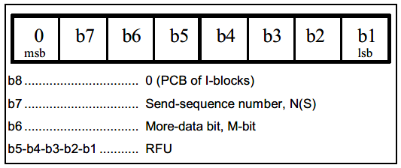
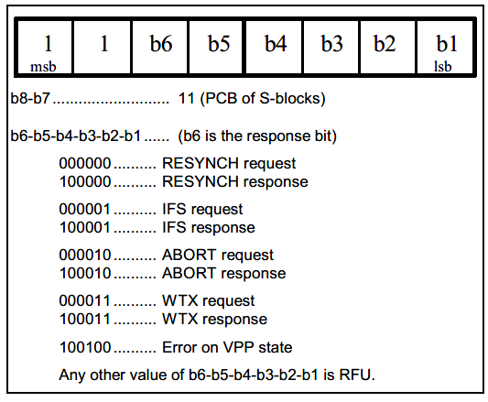
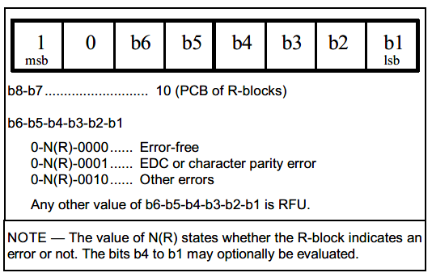
T=1 Protocol
Block based protocol
Prologue |  |  | Information | Epilogue
NAD | PCB | LEN | INF | EDC
1 Byte | 1 Byte | 1 Byte | 0 to 254 Bytes | 1 or 2 Bytes

Slide 14
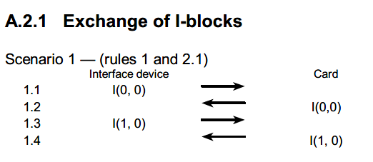
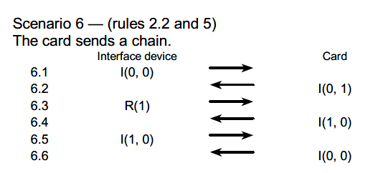
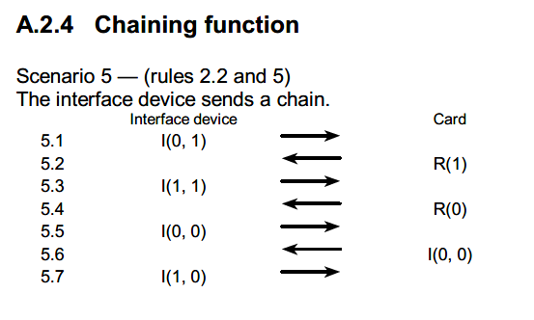
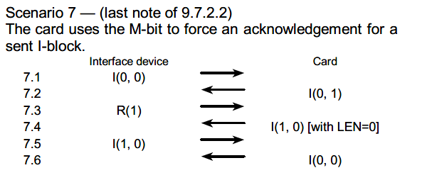
T=1 scenarios

Slide 15
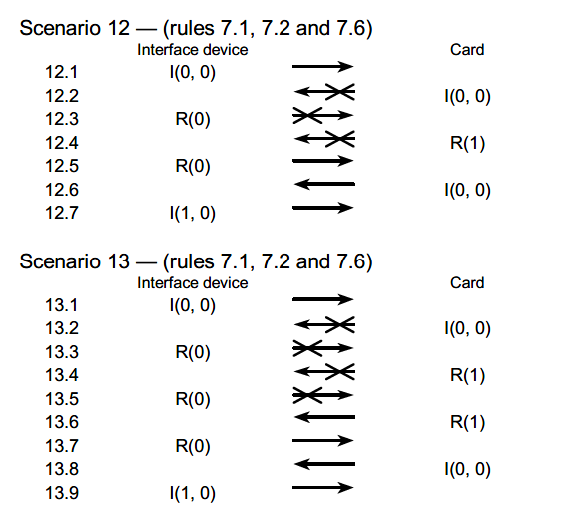
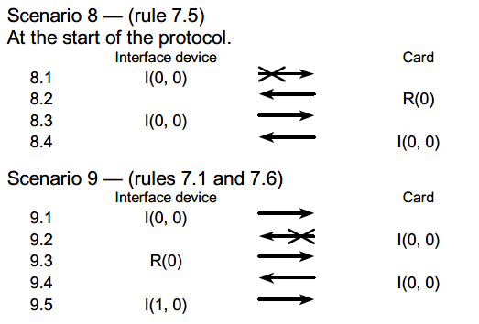
T=1 scenarios continued

Slide 16
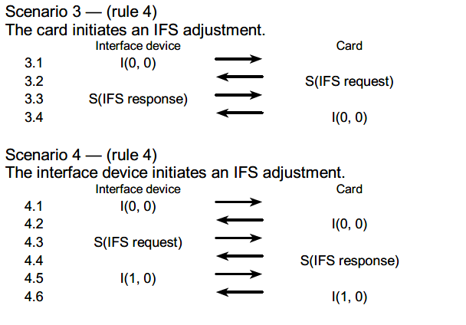
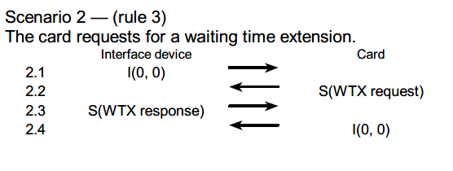
T=1 scenarios continued

