Slide 1

CMSC491?
Programming Embedded Systems
Introduction

Slide 2
What is an embedded system?
“An embedded system is an application that contains at least one programmable computer (typically in the form of a microcontroller, a microprocessor or digital signal processor chip) and which is used by individuals who are, in the main, unaware that the system is computer-based.”
Michael J. Pont, Embedded C

Slide 3
What is a microcontroller?
“A microcontroller is a computer-on-a-chip, or, if you prefer, a single-chip computer. Micro suggests that the device is small, and controller tells you the device might be used to control objects, processes, or events. Another term to describe a microcontroller is embedded controller, because the microcontroller and its support circuits are often built into, or embedded in, the devices they control.”
The Microcontroller Idea Book, Jan Axelson

Slide 4
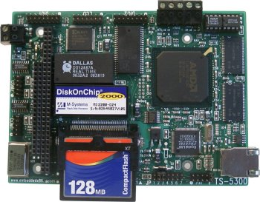

Slide 5
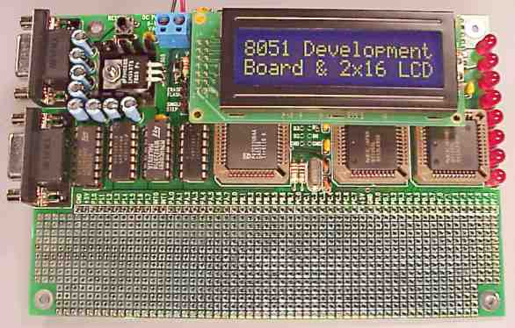

Slide 6
Perversities of Embedded Systems
“One very unfortunate aspect of embedded systems is that the terminology surrounding them is not very consistent. For every word, there are four or five subtly different meanings. You will just have to live with this problem.”
An Embedded Software Primer, David E. Simon

Slide 7
Size of market
“What is often surprising is that embedded processors account for virtually 100% of worldwide microprocessor production! For every microprocessor produced for use in a desktop computer, more than 100 are produced for use embedded systems….the number of embedded microprocessors found in the average middle-class household in North America was estimated to be between 40 and 50.”
Fundamentals of Embedded Software, Where C and Assembly Meet, Daniel W. Lewis

Slide 8
Most important concern
“The two most important concerns when building an embedded system are cost and cost. Of the two, cost is the most important!”
unknown

Slide 9
Example
“Most large organizations that build embedded systems have fully equipped labs with hardware simulators and software analysis tools for producing inexpensive circuit boards and complex software to run on them. Clearly, the cost of the equipment can easily be spread over millions of units that the company produces. Likewise, the cost of developing the software is amortized….For example, if a company can eliminate one RAM chip by using a complex memory compression scheme, there is a valid business case for hiring a large software team to implement this added complexity.”
Dr. Dobbs Journal, Feb 2004, “Multitasking on the Cheap”

Slide 10
What is the biggest problem?
According to Jack Ganssle:
  “80% of all embedded systems are delivered late”
  “Bugs are the #1 cause of late projects.”
  “New code generally has 50 to 100 bugs per 1000 lines .”
  “ Traditional debugging is the slowest way to find bugs.”

Slide 11
What is the biggest problem? - II
  “Writing drivers for complex peripherals is more art than science. Most traditional programming techniques fail when confronted with ISRs and performance issues.”

Slide 12
Solution
The only way to develop quality embedded software is to know how to develop quality software!

Slide 13
Examples of embedded systems
Mobile phone
Braking systems
Traction control
Engine management units
Steer-by-wire (includes fly-by-wire)
Cruise control
VCR
Auto-pilots
Flight control systems
Radar systems
Missile guidance systems

Slide 14
What is different?
Embedded programming is going to do more bit manipulation.
Uses IO ports.
Uses polling, DMA and interrupts.
Is more hardware-centric.
More concerned with performance.
More concerned with cost.
More concerned with memory use.
More concerned with reliability.
Use ICEs, oscilloscopes, and logic analyzers.

Slide 15
What is different? - II
May require real time programming.
May be more concerned with the operations of the operating system in order to improve performance.
More involved with assembly language programming.
More involved with the actual hardware design.

Slide 16
What is different? - III
“Although a software engineer who writes only applications may spend an entire career and learn nothing about hardware, an embedded-systems software engineer usually runs up against hardware early on. The embedded-systems software engineer must often understand the hardware early on. The embedded-systems software engineer must often understand the hardware in order to write correct software; must install the software on the hardware; must sometimes figure out whether a problem is caused by a software bug or by something wrong in the hardware; may even be responsible for reading the hardware schematic diagram and suggesting corrections.”
An Embedded Software Primer, David E. Simon

Slide 17
Important Decisions
Processor
Programming Language
Operating System

Slide 18
Processor
Desktop processors (x86) cost more than $100 per unit.
8051 devices start at less than $1.00.
8-bit devices do not have very much “muscle” or memory.
Objective to have just enough processing power at lowest cost.

Slide 19
Language
Interpreters are too slow! BASIC and Java are out!
Complex languages are too slow! C++ and Java are out.
Speed of execution and limited use of memory are in.
C and assembly are in!
“Which programming language you use depends on things like desired execution speed, program length, and convenience, as well as what’s available in your price range.” The Microcontroller Idea book, Jan Axel

Slide 20
Assembly VS C
Assembly is the fastest, however, it is difficult to find or train assembly experts. Then if a new processor is required, you have to start over!
C is mid-level, lots of good C programmers available, C compilers are available. C is on 8-, 16-, 32-, and 64-bits processors.

Slide 21
Operating System
Most applications (especially 8-bit systems) consist of only one program, and therefore do not need a “traditional” operating system. ROM monitors replace the operating system.
Today’s more complex systems require more complex control and therefore need an operating system of some kind.

Slide 22
Real-time systems
Subclass of embedded systems.
“’real-time system’ is a computer system that has timing constraints. In other words, a real-time system is partly specified in terms of its ability to make certain calculations or decisions in a timely manner. These important calculations are said to have deadlines for completion. And, for all practical purposes, a missed deadline is just as bad as a wrong answer.”
Programming Embedded Systems in C and C++, Michael Barr
A missed deadline is considered a system failure!

Slide 23
Our Decisions
In this course, we will be looking at:
  8051 (this is really of family of over 400 models.) This is an old 8-bit chip with a ROM monitor, but still extremely popular. We will look at assembly language and C. We will be using AS51 and SDCC C compiler.
  8086. This is a capable 16-bit chip and will we will use C and assembly language. We will look into developing a control program. Uses MASM and Visual C++.
  AMD 5x86. This is a modern 32-bit chip that runs Linux. It uses SanDisk 16MB chip as a “hard disk”. Linux uses mostly C, using gcc, and NASM.

Slide 24
Develop embedded system
Build the hardware
  breadboard prototype
  hardware designer
Develop software
  done on another platform
    cross-compilers
    emulators
    development tools, flash programmer

Slide 25
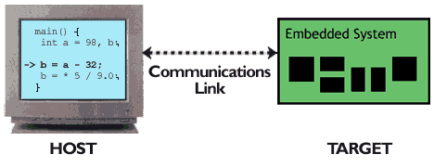
Cross-platform development

Slide 26
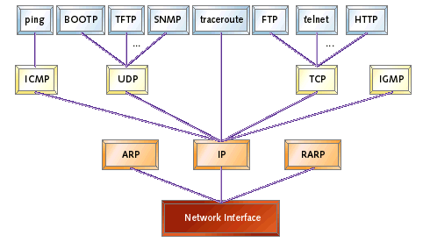
Need for “Muscle” processor

Slide 27
Prerequisites
CMSC421
  context switch
  counting semaphore
  critical section
  deadlock
  interrupt
  interrupt service routine
  intertask communication/synchronization

Slide 28
Prerequisites - II
  kernel
  memory-mapped I/O
  multiprocessing
  multitasking
  mutex
  physical address
  preemptive

Slide 29
Prerequisites - III
  polling
  race condition
  scheduler
  thread

Slide 30
Prerequisite - IV
Additional information comes from the following courses:
  CMSC201
  CMSC211
  CMSC311
  CMSC313 (replacement for 211/311)
  CMSC341
  CMSC411

Slide 31
References
An Embedded Software Primer, David E. Simon, 1999, Addison-Wesley
Embedded C, Michael J. Pont, 2002, Addison-Wesley
Fundamentals of Embedded Software, Where C and Assembly Meet, Daniel W. Lewis, 2002, Prentice Hall
Programming Embedded Systems in C and C++, Michael Barr, 1999, O’Reilly & Associates, Inc
The Microcontroller Idea Book, Jan Axelson, 1994, Lakeview Research
www.Ganssle.com
Dr. Dobb’s Journal

